Slide 1
Impact of Agri-Food Sector on Climate Change – Analysis & Insights
Prepared by Stephanie Austin & Willie Foster

Slide 2
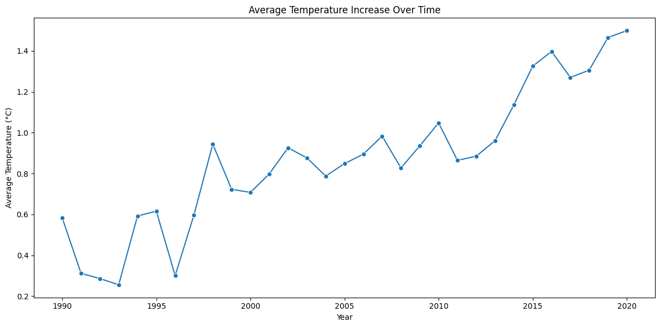
Project Overview
Aim: Quantify and predict temperature change drivers from agri-food emissions
Stakeholders: Policymakers, Agricultural Businesses, NGOs
Data sources: FAO, IPCC
Why now: Agri-food = large, rising share of global emissions; targeted actions can bend the curve.
Average temperatures have been steadily increasing over the past 30 years

Slide 3
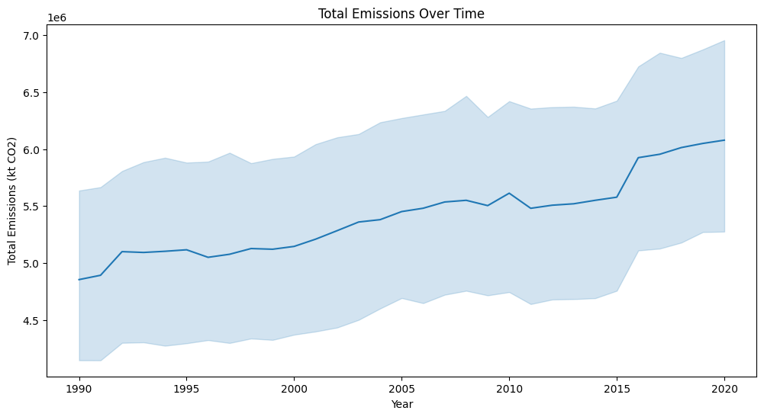
Key Emission Sources
Production: Fertiliser manufacturing, Manure management, Rice cultivation
Processing & Retail: Food processing, Packaging, Retail, Waste
Logistics: Food transport, On-farm energy/electricity
Land Use: Forestland (carbon sink), Net forest conversion, Fires
These have led to a steady increase in total emissions over the past 30 years.

Slide 4
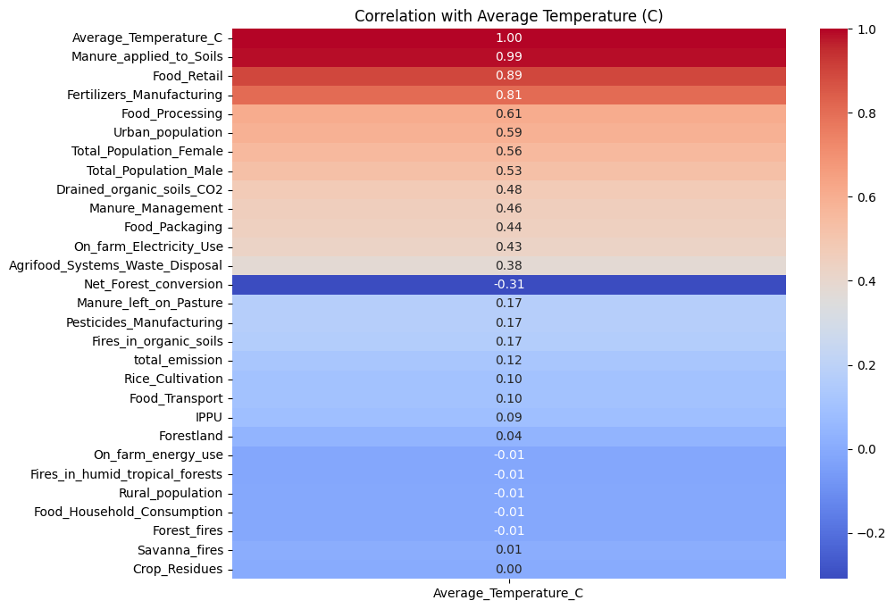
Correlation Findings
Highest correlation with temperature rise: manure applied to soils, fertiliser production, retail/processing
Forestland shows negative correlation (carbon sink)

Slide 5
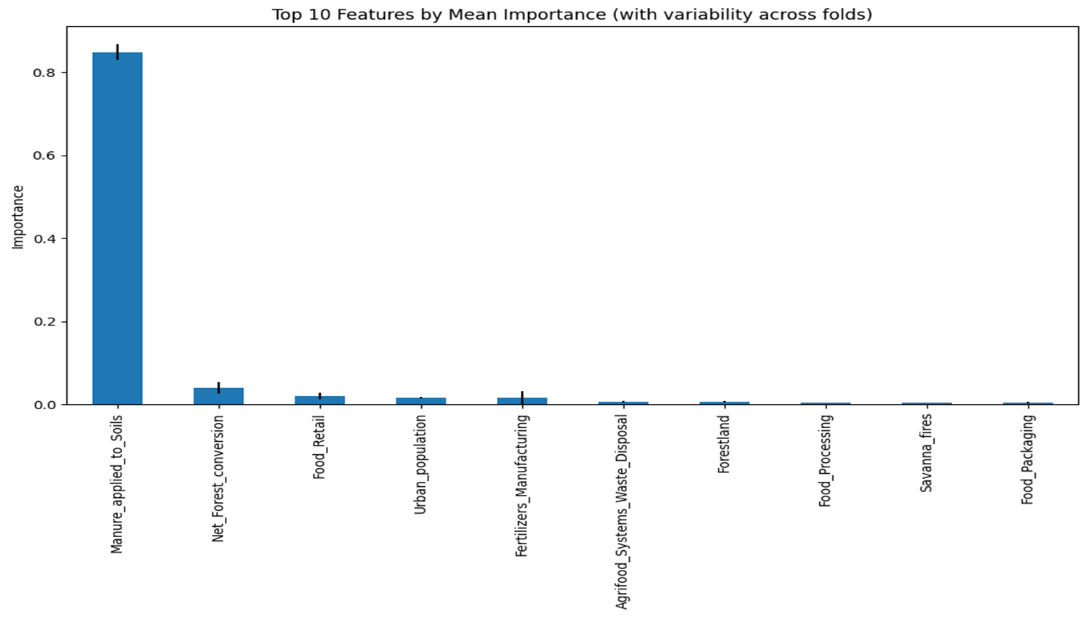
Model Results
Linear Regression: R² ~0.7 (single feature baseline)
Multiple Linear Regression: improved accuracy
Random Forest & Stacking: best generalisation, stable across folds
Top features: manure, fertilisers, retail, waste; Forestland negative

Slide 6
Insights for Stakeholders
Soil & inputs drive outsized warming (manure, fertilisers)
Forests are immediate, scalable mitigation levers
Post-farmgate is a hidden hotspot (retail, processing, waste, transport)

Slide 7
Sustainable Farming Recommendations
Manure: anaerobic digestion/composting; precision application
Fertilisers: precision agronomy; bio-fertilisers; nitrification inhibitors
Rice: alternate wetting & drying; improved varieties
Energy: on-farm renewables; electrify machinery
Supply chain: reduce food waste, optimise logistics, packaging redesign
Forests: preservation, agroforestry, re/afforestation

Slide 8
Closing & Next Steps
Expand analysis with temporal & regional trends
Run policy simulations (e.g., -10% fertiliser use, +20% forest cover)
Engage stakeholders for implementation
Pilot projects with measurement, reporting and verification (MRV)

Slide 9
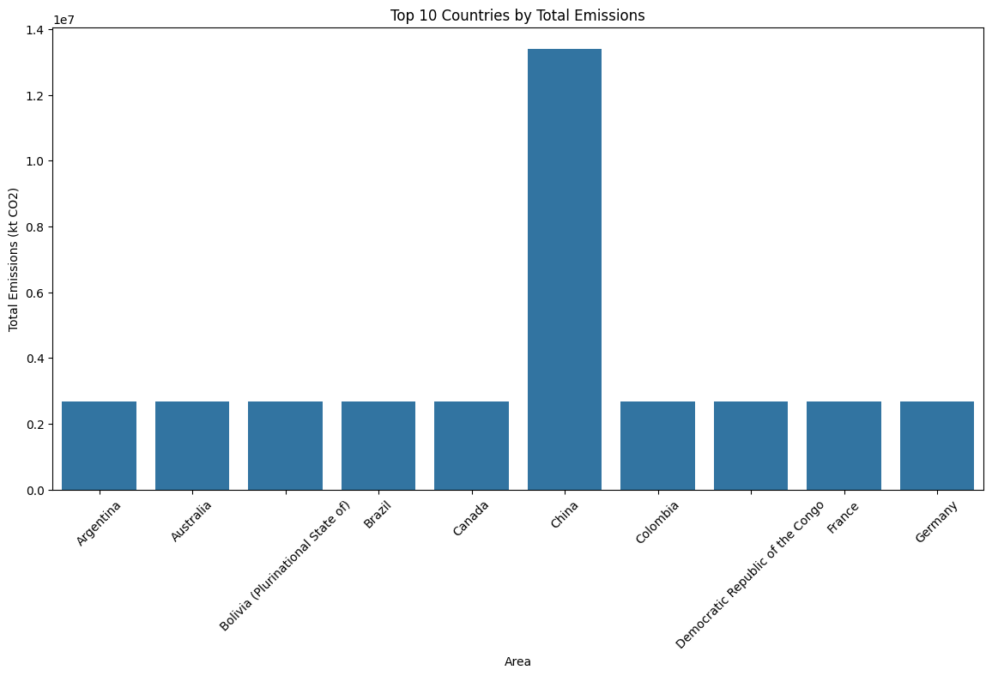
Regional Trends
Top 10 areas by OLS slope of temperature vs year highlight steeper warming in some regions
Guides policy focus where trends are strongest

Slide 10

Feature Stability Across Folds
Random Forest importance tested across CV folds
Consistent top drivers: manure, fertilisers, retail
Low variability = reliable predictors

