Slide 1

How The World Works
What data does the project require, and how does it all fit together?

Slide 2
Types of Data: World Definition
Types of Data: World Definition - Size of world, maximum population, fertility, terrain, climate.
This information describes the world the creatures will live in. There are some tradeoffs (larger world means longer computer run time, for instance) but choice of world data is up to the team.

Slide 3
Types of Data: Laws of Physics
Laws of physics - relationships between creature characteristics. How is speed related to size, for instance?
These are the meat of the project. Physical constraints apply to all creatures. In general, they should be based on research, but remember that this is an alien world. What would change if gravity were more (or less)?

Slide 4
Types of Data: Species Characteristics
Species characteristics are things about a species that do not change over time, and change very slowly with evolution. These things define the difference between species, and might include maximum size, diet, breeding rules, maximum age, and metabolism.

Slide 5
Types of Data: Creature Variables
These data describe how a creature is doing right now. They include things that change from tick to tick, such as size, hunger, age, and ability to breed.
These change as the creature interacts with the environment and other creatures.

Slide 6
How Time Works
Time is measured in ‘ticks’. It’s up to the team to decide how long a tick is, but keep in mind that a creature can have only one dominant behavior during a tick.
Things like biomass production, aging, and movement are all calculated relative to ticks. Current thinking is that a tick is about a day.

Slide 7
How Behavior Works
All creatures have the same motivations:
Desire to eat more
Desire to look for greener pastures
Desire to sleep
Desire to breed
Each creature will try to eat a little, and then act one one of these during each tick.

Slide 8
Behavior, Continued
Each creature has a genetic inclination for each behavior. This inclination is used in a calculation. For example:
E = H * EF where
  E is desire to eat
  H is Hunger (defined as %emptiness of belly)
  EF is genetic propensity for eating

Slide 9
Behavior, Continued
Each desire is calculated in turn. The strongest determines the behavior for the current tick.
The team is welcome to suggest additional behaviors (escape from predators might be useful when we get to that point).
All calculations are linear at this point. Non-linear behaviors would be interesting.

Slide 10
Emergent Behavior
This is a relatively new field of study. Emergent behavior is the situation where complex group behaviors result from very simple rules that each member follows. It has been studied in ants, bees, birds, and bacteria. This project offers a unique chance to study emergent behavior.

Slide 11
Evolution and Breeding
A major part of the world is the potential for creatures to breed and evolve. When creatures reach the necessary size, they will start to look for suitable mates (depending on their relative motivations). The team may want to develop breeding behavior - at present, the closest suitable mate is chosen.

Slide 12
Breeding
When two creatures who want to breed are physically close enough, they will produce an offspring. The offspring inherits each trait randomly from one of the parents.
For instance, the new creature’s maximum size will be chosen at random from one of the parents. (It could also be a random value somewhere between the parent’s values).

Slide 13
Mutation
There may also be a mutation introduced - mutation is a random change to an inherited characteristic. For instance, a new creature might inherit a maximum size potential of 115kg. Mutation would change that by a random amount up to the mutation factor - currently +/- 5%. Mutation allows species characteristics to change.

Slide 14
Curve Fitting
In order for the world to work properly, all values must be calculated in some way. The laws of physics define relationships that must be obeyed. In these cases, we must define the relationship mathematically. Maximum speed must be calculated from any given size, for instance.

Slide 15
Curve Fitting
Take the example of speed vs. mass. You might do research and build a table (this one is bogus - just an example):
  Mass (kg) Max Speed (m/s)
  0.1 0.25
  0.3 1
  1 2
  3 3
  10 5
  30 8
  100 9
  300 8
  1000 5
  3000 1

Slide 16
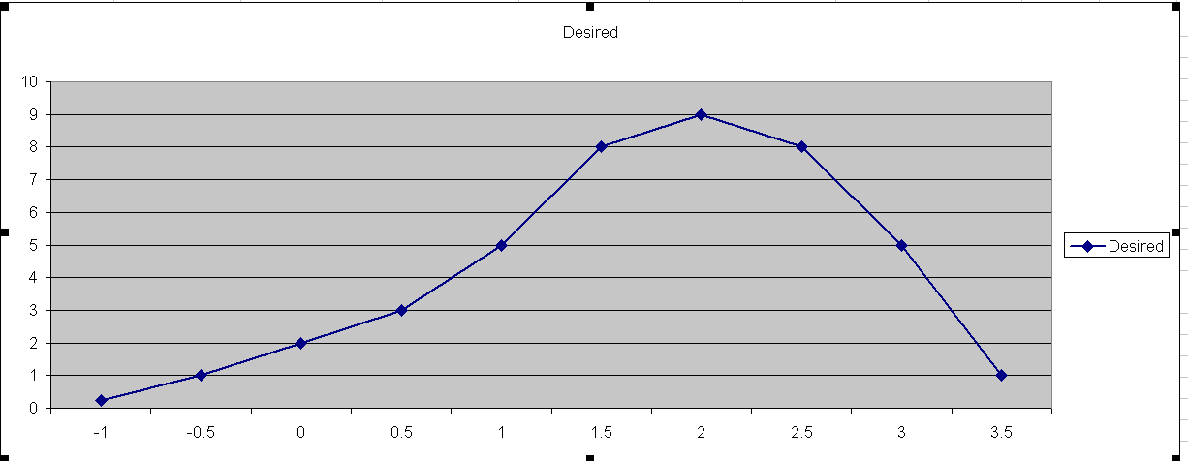
Curve Fitting
Such a table could be graphed:
Speed
Mass (log scale)
Note sneaky use of log scale……..

Slide 17
Curve Fitting
We have to define the relationship between mass and speed (Blue line) as a function.
This is necessary so that the computer can calculate the maximum speed for a creature of any size.

Slide 18
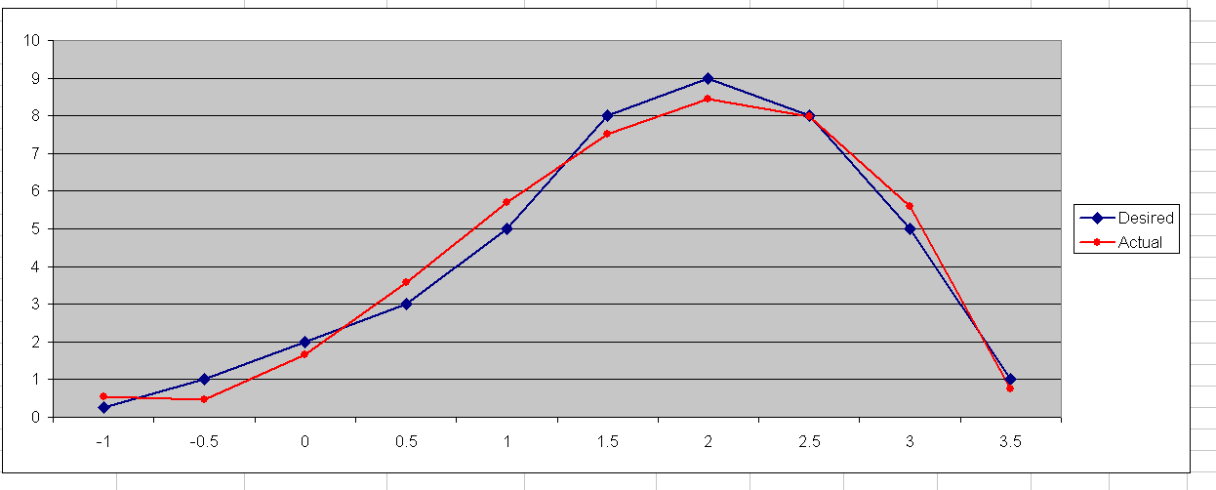
Curve Fitting, Continued
Curve fitting gives us an approximation (Red line) that can be computed:
speed = (-0.7094 * log(mass)³) + (1.4708 * log(mass)²) + (3.2857 * log(mass)) + 1.6582
Speed
Mass (log scale)
Thank goodness for computers!

Slide 19
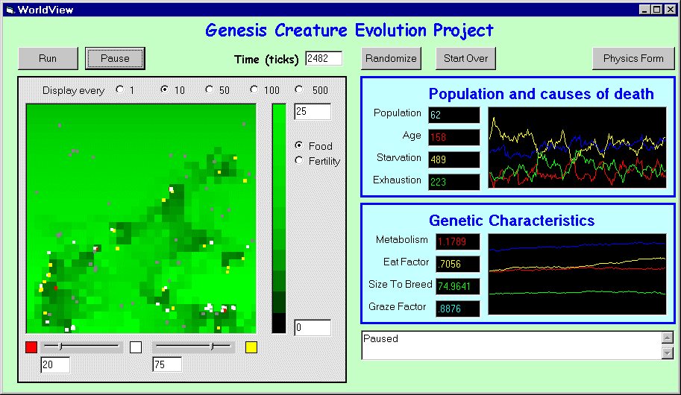
User Interface
Map of the world
Moving Charts
Creature:
Click for details
Set creature color
thresholds

Slide 20
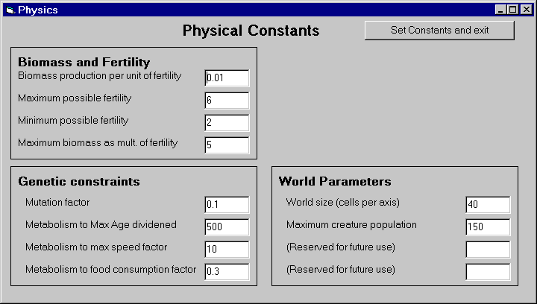
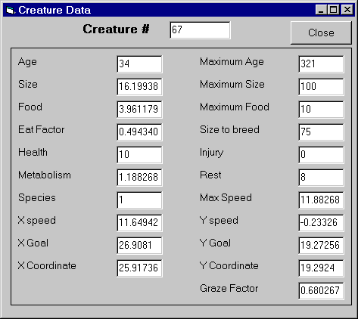
More User Interface
The ‘Physics Form’ button gives you this form
These forms allow you to see detailed information about a creature, or set parameters for the world.
Clicking on a creature in the map window gives you this form

Slide 21
What do we need?
Bazillions of rules and factors
  Food requirements as a function of what?
  Weight gain as a function of what?
  Speed as a function of what?
Behaviors
  Mating rules
  Predator / prey rules
Species

