Slide 1
1.2 Data, Sampling, and Variation in Data and Sampling
Recognize and differentiate between key terms
Apply various types of sampling methods to data collection
Create and interpret frequency tables

Slide 2
Qualitative Data
Also known as categorical data
Describes attributes
e.g., hair color, blood type, place of birth
Easy to work since there’s less math involved

Slide 3
Quantitative Data
Numbers!
e.g., money, pulse, height
Discrete quantitative data means only certain numbers, typically whole numbers
e.g., number of people in a household
Continuous quantitative data is data where all numbers in a range are valid
e.g., height, weight, time
! Limited accuracy doesn’t imply discrete !

Slide 4
Discrete or Continuous?
Number of classes in a schedule?
Square footage of a room?
Minutes spent at practice?
Ask if you are counting or measuring.

Slide 5
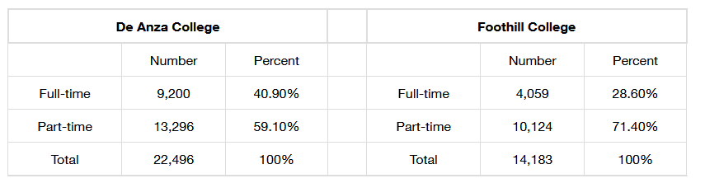
Displaying Qualitative Data: Tables
Helpful for organization
Poor for understanding
Including percentages is good for comparing data sets of different sizes

Slide 6
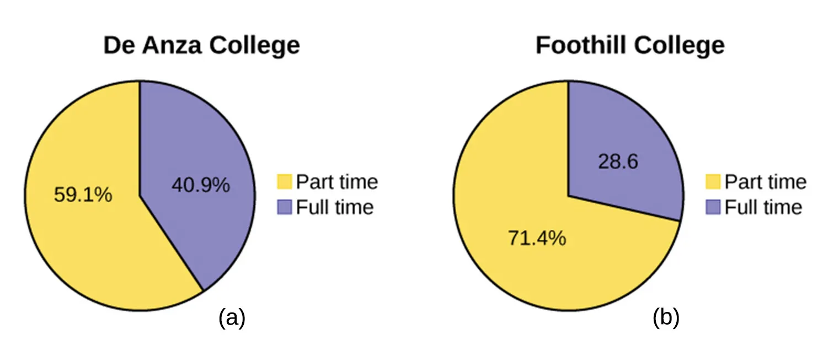
Displaying Qualitative Data: Pie Chart
Wedges represent each category
Should only be used when percentages add up to 100%
Best for showing portion of the whole

Slide 7
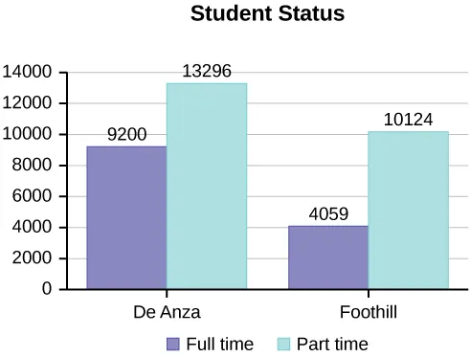
Displaying Qualitative Data: Bar Graph
Good for change over time or comparisons
Preferable to pie charts if there are many categories

Slide 8
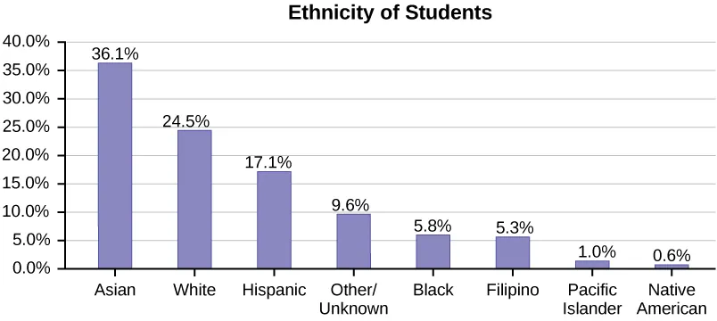
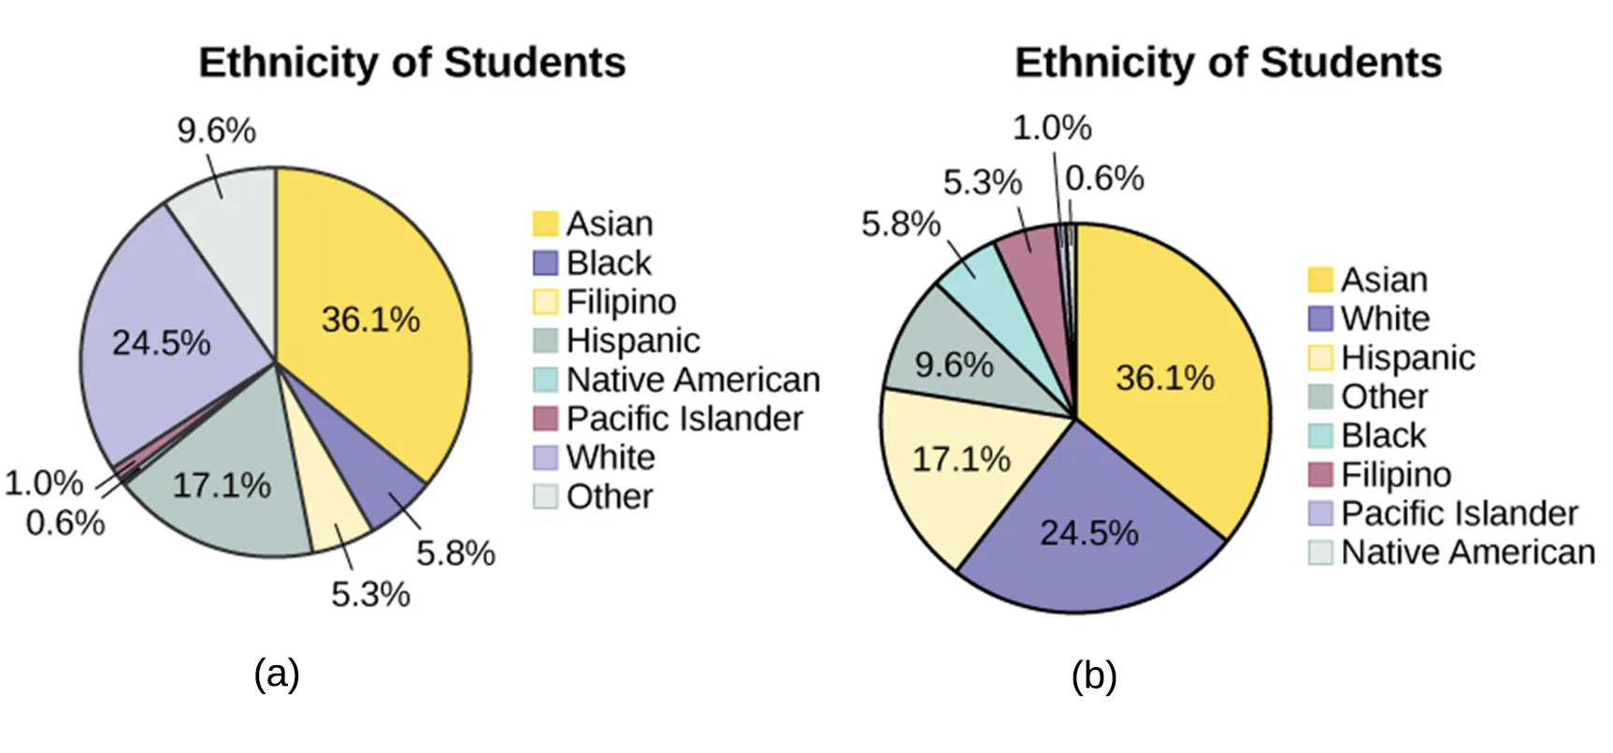
When bars are in descending order, it’s a Pareto chart

Slide 9
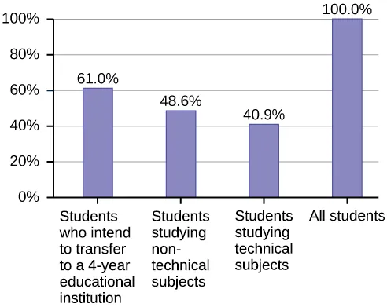
Percentages Over 100%

Slide 10
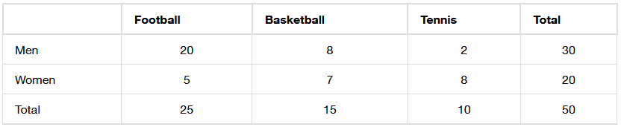
Two-Way Tables
Two categories means two-way
Marginal distributions are the totals (on the margins/edges)
Conditional distribution involve specific subsets
E.g., men who prefer basketball, which is 8
Inner vs outer part of the table

Slide 11
Two-Way Tables: Two Conditionals
What percentage of men prefer basketball?
What percentage of basketball fans are men?
“Of” signifies the total you should be looking at

Slide 12

Sampling
Population too big? Just get some of them, randomly.
Simple random: everyone has equal chance of being picked
Stratified sample: group by a characteristic, then randomly
Cluster sample: break population into groups that mirror the population, then sample random clusters
Systemic sample: sample every $n$^{th} subject
Convenience sampling: just getting whoever is available

Slide 13

Sampling
Population too big? Just get some of them, randomly.
Simple random: everyone has equal chance of being picked
Stratified sample: group by a characteristic, then randomly
Cluster sample: break population into groups that mirror the population, then sample random clusters
Systemic sample: sample every $n$^{th} subject
Convenience sampling: just getting whoever is available
Avoid bias by keeping your population in mind

Slide 14
Critical Evaluation of Your Study
Problems with samples?
Self-selected samples?
Sample size issues?
Undue influence?
Non-response?
Causality?
Self-funded study?
Misleading use of data?

