Slide 1
1.3 Frequency, Frequency Tables, and Levels of Measurement
Recognize and differentiate between key terms
Apply various types of sampling methods to data collection
Create and interpret frequency tables

Slide 2
Answers and Rounding Off
Don’t sweat reducing fractions
Avoid rounding decimal values until the very end
For final answers, round to one more decimal place than was in the original data
E.g., Original data had three decimal place, round final answers to four decimal places

Slide 3
Levels of Measurement
Nominal
Ordinal
Pure categorical data
Calculations not possible, only grouping
Looks like qualitative data, but can be ordered
Calculations still not possible
E.g., excellent, good, satisfactory, and unsatisfactory

Slide 4
Levels of Measurement
Interval
Ratio
Quantitative data with no real starting point
Zero doesn’t mean zero
E.g., Fahrenheit/Celsius, SAT scores
Calculations are possible except for ratio-related ones
60° is not twice as hot as 30°
Quantitative data where zero mean zero
Most measurements fall in this category
All calculations are possible
4 meters is twice the distance as 2 meters

Slide 5
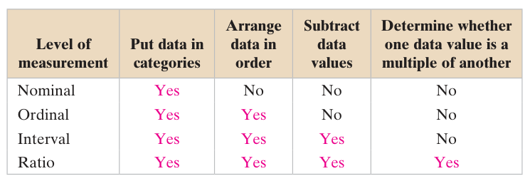
Levels of Measurement

Slide 6
What level of measurement?
High school soccer players classified by their athletic ability: superior, average, above average
Baking temperatures for various main dishes: 350, 400, 325, 250, 300
The colors of crayons in a 24-crayon box
Social security numbers
Incomes measured in dollars
A satisfaction survey of a social website by number: 1 = very satisfied, 2 = somewhat satisfied, 3 = not satisfied
Preferred TV shows: comedy, drama, science fiction, sports, news
Time of day on an analog watch
The distance in miles to the closest grocery store
The dates 1066, 1492, 1644, 1947, and 1944
The heights of 21–65-year-old women
Common letter grades: A, B, C, D, and F

Slide 7
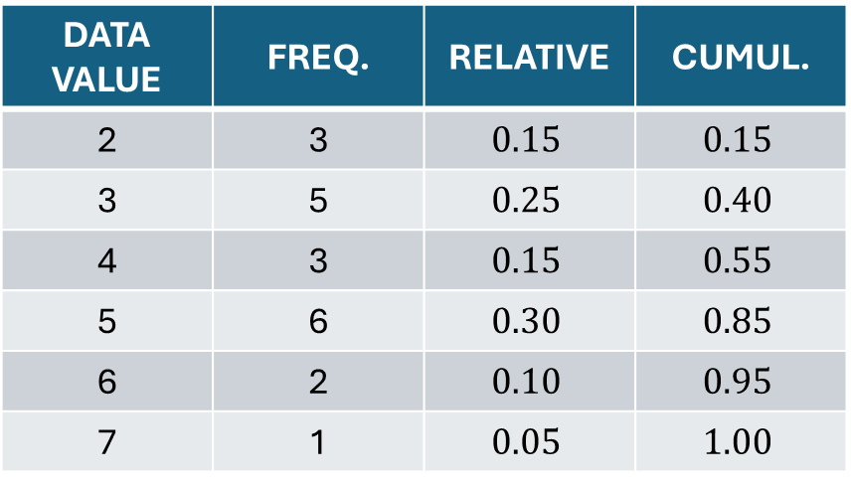
Frequency
Number of times a data value occurs
Relative frequency is ratio to the total
Cumulative relative frequency is the accumulation of previous ones
DATA VALUE | FREQ. | RELATIVE | CUMUL.
2 | 3 | $$0.15$$ | $$0.15$$
3 | 5 | $$0.25$$ | $$0.40$$
4 | 3 | $$0.15$$ | $$0.55$$
5 | 6 | $$0.30$$ | $$0.85$$
6 | 2 | $$0.10$$ | $$0.95$$
7 | 1 | $$0.05$$ | $$1.00$$

Slide 8
Frequency and Cumulative Data
HEIGHTS (INCHES)* | FREQUENCY | RELATIVE FREQUENCY | CUMULATIVE RELATIVE FREQUENCY
59.95–61.95 | 5 | 5/100 = .05 | .05
61.95–63.95 | 3 | 3/100 = .03 | .05 + .03 = .08
63.95–65.95 | 15 | 15/100 = .15 | .08 + .15 = .23
65.95–67.95 | 40 | 40/100 = .40 | .23 + .40 = .63
67.95–69.95 | 17 | 17/100 = .17 | .63 + .17 = .80
69.95–71.95 | 12 | 12/100 = .12 | .80 + .12 = .92
71.95–73.95 | 7 | 7/100 = .07 | .92 + .07 = .99
73.95–75.95 | 1 | 1/100 = .01 | .99 + .01 = 1.00
 | Total = 100 | Total = 1.00
*Data had one decimal place, so ranges have two to prevent overlap

