Slide 1

BCA (Black Carbon Growth Rate) Indicators Analysis 1995–2020
Date: January 15, 2025
Notes:
Welcome to my presentation on Black Carbon Growth Rate (BCA) indicators analysis from 1995 to 2020. This project explores trends, changes, and key insights using data analysis and visualization techniques.

Slide 2
Project Overview
Objective: Explore trends and changes in BCA（Black carbon growth rate） indicators from 1995 to 2020.
Data Source: BCA_ind_na.csv
Methods: Data cleaning, statistical analysis, and visualization.
Tools: Python (Pandas, Matplotlib, Seaborn, Geopandas).
Notes:
This project aims to explore trends in BCA indicators, understand changes over time, and identify regional differences. The data was sourced from the BCA_ind_na.csv file, analyzed using Python libraries such as Pandas, Matplotlib, and Geopandas.

Slide 3
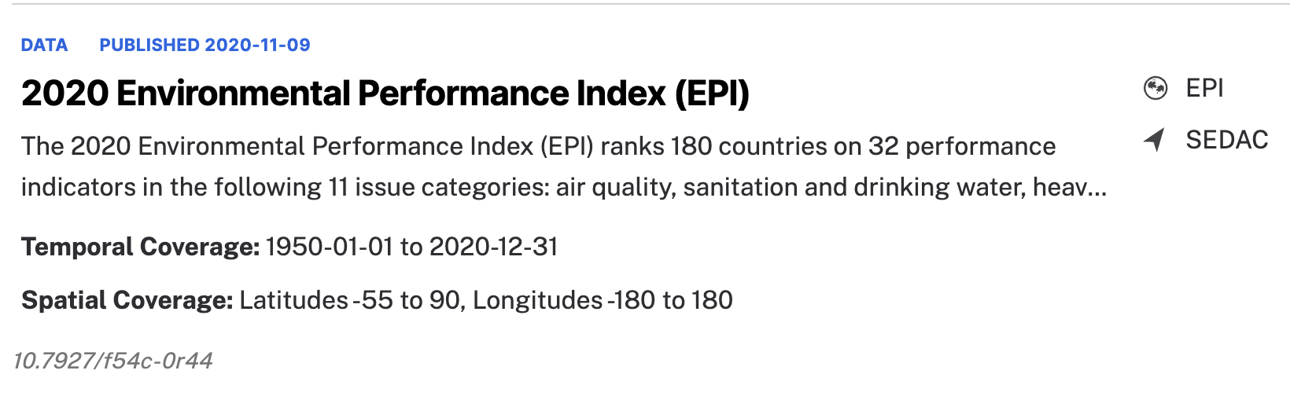
Dataset Summary
Data Source：https://www.earthdata.nasa.gov/data/catalog/sedac-ciesin-sedac-epi-2020-2020.00
Structure: 220 rows, 29 columns.
Sample data preview (first few rows).
Missing value distribution visualized using a heatmap.
Notes:
The dataset is from NASA official website， contains 220 rows and 29 columns. We began by exploring the data structure and visualized missing values using a heatmap. This helped us identify areas requiring data cleaning.

Slide 4
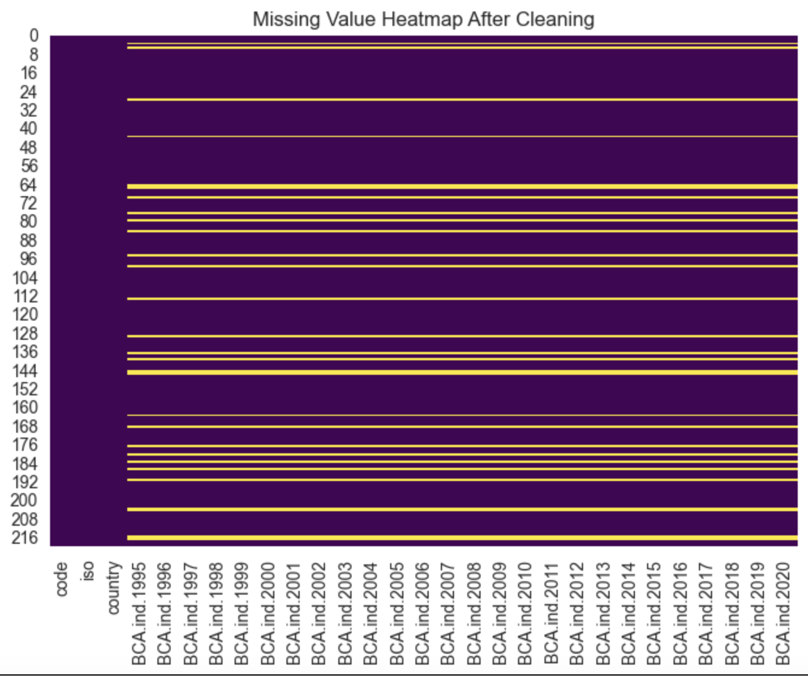
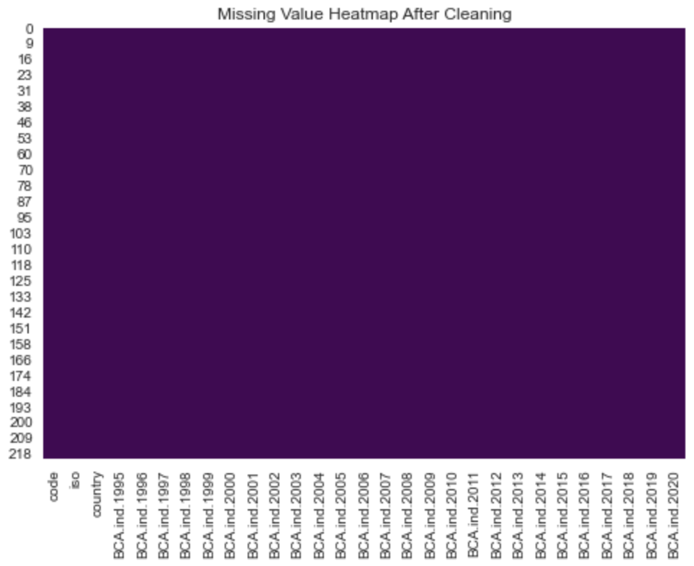
Data Cleaning
Cleaning Approach
- Missing values handled by mean imputation and high-missing row removal.
- Interpolation applied for time-series data.
- Post-cleaning data completeness statistics.
Missing Values（Yellow lines）
No Missing Values after cleaning
The plot shows after datacleaning no missing value anymore
Notes:
We handled missing values using mean imputation and removed rows with excessive gaps. For time-series data, we applied interpolation. Post-cleaning, the dataset was complete, enabling accurate analysis.

Slide 5
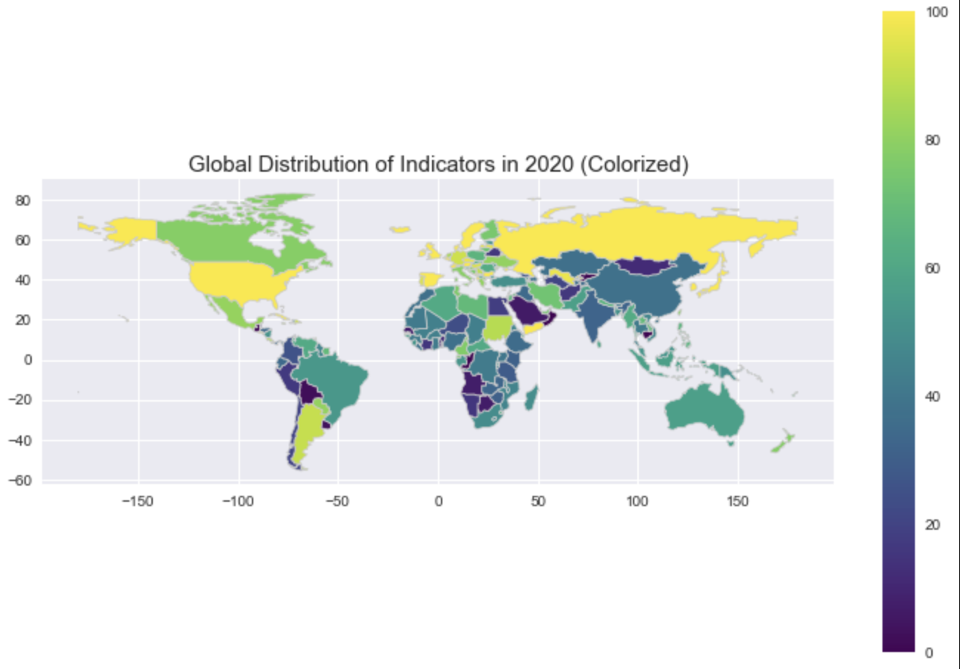
Global Indicator Distribution in 2020
Notes:
This map visualizes the global distribution of BCA indicators in 2020 using a color gradient.
Yellow regions represent the highest indicator values, potentially reflecting significant industrial growth or less stringent regulations.
Dark purple regions indicate the lowest indicator values, possibly due to stringent environmental policies or reduced industrial activity.
This visualization highlights the stark contrasts between regions like North America and parts of Africa or South America.
Understanding these variations is crucial for analyzing the impact of policies and regional dynamics.

Slide 6
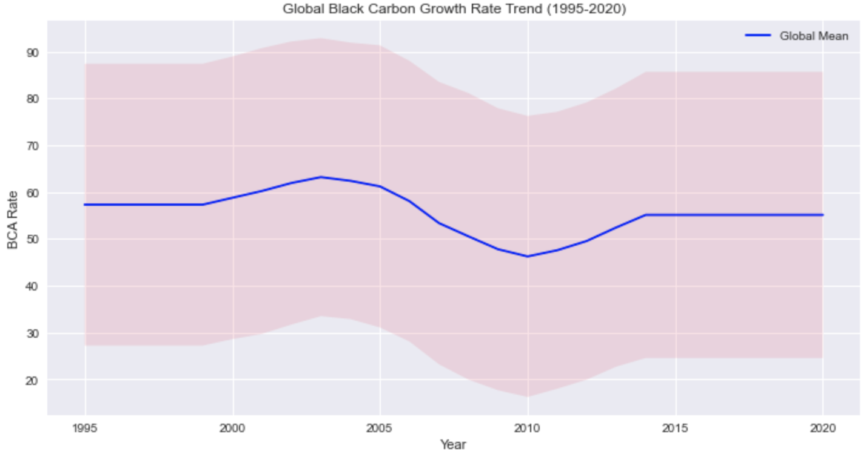
Trends of BCA Indicators (1995–2020)
Time-series trend visualization of global BCA indicators.
Year-wise trends observed across countries.
Notes:
This time-series plot shows global trends in BCA indicators over the years. We observed significant fluctuations, with notable changes in specific time periods and countries.

Slide 7
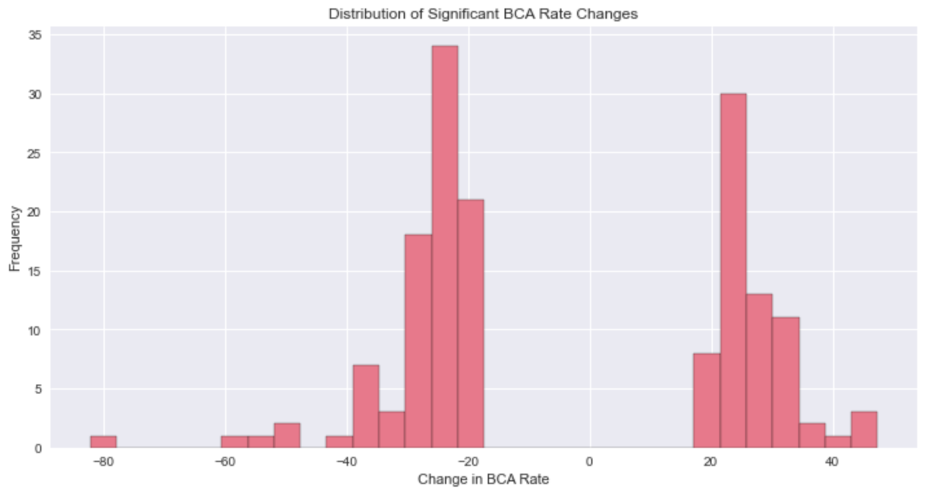
Country-wise Indicator Trends
Two distinct groups of significant changes in BCA rates: one group with negative changes and another with positive changes.
The peak around -20 suggests that a significant proportion of countries experienced a negative changenvironmental interventions.
Notes:
We identified two groups of countries: one with negative changes in BCA rates, possibly due to environmental interventions, and another with positive changes. For example, Costa Rica and Niger showed the largest fluctuations, while Belarus and Albania were more stable.

Slide 8
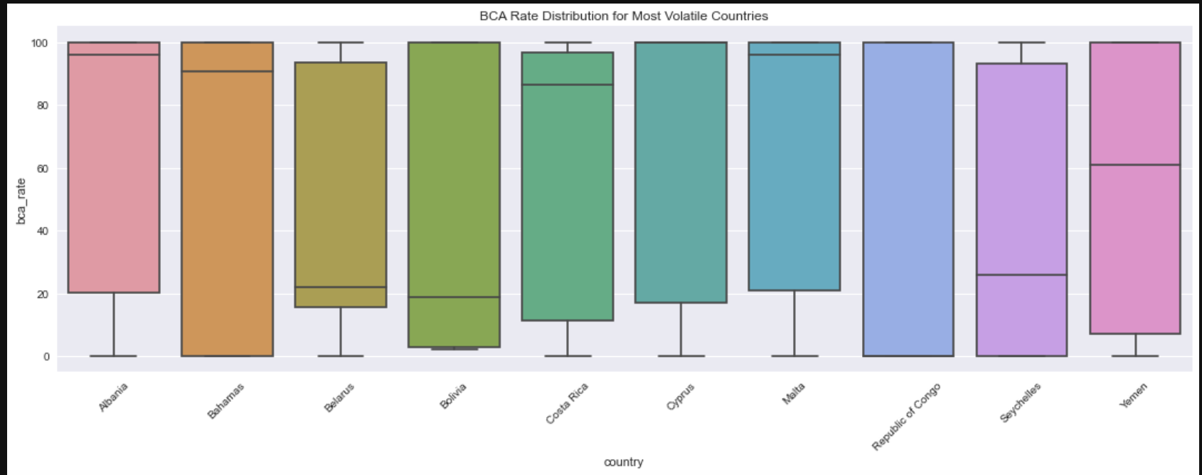
Country-Specific BCA Rate Variations and Outliers
Countries like Costa Rica and Niger show the widest range of BCA rates, indicating significant fluctuations over time.
Stable Countries: Belarus and Albania exhibit tighter interquartile ranges, suggesting more stable BCA rates.
Outliers: Several countries, such as Malta and Republic of Congo, have visible outliers, indicating occasional extreme changes in BCA rates.
Notes:
This boxplot highlights the variations in BCA rates across the most volatile countries.
Countries like Costa Rica and Niger show the widest range of fluctuations, indicating significant instability.
On the other hand, Belarus and Albania demonstrate tighter interquartile ranges, signifying greater stability in their BCA rates.
Outliers, such as those seen in Malta and the Republic of Congo, suggest occasional extreme changes due to specific events or conditions.
Overall, this visualization emphasizes the diverse behavior of BCA rates across different nations.

Slide 9
Policy and External Factors Influencing BCA Rates
Year | Event/Policy | Description
2006 | Environmental policies introduced | Major environmental regulations aimed at controlling emissions were implemented.
2007 | Peak in industrial growth | Global industrial activity saw a significant increase, impacting BCA rates.
2008 | Global financial crisis begins | Economic slowdown led to reduced emissions in some industries.
2011 | Economic recovery starts | Global recovery efforts led to increased industrial production.
2012 | New environmental regulations | Strengthened global regulations to mitigate carbon emissions.
Notes:
This slide explores the external factors and policies that may have influenced BCA rates.
For instance, the peak observed in 2006-2007 could be linked to industrial policies or major environmental initiatives.
Similarly, the resurgence in 2011-2012 might correlate with global economic recovery or regulatory changes.
Understanding these external factors helps contextualize the trends and fluctuations we observe in the data.

Slide 10
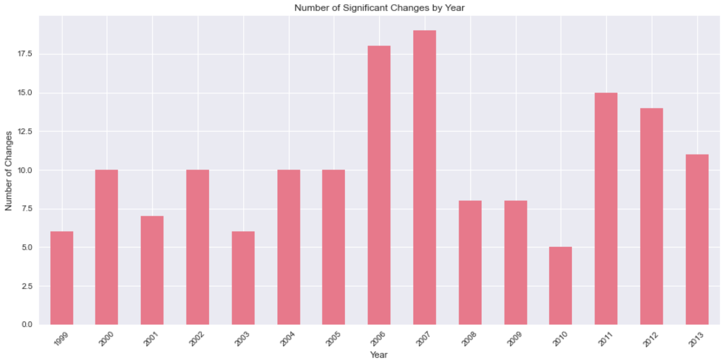
Number of Significant Changes by Year
Peak Years: The years 2007 and 2006 Consistent Activity:
Decline in Changes: Post-2008, there is a noticeable decline in the number of significant changesResurgence in 2011-2012:
The years 2011 and 2012 show a resurgence in significant changes, possibly due to new policies or external factors.
Notes:
This bar chart highlights the years with the most significant changes in BCA rates. Peaks occurred around 2006-2007, followed by a decline post-2008, with a resurgence in 2011-2012, potentially due to policy shifts.

Slide 11
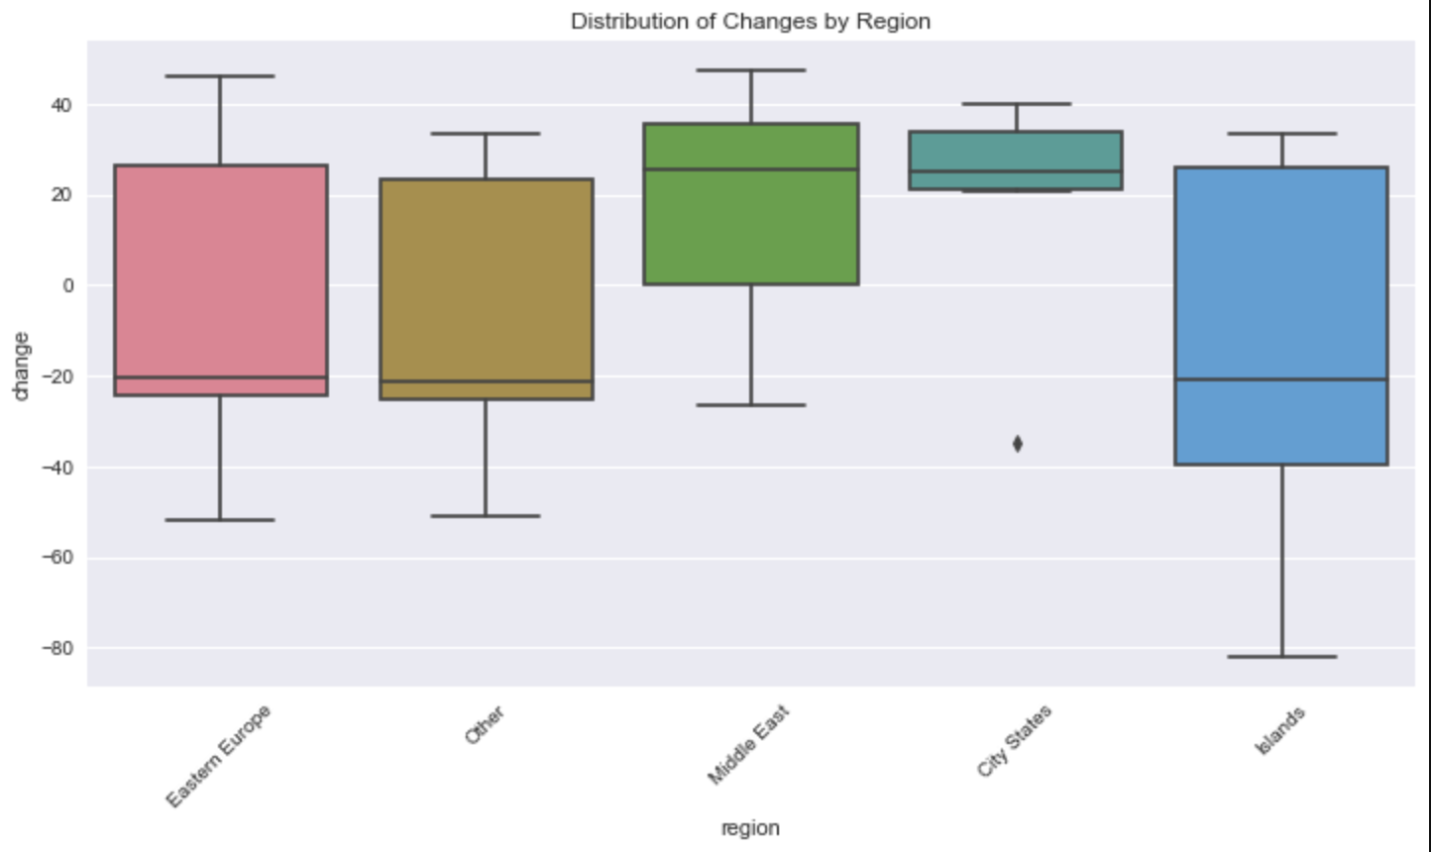
Indicator Distribution Comparison
Moderate variation, centered around zero with a balanced spread of positive and negative changes.
Middle East: Slightly higher median and smaller range compared to other regions, indicating more stable changes.
City States: Minimal variation with a very tight distribution, suggesting uniform behavior.
Islands: Highest variation, with extreme negative and positive changes, indicating significant volatility.
Notes:
Comparing distributions across regions, we see islands exhibit the highest variation, indicating significant volatility. In contrast, city-states show tight distributions, suggesting more uniform behavior.

Slide 12
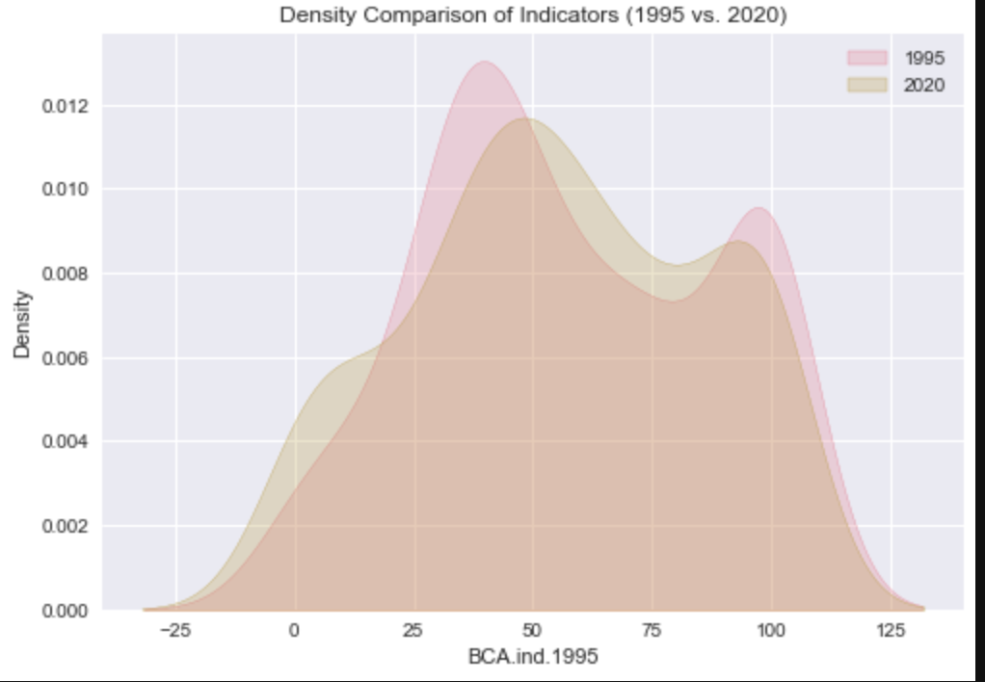
Geographical Visualization
Eastern Europe: Moderate variation, centered around zero with a balanced spread of positive and negative changes.
Middle East: Slightly higher median and smaller range compared to other regions, indicating more stable changes.
City States: Minimal variation with a very tight distribution, suggesting uniform behavior.
Islands: Highest variation, with extreme negative and positive changes, indicating significant volatility.
Notes:
This geographical heatmap visualizes regional variations in BCA rates. Eastern Europe and islands exhibit higher variability, while the Middle East has more stable indicators, possibly reflecting economic or policy influences.

Slide 13
Challenges and Limitations in the Project
Challenges:
Handling missing values, particularly for countries with incomplete records (e.g., Andorra and other smaller nations).
Representing a large dataset (220 rows, 29 columns) in a clear and concise manner.
Difficulty in integrating additional datasets, such as particle size or chemical composition, which were not provided.
Limitation
Lack of Granularity: No information on average particle diameter, size distribution, or composition of black carbon particles, which limits deeper physical and chemical insights.
Data Coverage: Lack of regional economic and industrial context to correlate with observed trends.
Simplistic Metrics: Using a single BCA indicator per year may oversimplify complex environmental processes.

Slide 14
Conclusion
The Black Carbon Growth Rate (BCA) has shown significant fluctuations across regions and years, with peaks in activity around 2006-2007 and more stable trends post-2010.
Islands and Eastern Europe exhibit the highest variability, while City States show consistent and stable rates. These differences may reflect geographical, economic, or policy-driven factors.
A clear shift in the distribution of indicators between 1995 and 2020 was observed. The increased variability and skew in 2020 highlight evolving global conditions, possibly influenced by industrial growth or environmental regulations.
Significant outliers in certain regions and years underline specific events or transitions that require deeper investigation, such as rapid industrialization or impactful environmental policies.
Despite noticeable fluctuations, there is considerable overlap in the density distributions of 1995 and 2020, suggesting that while some regions have undergone significant changes, others have maintained relative stability.
Notes:
In conclusion, BCA indicators have shown significant variability over time, influenced by regional, economic, and policy-driven factors. While some regions exhibit stability, others, like islands and Eastern Europe, show extreme changes, suggesting the need for further investigation.

