Slide 1

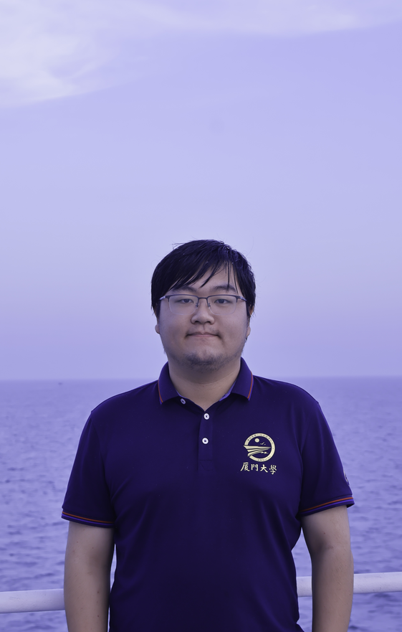
“
Maybe not today
maybe not tomorrow
maybe not next month
but one day I will be a champion
吴锴烨

