Slide 1
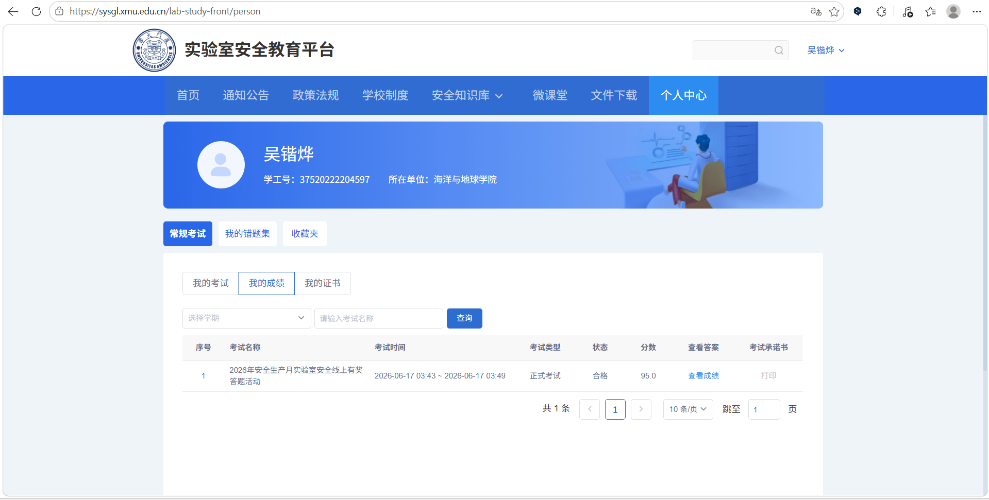
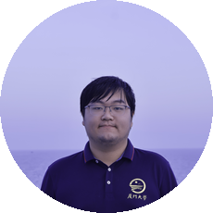
吴锴烨
寄语：Maybe not today, maybe not tomorrow, maybe not next month, but one day I will be a champion

