Slide 1

Ninja
Quiz.
Cyber-safety for young learners
503IT · Team The Originals · Coventry University London
Notes:
Good afternoon. We are The Originals. We were given a brief: build a game that teaches cyber-safety. This presentation is about how we worked together to do that.

Slide 2
THE BRIEF
What we were asked to build.
The client
503IT brief — build a cyber-safety game for young users
The problem
Kids face online risks daily, but lessons rarely engage them
The audience
Children aged 8–14 — schools, educators and parents
The ask
A working browser game — five people, four weeks
The constraint
HTML, CSS, JavaScript only — four-week window
NINJA QUIZ . 503IT . 02 / 18

Slide 3
The team.
Who we are. What we each owned.
NINJA QUIZ · 503IT · 03 / 18
Notes:
Before we talk about what we built — let's establish who we are and how we divided the work.

Slide 4
THE TEAM
Five people. One piece each.
01
Mukesh
Coordinator — planning, integration, client liaison
02
Suman
Implementer — login and registration system
03
Kishor
Specialist — question system and countdown timer
04
Bishal
Completer Finisher — slicing mechanics and visual effects
05
Aakash
Plant — scoring system and results screen
NINJA QUIZ · 503IT · 04 / 18
Notes:
Work was divided so every person owned one module end-to-end. No overlap meant clear accountability — when something needed fixing, we knew exactly who to speak to. This was a deliberate decision made in our first meeting.

Slide 5
How we worked.
Three tools. 4 weeks. Every decision documented.
NINJA QUIZ · 503IT · 05 / 18
Notes:
Now let's talk about process — how we actually organised, communicated and made decisions as a team.

Slide 6
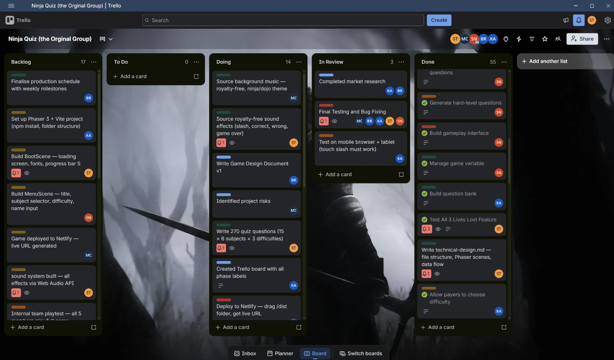
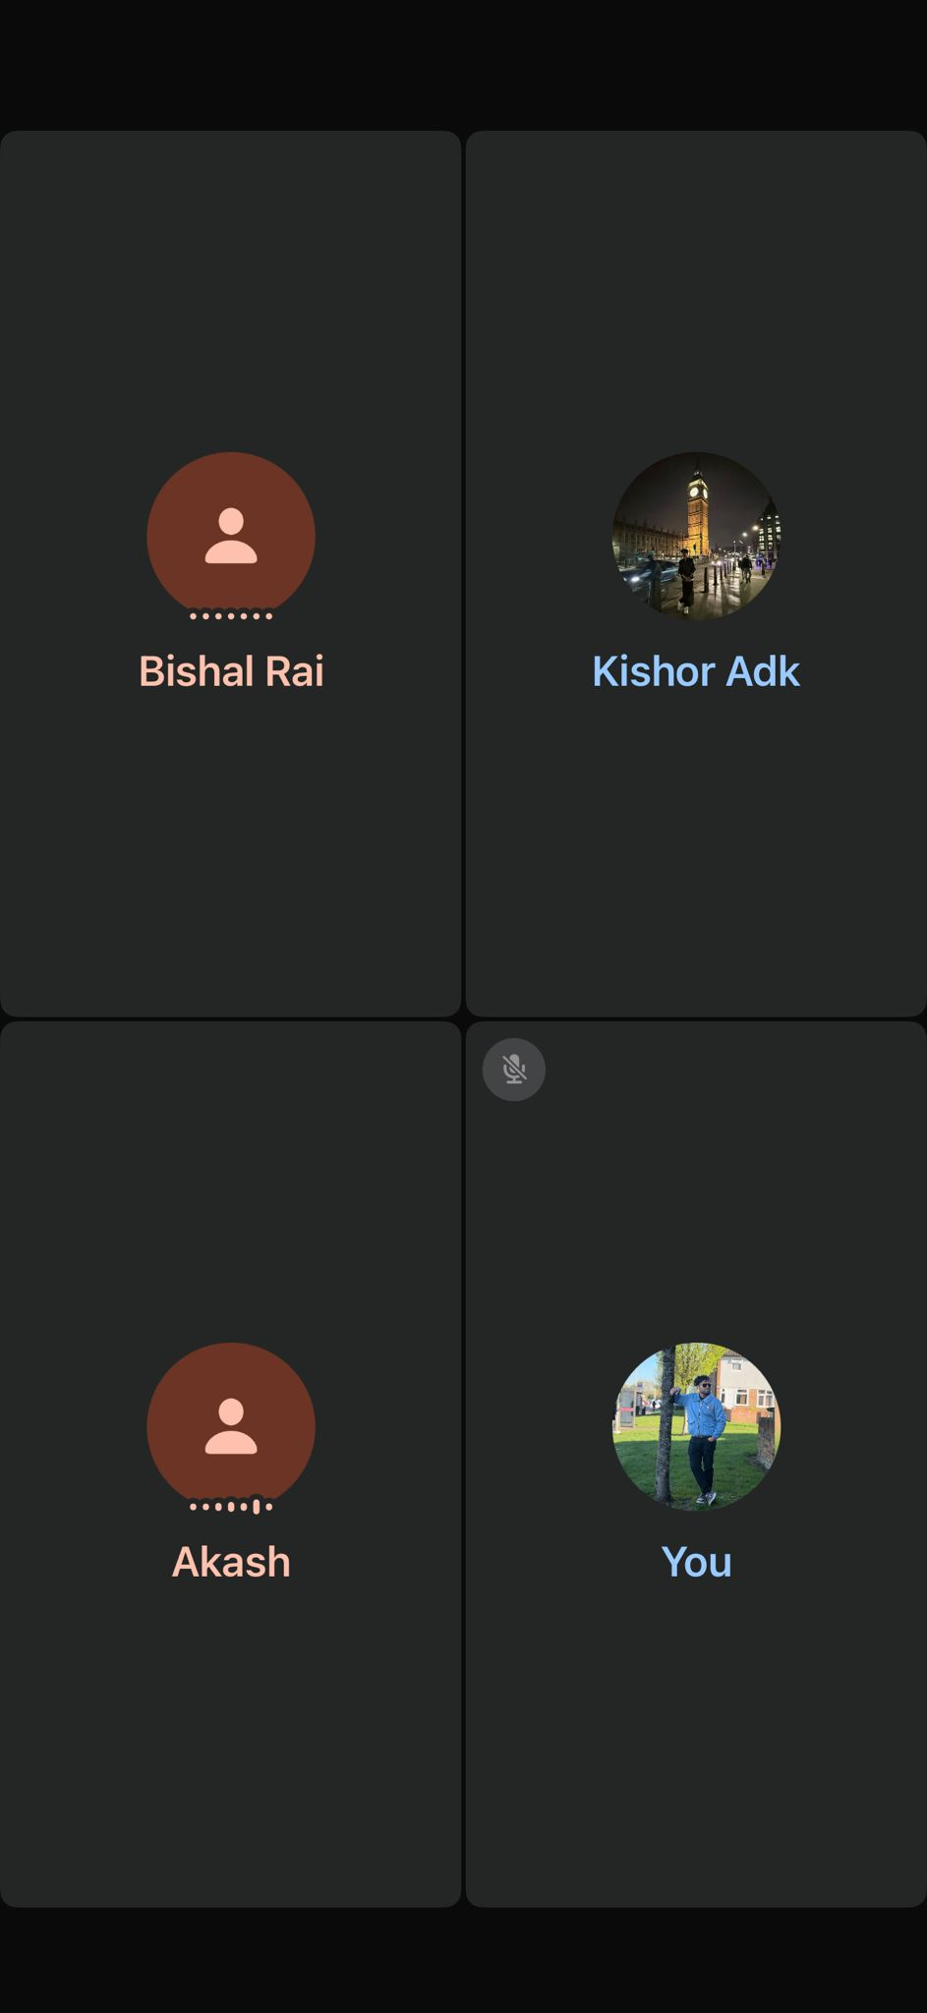
COLLABORATION TOOLS
Three tools kept us aligned.
01
Trello
Every task visible, assigned and prioritised — nothing fell through the gaps
02
GitHub
Branches per feature — no one overwrote anyone else's work
03
WhatsApp
Daily contact — issues raised same day, not a week later
Every tool had one purpose. No tool was used for everything.
NINJA QUIZ · 503IT · 06 / 18
Notes:
We chose three tools deliberately. Trello kept tasks visible to everyone — no one had to ask 'what are you working on?' GitHub meant five people could write code at the same time without conflicts. WhatsApp was our daily pulse — stand-ups every week.

Slide 7
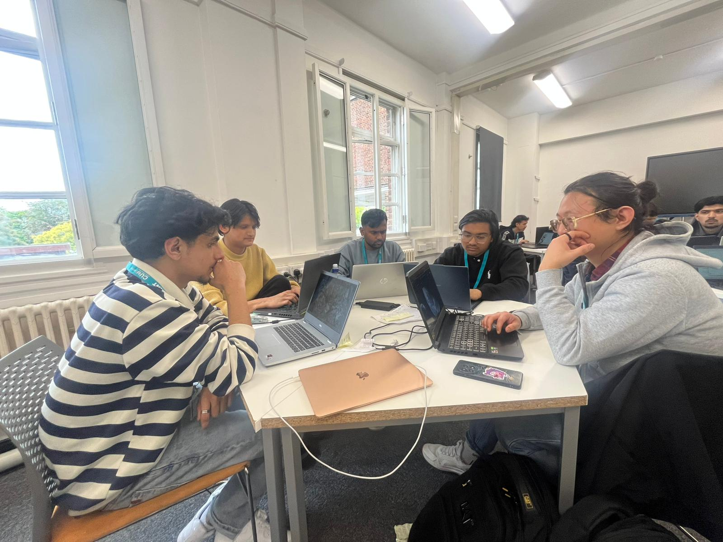
HOW WE MET
Same three questions.
Every week.
01
What did I finish?
02
What am I doing next?
03
What is blocking me?
NINJA QUIZ · 503IT · 07 / 18
Notes:
We ran eight stand-ups over eight weeks. Same three questions every time. This kept every team member focused on progress and surfaced blockers early — before they became emergencies. The stand-up format came from Agile methodology.

Slide 8
KEY DECISIONS
How decisions got made.
WITHOUT STRUCTURE
WITH STRUCTURE
Whoever spoke first won
Meeting minutes documented
No record of why
Trello card created for each decision
Decisions changed mid-sprint
Everyone had a vote
NINJA QUIZ · 503IT · 08 / 18
Notes:
Early in the project we recognised that undocumented decisions were causing confusion. We moved to a structured approach — minutes for every meeting, a Trello card for every decision. If someone was absent, they could catch up. Nothing was lost.

Slide 9
DELIVERY PROCESS
Built in five sprints.
01
Sprint 1 — Login & menu
Foundation. Every member set up. GitHub branches created.
02
Sprint 2 — Game engine
Core mechanics built. Daily check-ins via WhatsApp.
03
Sprint 3 — Slicing & sound
Visual integration. First merge conflicts resolved.
04
Sprint 4 — Leaderboard
Peer testing begins. Feedback collected and logged.
05
Sprint 5 — Testing & polish
Bug hunt, final fixes, review before submission.
NINJA QUIZ · 503IT · 09 / 18
Notes:
We used Agile methodology — five two-week sprints. Each sprint closed with a working demo and a team retrospective. This meant we were always building on something that worked, and the team reviewed its own process at the end of every cycle.

Slide 10
Then it broke.
How the team responded under pressure.
NINJA QUIZ · 503IT · 10 / 18
Notes:
Halfway through the project, we hit our biggest challenge. This is where the team's communication structure was actually tested.

Slide 11
PROBLEM & SOLUTION
The game stopped working.
THE DEFECT
THE FIX
Game ran.
Raised on WhatsApp immediately.
Question loaded.
Full team read the error log.
Answer targets — never appeared.
Root cause: two runtime errors.
Entire game depended on them.
Rebuilt in HTML. Resolved in 1 day.
NINJA QUIZ · 503IT · 11 / 18
Notes:
This was our make-or-break moment. The game ran but answer targets never appeared — the entire gameplay depended on them. The reason it was resolved in one day: the team communicated immediately. Everyone looked at the error log together. Root cause identified, component rebuilt. Not one person could have done that alone.

Slide 12
LESSONS FROM THE BUG
What fixing it taught us.
01
Raise it fast
Issue shared on WhatsApp the same hour it was found
02
One owner per module
We knew exactly whose code to look at — no confusion
03
Review together
Team read the log as a group — solved what one person would have missed
Structured communication turned a critical bug into a one-day fix.
NINJA QUIZ · 503IT · 12 / 18
Notes:
The bug was not just a technical problem — it was a test of our process. And our process worked. Because every person knew their role, issues were raised immediately, and the team reviewed code collaboratively, we resolved it without delaying the sprint.

Slide 13
The result.
Did we meet the brief?
NINJA QUIZ · 503IT · 13 / 18
Notes:
With the process covered — let's show what it produced.

Slide 14
BRIEF REQUIREMENTS
Every box. Ticked.
Cyber-safety concept taught
Phishing, passwords, 2FA, VPNs and more
Defined audience
Children and young teens aged 8–14
Educational value + replayability
45 cyber-safety questions · 3 difficulty levels · leaderboard
Complete working prototype
Runs in any browser — no install
Ready for demonstration
Live today — with supporting documentation
NINJA QUIZ · 503IT · 14 / 18
Notes:
The team delivered every client requirement. This was possible because of the structured process — clear roles, sprint planning, and documented decisions meant nothing was missed.

Slide 15
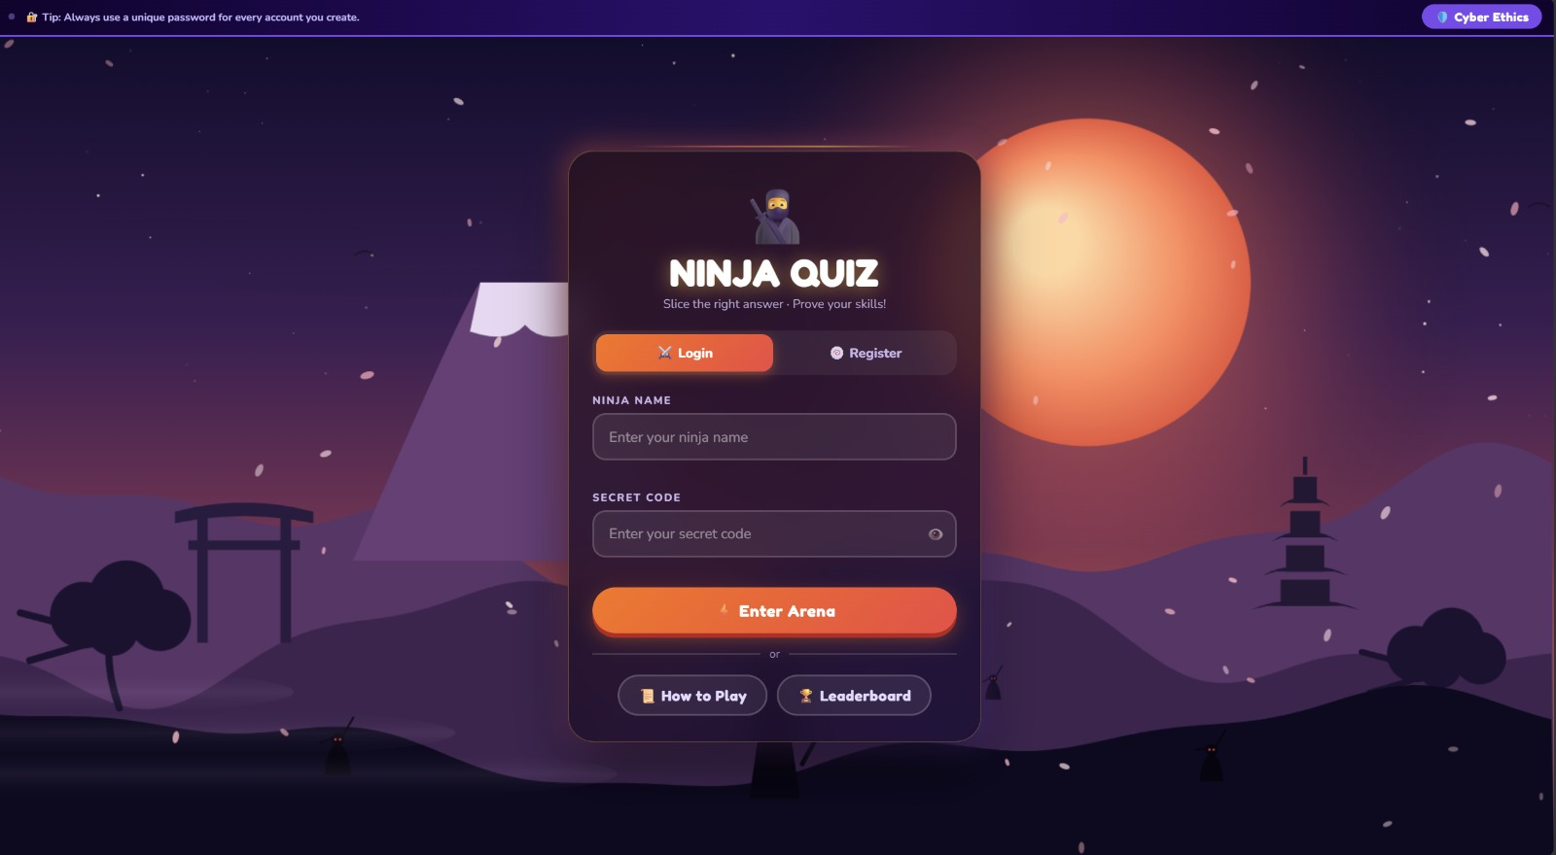
THE PRODUCT
This is what we built.
NINJA QUIZ · 503IT · 15 / 18
Notes:
This is Ninja Quiz in play. A cyber-safety question appears, four answer targets fly across the screen, and the player slices the correct one. The product is fully working and available for a live demo right now.

Slide 16
WHAT WE LEARNED
Communication
built the product.
Not the code. Not the tools. The way five people stayed aligned.
NINJA QUIZ · 503IT · 16 / 18
Notes:
Our biggest takeaway from this project: the game existed because of how we communicated — not just how we coded. Structured stand-ups, documented decisions, and fast escalation of issues made the difference between a broken prototype and a working product.

Slide 17
PROFESSIONAL DEVELOPMENT
This project taught us how
industry teams actually work.
Structured communication
Raising issues immediately, logging decisions in Trello and meeting minutes — these are professional standards, not student habits.
Real version control
Feature branches, no pushing to main without review. We left this project with actual Git workflow experience.
Agile delivery mindset
Five sprints with goals, retrospectives, and user testing mirrors how software teams ship in industry.
Resilience under pressure
When the game broke 2 weeks before submission, we diagnosed and fixed it in one day — as a team. That experience is irreplaceable.
NINJA QUIZ . 503IT

Slide 18
Thank you.
Questions welcome — happy to run a live demo.
Ninja Quiz · Team The Originals · 503IT
Notes:
Thank you. We are happy to take questions and run a live demo of the game. We are also happy to walk through any part of the team process in more detail.

