Slide 1

Cyber-Smart Gaming for Education
Coventry University · 503IT · Team Hexa · 6 Members
BOARD PRESENTATION · JUNE 2026 · 15 MINUTES

Slide 2
THE CHALLENGE
Digital Danger Is Rising.
Awareness Isn't.
77%
30%
14–15
Only receive regular online
safety education
peak age for
cyberbullying (38%)
of children experienced
online harm (Ofcom 2024)
PRESENTER 1 · MEMBER 1

Slide 3
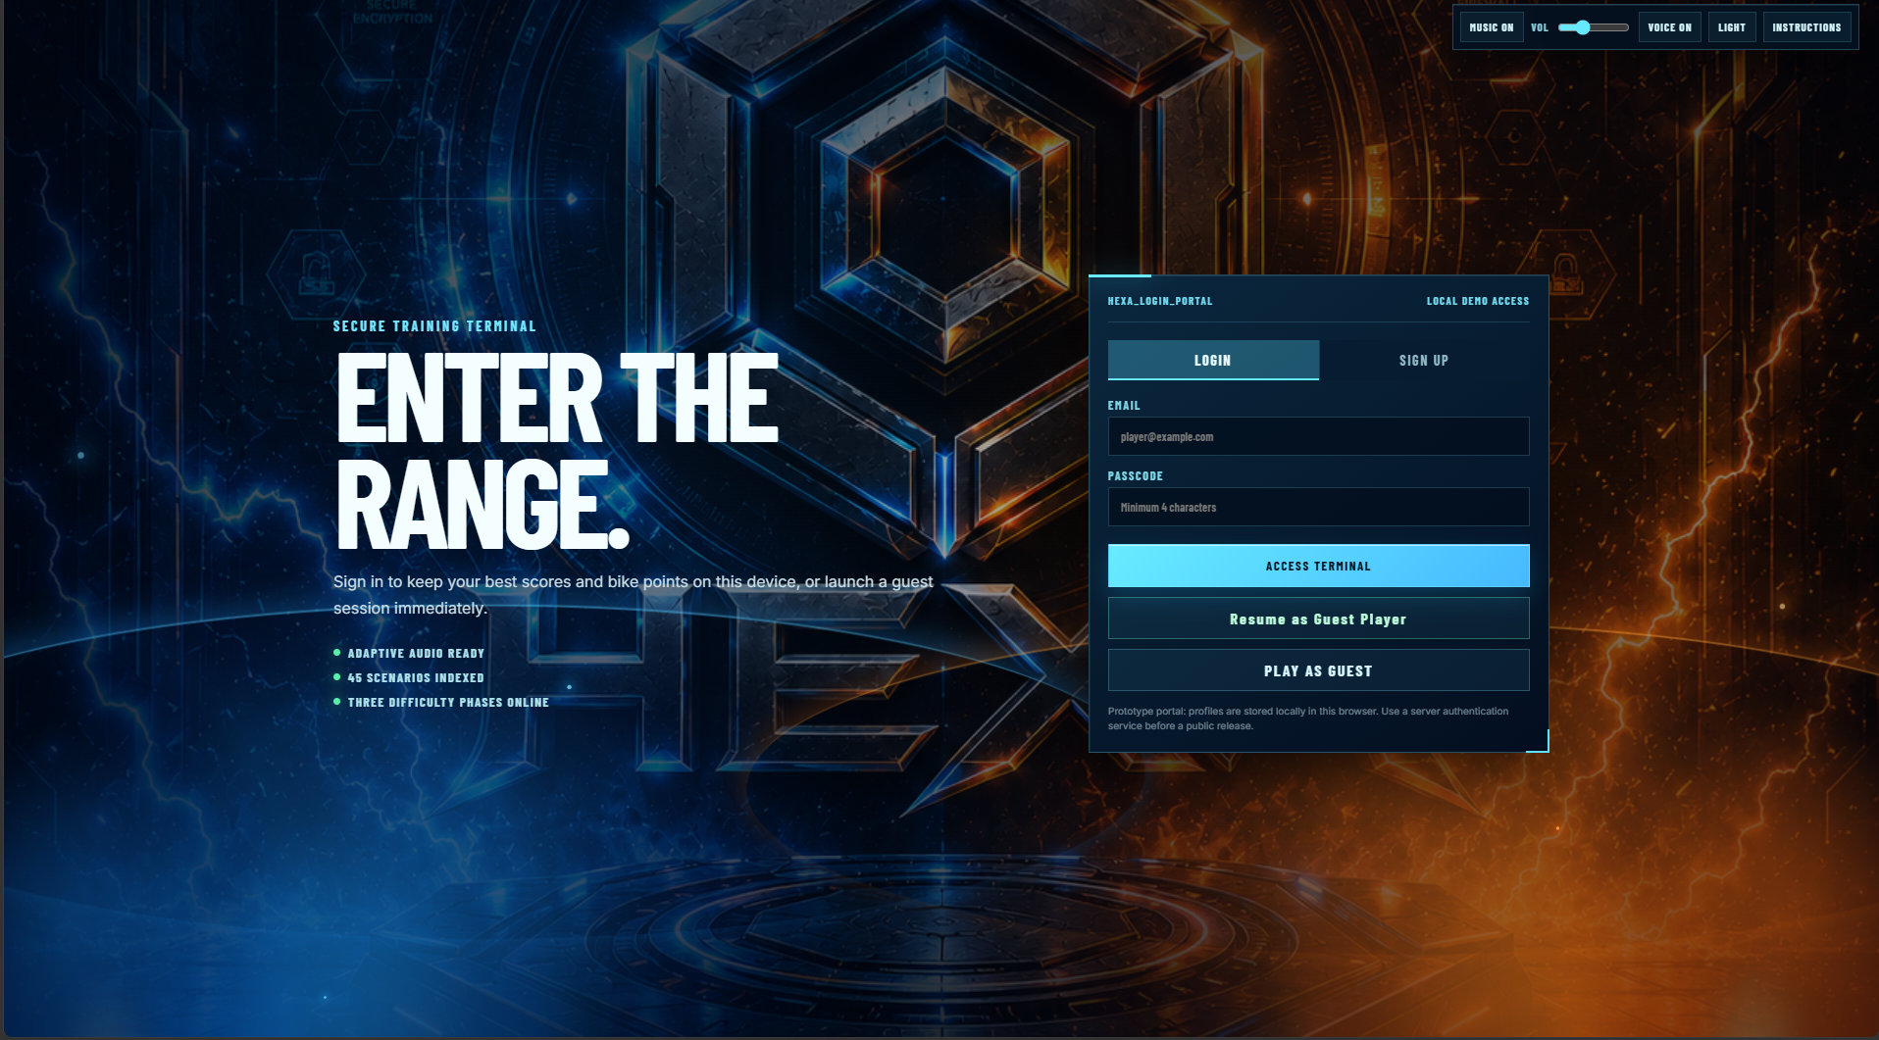
OUR SOLUTION
Introducing
Hexa.
45 Scenarios
3 Age Groups
Instant Feedback
Runs in Any Browser
PRESENTER 2 · MEMBER 2

Slide 4
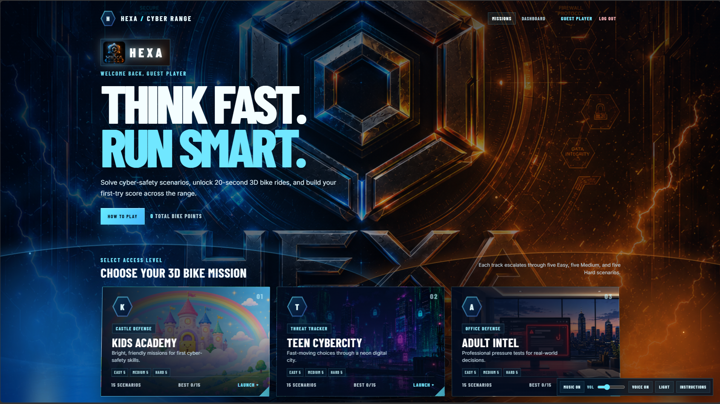
PRESENTER 2 · MEMBER 2

Slide 5
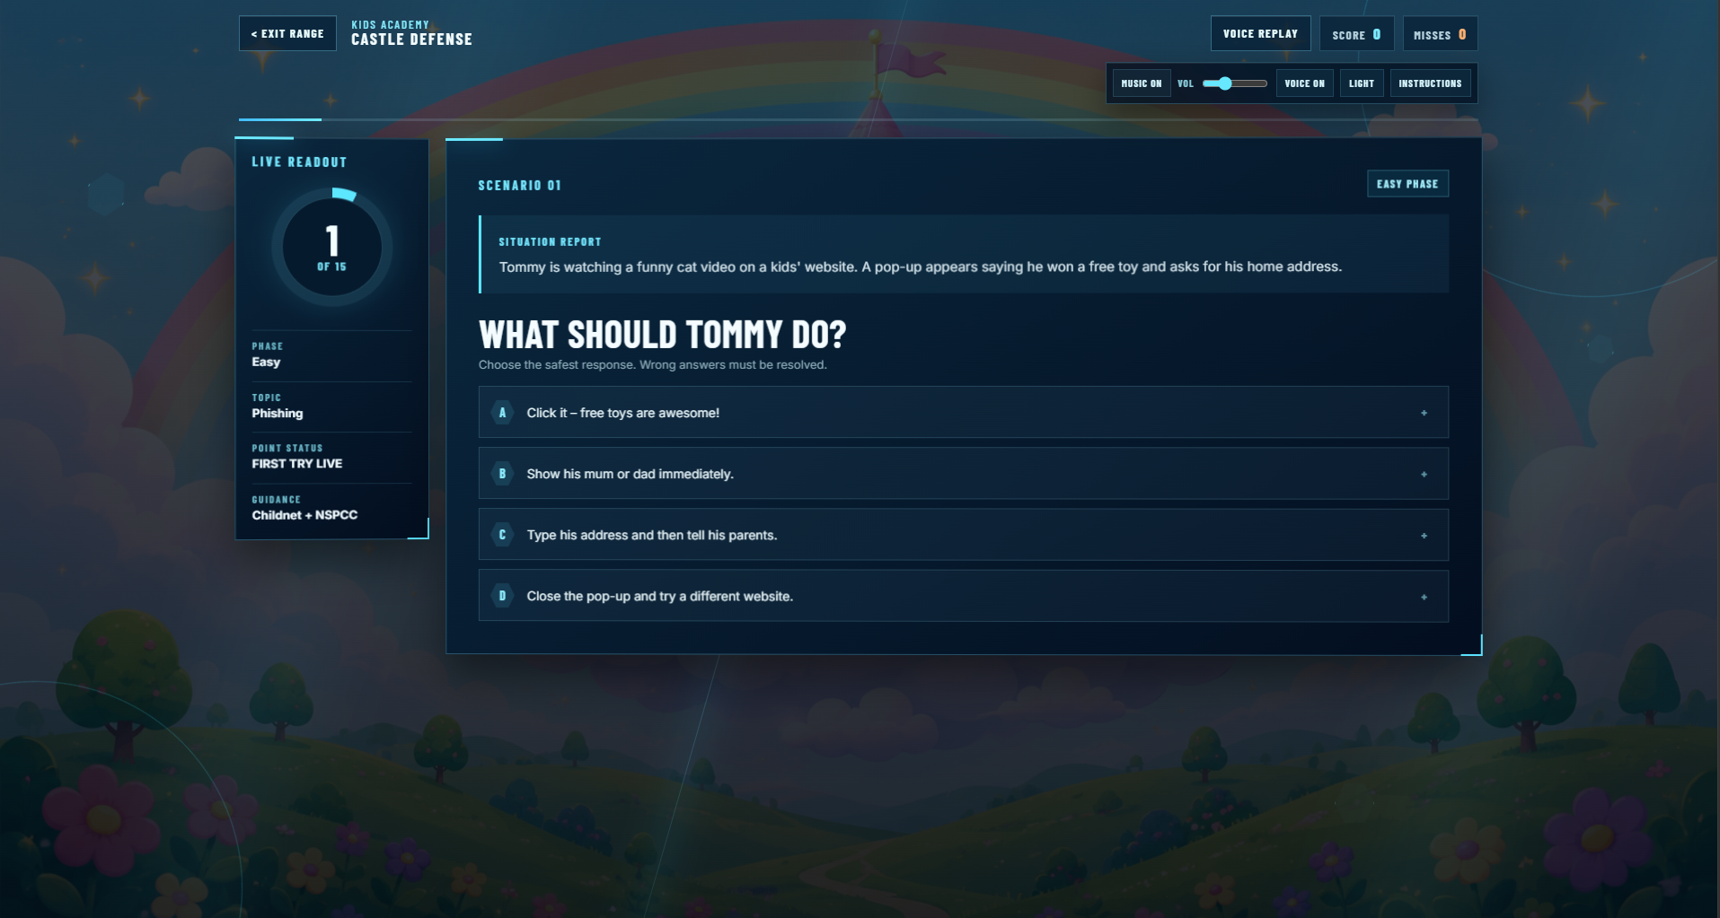
HOW IT WORKS
Learn by Deciding.
1
Enter a Scenario
A suspicious email,
a risky login, a social
media moment.
2
Make a Choice
Pick from realistic
multiple-choice options.
3
Instant Feedback
See the consequence +
a plain-English explanation.
4
Build the Habit
Replay to reinforce
safe behaviour.
PRESENTER 3 · MEMBER 3

Slide 6
DESIGNED FOR EVERYONE
One Game.
Three Audiences.
🏰
🏙️
🏢
CHILDREN
TEENS
ADULTS
Safe internet use
Social media safety
Workplace security
Personal information
Cyberbullying
Financial scams
Spotting online dangers
Phishing & digital privacy
Password & data protection
PRESENTER 3 · MEMBER 3

Slide 7




HOW WE BUILT IT
Built in the Open.
React
Structure & scenarios
Responsive, age-themed UI
Quiz logic, scoring, feedback
Supporting tooling & data
App.jsx ×
style.css ×
package.json ×
1
import React, { useState } from 'react';
2
import { scenarios } from './data/scenarios';
3
4
export default function HexaQuiz() {
5
const [score, setScore] = useState(0);
6
const [current, setCurrent] = useState(0);
7
// Handle player choice & feedback logic
8
const handleAnswer = (choice) => {
9
if (choice.correct) setScore(s => s + 1);
PRESENTER 4 · MEMBER 4
Notes:
Good [morning/afternoon]. My name is [Member 4], and I'll be walking you through the technology stack we used to build Hexa.
We chose a modern, open-source web stack so the game runs directly in any browser — no downloads, no installations required.
React handles the core structure and all 45 quiz scenarios. It lets us build a dynamic, component-based interface where each age group's content loads cleanly without reloading the page.
CSS manages the responsive layout and the age-themed visual design — so Children, Teens, and Adults each get a distinct look and feel that matches their experience level.
JavaScript powers everything under the hood — the quiz logic, the scoring system, and the instant feedback players receive after every choice.
Python was used for supporting tooling, data preparation, and backend utilities during development.
You can see a snippet of our actual code on screen — this is from App.jsx, our main quiz component. It shows real state management using React hooks, demonstrating this was a genuinely built, working application — not a prototype.

Slide 8
COLLABORATION
Built Together,
In the Open.
⑂
Git & GitHub
📋
Meeting Minutes
79 commits
Every sprint
One shared repo, branch-based workflow, pull request reviews.
Documented agendas, decisions, and action plans on file.
📖
Members Guide
✅
Task Tracking
6 members aligned
Clear ownership
Onboarding document keeping the whole team in sync.
Defined deadlines and responsible members for every item.
PRESENTER 4 · MEMBER 4
Notes:
Hexa wasn't built by one person — it was a team effort, and we structured our collaboration carefully.
We used Git and GitHub throughout the project. With 79 commits across the team, we worked on a single shared repository using a branch-based workflow with pull request reviews — the same professional standard used in industry.
Every sprint was documented through formal Meeting Minutes. We kept agendas, recorded decisions, and tracked action items — ensuring nothing was left to memory.
We also produced a Members Guide to onboard all six team members consistently. This kept everyone aligned on their roles, responsibilities, and how we expected the project to run.
Finally, we used structured Task Tracking — every item had a defined deadline and a named responsible member. This gave us clear ownership and helped us deliver on time.
In short, we didn't just build a game — we ran this project the way a real software team would.

Slide 9
USER TESTING
We Listened.
Then We Improved.
Early prototypes trialled with real players across all three age groups.
18
92%
4.3★
3×
players in
test sessions
completed a full
scenario unaided
rated the game
fun and clear
rounds of
feedback & iteration
PRESENTER 5 · MEMBER 5

Slide 10
ACCESSIBILITY & INCLUSION
Designed for
Everyone.
What Users Changed
Simpler Wording
◑
High-Contrast Colours
Re-wrote children's questions
in plainer language.
Text and buttons meet readability guidance against the dark theme.
⌨
Keyboard Friendly
Clearer Feedback
All quiz options reachable and selectable without a mouse.
Added 'why' explanation
after every answer.
✦
Plain, Age-Tuned Language
Wording matched to each audience — no jargon for younger players.
Bigger Tap Targets
Enlarged buttons for easier
use on touch screens.
🌐
Runs Anywhere
Browser-based and lightweight — no powerful device required.
PRESENTER 5 · MEMBER 5

Slide 11
THE TEAM
Six Members.
One Solution.
AB
Aaditya Bhandari
SJS
Sandesh Jung Shah
AB
Abdullah Badhurdeen
Frontend
UI / UX Design
Backend
M1
Sijan Bhandhari
M2
Johns Jimee
M3
Nabin Sunar
Content & Scenarios
Testing & QA
Docs & Comms
PRESENTER 6 · MEMBER 6

Slide 12
NEXT STEPS
What Comes Next.
NOW
Q3 2026
Q4 2026
2027
Public Release
School Pilots
Dashboard
Expansion
Deploy to Coventry
University network.
Partner with local
primary schools.
Teacher analytics &
progress tracking.
New scenarios,
new age tracks.
PRESENTER 6 · MEMBER 6

Slide 13
⬡
HEXA
Cyber-Smart Gaming for Education
Thank you.
Questions welcome · Team Hexa · Coventry University · 503IT
COVENTRY UNIVERSITY · 503IT · COMMUNICATION & COLLABORATION · JUNE 2026

