Slide 1
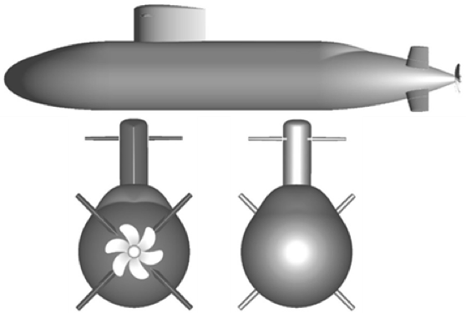




Inertial Frame I
Flow Frame F
$${\hat{w}}_{2}$$
$${\hat{t}}_{2}$$
$${\hat{t}}_{1}$$
$${\hat{w}}_{1}$$
Desired Path
Target Frame T

