Slide 1
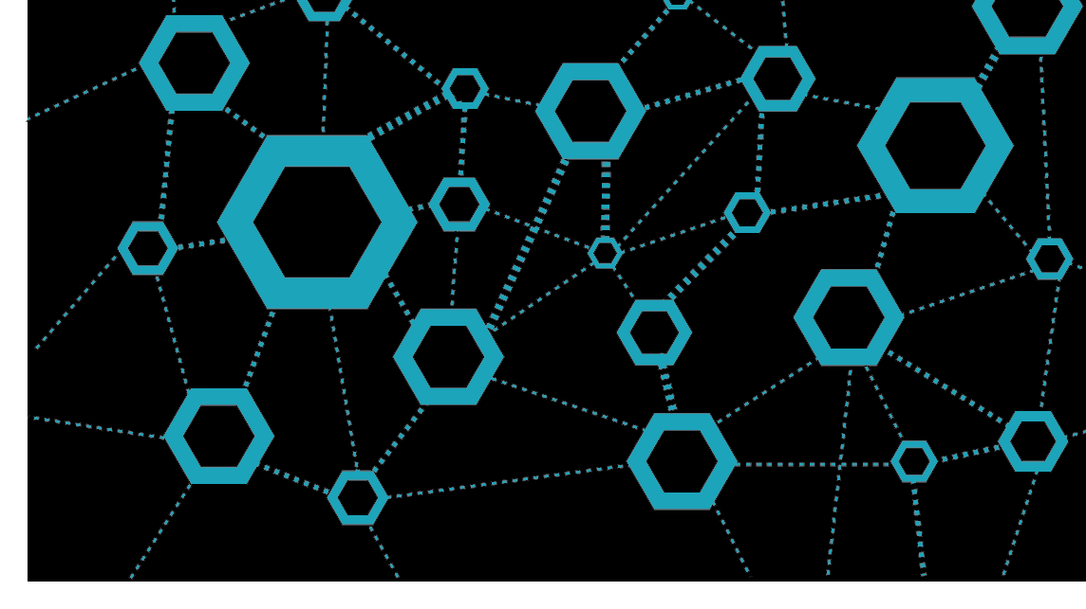

Deploy the mission-critical application in seconds and make it globally resistant
Vladimir Stefanovic, Microsoft Azure MVP, CSA @SuperAdmins

Slide 2
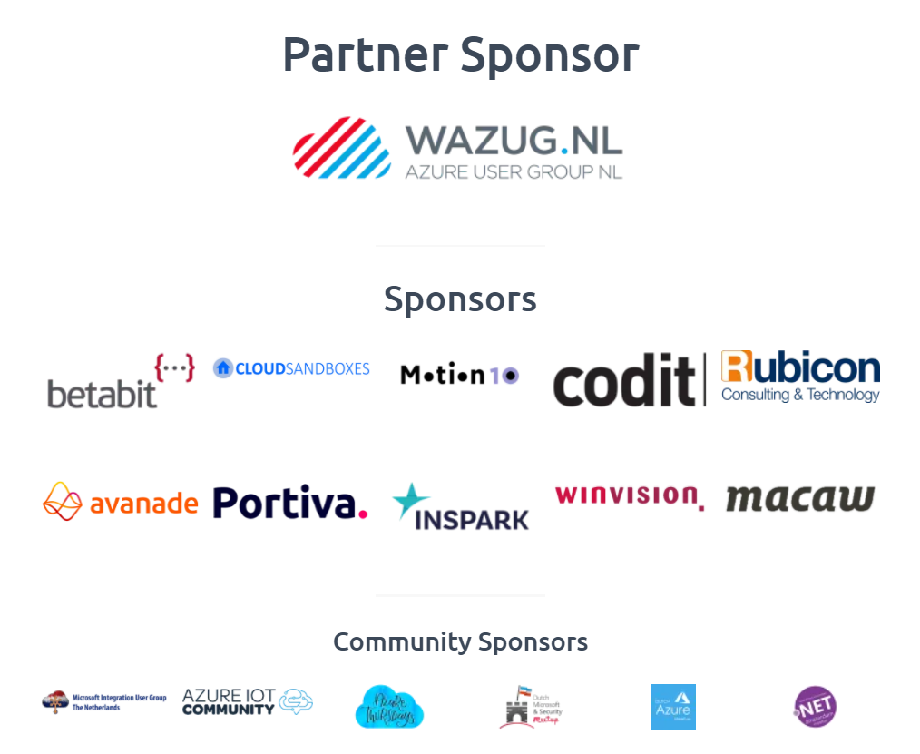
A special thank you to the sponsors!

Slide 3

Who am I
vladimir@Azure:~$ az speaker show –output json
{
"speakerName": "Vladimir Stefanovic",
"location": "Belgrade, Serbia",
"titles": "Microsoft MVP, MCT RL",
"position": „CSA @SuperAdmins",
„community": „Azure Serbia UG, AzureSaturaday.rs",
"twitter": "@wladinho31"
}

Slide 4
Why we need a geo-redundant application?
The business is growing on a global scale
We want to be protected from the region outage
The application must be accessible 24/7
We have enough money to pay for everything ☺
** This session is based on the project for South Africa’s medicare application

Slide 5





What Azure services do we need to use?
In a nutshell, all services are welcome, even VMs
But … Cloud-native services are more comfortable
Infrastructure design depends on the type of application
Don't forget on security

Slide 6
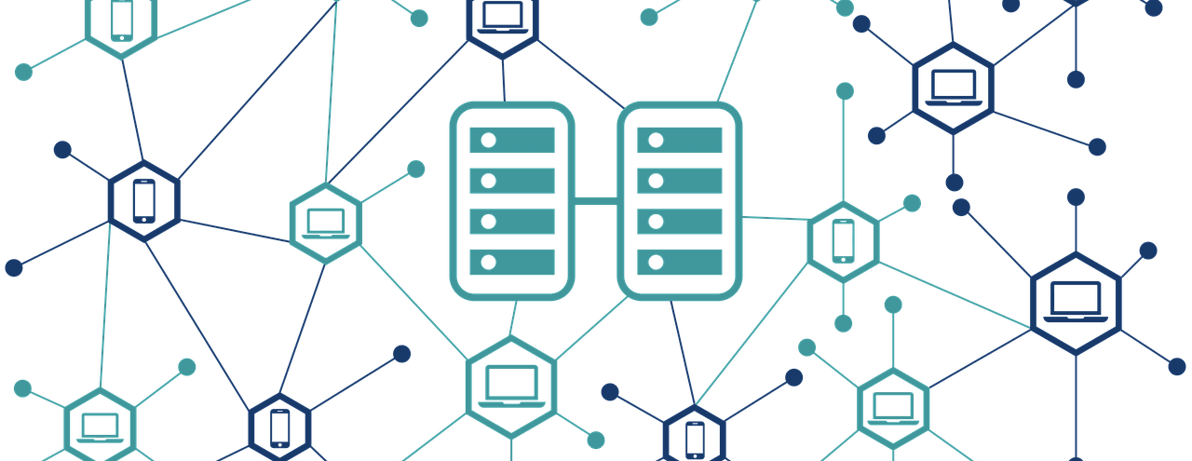
Demo
Let see does it will work :)

