Slide 1
Detection and control of liquid level in a tank
A Project using Intel Galileo Gen 2
Project Theme No. 15
Students: Supervisor :
Vlad Gabriel POPESCU Teacher: Nicolae Alexandru GUZU

Slide 2
Project Description - Recommended components Types of connections - Project Requirement
Project Description | Compon. | Types conne | Types of connections
A device will be developed to detect the liquid level in a 7-level tank. | Breadboard | 5V | Wiring
The device will start when the START button is pressed. It will be controlled by seven conductivity sensors | Conductivity sensors | Digital/ Analogue I/O | Pseudo-code (software diagram) to exemplify the logic of the approach.
The detected water level will be displayed on a seven-segment display | Control relay
You will be able to set any of the 7 levels as a default level. | Push button | GND | Realization of the wiring diagram
A second tank will be used to keep the liquid at a preset level. | LCD DISPLAY |  | Realization of the wiring diagram
The transfer between the two tanks will be done with a pump | Pump |  | Code in Intel Galileo compatible language
Bonus: a buzzer will signal if the level in the pot is high/low. | Resistors

Slide 3
Development of a device to detect the min, max levels and control the liquid level in tank with conductivity sensors;
The device is activated by a START button and uses seven conductivity sensors, a relay, a pump, a buzzer, a display and Intel Galileo Gen 2 motherboard;
Liquid levels are displayed on a LCD Display (16 chr on rows);
User can set any of the 7 levels as a default;
A second tank maintains the liquid at a preset level, with transfer controlled by a pump with a relay;
A buzzer signals when the liquid level is too high or too low.
the code entered for the microprocessor collects the data from the analog sensors, then analyzes and coordinates by giving execution commands for each component in the order of the process;

Slide 4
Implementation Method on Galileo - Methodology:
Sensors: Conductivity sensors detect the liquid level;
Display: The LCD display shows the current level of liquid;
Control: Microcontroller reads sensor data and controls the pump and buzzer:
- Pump adjusts liquid level between tanks based on preset level.
- Buzzer alerts for critical levels.
Principles of Operation:
Sensors: Analog conductivity sensors measure the water level.
The conductivity value indicates how well a material conducts electric current. With a conventional analog output and a large current measurement range that is scaled from 4 to 20 mA, any change in liquid conductivity can be directly detected and transmitted. The output is analog, giving a voltage depending on the water level;
Block Diagram: Sensors → ADC (Analog to Digital Converter) → Galileo → Display/Relay/Pump/ Buzzer

Slide 5
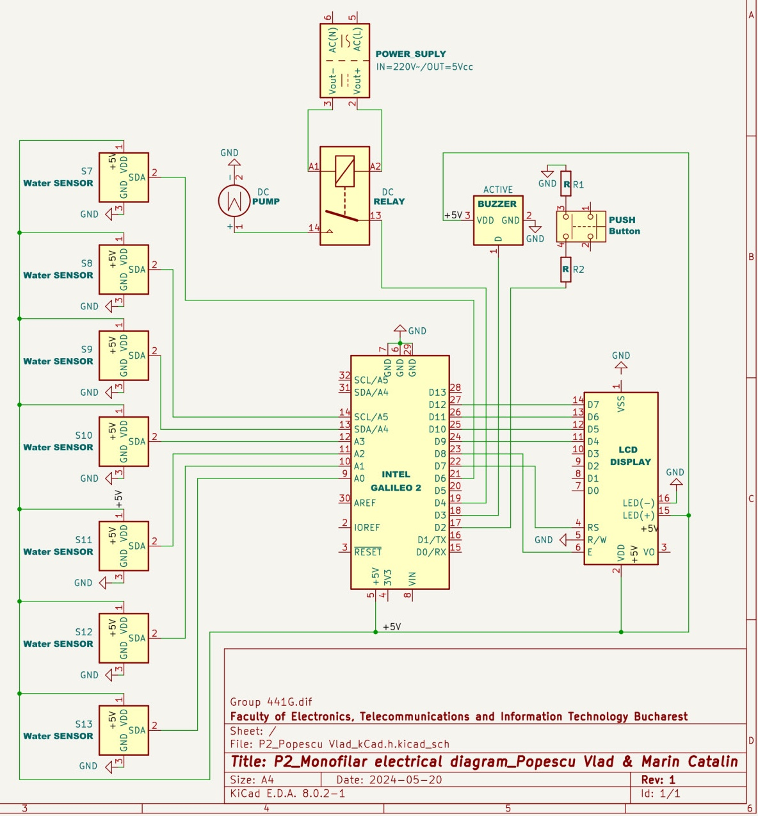
Wiring Solution, Connection diagram and Monofilar Electrical Diagram (KiCAD)

Slide 6
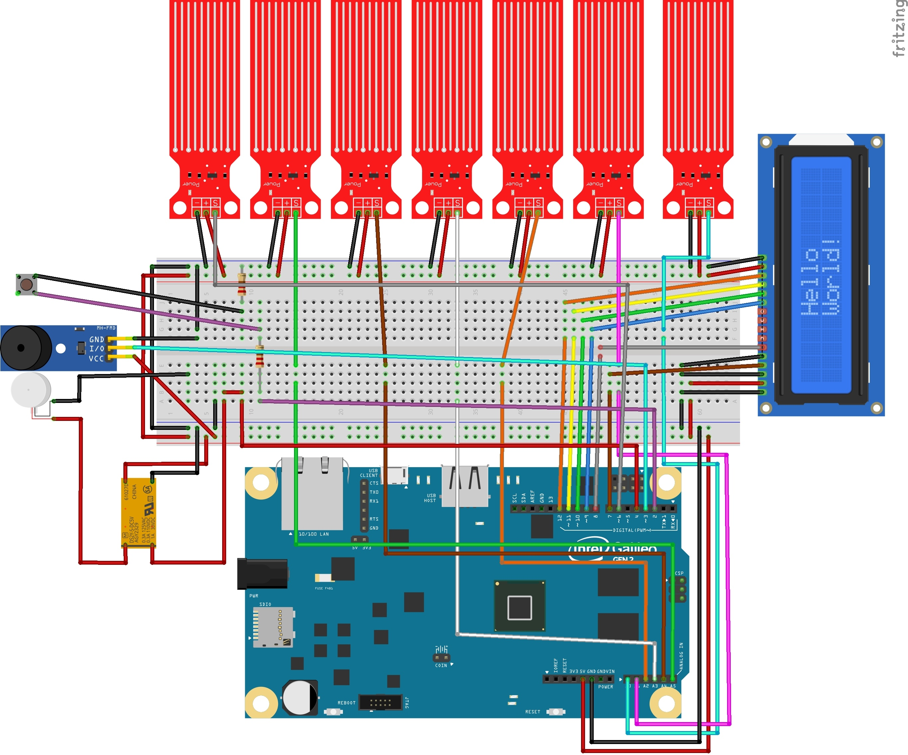
Wiring Solution (Fritz)

Slide 7
EXPLANATION OF THE MONOFILAR SCHEME OF CIRCUIT FUNCTION
Push button-> the signal goes to digital input pin D2
-> signal output on digital pin D4 which will transmit and maintain a signal in the relay and feed the pump with +5V-> the pump will start and run until the water fills the basin
- >through the mounted water level sensors, each one will pass through the analog output from pin S to the analog inputs A0--A5 of the Galileo board and they will each in turn signal a water level that will be transmitted to the microprocessor which, having the code entered by us, will analyze and then give signals to the LCD which will be displayed on the display or through the digital outputs of the Galileo board: D7,8.9,10,11 and 12 which lead the signal to the inputs of the LCD display: RS,RW, E,D4,D5,D6 ,D7, a text with the water levels reached according to the activated sensors
-> Then when the water reaches the last sensor, through the program code it will transmit an impulse to the relay through the digital output pin D4 which will cut the power to the pump and the pump will stop powering with water-
> also with the signaling of the maximum water level transmitted to the board, also through the code loaded in the microprocessor, it will transmit a signal from the digital output D3 to the input of a Buzzer that will signal the water reaching the maximum level, it will also be transmitted at the same time on the LCD display: Level 7 -Maximum / Tank Full, after 10 sec the buzzer will stop.

Slide 8
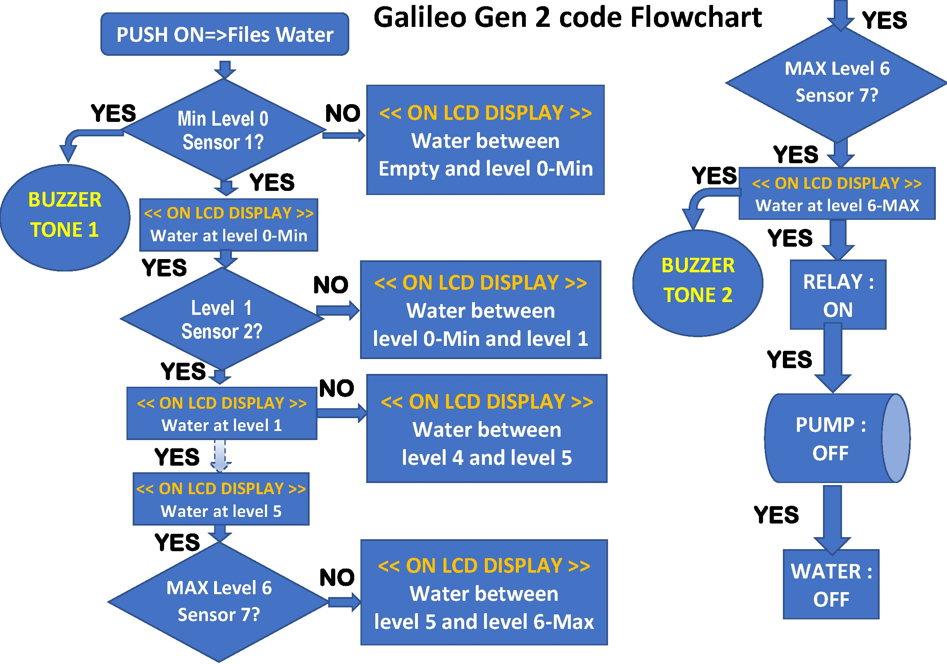

Slide 9
Flowchart of Galileo
Start: Detect START button press.
Read Sensors: Gather data from the conductivity sensors.
Display Level: Show current level on the seven-segment display.
Check Level: Compare current level with preset level.
Control Pump: Activate pump if liquid needs to be transferred.
Signal Alarm: Activate buzzer if levels are too high or too low.
Repeat: Continuously monitor and control.

Slide 10
Programming the microcontroller - Pseudo-code
Outlines the logical flow of the program to manage sensor readings, pump activation, and display updates.
1. Initialize the system.
2. Wait for the START button to be pressed.
3. Read the analog values from the conductivity sensors.
4. Determine the current liquid level based on sensor readings.
5. Display the liquid level on the seven-segment display.
6. Check if the liquid level is at the preset default level:
- If below, activate the pump to transfer liquid from the second tank.
- If above, deactivate the pump.
7. Use the buzzer to signal if the level is too high or too low.
8. Continuously monitor the liquid level and update the display.
BEGIN
SET default_level = 0
SET current_level = 0
WHILE START button is not pressed
WAIT
ON START button pressed
READ all conductivity sensors
UPDATE current_level based on sensor readings
DISPLAY current_level on seven-segment display
IF current_level < default_level
ACTIVATE pump
ELSE
DEACTIVATE pump
IF current_level is too high OR too low
ACTIVATE buzzer
ELSE
DEACTIVATE buzzer
END IF
END WHILE
END

Slide 11
Sources and References
Datasheets: Conductivity Sensors, Intel Galileo Gen 2.
Arduino Documentation: [Arduino](https://www.arduino.cc).
Microcontroller Programming: "Programming Interactivity" by Joshua Noble.
Control Systems: "Automatic Control Systems" by Benjamin C. Kuo.
Electronic Circuit Design: "The Art of Electronics" by Paul Horowitz and Winfield Hill.
Sistem automat de monitorizare si dozare a apei din bazin, Bogdan SMARAND
Principiile fizice ale senzorilor și traductoarelor, Hotinceanu M.
Măsurători de Nivel și Debit în Procese de Umplere, Clara Robu, 2020.
Traductoare şi instrumentaţie virtuală, Valentin Sgarciu,
http://www.deekshith.in/2012/04/automatic-water-level-controller-with.html
https://www.bitmi.ro/electronica
https://www.robofun.ro
https://learn.adafruit.com/character-lcds/wiring-a-character-lcd
https://www.sigmanortec.ro/LCD-2004-Display-Albastru-p135163856
https://www.sigmanortec.ro/Senzor-nivel-apa-lichid-p125423486
https://fritzing.org/projects/flow-meter

Slide 12
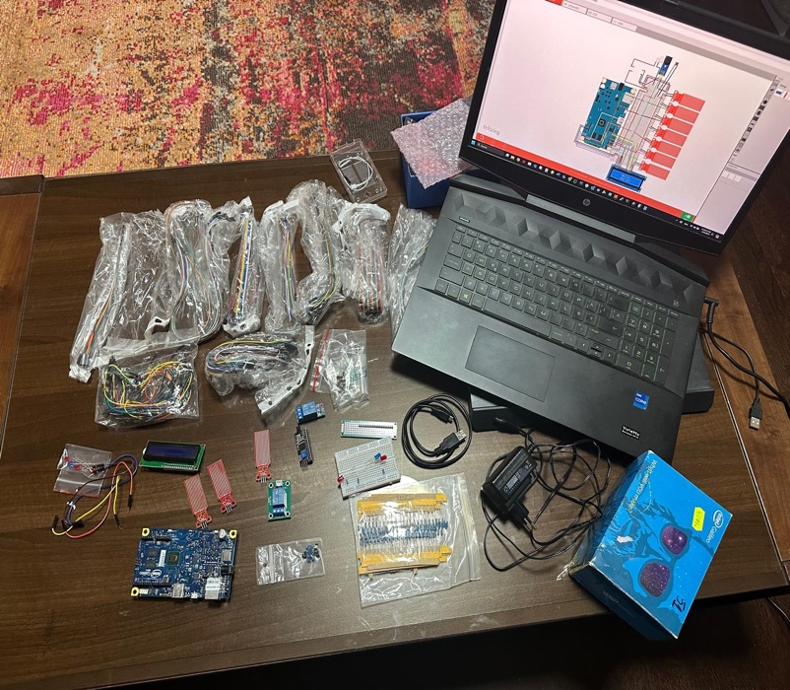
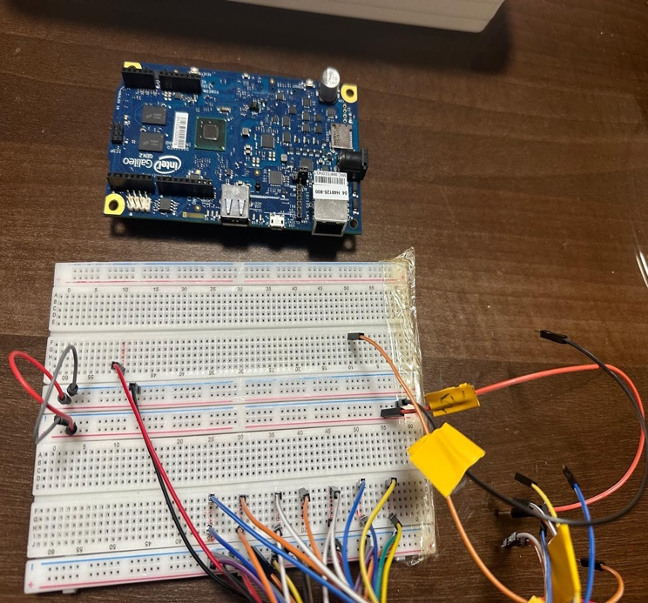
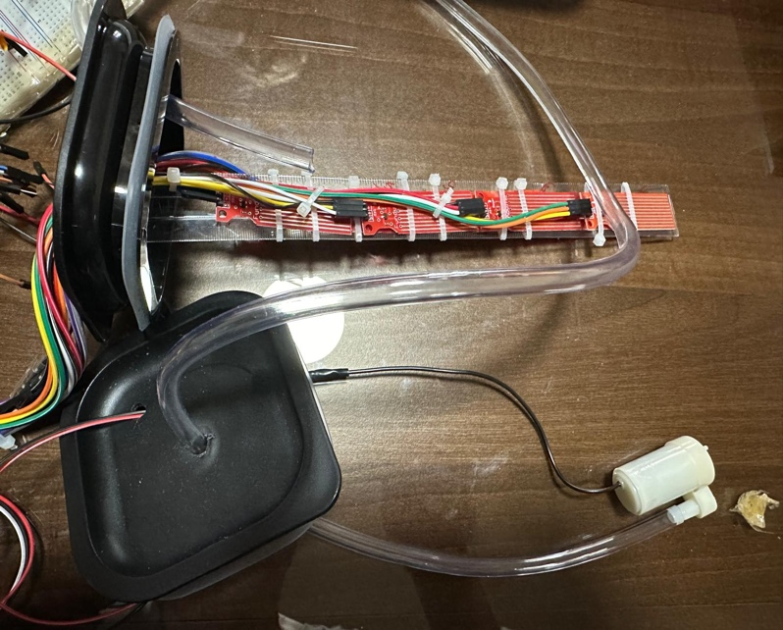
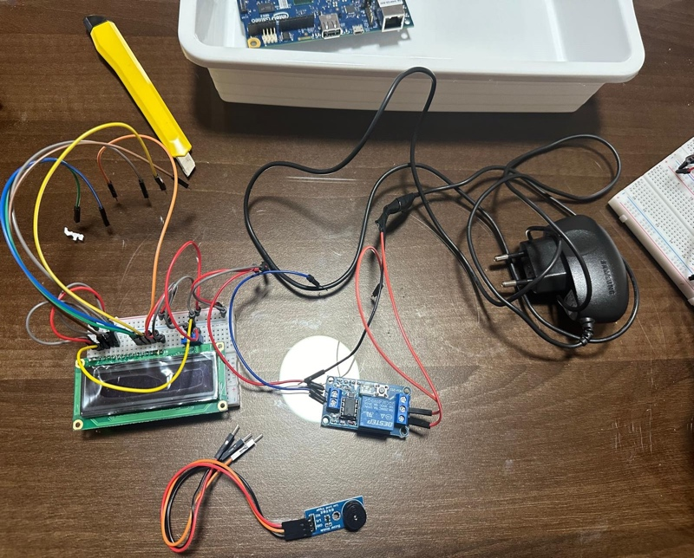
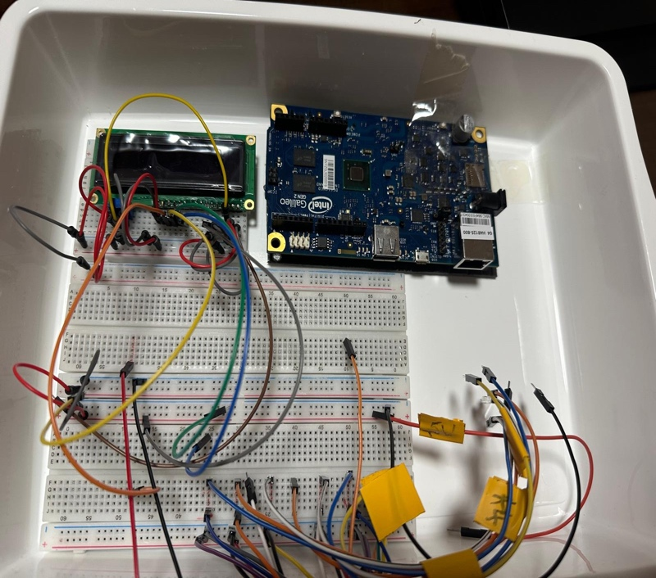
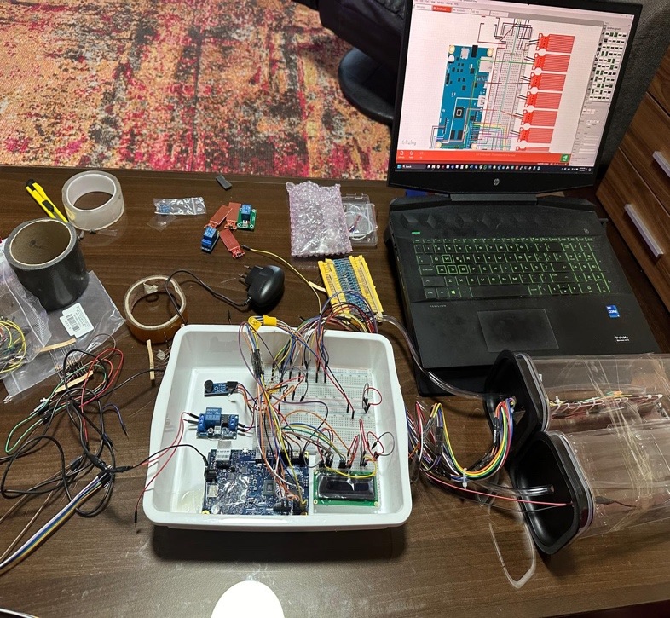
Pictures with the stages of the project

