Slide 1
Forecasting S&P 500 Volatility
An Exploration of Predictive Models
Matt Wladyka
June 2020

Slide 2
Motivation
Quantifying volatility is imperative for proper portfolio management
Forward-looking volatility predictions create better understanding of risk profile
Useful applications for portfolio managers, volatility traders and retail clients

Slide 3
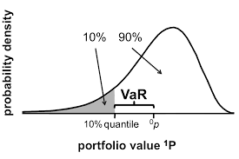
Volatility Applications
One application for volatility forecasts is Value-at-Risk (VaR)
VaR – Risk to portfolio given assumptions about moves in asset prices
VaR commonly used to gauge maximum losses

Slide 4
Data Overview
5 years S&P 500 ETF (SPY) daily price data
Date range: May 2015 – May 2020
Columns: Open, High, Low, Closing, and Adjusted Closing Price as well as Date and Volume Traded
1,259 rows and 7 columns
Source: Yahoo Finance

Slide 5
Data Manipulation
Calculations required to transform price data into daily changes and then into realized volatility
Realized volatility – numerical representation for how much a stock moved over a given period of time
A 1% move in stock corresponds roughly to .1989, or a realized volatility of 19.89

Slide 6
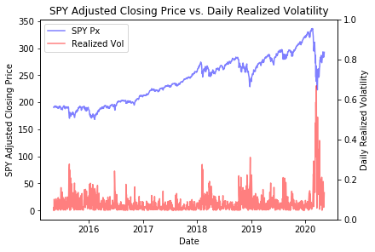
Exploratory Data Analysis (EDA)
Stocks more volatile going down than up
Volatility tends to revert to long term average
Persistence in volatility
Mean Volatility: .1361
Std Dev of Volatility: .1905

Slide 7
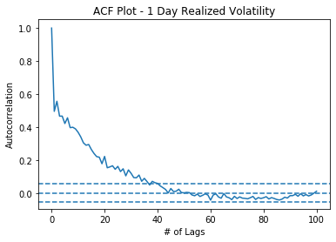
EDA
ACF Plot of realized volatility displays significant correlation from day-to-day
Correlation of a series with itself is called an autoregressive series
Allows visualization of persistence in volatility
Past volatility can be predictive of future volatility for over 1 month

Slide 8
EDA Takeaways
Since volatility is an autoregressive series, it requires the use of GARCH models, common for forecasting problems in finance
Several variants of GARCH, a few will be covered in the modeling section
GARCH models use lagged residuals and lagged variance to make forecasts

Slide 9
Modeling Overview
Modeling Framework – What is being forecast?
Data Pre-Processing – What steps are necessary to modify the data before modeling?
Summary statistics table
GARCH and related models
Non-GARCH models – Neural networks, classic machine learning algorithms and symbolic regression
Modeling conclusions

Slide 10
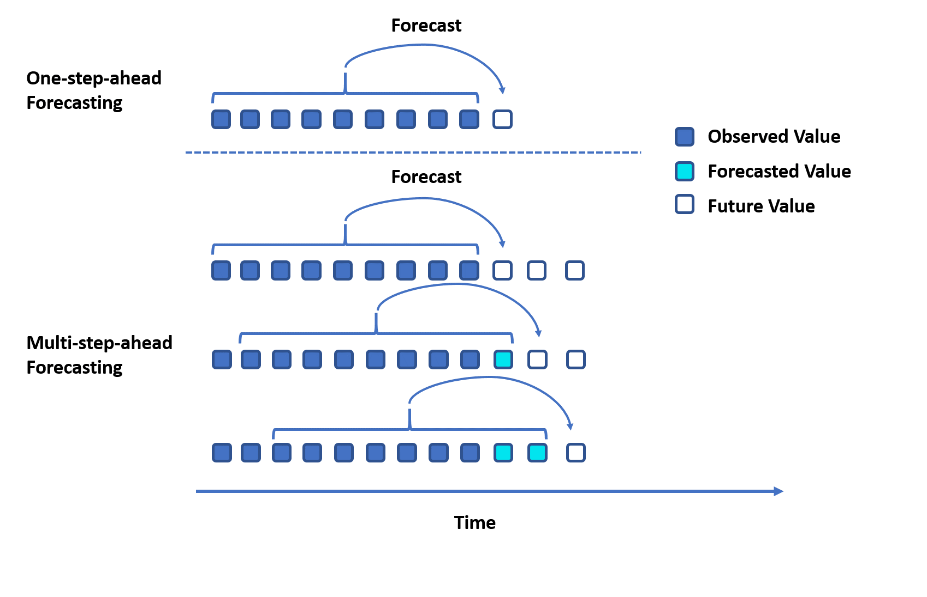
Modeling Framework
Models will generate one-step-ahead forecasts
Forecasts generated from data prior to current forecasting date
Large forecasting error issues with multi-step-ahead forecasts

Slide 11
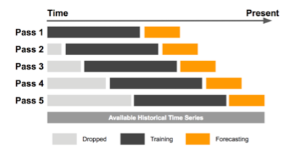
Data Pre-Processing: Fixed Rolling Window
Fixed Rolling Window – Interval used as input for forecasting is fixed
Window of fixed length slides forward to the present
Example: 21-day fixed rolling window uses 21 days of data to predict the current day

Slide 12
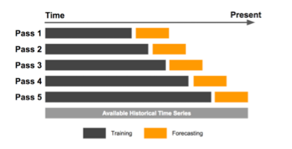
Data Pre-Processing: Expanding Window
Expanding Window – Start date remains the same, new data points are added in
Easily allows for addition of new data as it becomes available

Slide 13
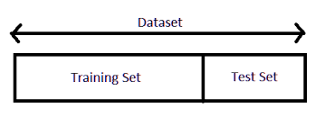
Data Pre-Processing: Train/Test Split
Train/Test Split – Part of the data is used for training, the unseen and remaining data used for testing
All non-GARCH models used this framework
Realized volatility and high/low price lags as inputs
50/50 split used for training and test sets

Slide 14
Modeling Summary Statistics
General Model Classification | Model | MAE
Null | Null Model | 0.1201
GARCH | GARCH (1,1) Fixed Rolling Window | 0.0845
GARCH | GARCH (1,1) Expanding Window | 0.0816
GARCH | EGARCH (1,1) Expanding Window | 0.0798
GARCH | GJR GARCH (1,1) Expanding Window | 0.0802
Neural Network (Recurrent) | LSTM RNN | 0.1087
Machine Learning – Random Forest | Random Forest Regressor (5d Lag) | 0.1103
Machine Learning – Linear Regression | Linear Regression (5d Lag) | 0.1072
Symbolic Regression | Symbolic Regression | 0.1095

Slide 15
Null Model
Null model constructed by using previous day’s realized volatility as prediction for next day
Simple model, but non-trivial
Volatility is an autoregressive process
Mean Absolute Error (MAE) – metric for comparing models
Easily interpreted: If MAE is .08, then the mean realized volatility prediction is off by .08

Slide 16
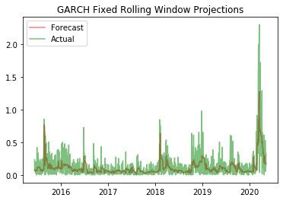
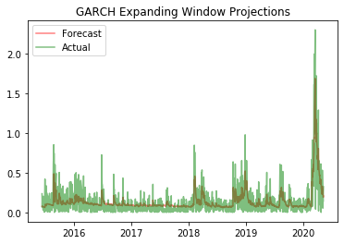
GARCH (1,1) Models
Fixed Rolling Window
Expanding Window

Slide 17
GARCH (1,1) Models
Fixed Rolling Window
Expanding Window
Slightly higher MAE (0.0845)
Does not do a great job capturing magnitude of spike in 2020
Slightly lower MAE (0.0816)
Visually performs better at capturing large volatility spike in 2020

Slide 18
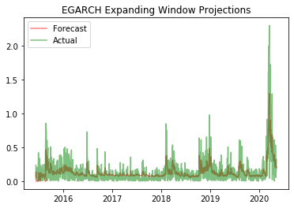
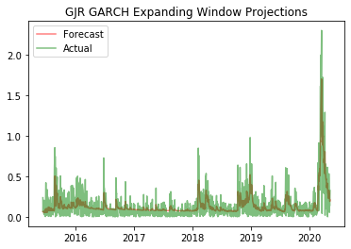
GARCH Variants
EGARCH (1,1)
GJR GARCH (1,1)

Slide 19
GARCH Variants
EGARCH (1,1)
GJR GARCH (1,1)
Best MAE of all GARCH models at 0.0798
Although best MAE, predictions look more like GARCH (1,1) fixed rolling window
Does not capture magnitude of 2020 spike
Very close to EGARCH MAE of 0.0802
Predictions similar to the GARCH(1,1) expanding window model
Reasonably captures 2020 volatility spike and has lower MAE

Slide 20
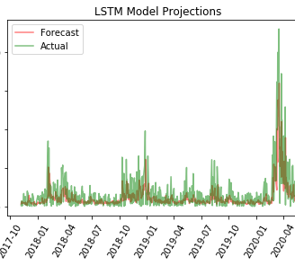
Long Short-Term Memory (LSTM) Recurrent Neural Network (RNN)
MAE of 0.1087 was higher than any GARCH models
Still reasonably accurate at predicting magnitude of volatility spikes

Slide 21
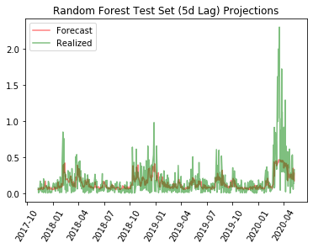
Random Forest Regressor
All Random Forest models (5, 10, 21d lags) had similar MAE, best was 0.1102
Visualization of predictions also very similar
Severe inability to capture magnitude of 2020 spike

Slide 22
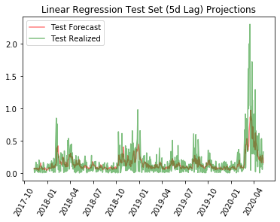
Linear Regression
All Linear Regression models (5, 10, 21d lags) also had similar MAE, best was 0.1072
Slightly better than RF models
Still subpar ability to capture 2020 spike

Slide 23
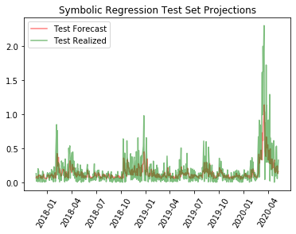
Symbolic Regression
MAE of .1095 similar to that of Linear Regression and LSTM models
Visual predictions are closer to Linear Regression model
Falls in category of models that does poorly at predicting 2020 spike

Slide 24
Modeling Conclusions
GARCH and its model variants performed best in predicting realized volatility
EGARCH and GJR GARCH are two best models in terms of MAE
GJR GARCH most likely to be used in practice as it more accurately captures spikes in realized volatility
Visual comparison important! Can have low MAE by getting a lot of the low volatility predictions right, but do poorly on more important high volatility predictions

Slide 25
Practical Uses for Model
Portfolio managers could adjust portfolio allocations based on volatility predictions
Volatility traders may choose to use volatility predictions as inputs when evaluating trades
Retail investors could use model to help make more informed decisions about options strategies
Example: Identify optimal times for overwriting equity holdings

Slide 26
Future Work
More variables as inputs into machine learning and neural network models
Different underlying assumptions for GARCH models (i.e. use Student’s t-distribution)
Multi-step forecasting
Include predictions about volatility distributions
Extend work to cover more securities, such as single stock equities (i.e. AAPL, MSFT, FB)

Slide 27
Contact Information
Matthew Wladyka, M.S. Mathematical Finance
Email: matt.wladyka@gmail.com
LinkedIn: https://www.linkedin.com/in/matt-wladyka-0364691a/
GitHub: https://github.com/wladykam

