Slide 1
Predicting Telecom Industry Customer Churn
Improving Retention and Increasing Lifetime Value
Matt Wladyka
April 2020

Slide 2
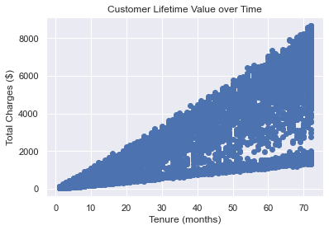
Motivation
Lower rates of churn imply longer tenure
Tenure clearly has high positive correlation with customer lifetime value
How best to structure product offerings to increase customer retention

Slide 3








Who Can Benefit?
Telecom Providers
Any business trying to retain customers!

Slide 4
Data Overview
7,043 rows of unique customer data
20 unique columns (3 numerical, 17 categorical)
Prediction variable of interest: Churn
Want to predict which customers are most likely to leave
Right censored data (tenure no longer recorded after 72 months)
Source: Kaggle Dataset
https://www.kaggle.com/blastchar/telco-customer-churn

Slide 5
Data Wrangling
Standard type conversions (categorical, int, float)
Address missing values
Convert blank entries in CSV file to NaN
Only 11 rows with NaN values, removed these data points
Remove Customer ID column, useless

Slide 6
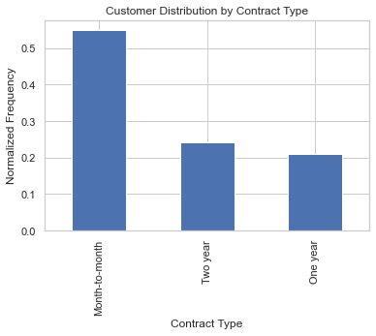
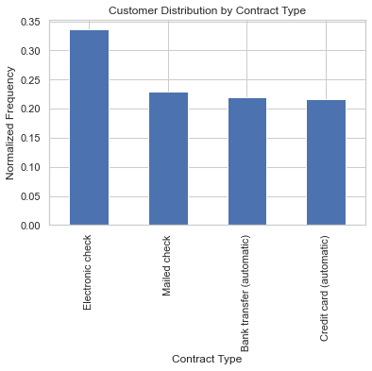
Exploratory Data Analysis (EDA)
Preferred Contract: Month-to-Month
Preferred Payment:
Electronic Check

Slide 7
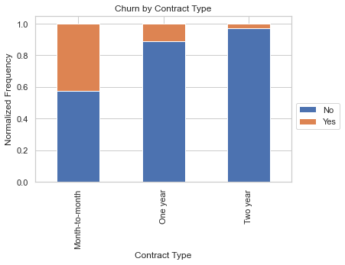
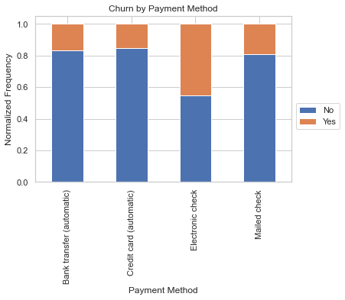
EDA
Highest Contract Type Churn: Month-to-Month
Highest Payment Method Churn: Electronic Check

Slide 8
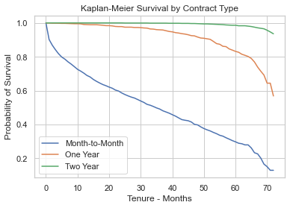
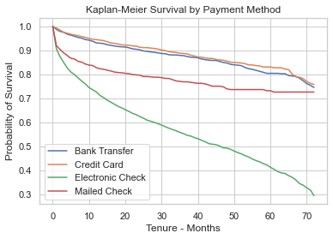
EDA
Month-to-Month: Survival Worse Across all Times
Electronic Payment: Survival Worse Over Time

Slide 9
EDA Takeaways
Contract type with highest percentage of users: month-to-month
Most used payment method: electronic check
Thoughts for deterring customers from these methods:
Incentivize towards other plans/methods
Example: Show upcharge for electronic check or discount for other payment methods
Remove options: no choice for electronic check and potentially get rid of month-to-month option

Slide 10
EDA Takeaways
Cost-benefit analysis of customers lost with options removed
Potentially limited time offerings of no month-to-month or removed electronic check option for new customers
Important to ensure profitability improves and customers are kept
EDA findings alone not enough
Further solidify our analysis with in-depth analysis of relevant machine learning models

Slide 11
Machine Learning: Modeling Overview
Binary Classification Problem (Churn or not churned)
Data pre-processing
Modeling pipeline
Model selection & fitting
Hyperparameter tuning
Model Comparisons
Conclusions

Slide 12
Data Pre-Processing
Encode Labels
Split Data: 70% training, 30% held out for testing
Scale Data (appropriate models only)
Cross-validation: 5-fold, repeated twice, stratified

Slide 13
Modeling Pipeline
Impute data for missing values
Scale values as required by model type/performance
Tune hyperparameters
Analyze numerical and graphical prediction results

Slide 14
Model Selection
k-Nearest Neighbors (kNN)
Logistic Regression
Random Forest
Support Vector Machine (SVM)
AdaBoost
Voting Classifier

Slide 15
Metrics for Comparison
ROC AUC – Area under ROC curve (compares tradeoff of true positive rate (TPR) and false positive rate (FPR) based on classification threshold)
PR AUC – Area under precision recall curve
Precision – Given a positive prediction, what is probability it is actually a positive result
Recall – Given a random positive result, what is the probability it is correctly predictive as positive
F1-score – Harmonic mean of either precision or recall

Slide 16
Model Comparison
Model | Class | Precision | Recall | F1-score | ROC AUC | PR AUC | Accuracy
kNN | 0 | 0.81 | 0.89 | 0.85 | 0.79 | 0.57 | 0.77
 | 1 | 0.59 | 0.42 | 0.49
Logistic Regression | 0 | 0.84 | 0.89 | 0.87 | 0.83 | 0.61 | 0.80
 | 1 | 0.64 | 0.55 | 0.59
Random Forest | 0 | 0.83 | 0.91 | 0.87 | 0.83 | 0.63 | 0.79
 | 1 | 0.65 | 0.49 | 0.56
SVM | 0 | 0.83 | 0.91 | 0.86 | 0.80 | 0.60 | 0.79
 | 1 | 0.64 | 0.47 | 0.54
AdaBoost | 0 | 0.84 | 0.89 | 0.86 | 0.84 | 0.64 | 0.79
 | 1 | 0.64 | 0.51 | 0.57
Voting Classifier | 0 | 0.82 | 0.91 | 0.87 | 0.83 | 0.63 | 0.79
 | 1 | 0.66 | 0.46 | 0.54

Slide 17
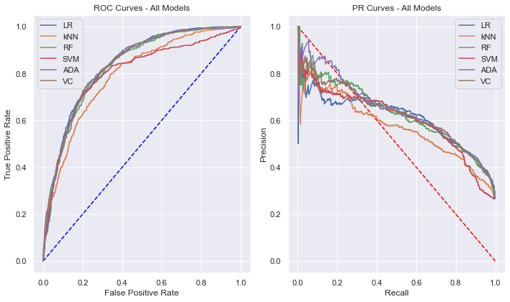
Model Comparison: ROC and PR Curves

Slide 18
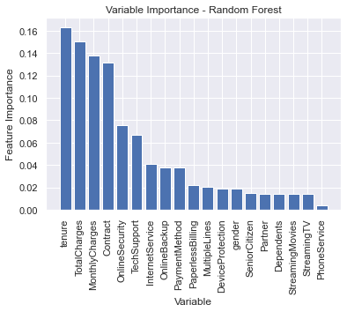
Random Forest: Feature Extraction
Random Forest models allow for easy feature extraction
Could be used for dimensionality reduction
Confirms initial EDA findings: contract type and payment method important

Slide 19
Model Conclusions
AdaBoost provides best overall results
Logistic Regression strong performer for predicting minority class (customers who churn)
Voting Classifier struggled relatively minority class
Random Forest useful for feature importance analysis

Slide 20
Modeling Applications
All models discussed predict classifications on customer churn and associated probabilities
These are just snapshots of data today
More useful to tell telecom client likelihood of churning at all future points in time
Will review one application: Random Survival Forest

Slide 21
Random Survival Forest
Well equipped to handle censored data
Dataset in this study is right censored
Further extension of random forest model used in survival analysis

Slide 22
Random Survival Forest: Setup
Again use split dataset (70% training, 30% test)
Use same optimized hyperparameter values from random forest model
Goal: generate survival curve for customer churn prediction at all points in time

Slide 23
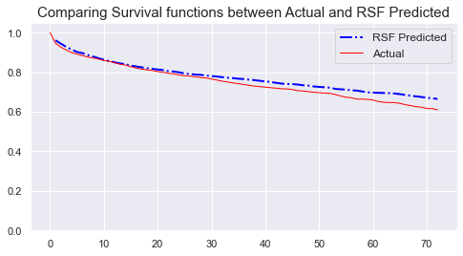
Random Survival Forest: Results
Concordance index (C-index): 0.88
Generalization of ROC AUC score for censored data
Best score of 1, random predictions score 0.5
Integrated Brier score: 0.08
Best score of 0, random predictions score 0.25

Slide 24
Random Survival Forest: Conclusion
Model is visually quite accurate at predicting survival curve
C-index of 0.88 and IBS of 0.08 support this finding
Useful in real-world applications for client
Ex: Customer has this churn profile, what is their probability of churning today and what does their survival curve look like?
Target marketing dollars accordingly

Slide 25
Future Work
Feature Selection
More models to compare with RSF (i.e. CSF, Extra Survival Trees)
Deal with slight class imbalance: upsampling, downsampling, SMOTE
Collaborate with telecom partner to score models set to optimize on client request (right now set to accuracy)

Slide 26
Conclusions
AdaBoost model most likely used in practice
Could develop risk ranking system for clients
Coordinate with marketing department to target clients with higher risk of churning
Prioritize based on churn risk today
Create retention pipeline utilizing survival curve for future efforts

Slide 27
Contact Information
Matthew Wladyka, M.S. Mathematical Finance
Email: matt.wladyka@gmail.com
LinkedIn: https://www.linkedin.com/in/matt-wladyka-0364691a/
GitHub: https://github.com/wladykam

