Slide 1
Project Bullseye: Budweiser Targeted Marketing Campaign
Walter Lai and Chad Reo
https://www.youtube.com/watch?v=T-WLpLs_eMk&t=5s

Slide 2
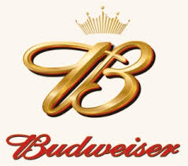
Question asked
Where Can We Sell New Products?
What New Products Can We Sell?
How Do You Know The Answers To These Questions?

Slide 3
Our approach
Acquired industry data concerning both beers and breweries within the United States.
Combining and cleaning this data has provided a wealth of statistics on both the number and characteristics of beers spread across the United States.
We plan to use this data to predict where and what style of beer to sell to a given location based on the number and characteristics of a given market.

Slide 4
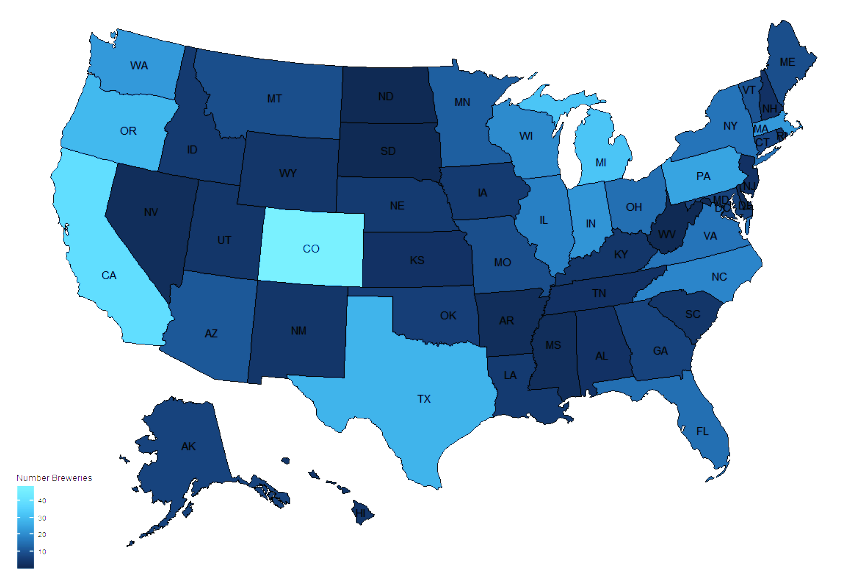
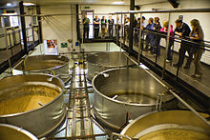
Current Overall Market
Almost 560 breweries large and small spread across the US.
Counts range from 1 per state all the way to 47 in Colorado.
This Photo by Unknown Author is licensed under CC BY-SA

Slide 5
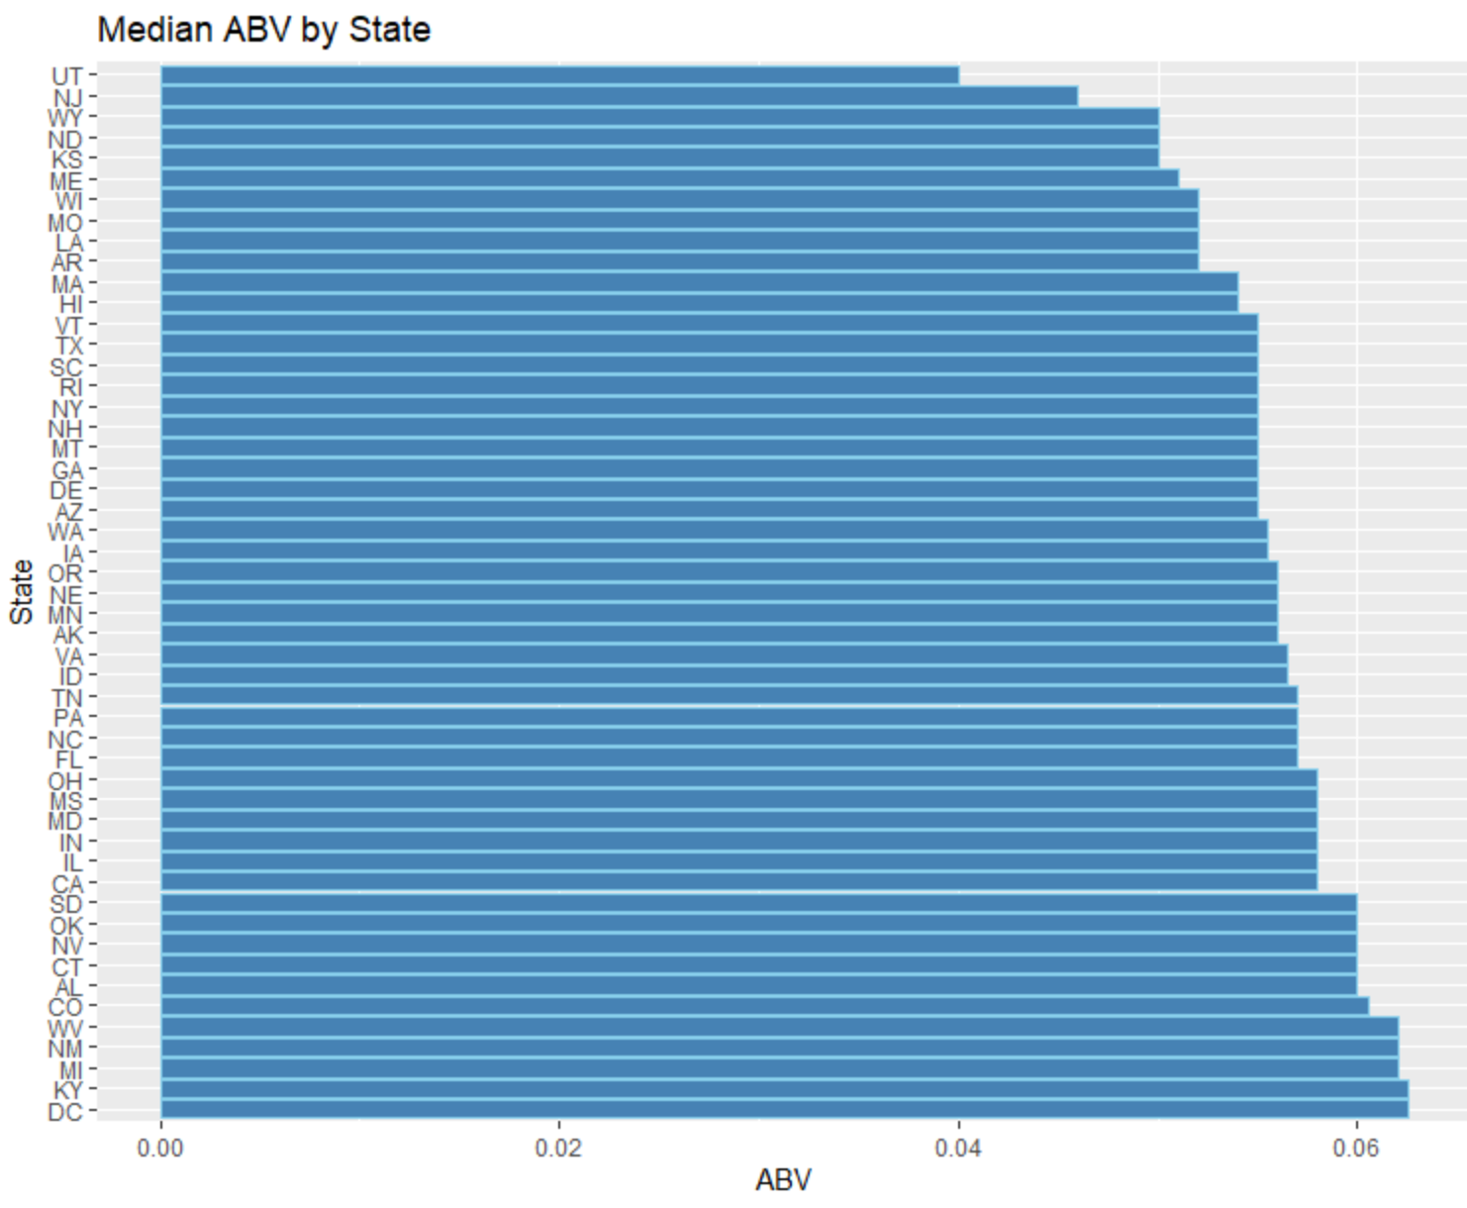
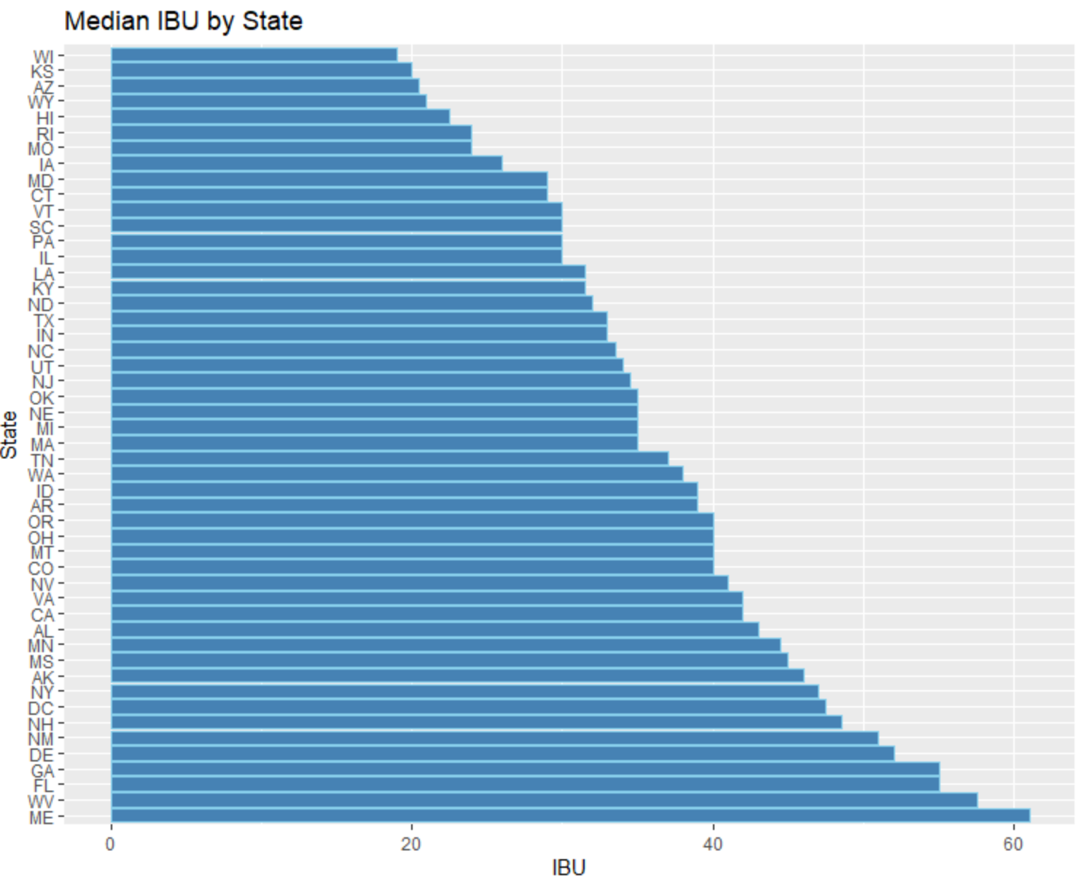
Variation by State
Min: Scotty K NA, brewed in Santa Cruz, CA with 0.001% ABV | Min: Summer Solstice, brewed in Boonville, CA with an IBU of 4
Max: Lee Hill Series, brewed in Boulder, CO with 0.128% ABV | Max: Bitter Bitch Imperial, brewed in Astoria, OR with an IBU of 138

Slide 6
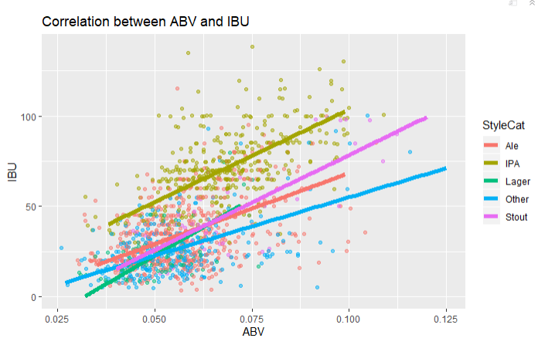
How IBU and ABV correlate
There is a moderate positive correlation between ABV and IBU. The upward slope is evidence of a positive relationship.
We can use this relationship to predict one value if given the other value.

Slide 7
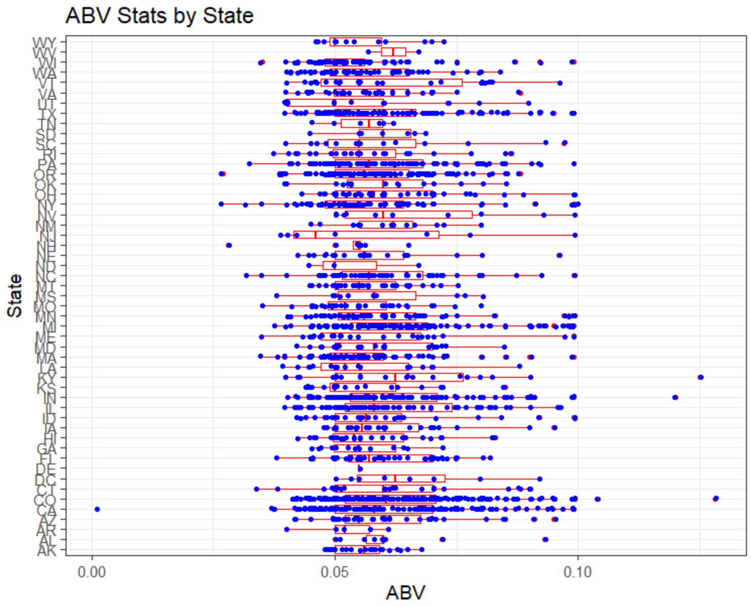
ABV Compared by State
Quite a bit a variation, even within the states
Consumers are demanding niche and craft beers
Our Market Share is Shrinking.

Slide 8
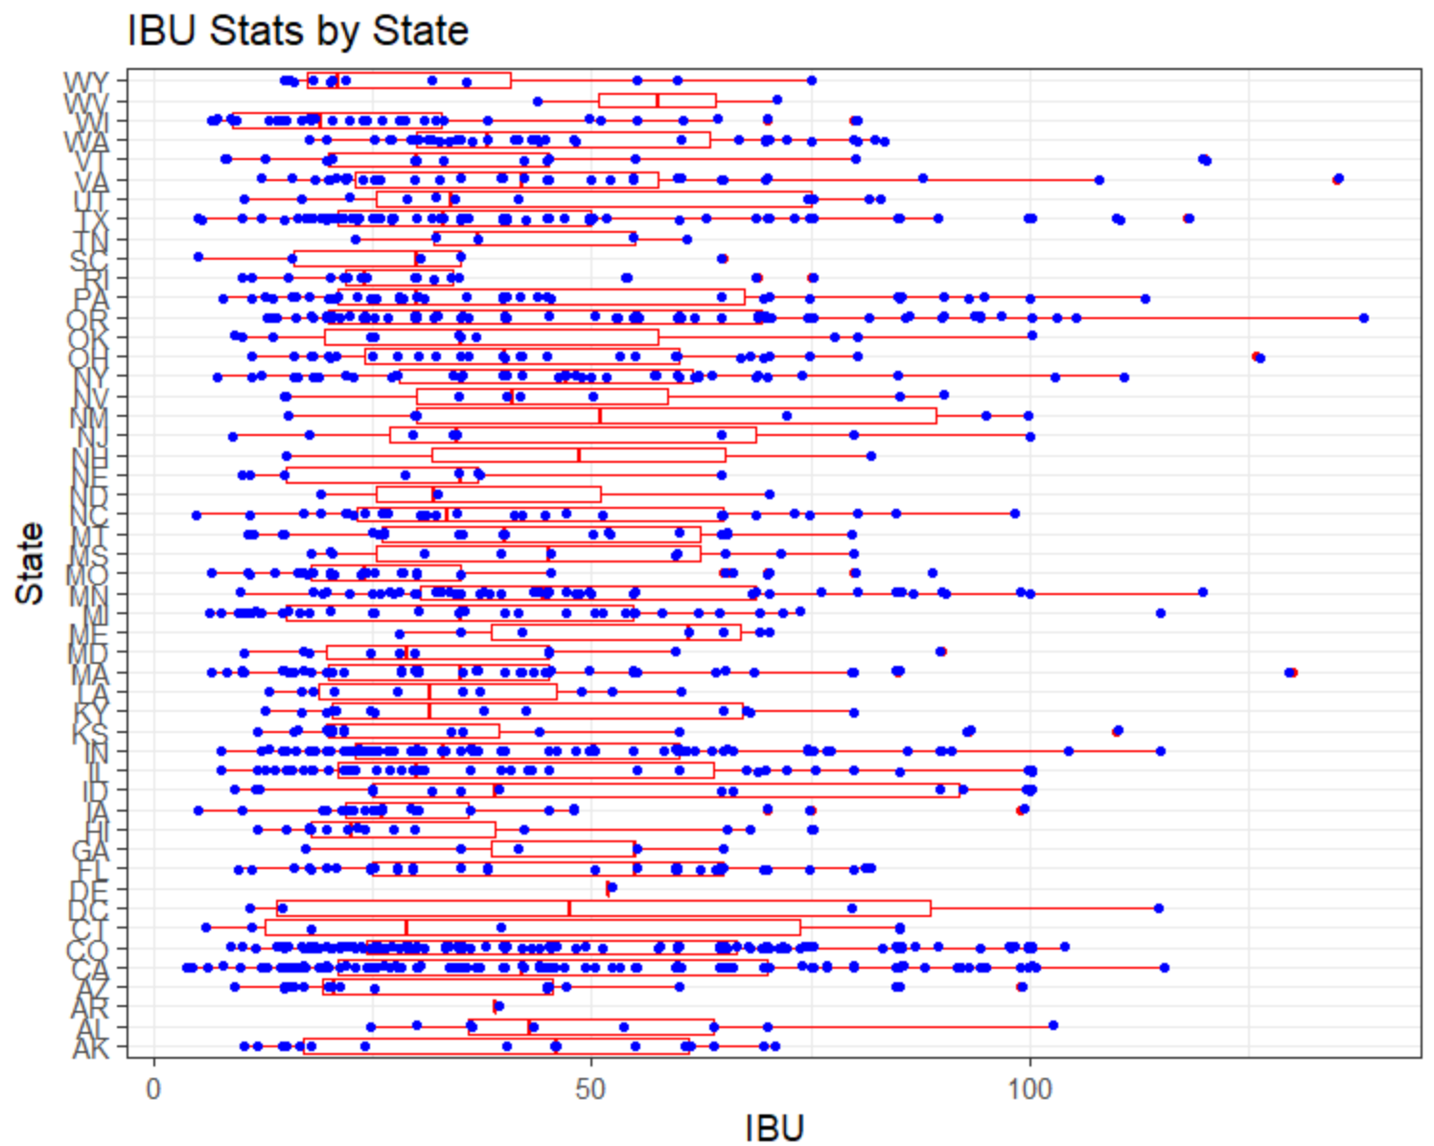
IBU Compared by State
Less variation as compared to ABV
Amount of variation is likely the same as ABV as seen from Scatter Plot
Data Quality is important

Slide 9
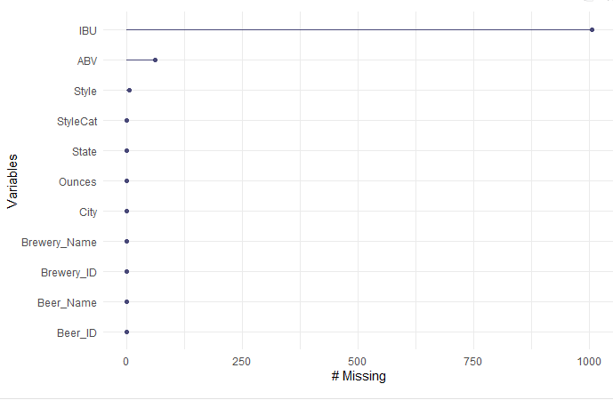
Data facts
2,692 Distinct Beers
558 Distinct Breweries
99 Distinct Styles Listed
Eight Separate Fields
However, Not All Data Is Provided!
Missing Values For:
IBU: | 1,005
ABV: | 62
STYLE: | 5

Slide 10
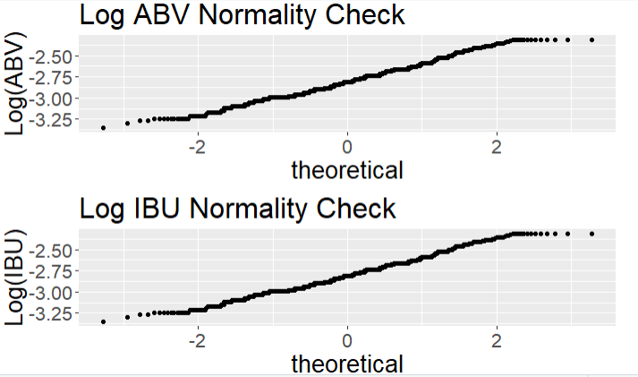
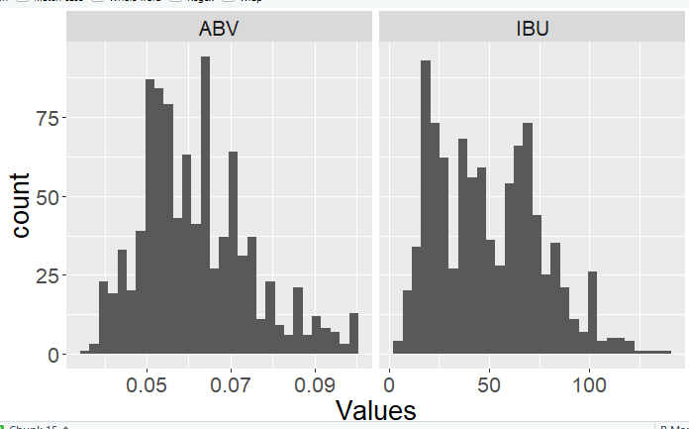
How can we use the abv?
Summary Stats
Min | 1st Qtr. | Median | Mean | 3rd Qtr. | Max
0.001 | 0.05 | 0.0560 | 0.0597 | 0.067 | .128
What this tells us is the data follows a normal pattern from which we may draw some inferences.

Slide 11
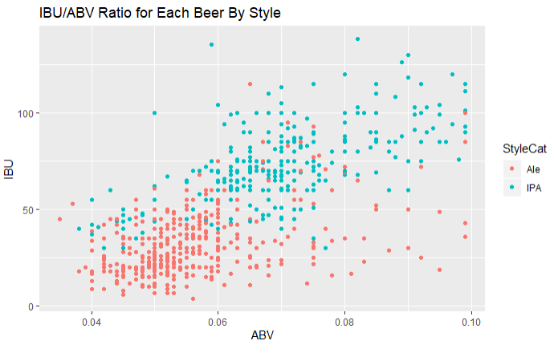
Example – Predict Style
IPAs and Ales form clusters in terms of their ABV and IBU values and the ratios of IBU/ABV.
We can test how well we can predict a beer’s style based on its ABV and IBU.
Confusion Matrix and Statistics classifications Ale IPA
Ale 143 29
IPA 17 94
Accuracy : 0.8375
95% CI : (0.7892, 0.8785)
Mean Accuracy: 0.85
Mean Sensitivity: 0.87
Mean Specificity: 0.82

Slide 12
What we propose
Where Should We Sell These Products?
Looking at the most populous cities with fewest beers per capita.
What New Products Can We Sell To Consumers?
Based on the identified locations, what styles of beer are underrepresented when compared to the national average.
How Do You Know?
We know this because we are evaluating a normally distributed sample from which we can make statistical inferences

Slide 13
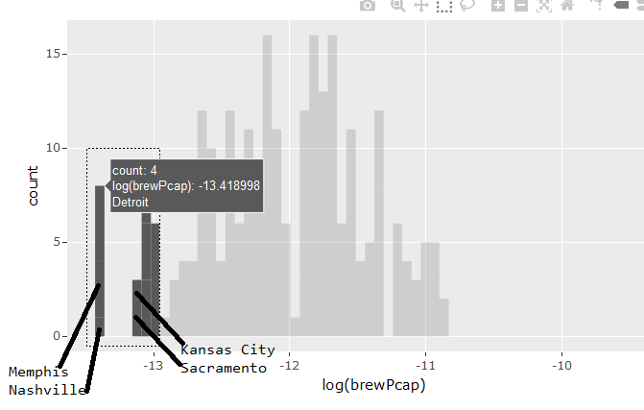
Who needs more Beer?
Find counts of varieties in a given city (314 most populous cities in USA.)
Combine with pop. data to get beer/capita.
Compare averages to see which cities are statistically significant from the mean.
Target these areas.

Slide 14
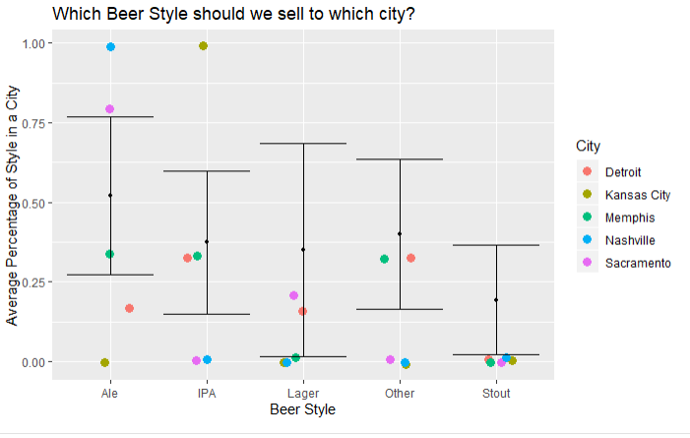
what to sell
Based on our target population of underserved consumers, the next layer is style.
Comparing percentage market mix of styles in these cities to their means, certain cities are considerably below the mean for market share.
This kind of data targeting marking ensures that we are identifying consumers who are more likely to purchase and even predicting their preference of what to purchase.

Slide 15
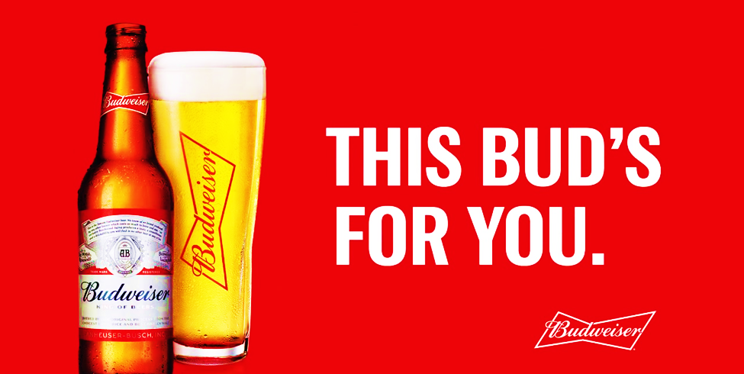
use data to make sure

Slide 16
Next steps
Assign Project Manager
Investigate Data Requirements
Resources Required
Determine Budget
Establish Project Charter
Create Project Plan

