Slide 1
Week 1 Day 2
Due Tuesday 10:00 am
Quiz 2 Chapters 2&3 Development Processes/Opportunity Identification
Today
Devotional
Tech Job Fair
Engineering Notebooks
Team Selection
Project Topic Selection
Team Time
Tuesday (tentative)
Project Opportunities from outside sponsors
Intellectual Property
Opportunity Identification
Team Time

Slide 2
Student Success Guide
Scan the contents
Discussion

Slide 3
Senior Design Rules
Rule #1
If it isn’t written down, it didn’t happen.

Slide 4
Engineering Notebook
Why keep an engineering notebook?
Documents everything that was done and when it was done.
Records an engineer’s work for other engineers.
Protects patent rights or it can be used to invalidate someone else's patent rights.
Could be part of legal proceedings when determining liability for accidents or mechanical failures

Slide 5

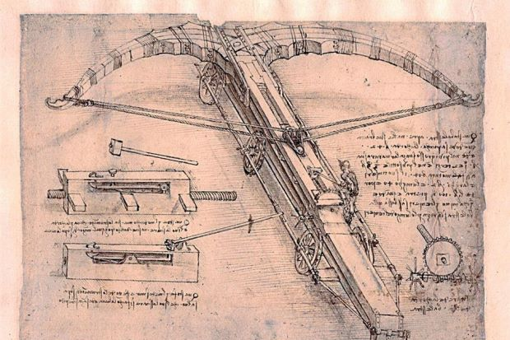
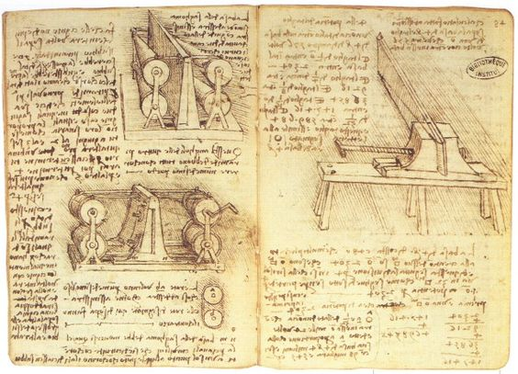
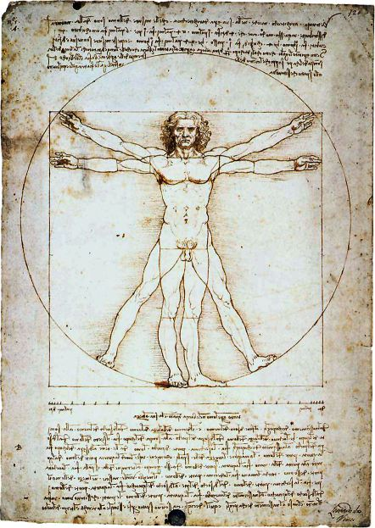

Slide 6
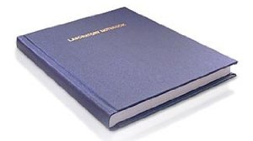
Engineering Notebook Format Old Style – Paper Notebooks
Must have sewn pages. That is, pages cannot be easily removed or added without it being obvious.
Pages must be permanently numbered.
All entries must be in ink.
No blank pages or pages with significant blank space (as filled out) Simply draw lines through blank or unused space as entries are made.
Each page must be signed and dated by the author.
Mistakes are marked through with a single line so that the mistake is still readable.
Corrections should be initialed and dated.
All entries should be original entries, not transcribed at a later date from some other paper.
All entries should be legible.
Should provide evidence of continuous work, with exceptions noted (parts unavailable, Christmas break, etc.) For this class, anything over three days.
Each page should be witnessed and dated by someone who understands the work. Not the author of the notebook.
When possible, entries should be read either vertically (portrait) or from the right (landscape).
In the first few pages of the notebook, there should be a table of contents page or pages.
Supplements should be permanently (glued or taped) attached to a notebook page and signed across all borders.
As the notebook becomes full, new notebooks should be consecutively filled out.
Generally, there should be one notebook per engineer.
The notebook may contain a single project or multiple projects.
Page headings should indicate task or investigation title.
Negative comments concerning the feasibility of the project should be avoided. Don’t say, “This won’t work.” or “Device is worthless.”

Slide 7
Engineering Notebook Format Advantages – Electronic Notebooks
The notebook is always available to the student / inventor – no absence of book while it is being reviewed / graded.
The notebook is always available – can be accessed via any computer or electronic device with internet capability
No possibility of losing the notebook or it being destroyed in a fire, flood, etc.
Can be shared with your other team members (even remotely).
Automatically date and time stamps your entries, so you don’t have to worry about appropriate dating formats.

Slide 8
Engineering Notebook Format Advantages – Electronic Notebooks
Can include original data files (audio, video, pdf, Excel or Word).
No entries are ever lost, so accidentally deleting something can always be recovered.
No risk of COVID-19 transmission.

Slide 9
Engineering Notebook: CONTENT
Include everything you contribute . . . Good, bad, and ugly
All original thought – capture it before you lose it or before everyone else knows!
All project assumptions as they occur.
Key concepts and ideas from your project proposal.
Sketches and pictures documenting the design process - annotate!
Research findings–reference information for all sources.

Slide 10
Engineering Notebook: CONTENT
Include everything you contribute . . . Good, bad, and ugly
Diagrams, schematics, or block diagrams for any system or sub-system which is to be tested. There should be an accompanying discussion of the principle design problems and decisions made.
Equations and formulae used in the design process, with references. If derived by you, provide enough information so that someone can recreate your work.
Documentation of testing and debugging. Indicate what is being tested and include set-up diagrams and all results. Difficulties should be noted with analysis and next steps defined.
Analysis of, and proposed solutions for, any problems. Include revisions to documents and test configuration.

Slide 11
Engineering Notebook: CONTENT
Include everything you contribute . . . Good, bad, and ugly
Documentation of testing and debugging. Indicate what is being tested and include set-up diagrams and all results. Difficulties should be noted with analysis and next steps defined.
Analysis of, and proposed solutions for, any problems. Include revisions to documents and test configuration.
Documentation of final performance tests and design verification.
Outlines for oral and written reports.
Interview information (who was contacted, why, when, and what was discussed or learned).
Group meeting notes.
Rationale for decisions.

Slide 12
Engineering Notebook Grades
Engr. Notebooks will be graded every two weeks.
Prof. Wells or Prof. White or Prof. Gibson will grade.
1st grading time is Thursday, September,2 beginning of class.
Grades will be based on:
Project Progression
Content
Communication
Graphics
Format
Not Graded this year

Slide 13
When will you know the quality level of your notebook?

Slide 14
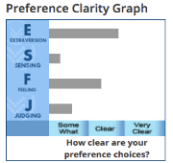
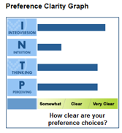
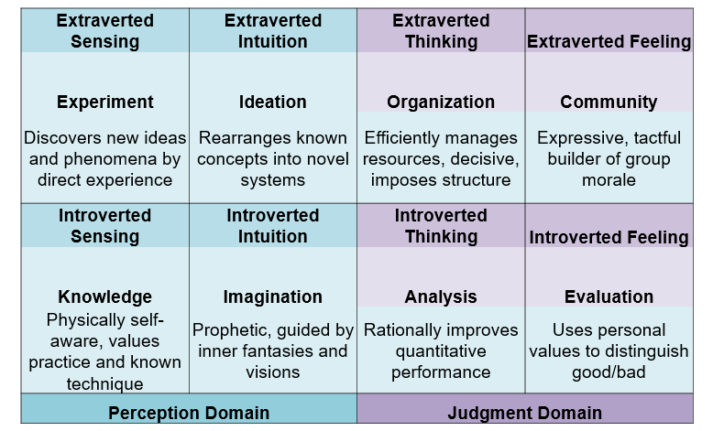
Senior Design Team Selection Process
Combine Strengths into
Communications (4) and Decision Processes (4)
Myers-Briggs Personality Profile
16 Categories
Proposed Plan
Finalized Team Select with broad faculty input
Cross Function Teams
Personality Profiles maximize diversity
GPA
Other diversities
Student requests
Hands on vs. Theoretical
Interaction strengths and possible conflicts
Cross Function Teams
Personality Profiles maximize diversity
GPA
Other diversities
Student requests
Hands on vs. Theoretical
Interaction strengths and possible conflicts

Slide 15
Drum Role Please!

Slide 16
2022-23 Project Teams
Group 1:
CE – Ricard Jove
CE – Ada Solak
ME – Zach Givens
ME – Jackson Bridges
Group 2:
EE – Wade Lamberson
EE – PJ Welch
ME – Bo Webb
ME – Sabrina Sanchez
Group 5 – Bison Baja
ME – Ryan Hankins
ME – Zach Hartzell
Group 3:
ME – Lane Bortell
ME – Justin Wideman
BME – Ragan Edison
BME – Chloe Ingersoll
Group 4:
CE – Garret Atkins
CE – Joshua Milnes
BME – Claire Chesney
BME – Ola Kalafarski

Slide 17
Project Topic Selection
Turn in the following for your selected project:
Project Topic: short phrase that describes your planned prototype
Problem(s) your product will solve
Project Description: full single paragraph depicting the overall function(s) of your proposed device and indicates the technological scope of the project.
Benefits: Describe how your device will provide benefit to it’s intended users.
Decision Matrix: Include for 3 or more project finalists with discussion summary.
Team Members and designated leader.
Submit one [.pdf] document per team to Canvas
Due Sept 8
Team
Charter

Slide 18
Team Charter
Each team will develop a charter intended to ensure good collaboration and communication.
Document Contact information and schedule
Establish team procedures
Identify expectations
Develop Timelines and milestones
Specify the protocol and consequences for failing to follow procedures and fulfill expectations
Due Sept 8

Slide 19
Team Time

