Slide 1
Week 2 Day 1
Due Thursday 10:00 am
Quiz 3 Chapter 5 Identifying Customer Needs
Engineering Notebook
Today
Devotional
Opportunity Identification
Potential Projects
Team Time
Lunch with Business Students @ 12:00
Thursday (tentative)
Decision Matrix
Customer Needs
Human Centered Design
Project Team Mentoring
Team Time

Slide 2
Project Topic Selection
Turn in the following for your selected project:
Project Topic: short phrase that describes your planned prototype
Problem(s) your product will solve
Project Description: full single paragraph depicting the overall function(s) of your proposed device and indicates the technological scope of the project.
Benefits: Describe how your device will provide benefit to it’s intended users.
Decision Matrix: Include for 3 or more project finalists with discussion summary.
Team Members and designated leader.
Submit one [.pdf] document per team to Canvas
Due Sept 8

Slide 3
Opportunity Identification

Slide 4
New need/market
Exploration into new markets
New-category
Products and service
Existing need/market that we do not address
Adjacent growth
Horizon 3 Opportunities
Horizon 2 Opportunities
Knowledge of Need (e.g., user/market)
Existing need/market that we currently serve
Horizon 1 Opportunities
Improvements, extensions, variants, and cost reductions
Next generation products and services for core markets
Exploration with new solutions, approaches
Existing solution that we currently use
Existing solution that we do not use
New solution
Knowledge of Solution (e.g., method/process/technology)

Slide 5
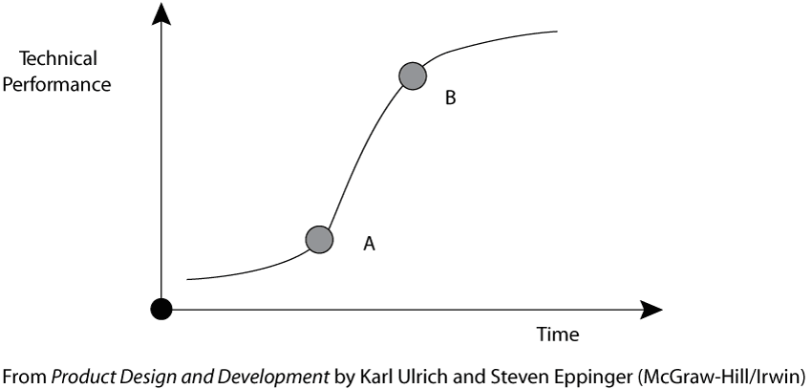
Technology S-Curves
Technology Limit
Initial Emergence
Rapid Growth - Experience

Slide 6
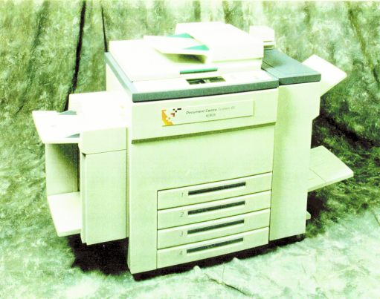
Technology S-Curves
Digital Technology
Copier Performance
Light-Lens Technology
Time

Slide 7
Class Exercise Teams
Group A: Develop the S-Curve for the following automotive technologies:
Gasoline internal combustion engine
Diesel internal combustion engine
Hybrids
Pure electric
Group B: Develop the S-Curve for the following energy production technologies:
Fossil Fuel Generation
Nuclear
Solar
Wind
Plot all on the same Performance vs. Time chart
Performance: reduced consumer costs
Time: From 1950 to 2030
Include a vertical line indicating today.

Slide 8
Team Progress
Forming
Storming
Norming
Performing

Slide 9
Potential Projects

Slide 10
Opportunities for nasa funds for this school year
Edmond Wilson, pHd
Nasa/Arkansas Space grant campus representative

Slide 11
Opportunities for nasa funds for this school year
Edmond Wilson, pHd
Nasa/Arkansas Space grant campus representative

Slide 12
The Arkansas space grant consortium haD its budget increased this year
There is an opportunity for several of you who are interested in enhancing your employability can benefit from participating in the NASA/ASGC

Slide 13
eligibility
The applicant must be:
• A U.S. citizen (permanent residents are not considered as US citizens for the purposes of this program)
• Pursing a degree in a STEM related field
• Enrolled as a full-time student at an ASGC member University
• In good academic standing with a GPA of at least 3.0 on a 4.0 scale

Slide 14
For senior design students – You can get scholarships and materials money
NASA/ASGC Student Intensive Training (SIT) grants - $10,000.00 maximum
At least two, but preferably more, students form a team
Provides Stipends, Travel, Materials & Supplies
Must show relevance to NASA Mission (Easy to do – see me)
Must have a mentor – Mr. Wells, Me, or other agreeable Engineering/Physics faculty

Slide 15
Typical budget ($10K Maximum)
Mentor - $1500.00 – required
Student Leader, Principle Investigator - $3000
Student Stipends – for 1 school year - $2000/student
Materials & Supplies – Amount Harding Allows for Senior Design Project
Travel - $0.00 – NASA has not opened its campuses yet because of COVID

Slide 16
Typical “straw” budget
Mentor $1500
PI (a student) $2500
3 Students @ $2000 each $6000
Materials - Is/could be provided by Harding $0000
Travel $0000
TOTAL REQUESTED FROM ASGC $10,000

Slide 17
Where to find information
www.asgc@ualr.edu
Choose “Contact Us - Arkansas Space Grant Consortium”
Choose “Student Support”
Choose “Student Intensive Training (SIT) Program

Slide 18
You will additionally Need
Letter of Support from your Mentor (Mr. Wells)
Letter of Support from your ASGC Campus Representative (Dr. Edmond Wilson)
Must be submitted to ASGC Office by 28 September 2022
We (Mr. Wells and I) are here to help you! Lets get started right away on your proposal.
I have lots of years (30 years) of experience with ASGC and I look forward to working with you!
It would be best to see me right away before you begin your application. In that way, I can save you a lot of time and worry!

Slide 19
We also encourage you to apply for a Workforce Development (WFD) Fellowship
This is a wonderful fellowship to undergraduates paying $7200.00 to the recipients to spend a summer at a NASA facility working with the top engineers and scientists on a project that they will present to you.
If you do not get accepted to a NASA facility, you can work with your mentor at Harding.
You first go online to apply for and internship at NASA and then see me to apply for the funds you will need. If you really want to do this, we need to contact people at NASA to ask for you!

Slide 20
Contact information
Dr. Edmond Wilson: Office 119 Science Building, Wilson@harding.edu, 501 278 7268 cell
I want to help you! Text me!
If you are a foreign national, I have a few scholarships for which you are eligible also.
If you are a freshman, sophomore, junior, or senior, you can get NASA funding!

Slide 21
Team Time

