Slide 1
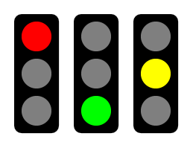

[project name]: A3 Status
Date: xxx
Members:
Background:
Enter information about project.
Include the main motivation(s) for your project.
Quantify the need for your project.
Proposed Countermeasures (Recommendations):
What is your proposal to reach the future state, the target condition?
How will your recommended countermeasures affect the root cause to achieve the target?
Coordinate with each analysis roadblock
Answers the question: What is your inner, altruistic motivation for working this project?
Current Conditions:
Green: ahead or on schedule
Yellow: less than one week behind
Red: More than one week behind
Crop picture to show status
Show full gantt chart to support designated status. Must include original with actual progress to date. On additional slides
Answers the question: How do your current accomplishments compare to the plan?
Answers the question: How do you know your action plans will eliminate your most important/urgent issues?
Recent Results:
Activities completed recently with results.
Show engineering data/graphs
Goals/Targets
What specific outcomes are required?
How will you measure your success?
Answers the question: How well did you do what you said you were going to do?
Answers the question: How will you measure product success?
Analysis (roadblocks, unresolved issues):
What is(are) the root cause(s) of the problem(s)?
What is your current focus on what to improve?
Next Steps:
What do you plan to accomplish in the next two weeks? Who and What.
Overall: Format red text to highlight changes from previous status report (beginning the second submission).
Answers the question: How well do you understand your most important/urgent issues?
Answers the question: How focused are your next action items?

