Slide 1




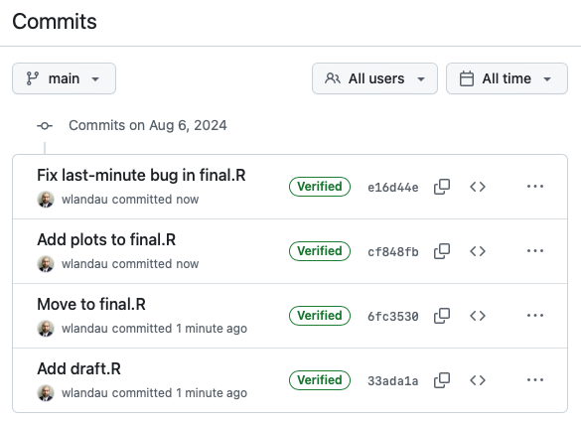
😱
😌
final2.R
final.R
2024-08-06.R
draft.R
final-actually-final.R

Slide 2

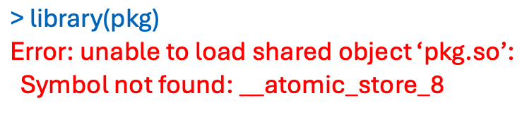
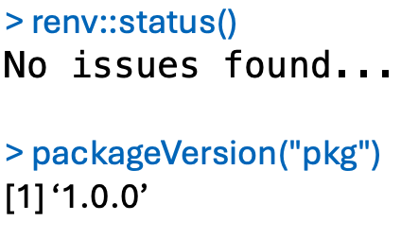
😱
😌

Slide 3

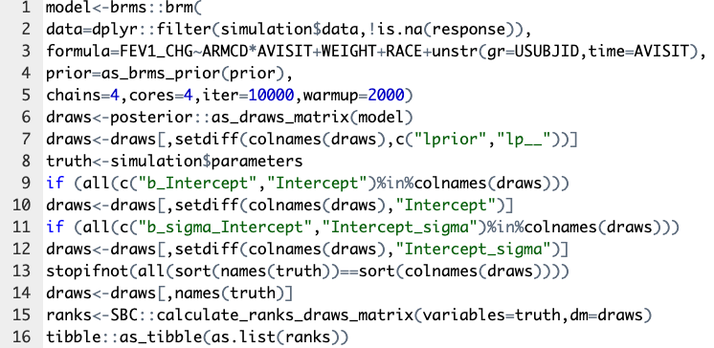
😱
🧐
messy-script.R

Slide 4

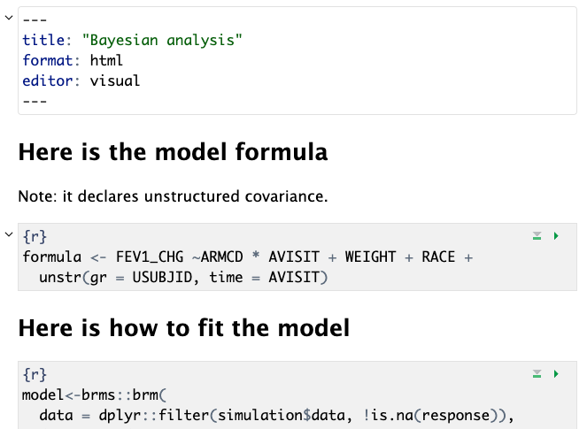
😱
😌
messy-script.R

Slide 5

😱
😬
Can't understand the workflow!
Too many scripts and data files!
Takes too long to run everything!
Do I even need to rerun this??!!
R_OPTS=--vanilla
.PHONY: clean
all: mypaper.pdf
report.html: report.bib report.qmd fig/table.png fig/plot.png
quarto render report
figures/%.pdf: R/%.R
cd $(<D);R CMD BATCH ${R_OPTS} $(<F)
clean:
rm -rf figures report.html
???
Credit: https://kbroman.org/minimal_make/

Slide 6

😱
😌
Can't understand the workflow!
Too many scripts and data files!
Takes too long to run everything!
Do I even need to rerun this??!!

Slide 7


Remake
1976
2014
2017
2020
Make

Slide 8
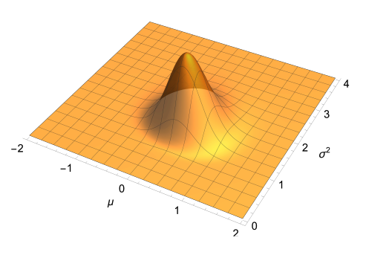
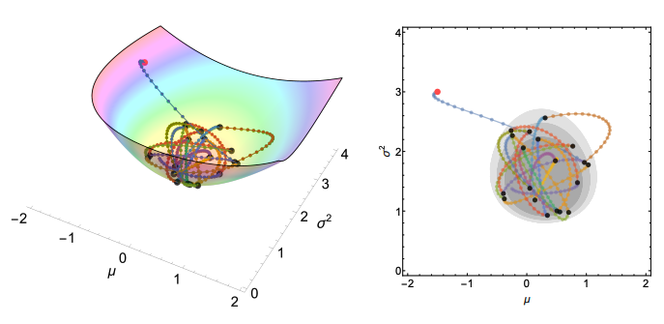
Credit: Prof. David Kahle, Baylor University

Slide 9


👋🏽
ranks_subgroup_1
prior_subgroup
results_subgroup
ranks_subgroup_2
👋🏽
ranks_unstructured_1
prior_unstructured
results_subgroup
ranks_unstructured_1

Slide 10
ranks_subgroup_1
prior_subgroup
results_subgroup
ranks_subgroup_2
👋🏽
ranks_unstructured_1
prior_unstructured
results_subgroup
ranks_unstructured_1

Slide 11
😴
ranks_subgroup_1
prior_subgroup
results_subgroup
ranks_subgroup_2
ranks_unstructured_1
prior_unstructured
results_subgroup
ranks_unstructured_1

Slide 12

😴
ranks_subgroup_1
prior_subgroup
results_subgroup
ranks_subgroup_2
ranks_unstructured_1
prior_unstructured
results_subgroup
ranks_unstructured_1

