Slide 1




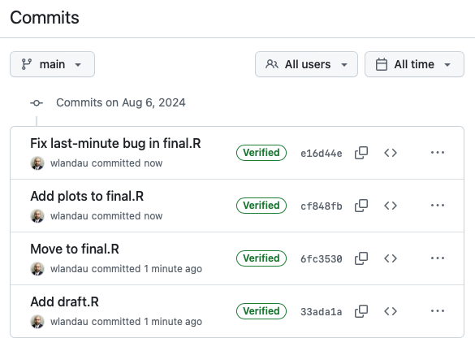
😱
😌
final2.R
final.R
2024-08-06.R
draft.R
final-actually-final.R

Slide 2

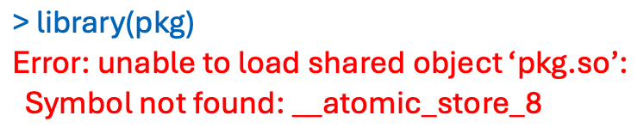
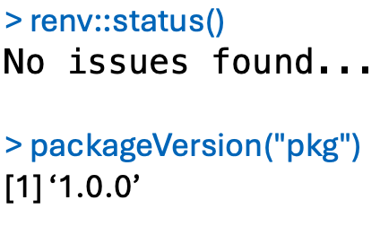
😱
😌

Slide 3

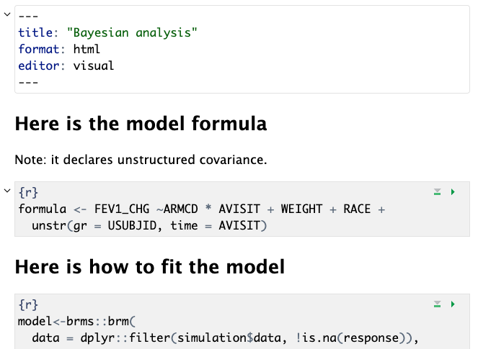
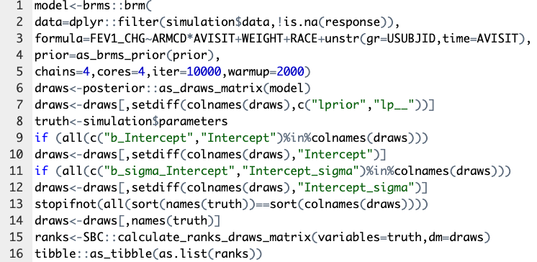
😱
😌
messy-script.R

Slide 4

😱
😌
Can't understand the workflow!
Too many scripts and data files!
Takes too long to run everything!
Do I even need to rerun this??!!

Slide 5
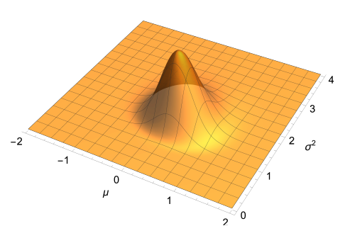
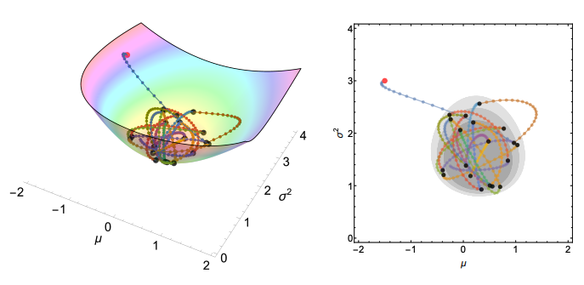
Credit: Prof. David Kahle, Baylor University

