Slide 1

mlrFDA: an R toolbox
for functional data
analysis
Laura Beggel, Xudong Sun, Florian Pfisterer, Bernd Bischl
Ludwig-Maximilians-Universität München
Statistical Computing, 07/24/2017

Slide 2
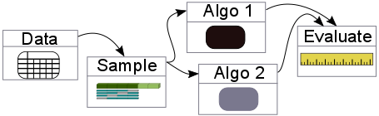
mlr
How does your code for experiments look like?
-> mlr: unified interface for machine learning algorithms
Supported tasks: classification, clustering, regression, survival
for performance evaluation, resampling, preprocessing and
feature selection, hyperparameter tuning, imputation, parallelization, …
Possibility to add custom learners
2
CR/AEY2 | 07/24/2017
© Robert Bosch GmbH 2016. All rights reserved, also regarding any disposal, exploitation, reproduction, editing, distribution, as well as in the event of applications for industrial property rights.

Slide 3

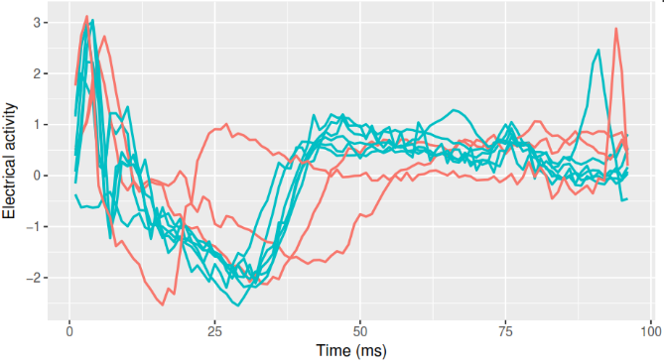
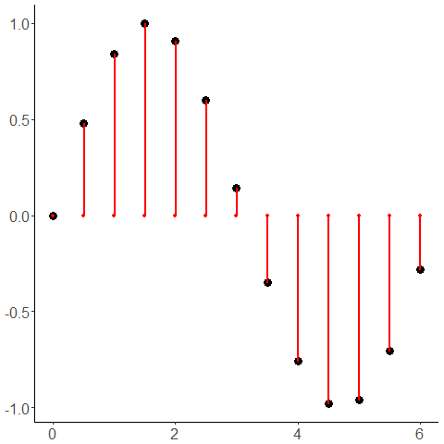
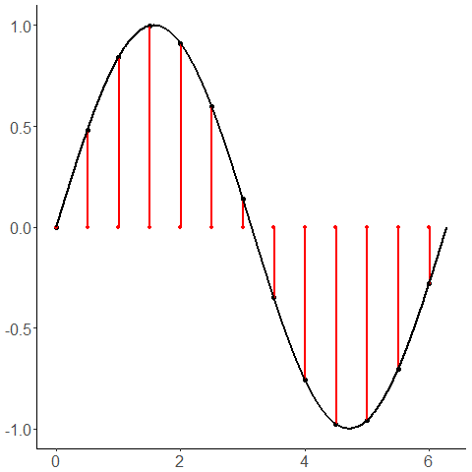
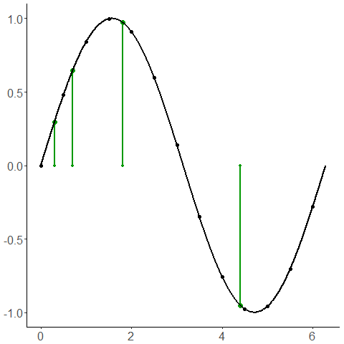

[1]
Functional data
Data is sampled over an ordered continuum
Here: time
Smootheness assumption allows for more data information
Interpolation
Sampling
[1] Psych.mcgill.ca/misc/fda/index.html
3
CR/AEY2 | 07/24/2017
© Robert Bosch GmbH 2016. All rights reserved, also regarding any disposal, exploitation, reproduction, editing, distribution, as well as in the event of applications for industrial property rights.

Slide 4
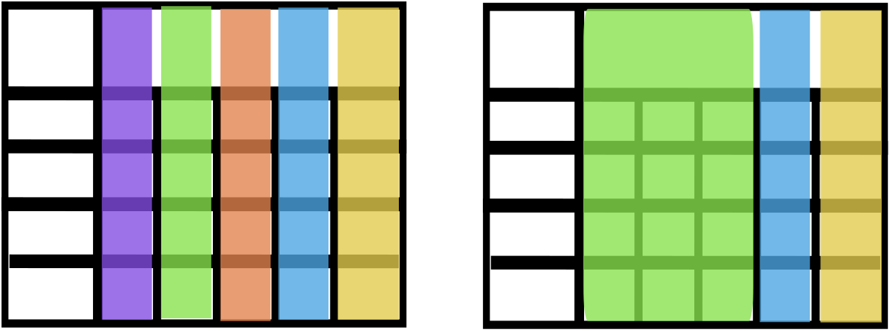
Data handling
mlrFDA
mlr internally: data frame with annotations
NOW: Functional features are not scalar
-> data frame with matrix structure
Standard data frame
Functional data frame
4
CR/AEY2 | 07/24/2017
© Robert Bosch GmbH 2016. All rights reserved, also regarding any disposal, exploitation, reproduction, editing, distribution, as well as in the event of applications for industrial property rights.

Slide 5
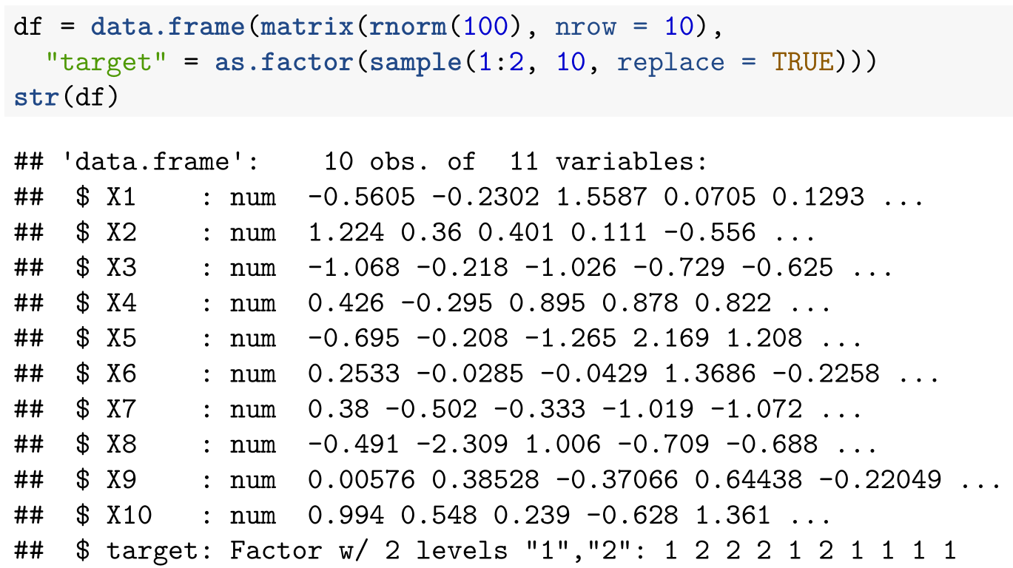
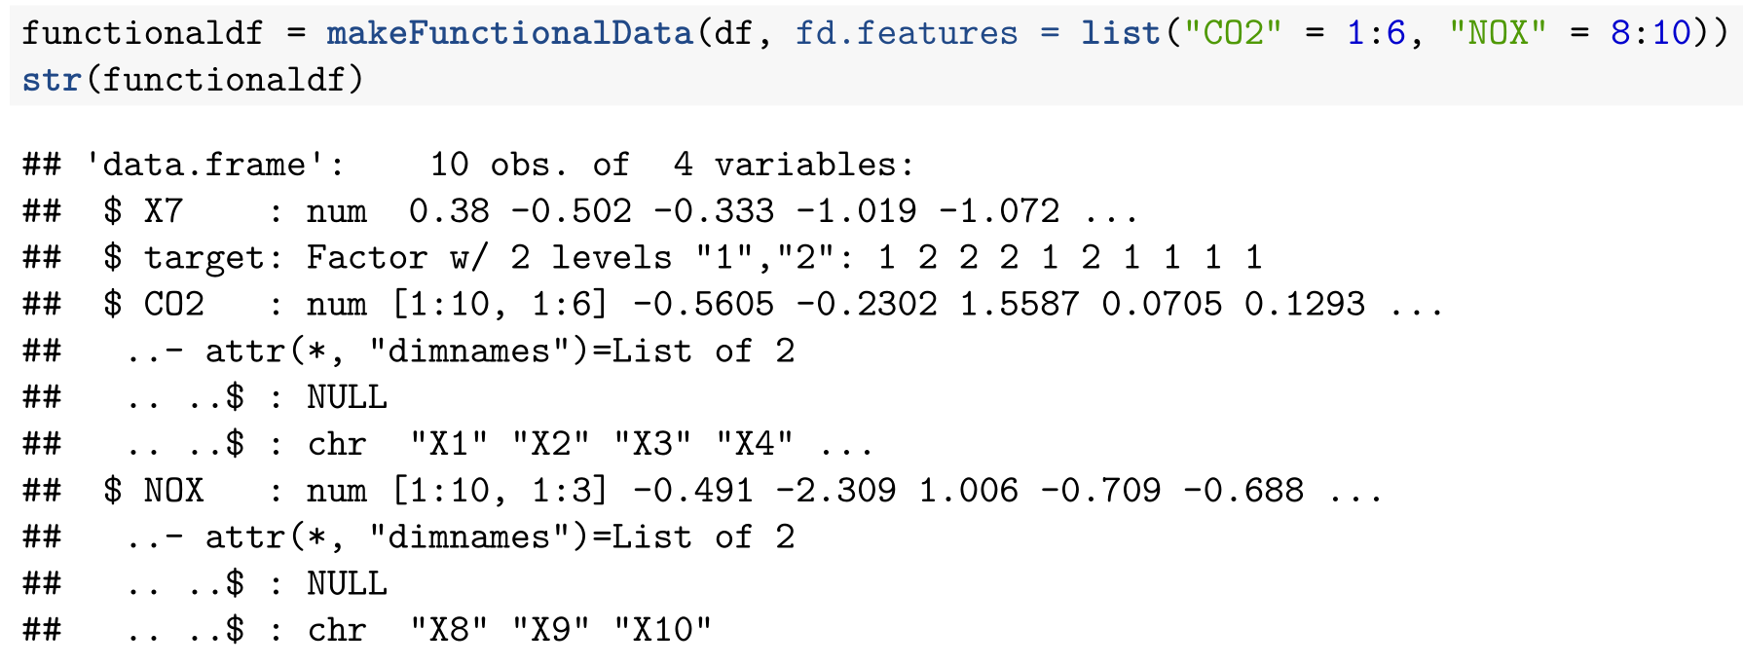
Data handling
mlrFDA
Standard data frame
Functional data frame
5
CR/AEY2 | 07/24/2017
© Robert Bosch GmbH 2016. All rights reserved, also regarding any disposal, exploitation, reproduction, editing, distribution, as well as in the event of applications for industrial property rights.

Slide 6
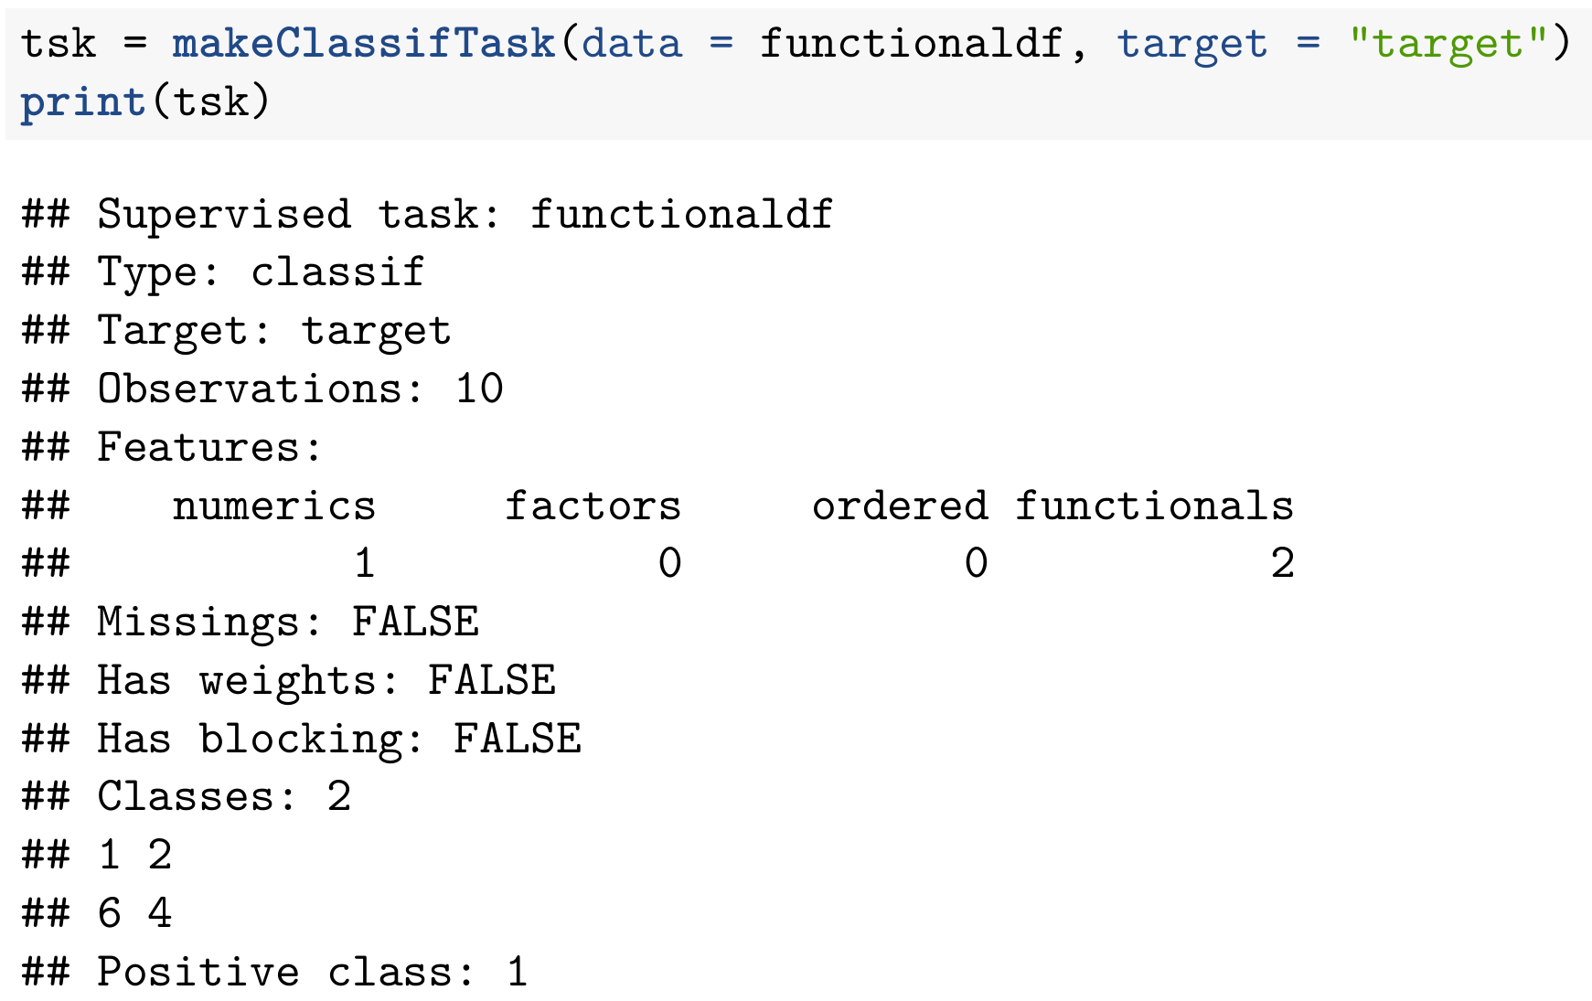
Task abstraction
mlrFDA
Supported Tasks: classification, regression
6
CR/AEY2 | 07/24/2017
© Robert Bosch GmbH 2016. All rights reserved, also regarding any disposal, exploitation, reproduction, editing, distribution, as well as in the event of applications for industrial property rights.

Slide 7
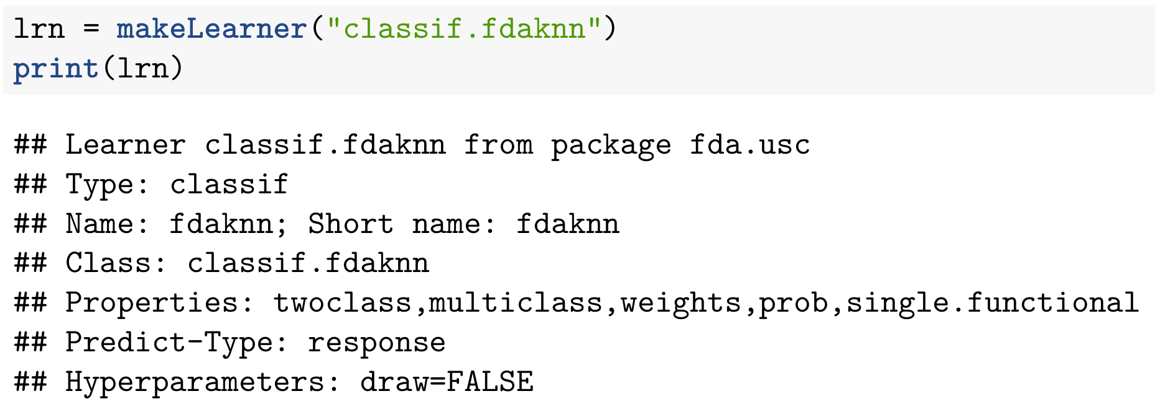
Fda learning algorithms
mlrFDA
Currently implemented learners:
Classification: fdaknn, fdakernel, fdanp, fdaglm (pkg: fda.usc)
Regression: fdafgam (pkg: refund), fdaFDboost (pkg: Fdboost)
Learner consists of training and prediction functions and
parameter set specifications
7
CR/AEY2 | 07/24/2017
© Robert Bosch GmbH 2016. All rights reserved, also regarding any disposal, exploitation, reproduction, editing, distribution, as well as in the event of applications for industrial property rights.

Slide 8
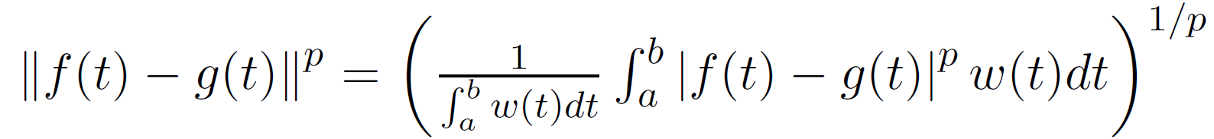
Fda learning algorithm: fdaknn
mlrFDA
Calculate distance between a pair of functional data
Distance measures are “functional data specific” such as Lp-Norm
Classification itself via k nearest neighbours:
8
CR/AEY2 | 07/24/2017
© Robert Bosch GmbH 2016. All rights reserved, also regarding any disposal, exploitation, reproduction, editing, distribution, as well as in the event of applications for industrial property rights.

Slide 9
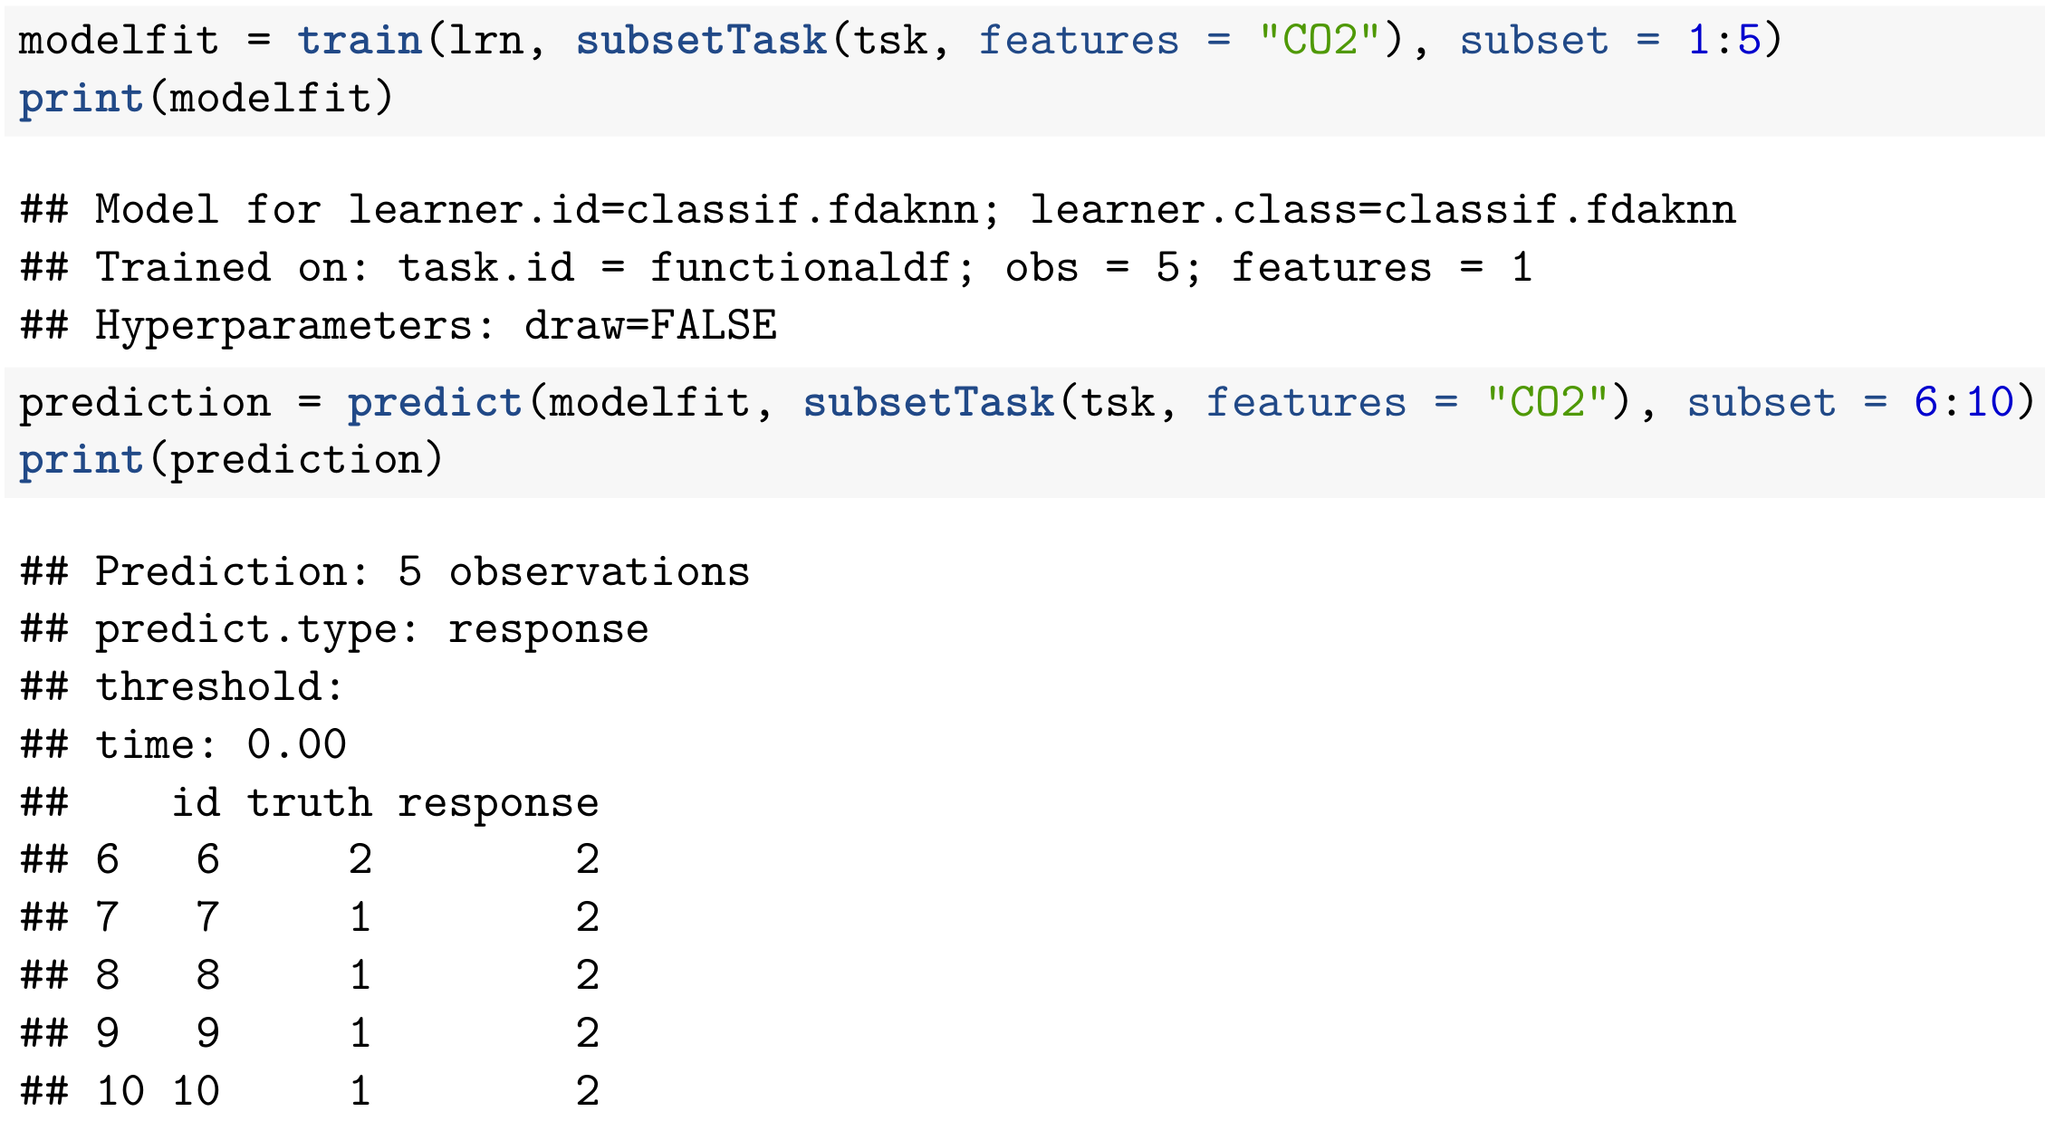
Fda learning algorithms
mlrFDA
9
CR/AEY2 | 07/24/2017
© Robert Bosch GmbH 2016. All rights reserved, also regarding any disposal, exploitation, reproduction, editing, distribution, as well as in the event of applications for industrial property rights.

Slide 10
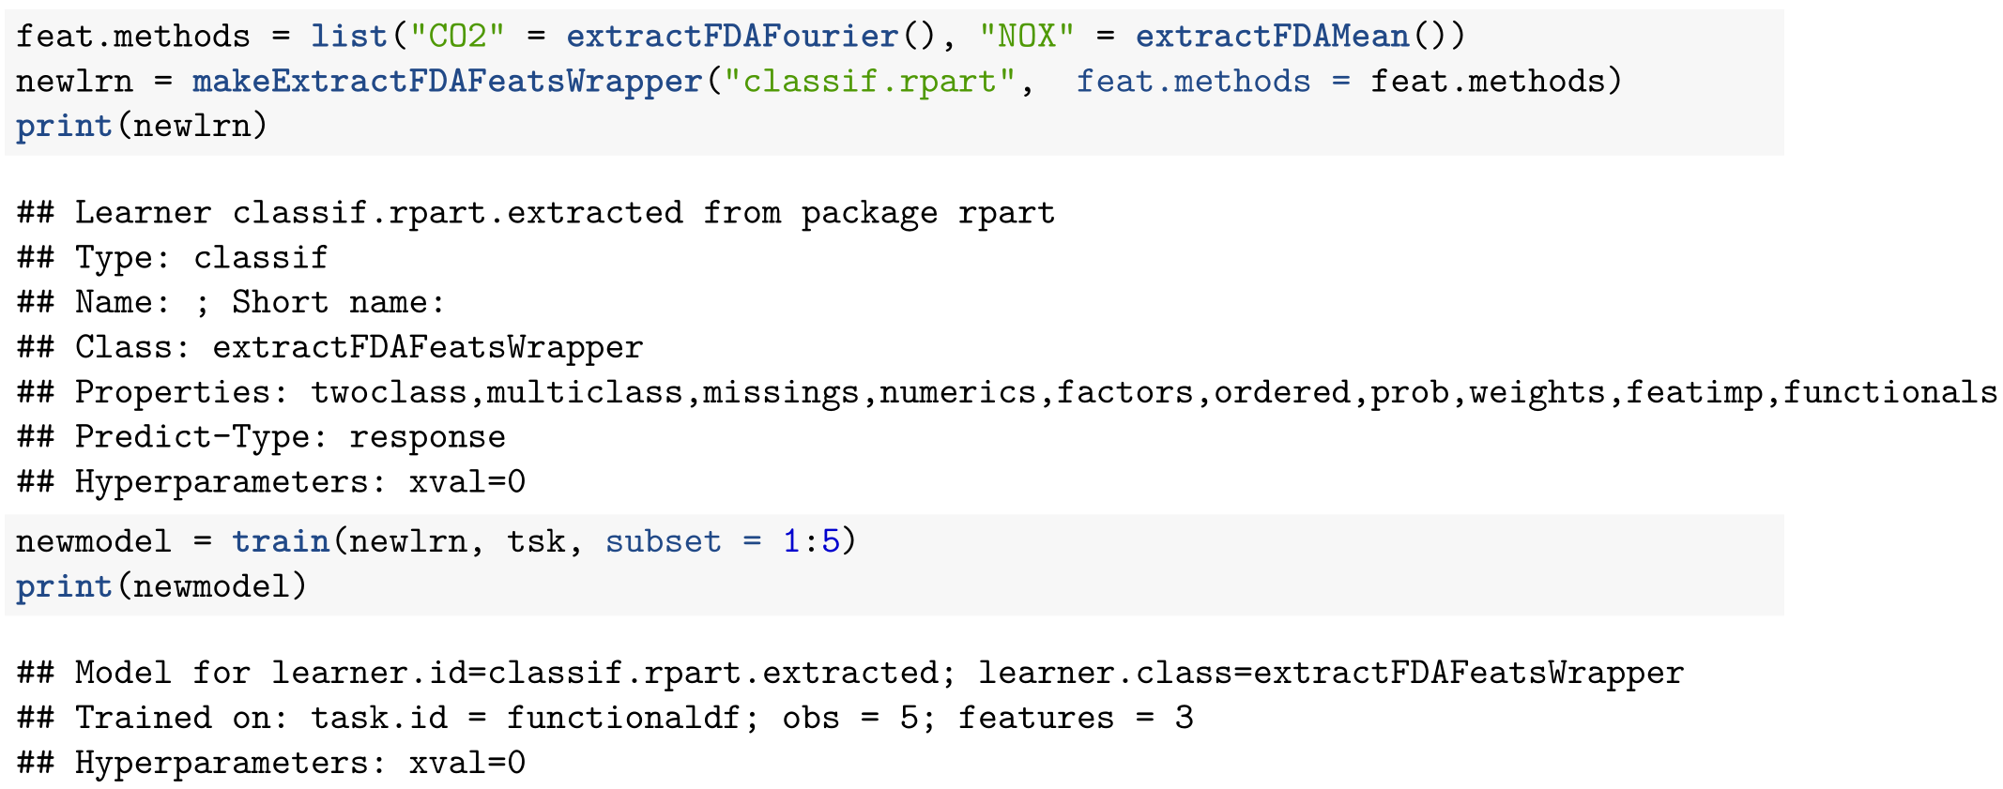
Fda feature extraction
mlrFDA
How can we apply non-functional ML algorithms to functional data?
Currently implemented: Mean, Min, Fourier and wavelet, FPCA, …
- Ignore functional structure
- Extract non-functional functional features
10
CR/AEY2 | 07/24/2017
© Robert Bosch GmbH 2016. All rights reserved, also regarding any disposal, exploitation, reproduction, editing, distribution, as well as in the event of applications for industrial property rights.

Slide 11
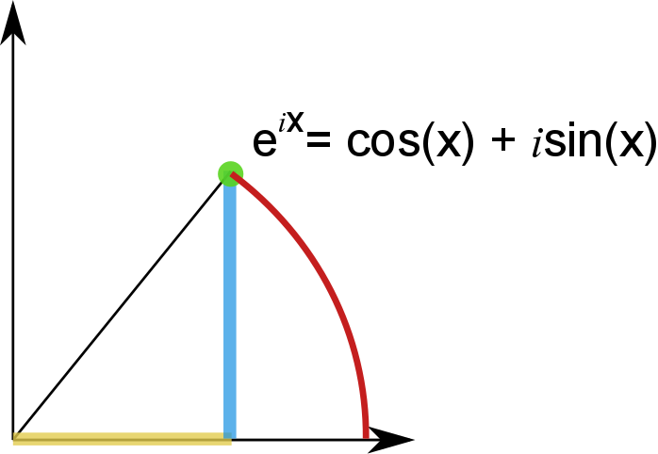
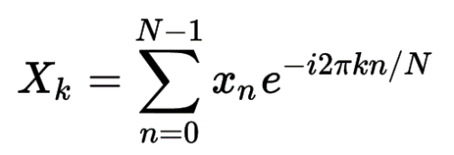
Fda feature extraction: fourier transform
mlrFDA
Key idea: each signal (over time) can be filtered into combinations of
circular paths, i.e.
Signal over time
Signal over frequencies
functional
non-functional
11
CR/AEY2 | 07/24/2017
© Robert Bosch GmbH 2016. All rights reserved, also regarding any disposal, exploitation, reproduction, editing, distribution, as well as in the event of applications for industrial property rights.

Slide 12
Benchmark experiments
[2]
Compare to UCR Time Series Classification Repository Bakeoff
83 classification data sets (univariate time series)
Fixed train-test split, LOOCV <-> 3fold CV
tuning via random search (100iters) and MBO (100iters)
Bake Off
36 (non) time series learners
mlrFDA
4 functional learners
6 standard ml learners
default
Euclidean_1NN
ST
BOSS
COTE
…
fdanp
fdaglm
fdaknn
fdakernel
default
xgboost
ranger
ksvm
glmnet
rpart
cvglmnet
d + extract
tuned
[2]
t + extract
- Anthony Bagnall, et al., 2016, The Great Time Series Classification Bake Off: a Review and Experimental Evaluation
of Recent Algorithmic Advances, Data Mining and Knowledge Discovery, Online First
- Anthony Bagnall, et al., The UEA & UCR Time Series Classification Repository, www.timeseriesclassification.com
12
CR/AEY2 | 07/24/2017
© Robert Bosch GmbH 2016. All rights reserved, also regarding any disposal, exploitation, reproduction, editing, distribution, as well as in the event of applications for industrial property rights.

Slide 13
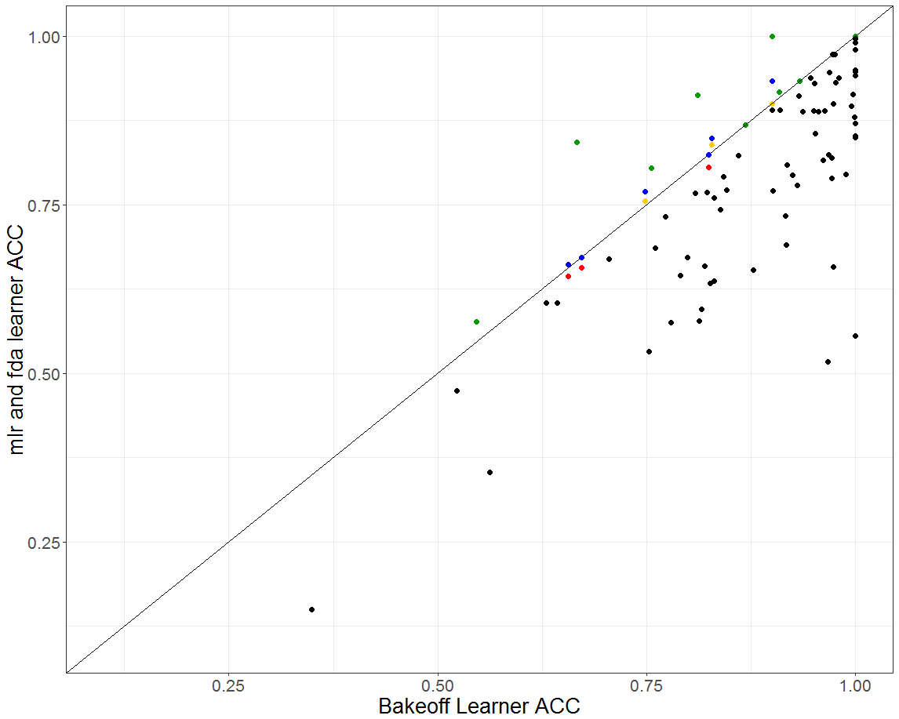
Overview ACC
Benchmark experiments
1 point is one data set
Bakeoff wins
Fda wins
mlr ML wins
Fda ACC for
Fda ACC for
We can improve ACC 16 times
13
CR/AEY2 | 07/24/2017
© Robert Bosch GmbH 2016. All rights reserved, also regarding any disposal, exploitation, reproduction, editing, distribution, as well as in the event of applications for industrial property rights.

Slide 14
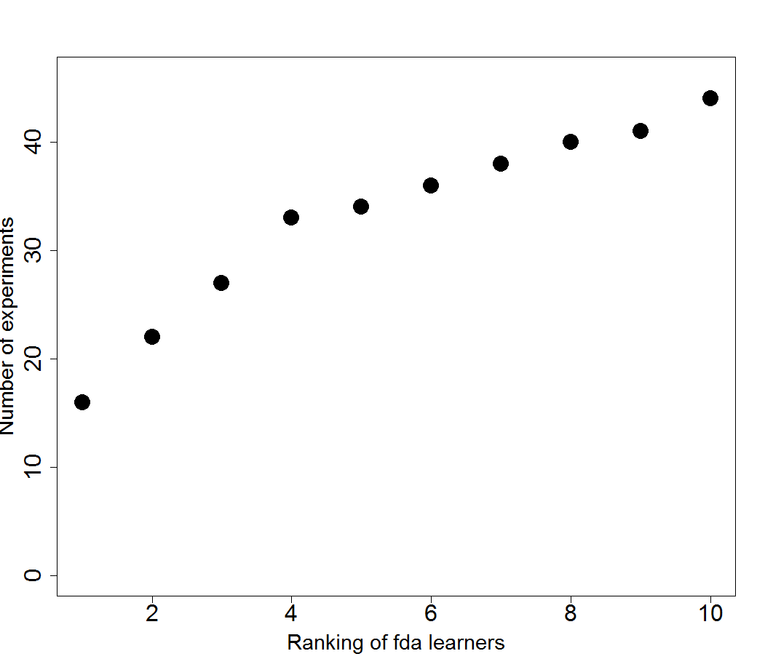
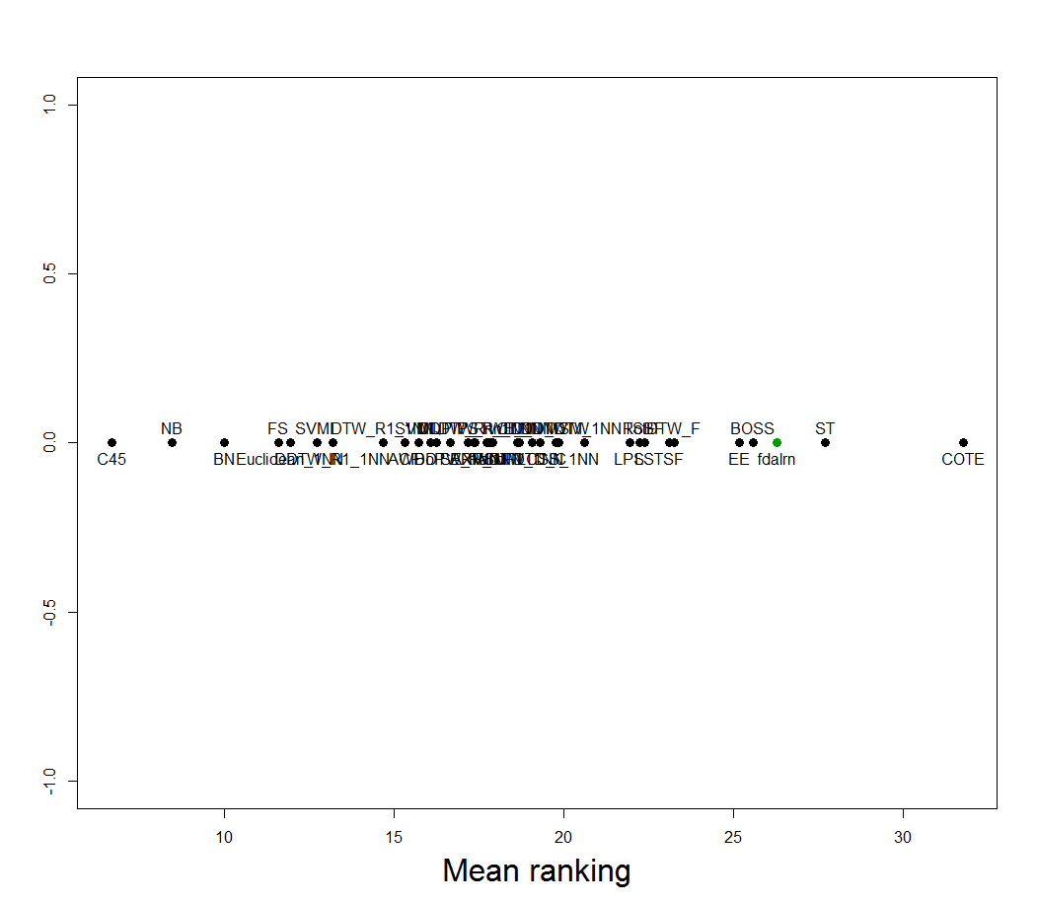
Ranking
Benchmark experiments
In more than 0.5 * 83 experiments we are under the 10 best performing learners
14
CR/AEY2 | 07/24/2017
© Robert Bosch GmbH 2016. All rights reserved, also regarding any disposal, exploitation, reproduction, editing, distribution, as well as in the event of applications for industrial property rights.

Slide 15
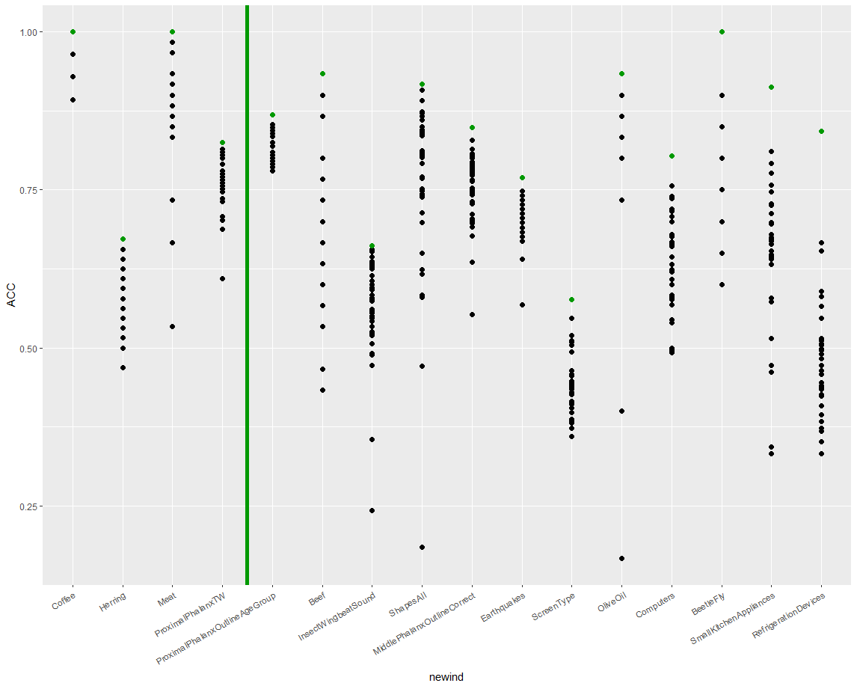
Individual datasets
Benchmark experiments
15
CR/AEY2 | 07/24/2017
© Robert Bosch GmbH 2016. All rights reserved, also regarding any disposal, exploitation, reproduction, editing, distribution, as well as in the event of applications for industrial property rights.

Slide 16
Summary
How is functional data analysis integrated into mlr?
What can you do with mlrFDA and how?
Considering functional learners in time series applications is worth a try
Standard data frame
Functional data frame
Functional classification and regression
Feature extraction for standard ML methods
16
CR/AEY2 | 07/24/2017
© Robert Bosch GmbH 2016. All rights reserved, also regarding any disposal, exploitation, reproduction, editing, distribution, as well as in the event of applications for industrial property rights.

Slide 18
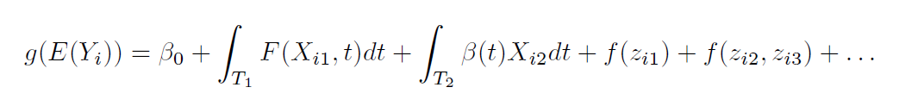
fgam
Header of section
Functional generalized additive models for regression of functional
predictor to scalar response
18
CR/AEY2 | 07/24/2017
© Robert Bosch GmbH 2016. All rights reserved, also regarding any disposal, exploitation, reproduction, editing, distribution, as well as in the event of applications for industrial property rights.

Slide 19
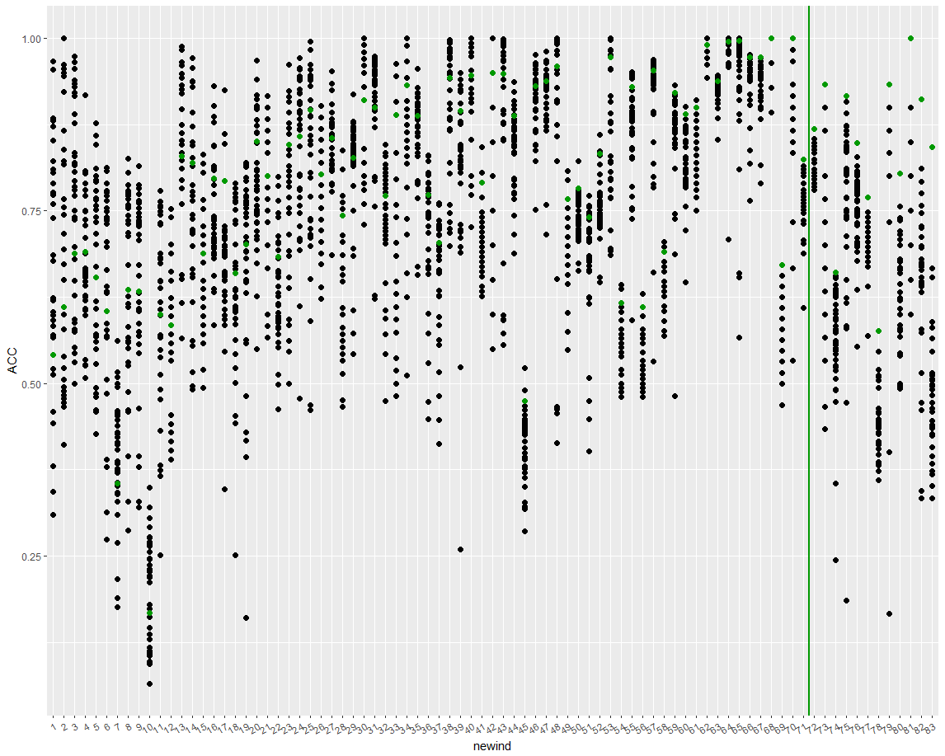
19
CR/AEY2 | 07/24/2017
© Robert Bosch GmbH 2016. All rights reserved, also regarding any disposal, exploitation, reproduction, editing, distribution, as well as in the event of applications for industrial property rights.

