Slide 1
Introduction

Slide 2
Outline
Bayesian Principles
Prior Distribution
Posterior Computation
Predictive Distribution
Comparison Bayesian-Frequentist
What you will need for use cases
Second session
MCMC sampling (Metropolis, Gibbs, NUTS etc.)​
Convergence check​

Slide 3
Bayesian methods: General principles
Example: clinical trial to collect evidence of an unknown treatment effect
Frequentist analysis:
point estimate and confidence intervals as summaries of size of treatment effect
Asks: what this trial tells us about the treatment effect
Bayesian analysis:
Before the trial: a priori opinion on the treatment effect
Asks: how should this trial change our opinion about the treatment effect?
Motivation for adopting Bayesian approach:
Natural and coherent way of thinking about science and learning

Slide 4
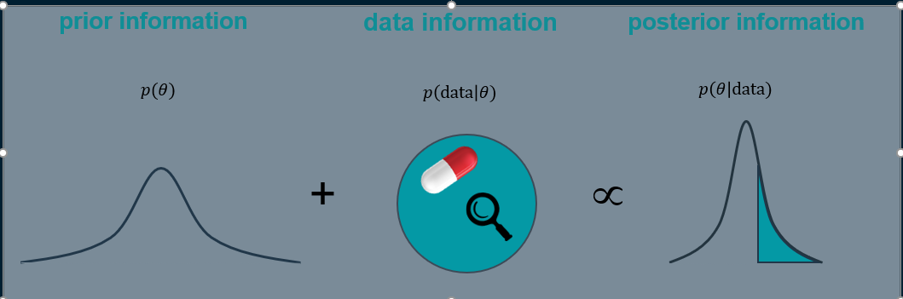

Bayesian inference is the mechanism used to update the state of knowledge
The process to arrive at a posterior distribution makes use of Bayes’ formula.

Slide 5
Bayesian principle
“PRIOR DISTRIBUTION” from previous studies, expert opinion, literature,…
“LIKELIHOOD” data coming from the experiment
Available Data
Observed Data
Total Data
+
=
“POSTERIOR DISTRIBUTION” combination of information collected before the experiment and what comes from the experiment data

Slide 6

Bayesian principle
$$\frac{p\left(θ\right)p\left(y | θ\right)}{p(y)}=p\left(θ | y\right)$$
Available Data
Observed Data
Total Data
+
=
Total Data is on its way to become the prior of the next experiment !

Slide 7

Bayesian principle: the scientific process
Prior
Power/Assurance
Inference /
Predictions
Posterior
Design
When we are asked to design, are we asking what’s known ?
$$p\left(θ | y\right)=\frac{p\left(θ\right)p\left(y | θ\right)}{p(y)}$$
Model
Observation
The topic of most presentations will be the implementation of this cycle (at least one)

Slide 8
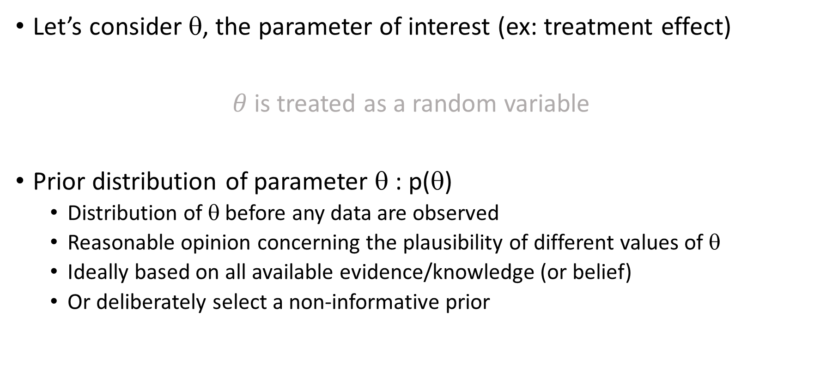
Bayesian principle: Prior information
Let’s consider θ, the parameter of interest (ex: treatment effect)
$θ$is treated as a random variable
Prior distribution of parameter θ : p(θ)
Distribution of θ before any data are observed
Reasonable opinion concerning the plausibility of different values of θ
Ideally based on all available evidence/knowledge (or belief)
Or deliberately select a non-informative prior

Slide 9
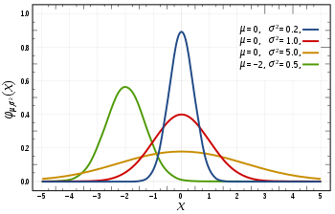
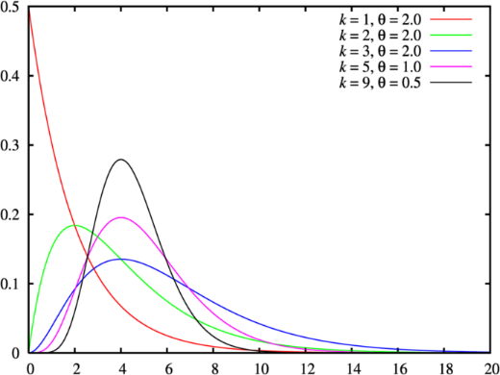
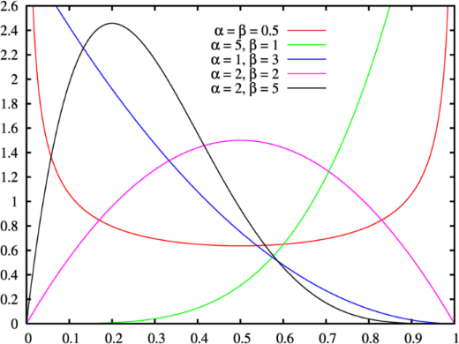

Examples of prior distributions
Prior distribution ➔ Specify the domain of plausible values
➔ Specify the weights given to these values
$θ$is treated as a random variable
Normal distributions
Gamma distributions
Beta distributions

Slide 10
Bayesian principle: Prior information
Don’t underestimate prior!
Very powerful
“If I am going to make an experiment to save the world, I better use my prior”
[A. Gelman]
Part of the scientific process
Can advantageously replace data when well defined
Expert opinion
Comparable historical data
Likely the one piece of your model on which you will receive all the questions

Slide 11
Bayesian principle
Likelihood (assuming a model)
Conditional probability of the data given θ: p(y| θ)
Based solely on data
Posterior distribution:
Distribution of θ after observed data have been taken into account and combined with prior: p(θ|y)
Final opinion about θ
Predictive distribution:
Given the model and the posterior distribution of its parameters, what are the plausible values for a future observation y*? p(y*| y)

Slide 12
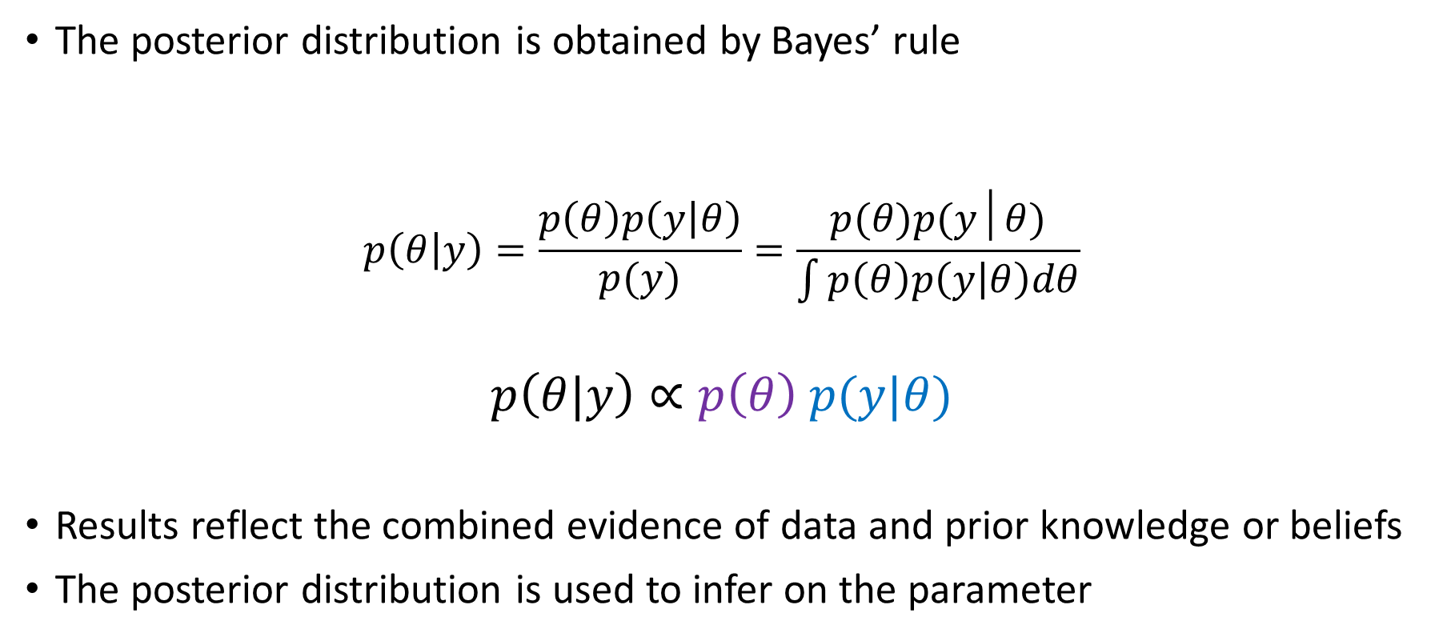
Posterior Distribution
The posterior distribution is obtained by Bayes’ rule
$$p\left(θ | y\right)=\frac{p\left(θ\right)p\left(y | θ\right)}{p(y)}=\frac{p(θ)p(y│θ)}{\int{p\left(θ\right)p\left(y | θ\right)dθ}}$$
$$p\left(θ|y\right)∝p\left(θ\right) p(y|θ)$$
Results reflect the combined evidence of data and prior knowledge or beliefs
The posterior distribution is used to infer on the parameter

Slide 13
Use the posterior distribution for decision making
Uncertainty is described in terms of probability :
Posterior distribution
0.25
0.20
P(θ>5.5) = 0.401
0.15
➔ Various questions can easily be answered once posterior distribution is available
0.10
0.05
0.00
-5
0
5
10
15
Theta

Slide 14
Bayesian Predictions

Slide 15

Difference Simulations/Predictions
Simulations
the “new observations” are drawn from distribution “centered” on estimated location and dispersion parameters (treated as “true values”).
Predictions
the uncertainty of parameter estimates (location and dispersion) is taken into account before drawing “new observations” from relevant distribution

Slide 16
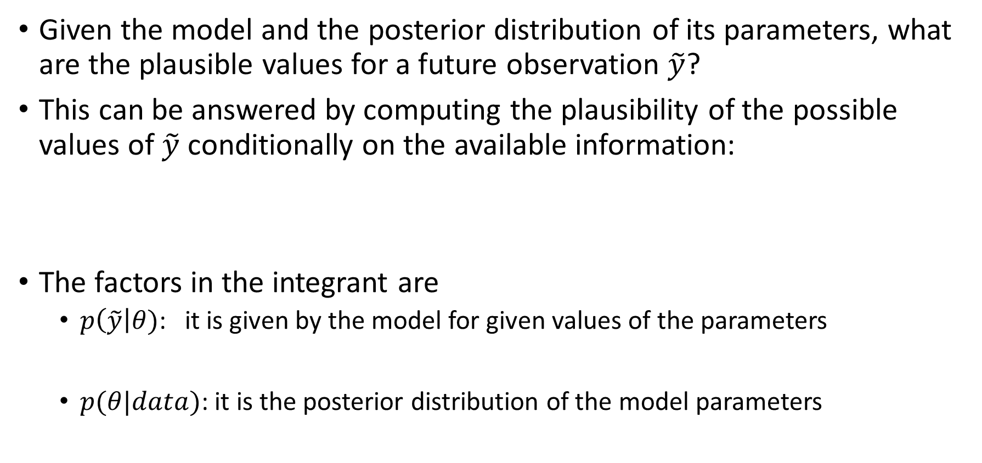
Predictions
Given the model and the posterior distribution of its parameters, what are the plausible values for a future observation $\tilde{y}$?
This can be answered by computing the plausibility of the possible values of $\tilde{y}$ conditionally on the available information:
The factors in the integrant are
$p\left(\tilde{y}\right|θ)$: it is given by the model for given values of the parameters
$p(θ|data)$: it is the posterior distribution of the model parameters

Slide 17
Practically, how to make predictions
2nd, draw an observation from the resulting distribution Y~ Normal(µ_{i}, σ²_{i} )
3rd, repeat this operation a large number of times to obtain the predictive distribution
1st, draw a mean and a variance from:
Posterior of mean µi
Posterior of Variance σ²_{i} given mean drawn
X
X
X
X

Slide 18
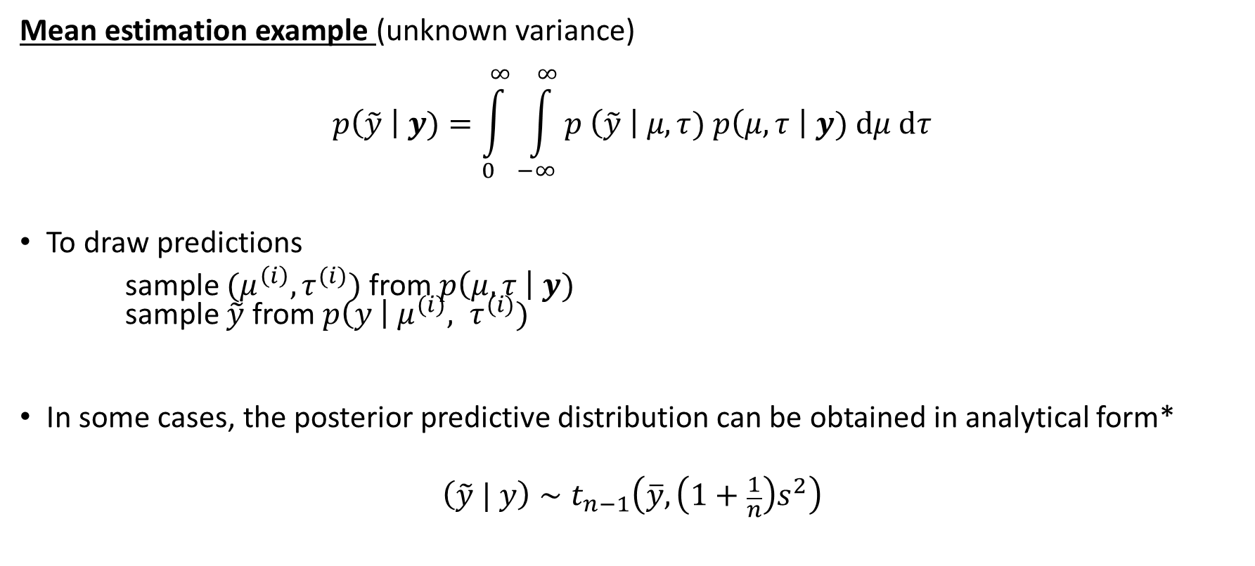
Posterior predictive distribution
Mean estimation example (unknown variance)
$$p\left(\tilde{y} \right| y)=\int_{0}^{∞}{\int_{−∞}^{∞}{p \left(\tilde{y} \right| μ, τ) p\left(μ, τ \right| y) dμ dτ}}$$
To draw predictions
sample $(μ^{\left(i\right)}, τ^{(i)})$ from $p\left(μ, τ \right| y)$ sample $\tilde{y}$ from $p\left(y \right| μ^{(i)}, τ^{(i)})$
In some cases, the posterior predictive distribution can be obtained in analytical form*
$$\left(\tilde{y} | y\right)∼t_{n−1}\left(\overline{y}, \left(1+\frac{1}{n}\right)s^{2}\right)$$
*see: Gelman, A., Carlin, J. B., Stern, H. S. and Rubin, D. B. (2004). Bayesian Data Analysis. Chapman and Hall/CRC, 2nd ed. Chapter 3, p 77.

Slide 19

Added value of Bayesian Statistics
Use the posterior distribution to compute probability for decision making
Simulations VS predictions: Predictions take into account the uncertainty in estimating the model parameters.
Prior knowledge is also used to make the trial design more effective and informative.
simulations
predictions
Design
Study
Model
Knowledge
Prior

Slide 20
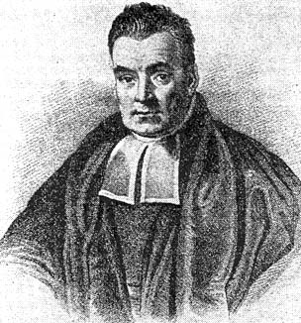

Why now and not before?
1702 - 1761
16 / 18

Slide 21

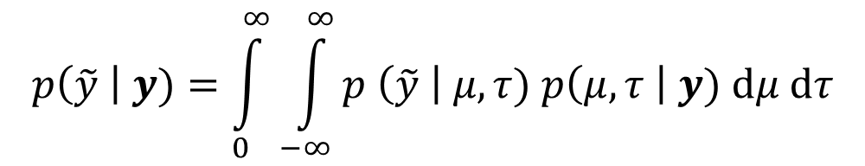
Why now and not before?
In principle, there are two main equations to compute:
Analytical derivation
Get closed-form formulae for posterior distribution of parameters and predictive distribution of responses…
MCMC
Often, the mathematics become intractable, then, need to rely on computer simulation to instead get some samples of the posterior and the predictive
Examples:
Metropolis-Hastings algorithm
Gibbs sampling
…
Hamiltonian Monte-Carlo (HMC)
No U-turn Sampler (NUTS part of HMC)
Some methodologies in between (e.g. INLA)
$$p\left(\tilde{y} \right| y)=\int_{0}^{∞}{\int_{−∞}^{∞}{p \left(\tilde{y} \right| μ, τ) p\left(μ, τ \right| y) dμ dτ}}$$
$$p\left(θ | y\right)=\frac{p\left(θ\right)p\left(y | θ\right)}{p(y)}$$

Slide 22
Comparison Bayesian-Frequentist

Slide 23
Comparison Bayesian-Frequentist
Distribution vs. fixed value
Bayesian: probability of parameters given observed data
Frequentist: probability of observed data given parameters
Evidence used (in the analysis)
Bayesian: all available (relevant) information/knowledge
Frequentist: specific to experiment

Slide 24
Comparison Bayesian-Frequentist
Inference
Bayesian : examine the probability of θ given the data.
Frequentist: test of significance are performed by supposing that a hypothesis is true (the null hypothesis) and then computing the probability of observing a statistic at least as extreme as the one actually observed during hypothetical future repeated trials. (This is the P-value).
Intervals
Bayesian : credible interval : 95% most plausible/credible values
Frequentist : Confidence interval: “If we repeat the same experiment a large number of times, the confidence interval will contain the true value in 95% of the cases.”

Slide 25
Comparison Bayesian-Frequentist
Design flexibility
Bayesian : May adapt trial design as evidence accumulates
Sample size does NOT need to be pre-specified
Interim analysis may be conducted anytime and at any frequency
Frequentist: Interim analyses possible, but restricted
Must be pre-specified
Number and timing affect the analyses

Slide 26
Confidence interval versus credible interval
Strictly speaking, a confidence interval does not state that the true value of the parameter has a certain probability of being in the confidence interval, given the observed data.
In fact, the unknown population parameter does not vary (Frequentist perspective).
Intervals with this property are called credible intervals
Credible intervals only exist in the Bayesian paradigm

Slide 27
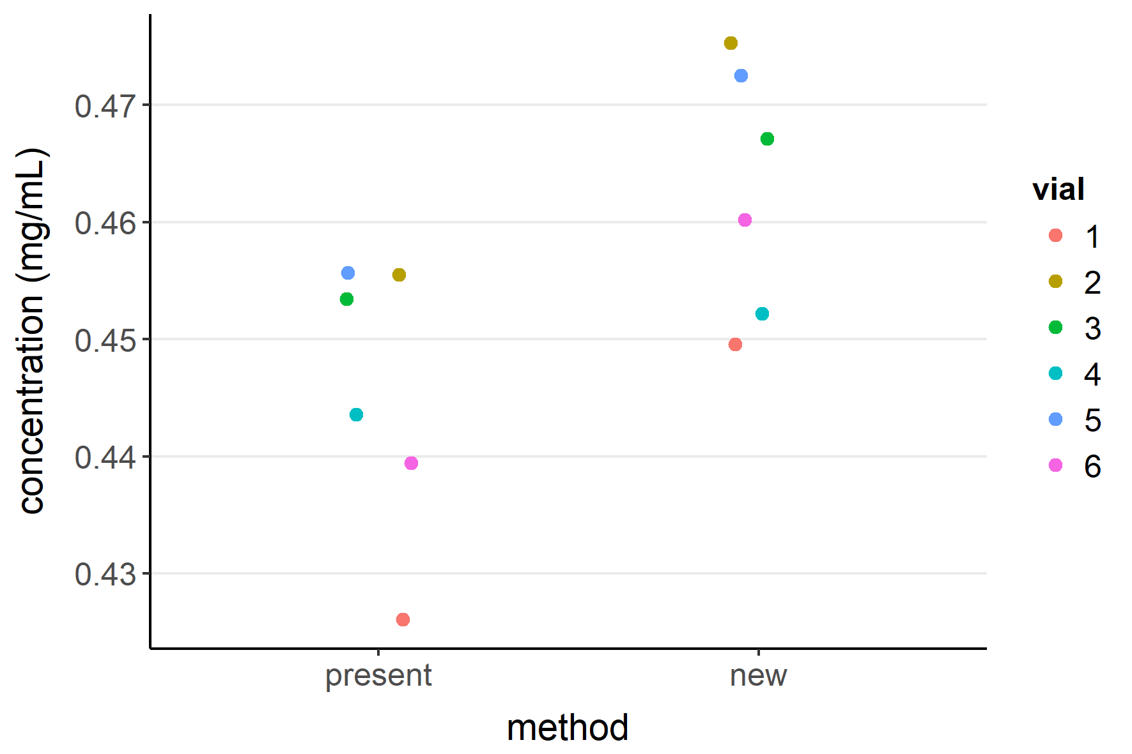
Comparison of two analytical methods
6 vials are selected from a lot of drug product
Each vial is split into half, and each half is measured using a different analytical method (paired design)
The two methods are considered equivalent if the true difference in mean concentration is not greater than 0.02 mg/mL
PASS/FAIL vs continuous answer
Burdick, R. K., LeBlond, D. J., Pfahler, L. B., Quiroz, J., Sidor, L., Vukovinsky, K. & Zhang, L. (2017). Statistical Applications for Chemistry, Manufacturing and Controls (CMC) in the Pharmaceutical Industry. Springer.

Slide 28
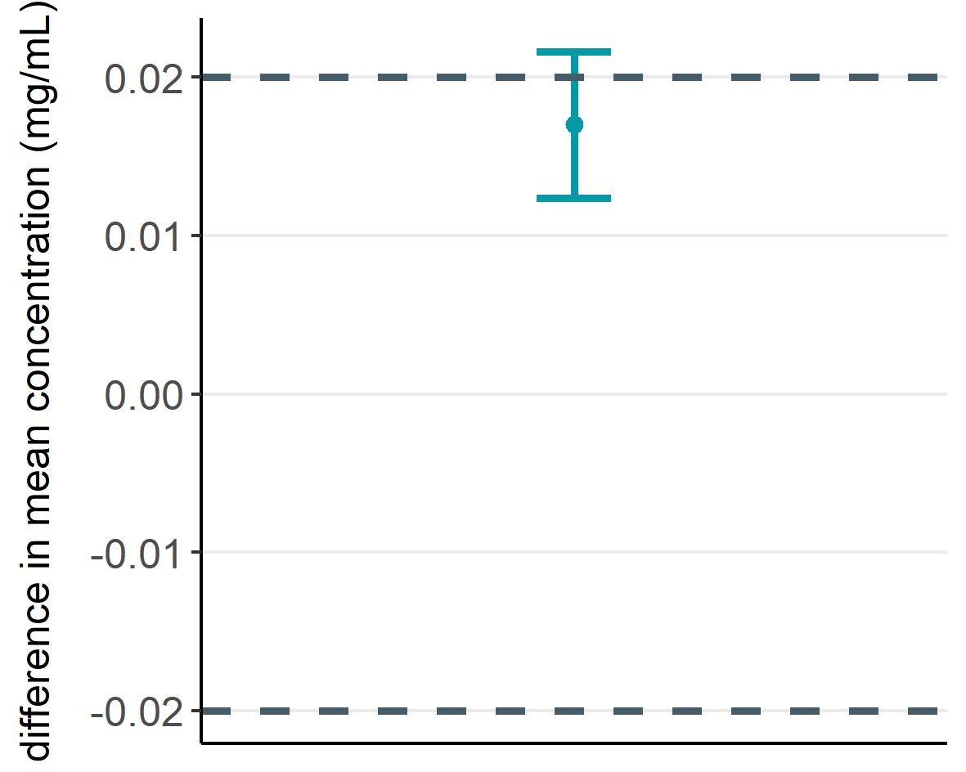
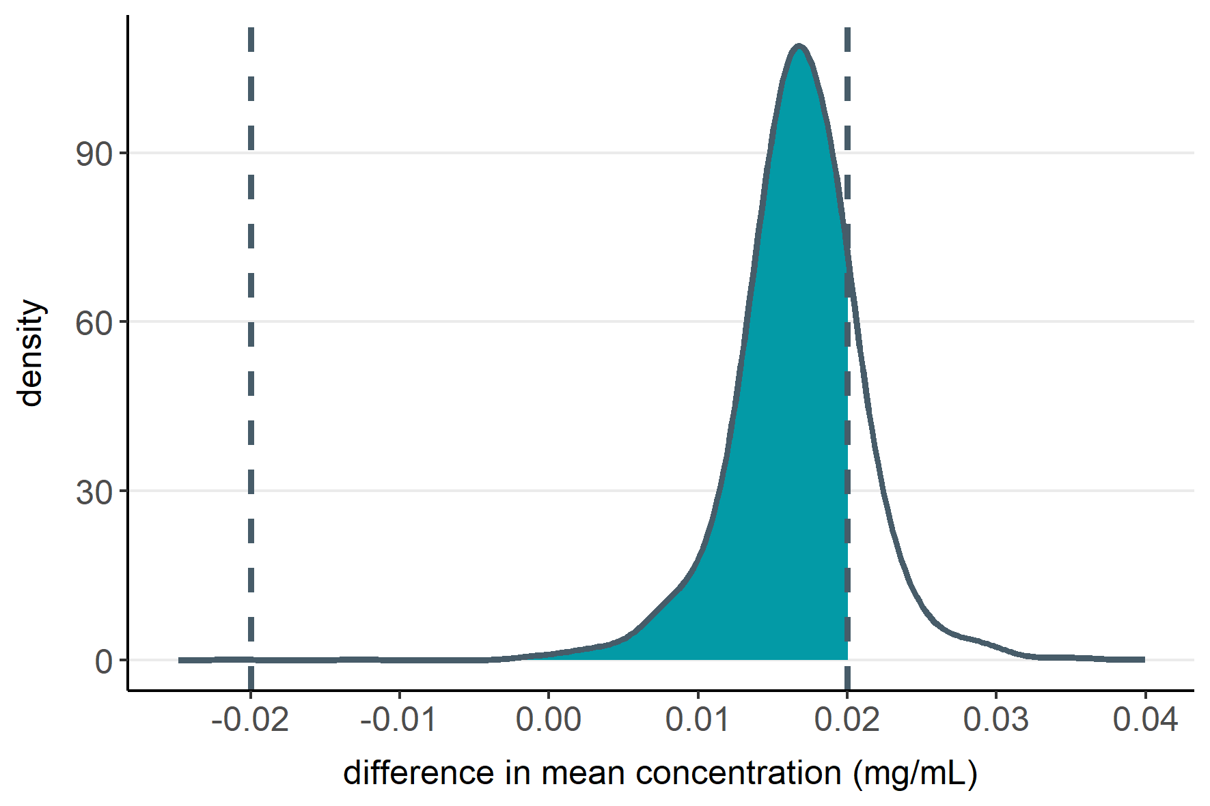

Comparison of two analytical methods
Frequentist approach (TOST)
Bayesian approach
90% CI
$$\operatorname{Pr}\left(within margins\right)=0.83$$
Failed
Distribution and probability available

Slide 29
Comparison Bayesian-Frequentist
In Bayesian analytical derivation, under non-informative (e.g. Jeffrey) prior, one often discovers that the width of the posterior is driven directly by what is called the standard error in Frequentist
It just happens in the computation
Quite logically, as in “non”-informative situation, only the likelihood is non-constant. Hence, going over it, integrating it is exactly what Frequentists do
However, interpretation remains different
Confidence vs. coverage
Posterior uncertainty vs standard error (In Frequentist, parameters should be fixed, so anyway, what’s a standard error if nothing else than the data sampling variability propagated/imputed around a fixed value ?)
And conversely, in the Bayesian, what’s a standard error if only the knowledge (or lack of) about a parameter value, after having observed the data (and the prior) ? (but what if you have a bimodality ?)
All of that always remains very confusing, but at the end, if it’s the same…

Slide 30
Bayesian Credibility Interval
Highest posterior density (HPD) interval
Shortest interval containing 95% of the posterior probability.
If the posterior distribution is approximately symmetric, the HPD and quantile-based credible interval are very similar.
H PD
Quantile-based
HPD
Quantile-based

Slide 31
The prediction interval is of beta-expectation !
Sometimes, solutions co-exist exactly
Under ‘uninformative’ prior, obviously
For symmetrical distribution (HPD can be different compared to quantiles)
E.g. a prediction interval in frequentist is exactly the same as its Bayesian counterpart, the β-expectation tolerance interval
However, interpretation is slightly different
Confidence level vs. expected coverage

Slide 32
Tools
After the completing the basics, we will dive in use cases
This will be the occasion to try to adjust models using Stan/brms, rjags, nimble, or even SAS proc MCMC if you like !
And analyze if the full scientific cycle was followed, what could be improved, etc.
Installation instructions:
Stan: https://mc-stan.org/users/interfaces/
Installation script for BiostatShiny server (Janssen VPCx)
Rstan (on windows, this may be the trickiest, as Stan needs Rtools to get a C++ compiler)
CmdStanR
brms: https://paul-buerkner.github.io/brms/
rjags: https://cran.r-project.org/web/packages/rjags/index.html
(Simple install package from CRAN)
nimble: https://cran.r-project.org/web/packages/nimble/index.html
(Simple install package from CRAN)
Design
Study
Model
Knowledge
Prior

Slide 33
Backup slides

Slide 35
MCMC simulations

Slide 36
MCMC simulations
Simulations are needed.
In most cases, the analytical form of the posterior (or predictive) distribution is intractable.
We need to be able to generate random samples from the posterior distribution.
In some cases, the univariate densities belong to well-known families -> easy to generate
Otherwise, use other algorithms to sample from univariate or multivariate distribution: MCMC algorithm

Slide 37
MCMC simulations
The samples are drawn sequentially so that each draw depends on the previous one, thus forming a Markov Chain.
Eventually, the Markov chain converges to a stationary distribution that is the joint posterior distribution
Algorithms for MCMC include:
Gibbs sampling
Metropolis-Hastings algorithm
Hamiltonian Monte-Carlo (HMC)
No U-turn Sampler (NUTS part of HMC)

Slide 38
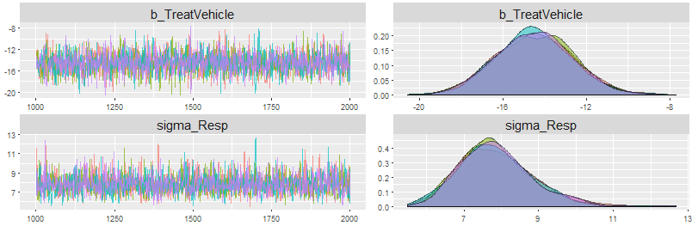
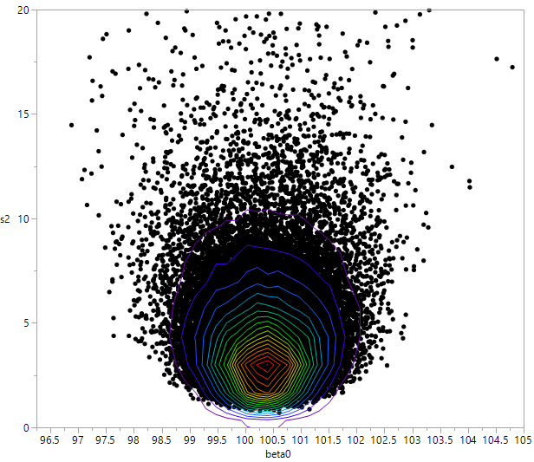
Numerical methods mostly required: Monte Carlo Markov Chain or MCMC
Gibbs sampling
Metropolis-Hastings Algorithm
HMC (Hamiltonian Monte Carlo) such as NUTS algorithm
Goal: To generate a chain of values that belong to the posterior distribution
Numerous diagnostic tools to ensure that there is a convergence in distribution !
A full topic by its own
Will be covered later

Slide 39
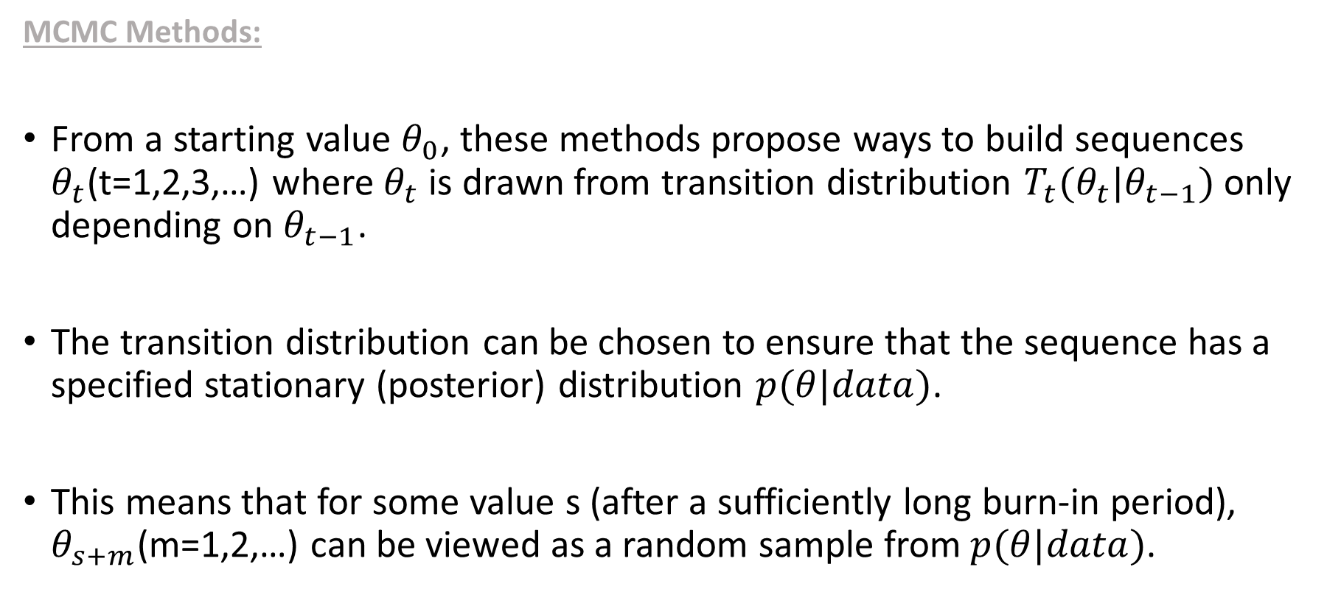
MCMC simulations
MCMC Methods:
From a starting value $θ_{0}$, these methods propose ways to build sequences $θ_{t}$(t=1,2,3,…) where $θ_{t}$ is drawn from transition distribution $T_{t}(θ_{t}|θ_{t−1})$ only depending on $θ_{t−1}$.
The transition distribution can be chosen to ensure that the sequence has a specified stationary (posterior) distribution $p(θ|data)$.
This means that for some value s (after a sufficiently long burn-in period), $θ_{s+m}$(m=1,2,…) can be viewed as a random sample from$p(θ|data)$.

Slide 40
MCMC with correlations
Sampling a multivariate distribution from a univariate proposal
Very slow exploration of the parameter space
especially if correlation is present
As sample j is very close to sample j-1 → autocorrelation
Convergence can be very slow as well
proposal
Notes:
with M-H, the new sample is often rejected as potentially very far from the posterior

Slide 41
How to improve exploration ?
Take a multivariate distribution as proposal
If correlations can be roughly estimated, the sampling can be improved to account for the dependency structure
Still, it does not work well with exotic distribution (e.g. banana shaped, etc.)
Sampling by block easier if interesting blocking of similar parameters can be identified
E.g. in a regression, sample the regressors and the variance in two blocks
Thin the samples
Keeping only one sample out of, say, 10, to obtain a ‘faster’ exploration of the distribution
Transform the model to obtain uncorrelated parameters
E.g. in STAN: mu[i] = alpha + beta * (x[i] - x.mean)
Overrelaxation method

Slide 42
Hamiltonian Monte-Carlo
The idea is to avoid the random walk behavior of MCMC algorithms
Uses Hamiltonian dynamics
Auxiliary momentum vector
So, a state (one sample) has a position and a momentum (mass*velocity)
A potential energy (∝ to the posterior density height) A kinetic energy (momentum & mass)
The target density defines a potential energy function using Hamiltonian equations
One sampling iteration consists in moving on the posterior following these dynamics
instead of moving using a simpler proposal distribution
Theory terminology is often hard for statisticians without a good knowledge of physics
Notes:
Puck example from Neal

Slide 43
Hamiltonian Monte-Carlo
Two types of proposals are used iteratively
1. randomize the momentum variable (give a velocity)
2. move on the posterior using Hamiltonian equations
Leapfrog function
Discard the momentum variables and keep only the sequence of position (i.e. samples)
Hoffman, Matthew D. and Andrew Gelman. In press. The No-U-Turn Sampler: Adaptively Setting Path Lengths in Hamiltonian Monte Carlo. Journal of Machine Learning Research.
Notes:
red x : the samples are discarded because the detailed balance is not respected
If all leapfrogs are discared : means reject of the proposal

Slide 44
Hamiltonian Monte-Carlo
Why it is performant ?
Rely on the gradient of the current location of the posterior to better know the direction to take towards the next sample
Leapfrog functions are used to discretize the Hamiltonian equations
Computers can work with them very efficiently
Explore the posterior distribution more efficiently using several leapfrogs to reduce autocorrelation
Neal, R. MCMC using Hamiltonian dynamics, in Handbook of Markov Chain Monte Carlo, Brooks et al, Chapman & Hall, 2010
Notes:
Gradient can be easily and efficiently approximated using numerical derivatives

Slide 45
NUTS
Using the leapfrog function, two parameters have to be tuned
The size of the leap (the step)
The number of leaps
Tuning them is a complex task that may require many additional runs
The No-U-Turn Sampler (NUTS) is an improvement of HMC that have routines to tune these parameters on-the-fly
Choose randomly among the valid candidates the next sample/position
Notes:
If velocity is high, more leapfrogs... but this is automatically tuned by the no u-turn sampler

Slide 46
Convergence checks

Slide 47
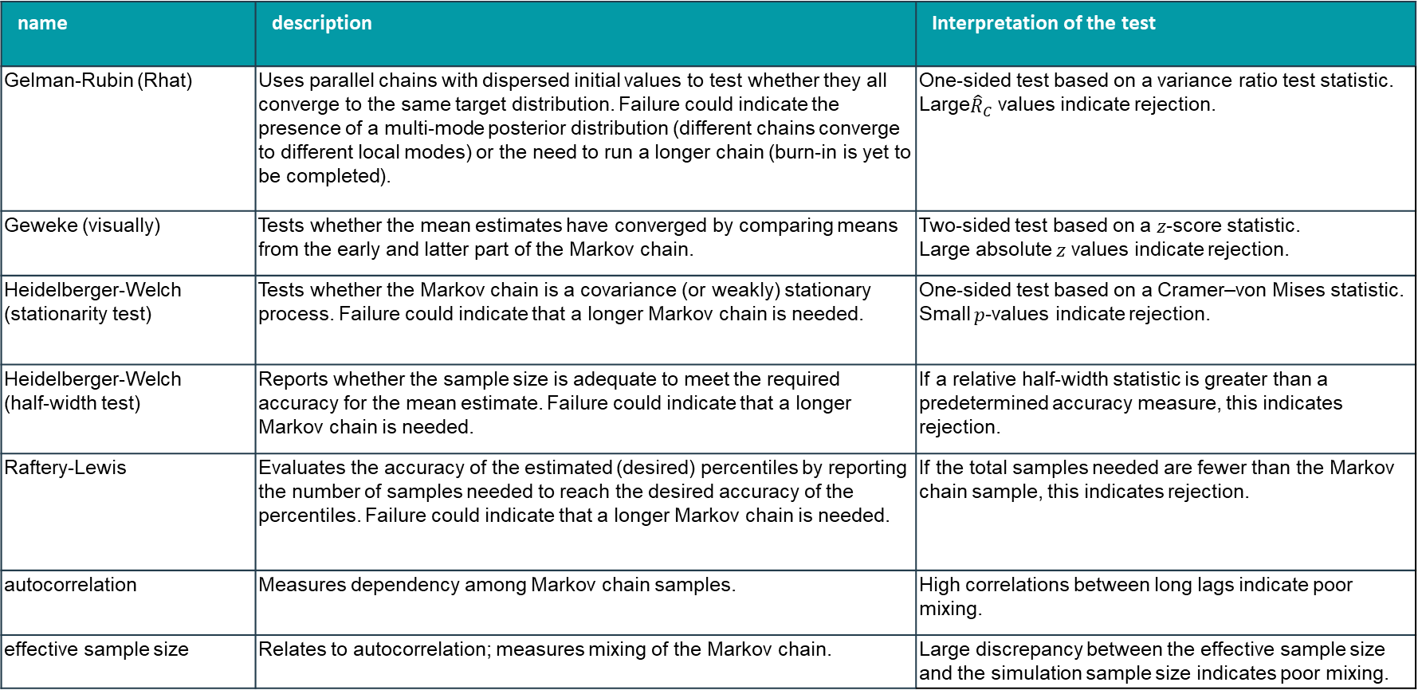
Convergence diagnostics
name | description | Interpretation of the test
Gelman-Rubin (Rhat) | Uses parallel chains with dispersed initial values to test whether they all converge to the same target distribution. Failure could indicate the presence of a multi-mode posterior distribution (different chains converge to different local modes) or the need to run a longer chain (burn-in is yet to be completed). | One-sided test based on a variance ratio test statistic. Large${\hat{R}}_{C}$ values indicate rejection.
Geweke (visually) | Tests whether the mean estimates have converged by comparing means from the early and latter part of the Markov chain. | Two-sided test based on a $z$-score statistic. Large absolute $z$ values indicate rejection.
Heidelberger-Welch (stationarity test) | Tests whether the Markov chain is a covariance (or weakly) stationary process. Failure could indicate that a longer Markov chain is needed. | One-sided test based on a Cramer–von Mises statistic. Small $p$-values indicate rejection.
Heidelberger-Welch (half-width test) | Reports whether the sample size is adequate to meet the required accuracy for the mean estimate. Failure could indicate that a longer Markov chain is needed. | If a relative half-width statistic is greater than a predetermined accuracy measure, this indicates rejection.
Raftery-Lewis | Evaluates the accuracy of the estimated (desired) percentiles by reporting the number of samples needed to reach the desired accuracy of the percentiles. Failure could indicate that a longer Markov chain is needed. | If the total samples needed are fewer than the Markov chain sample, this indicates rejection.
autocorrelation | Measures dependency among Markov chain samples. | High correlations between long lags indicate poor mixing.
effective sample size | Relates to autocorrelation; measures mixing of the Markov chain. | Large discrepancy between the effective sample size and the simulation sample size indicates poor mixing.

Slide 48


MCMC representativeness
The values in the chain must be representative of the posterior distribution.
not influenced by the initial value
fully explore the range of the posterior distribution without getting stuck
trace plot [visual check of the chain trajectory]
Gelman-Rubin statistic [numerical check of convergence]

Slide 49

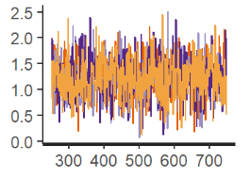

Trace plot (1)
If the chains are representative, they should overlap and mix well. [« hairy caterpillar »]
If any chain was isolated from the others, if would be a sign that convergence had not been achieved.
The 4 chains mix well and converge to the same region of the parameter space

Slide 50
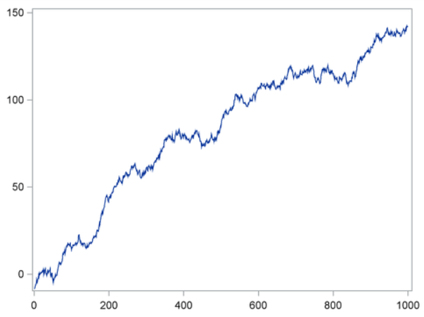
Trace plot (2)
This trace plot depicts a chain with serious problems.
This type of chain is entirely unsuitable for making parameter inferences.

Slide 51
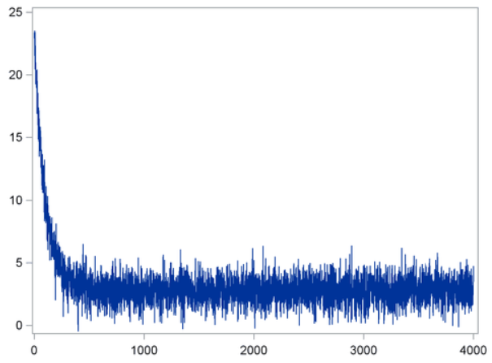
Trace plot (4)
It can take a few steps for the chain to move from its unrepresentative initial value to reach and explore the target density.
The first steps of the chain should be discarded because they are not representative.
burn-in

Slide 52

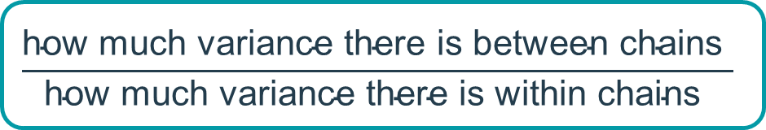
Gelman-Rubin statistic
If one or more chains is orphaned or stuck, it will increase the between-chain variance relative to the within-chain variance.
As a heuristic, the Gelman-Rubin statistic Rhat should be $< 1.1$or so. Preferably 1.0
$$\frac{\text{h}\text{ow} \text{much} \text{variance} \text{there} \text{is} \text{between} \text{chains} }{\text{h}\text{ow} \text{much} \text{variance} \text{there} \text{is} \text{within} \text{chains} }$$

