Slide 1



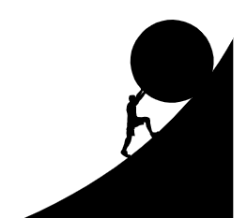


Perception
Reality
Burden
Behavior
https://openclipart.org/

Slide 2


Will the output
be reproducible?
What do I rerun?
Skip to
save time?
Skip to
save time?
Rerun which
models?
Rerun
everything?
Rerun
everything?
01-import.Rmd
02-tidy.Rmd
03-models.Rmd
04-visualize.Rmd
05-communicate.Rmd
https://openclipart.org/

Slide 3




