Slide 1
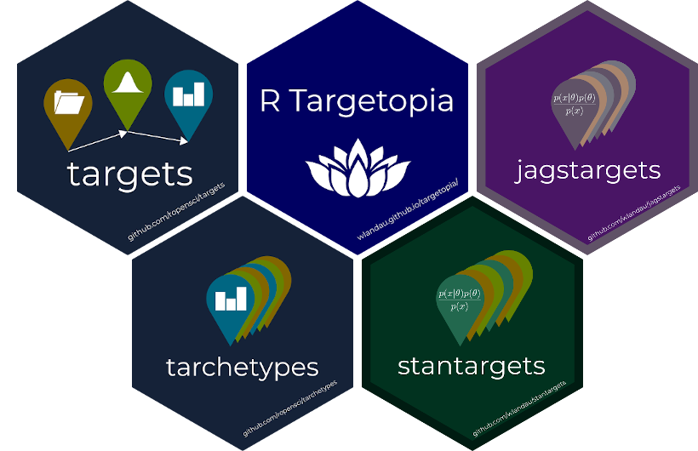

Slide 2



Slide 3
Make-like
Airflow-like
Skip up-to-date tasks.
Orchestrate tasks in a graph.
Distributed computing.
Data management.
Historical data management.
End-to-end reruns on a schedule.
GNU Make
Prefect
DVC
{targets}
Airflow
Metaflow
{targets} + {gittargets} or AWS/GCP

Slide 4
Pros
Cons
Compact.
Simple to understand.
Only tracks the current state.
Reverting to old code invalidates the targets.

Slide 5
“First commit”
“Develop model”
“Update data”
Code commits
e8ad30b
f81862f
777b678
Data branches
code=e8ad30b
code=777b678
Data snapshots
e8ad30b
e8ad30b
e8ad30b
Old superseded snapshots
e8ad30b

Slide 6

https://publicdomainvectors.org/en/free-clipart/Black-scales-of-justice-vector-graphics/17278.html

Slide 7

Perception
Reality
10x?
100x?
1x
https://openclipart.org/

Slide 8
01-import.Rmd
02-tidy.Rmd
03-models.Rmd
04-visualize.Rmd
05-communicate.Rmd
https://openclipart.org/
https://unsplash.com/photos/_sh9vkVbVgo

Slide 9
01-import.Rmd
02-tidy.Rmd
03-models.Rmd
04-visualize.Rmd
05-communicate.Rmd
03-out-models.csv
02A-prep-analysis.csv
04-out-vis.csv
01-out-import.csv
02-out-tidy.csv
02A-prep-analysis.Rmd
https://openclipart.org/
https://unsplash.com/photos/_sh9vkVbVgo

Slide 10


What do I rerun?
Will the output
be reproducible?
Skip to
save time?
Skip to
save time?
Rerun
everything?
Rerun
everything?
Rerun which
models?
01-import.Rmd
02-tidy.Rmd
03-models.Rmd
04-visualize.Rmd
05-communicate.Rmd
03-out-models.csv
02A-prep-analysis.csv
04-out-vis.csv
01-out-import.csv
02-out-tidy.csv
02A-prep-analysis.Rmd
https://openclipart.org/
https://unsplash.com/photos/_sh9vkVbVgo

Slide 11



