Slide 1
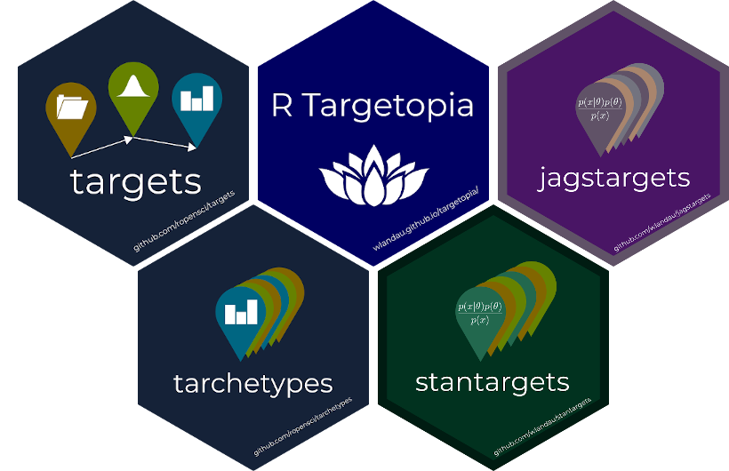

Slide 2
Make-like
Airflow-like
Automatically skip up-to-date targets to save time.
Examples:
GNU Make
targets
drake
DAG orchestration.
Distributed computing.
Object storage (depending on the tool).
Examples:
targets + gittargets/cloud + CRON.
Prefect
Run on a schedule.
Historical results storage.
Manually resume from a failed step.
Examples:
Airflow
Metaflow

Slide 3

https://publicdomainvectors.org/en/free-clipart/Black-scales-of-justice-vector-graphics/17278.html

Slide 4

Perception
Reality
10x?
100x?
1x
https://openclipart.org/

Slide 5
01-import.Rmd
02-tidy.Rmd
03-models.Rmd
04-visualize.Rmd
05-communicate.Rmd
https://openclipart.org/

Slide 6
01-import.Rmd
02-tidy.Rmd
03-models.Rmd
04-visualize.Rmd
05-communicate.Rmd
01-out-import.csv
04-out-vis.csv
03-out-models.csv
03.A-models.Rmd
02-out-tidy.csv
https://openclipart.org/
03.A-models.Rmd

Slide 7




