Slide 1
Decision making and hazard evaluation in the field
© 2019, Tahoe Backcountry Ski Patrol. This document may be freely used, modified or copied for any non-profit purpose as long as this copyright notice is maintained. Not reviewed by NSP. User has responsibility for determining fitness for use.

Slide 2
What’s avalanche danger?
Danger = Probability x Consequence
What factors contribute?
Terrain, Weather, Snowpack, Human
What questions to ask?
Is the terrain safe?
Does the weather contribute to instability?
Will it slide?
Are we contributing to the danger?

Slide 3
How to make a safe decision?
Fast decisions are efficient but based on
Presumptions
pattern recognition (mental shortcuts and biases)
and intuition (e.g., gut feeling, guessing)
Gather plenty of information (regional, intermediate, local)
Minimize uncertainty
Prioritize bull’s-eye data points
Prioritize evidence of hazard
Evidence-based decision (like a scientist)
Use logical brain to make a decision (slow and rational)
Use protocols, checklists, and rule-based decision making tools

Slide 4

Bull’s eye approach
Least relevant
Not reducing uncertainty
More relevant
Reduces uncertainty a bit
Most relevant
Reduces uncertainty

Slide 5
Exercise: Bull’s eye approach
Outer ring
Snow is white
The slope is 800 ft high
Inner ring
Temperature trend is 4 F/4 hours
Cornices
Avy center warns of potential weak layer 70 cm below surface
One snowpit in a nonrepresentative spot showed unstable snow
Signs of recent wind loading: rippled pillowy texture
There’s no wind
Bull’s eye
Recent avalanche activity on similar aspect, angle
Someone got killed on that slope last season
Sinking into wet snow to your calves
Snow is cracking
Sky is blue
Wind is bowing from SW
A fridge-size cornice can trigger an avalanche
The slope of interest slides
Stability tests show easy fracturing
Hollow sounds or whumpfing
Widespread rollerballs and pinwheels
Test slope fractures when jumped on

Slide 6

At home
Advanced Planning and Preparations
Know the weather and snowpack history
Collect regional scale information
Look up avalanche advisory
Look up weather forecast
What are the avalanche problems?
What terrain/slopes to avoid?
Who am I going with?
Have a rough plan/goal for the day
Decide on a general area

Slide 7
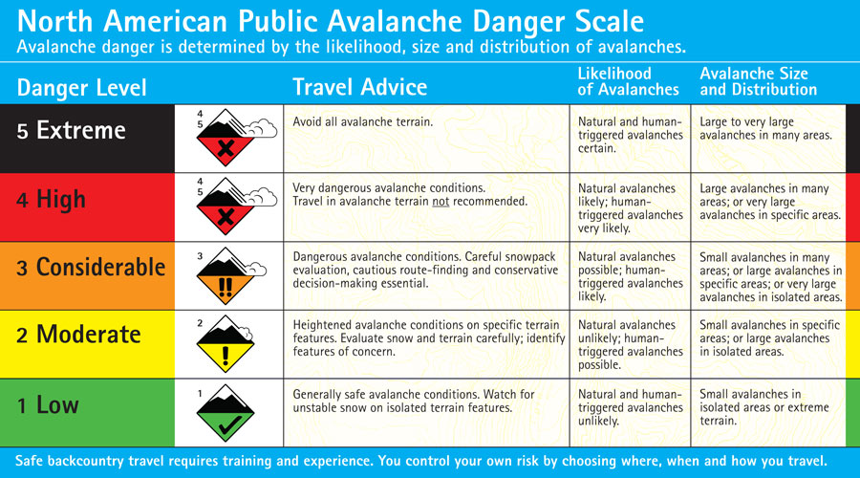
Regional avalanche advisory
https://utahavalanchecenter.org/avalanche-danger-scale

Slide 8
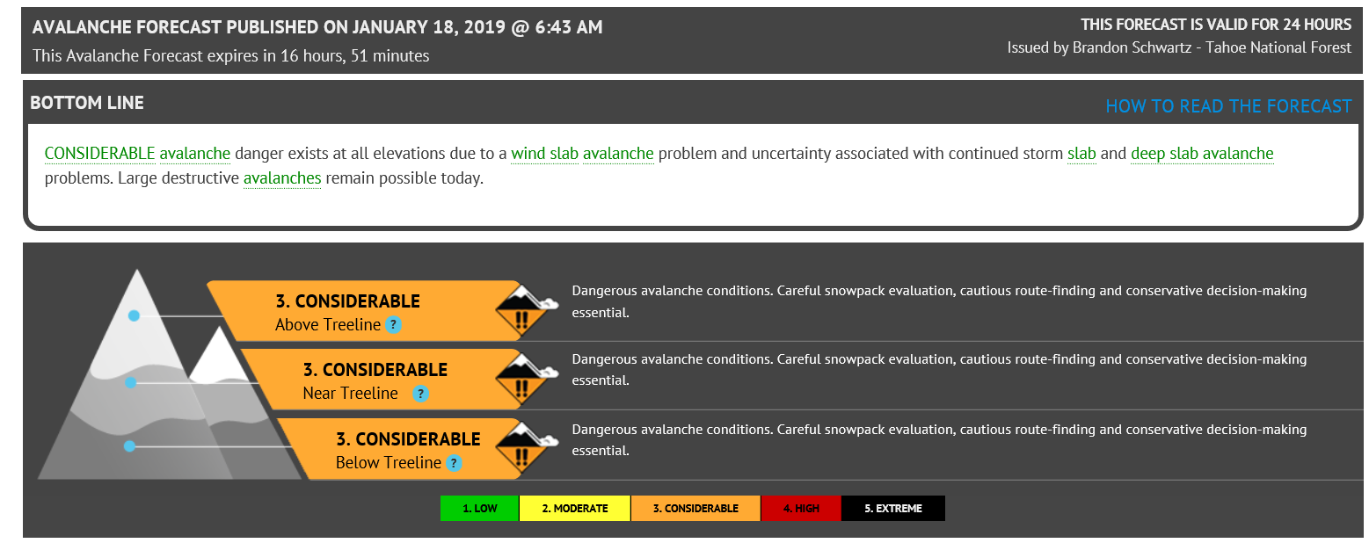
Regional avalanche advisory

Slide 9
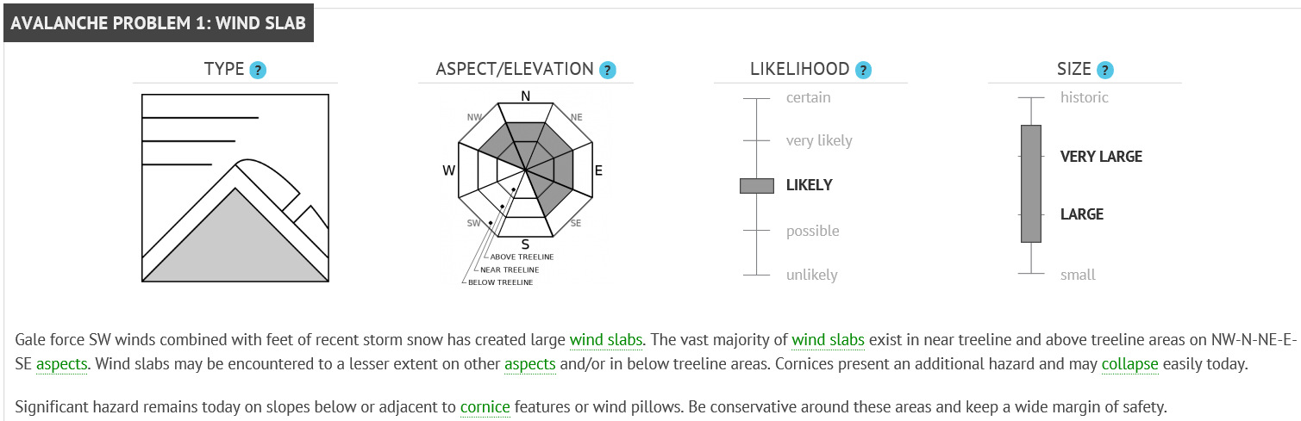
Problem and characteristics

Slide 10
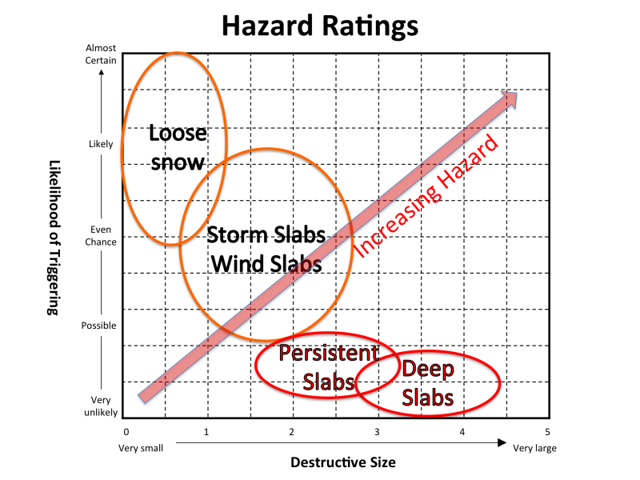
Ratings for typical problems

Slide 11

In the car
Collect intermediate/mountain scale info
Recent avalanche activity
Weather
Recent snowfall or rain
Temperatures and trend
Wind speed and direction (where to look?)
Evaluate terrain
Communicate to make a more refined plan, use checklist
Agree on a goal, an alternative, an no-go zones
Which slopes are possible? Which are not?

Slide 12

On the approach
Start-of-the-trip procedures
Collect local-scale information starting at the trailhead
Data will either support or refute existing picture of snowpack
Stay alert for new clues (look up), 5 red flags
Perform quick informal tests as you go

Slide 13
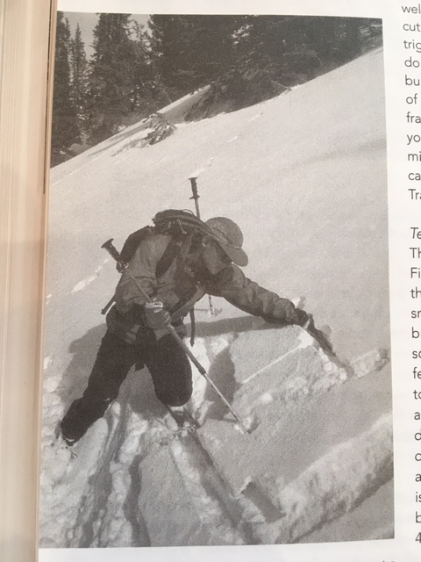
Tests as you go
Step outside the track
Ski pole test
Armpit test/hand-shear test
Switch-back test
Jump on test slope (10-20 ft drop)
Bruce Tremper

Slide 14

At the slope
Look for obvious clues and 5 red flags
Look for volunteer testers (other group, old tracks)
Snowpit tests
Slope cut*
Cornice drop*
Evaluate human factors, communicate and converge to agreement
Cherry-picking data, social proof, expert bias, summit fever, denial, underestimation of uncertainty, laziness, inattention, risk tolerance
Be ok with saying “no” and playing devil’s advocate
Put it all together:
Go? Apply safe travel rituals
No-Go? Check alternative route and new decision

Slide 15
Putting it all together
High danger
Travel not
recommended
34-45
Medium danger
Experts only
Steepness
Increasing Terrain Hazard
<30
Low danger
Relatively safe
Consequence
Increasing Snowpack Hazard
Balance danger of terrain with danger of snowpack
Choose safer terrain in dangerous snowpack
Go for more challenging terrain in safe snowpack
Trigger Probability
D0 D5
Avalanche size
adapted from Bruce Tremper

Slide 16
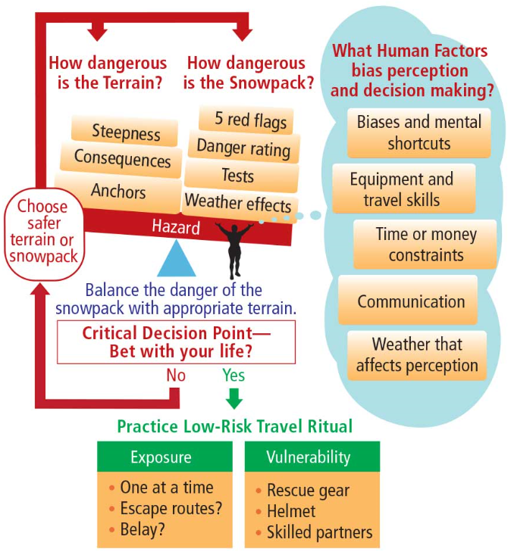
Avalanche Smart Card
Bruce Tremper

Slide 17
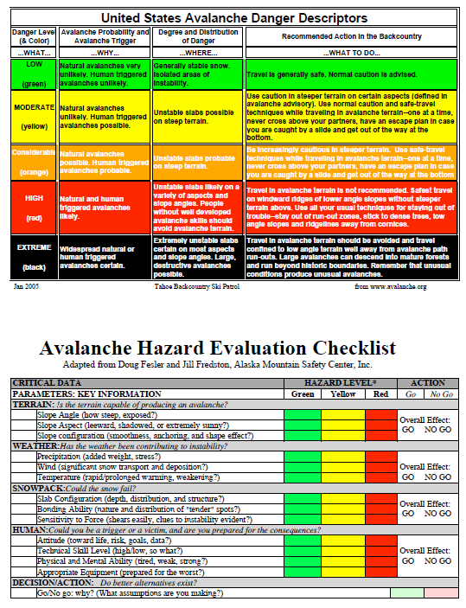
Notes:
Topic 5: Personal Safety
Overview
This topic brings together different aspects of personal safety in avalanche terrain. It introduces advance-planning principles, travel techniques and procedures that build in safety and act as a counterpoint to rash decision making. Students should also understand that plans and travel formulas are not perfect; decision making in the field is still essential for safe and efficient travel. Familiarization with the use of decision-making tools helps us to objectify the process and increases the likelihood that these tools will be used in the field. One also needs techniques for improving survival chances if risk management fails and he/she becomes caught in an avalanche.
If there are snowmobilers in the class, be sure to discuss how the principles and practices covered in this topic apply to that mode of travel.
5C: Decision Making in the Field
(Minimum duration: 40 minutes)
Overview
Advance plans are the foundation of a continuous decision-making process, but plans then need frequent modification based on realities of the environment. Emphasize that this is where people most often make decisions that get them into trouble.
Decision-making aids help to objectify the process—another safeguard against the potentially harmful effects of human factors. At least half of the allotted time for this session should be devoted to familiarization and practice with a variety of decision-making aids, which then need to be put to use in the field (thus encouraging likely use).
Mock scenarios in the classroom will help students to become familiar with decision-making aids but follow-up in the field is necessary to make this content stick.
Concluding Objectives—students should be able to:
List pertinent data for decision-making.
Integrate multiple types and sources of information when making decisions
Prioritize evidence of hazard
Use a variety of decision-making aids.
Key Terms
(None)
Sample Set
As the safety evaluation process begins with initial trip plans, it continues with the ride from home to the resort or trailhead. This is where the plan can begin calibration with reality.
Content
Data Gathering
Approach to departure site (What can you see from the car?)
Weather
Avalanche activity
At the departure site
Gather baseline snowpack data
Use decision making aids (demonstrate)
Information-Based
Avalanche Center Advisory information (interpretation and application)
Where/how to access
North American Public Avalanche Danger Scale
What categories mean
Limitations
Snow profiles
Danger Roses
Commentaries
Avalanche Problems/Concerns
Travel advisories
Prioritizing the clues—bull’s eye approach
Outer ring—general data (Class III)
Weather reports
Avalanche center bulletins
Inner ring—local interpolated data (Class II)
Weather
Snowpack
Terrain
Bull’s eye—direct data (Class I)
Observed avalanches
Shooting cracks
Hollow, drum-like sounds underfoot
“Whumpfing” underfoot
Recognizing/evaluating human factors
Unexpected changes
Physical and mental condition of your party members
Acceptance of risk and vulnerability
Rule based decision making aids
Examples
Obvious Clues (ALPTRUTh)
Green/Yellow/Red light checklist (Fredston/Fesler)
NSP Hazard Evaluation Checklist
Avaluator
Options indicated
No-go
Route, destination or activity modification
Planned route, extra caution
Go as planned
Decision to go
Constant reevaluation of factors en route
Weather
Snowpack
Terrain
Human
Alert to the heuristics acting on others
Others watch for those acting on you
Alternatives if conditions indicate increased danger
Continue on original route
Alternate route
Wait until conditions improve
Same route back
Precautions if a suspect avalanche slope must be crossed
Consider alternatives again
Route the least skilled member can traverse without falling
Identify the point of no return
Choose an escape route
Bundle up (especially parka hood, waist drawcord and cuffs)
Snug pack straps
Remove pole/ski/board straps
Avalung® mouthpiece in mouth, if so equipped
Access to avalanche air bag triggering system
Cross high and fast
From identified safe point to safe point
One at a time
Same tracks
All eyes on person crossing
Bottom line
Quick decisions in the field are usually Type 1
Irrational
Faulty
Decision-making tools help engage Type 2
Conclusions still vulnerable to Type 1 filtering
Decisions must focus on terrain choices
Suggested Demonstrations/Activities
Conduct a decision-making exercise integrating the material from this lesson with that from the human factors lesson.
Draw a bull’s eye and have the students categorize notional data.
Invoke the Alice in Wonderland quote, "I give myself very good advice, but I seldom follow it."
Give notional weather, snowpack, terrain and human factor data. Have students use decision-making aids to make go/no-go decisions.
Suggested Questions for Summary/Evaluation
What did you learn from this presentation? (What else?)
What kinds of information need to be gathered constantly while traveling in the backcountry?
How does the North American Public Avalanche Danger Scale help with decision-making?
What did you learn from this presentation? (What else?)
What kinds of information are used to assess stability?
How is stability information prioritized?
Why is it important to make several test pits and observations on the move?
What is the usefulness of avalanche advisories?
Why does discovery of a relatively small, isolated area of instability outweigh many, widespread findings of stability?
What is a convenient acronym for assessing avalanche potential?
Which decision-making tool do you prefer? Why?
Why might it be useful to have members of a group use more than one type of decision-making tool?
If the data and tools indicate moderate or higher hazard, what are your options?

Slide 18
Interpreting the Checklist (p.99)
Scenario | Terrain | Weather | Snowpack | Human | Go/No Go
1 | R | R | R | G | R
2 | G | G | G | G | G
3 | R | G | R | G | R
4 | R | G | G | G | G
5 | R | R | G | G | G/Y/R
6 | G | R | R | G | G
7 | R | Y | Y | G | R
How could go make a go decision?
Be conservative, leave large margin for error!
Adapted from Fredston and Fesler, 2010
Notes:
Topic 5: Personal Safety
Overview
This topic brings together different aspects of personal safety in avalanche terrain. It introduces advance-planning principles, travel techniques and procedures that build in safety and act as a counterpoint to rash decision making. Students should also understand that plans and travel formulas are not perfect; decision making in the field is still essential for safe and efficient travel. Familiarization with the use of decision-making tools helps us to objectify the process and increases the likelihood that these tools will be used in the field. One also needs techniques for improving survival chances if risk management fails and he/she becomes caught in an avalanche.
If there are snowmobilers in the class, be sure to discuss how the principles and practices covered in this topic apply to that mode of travel.
5C: Decision Making in the Field
(Minimum duration: 40 minutes)
Overview
Advance plans are the foundation of a continuous decision-making process, but plans then need frequent modification based on realities of the environment. Emphasize that this is where people most often make decisions that get them into trouble.
Decision-making aids help to objectify the process—another safeguard against the potentially harmful effects of human factors. At least half of the allotted time for this session should be devoted to familiarization and practice with a variety of decision-making aids, which then need to be put to use in the field (thus encouraging likely use).
Mock scenarios in the classroom will help students to become familiar with decision-making aids but follow-up in the field is necessary to make this content stick.
Concluding Objectives—students should be able to:
List pertinent data for decision-making.
Integrate multiple types and sources of information when making decisions
Prioritize evidence of hazard
Use a variety of decision-making aids.
Key Terms
(None)
Sample Set
As the safety evaluation process begins with initial trip plans, it continues with the ride from home to the resort or trailhead. This is where the plan can begin calibration with reality.
Content
Data Gathering
Approach to departure site (What can you see from the car?)
Weather
Avalanche activity
At the departure site
Gather baseline snowpack data
Use decision making aids (demonstrate)
Information-Based
Avalanche Center Advisory information (interpretation and application)
Where/how to access
North American Public Avalanche Danger Scale
What categories mean
Limitations
Snow profiles
Danger Roses
Commentaries
Avalanche Problems/Concerns
Travel advisories
Prioritizing the clues—bull’s eye approach
Outer ring—general data (Class III)
Weather reports
Avalanche center bulletins
Inner ring—local interpolated data (Class II)
Weather
Snowpack
Terrain
Bull’s eye—direct data (Class I)
Observed avalanches
Shooting cracks
Hollow, drum-like sounds underfoot
“Whumpfing” underfoot
Recognizing/evaluating human factors
Unexpected changes
Physical and mental condition of your party members
Acceptance of risk and vulnerability
Rule based decision making aids
Examples
Obvious Clues (ALPTRUTh)
Green/Yellow/Red light checklist (Fredston/Fesler)
NSP Hazard Evaluation Checklist
Avaluator
Options indicated
No-go
Route, destination or activity modification
Planned route, extra caution
Go as planned
Decision to go
Constant reevaluation of factors en route
Weather
Snowpack
Terrain
Human
Alert to the heuristics acting on others
Others watch for those acting on you
Alternatives if conditions indicate increased danger
Continue on original route
Alternate route
Wait until conditions improve
Same route back
Precautions if a suspect avalanche slope must be crossed
Consider alternatives again
Route the least skilled member can traverse without falling
Identify the point of no return
Choose an escape route
Bundle up (especially parka hood, waist drawcord and cuffs)
Snug pack straps
Remove pole/ski/board straps
Avalung® mouthpiece in mouth, if so equipped
Access to avalanche air bag triggering system
Cross high and fast
From identified safe point to safe point
One at a time
Same tracks
All eyes on person crossing
Bottom line
Quick decisions in the field are usually Type 1
Irrational
Faulty
Decision-making tools help engage Type 2
Conclusions still vulnerable to Type 1 filtering
Decisions must focus on terrain choices
Suggested Demonstrations/Activities
Conduct a decision-making exercise integrating the material from this lesson with that from the human factors lesson.
Draw a bull’s eye and have the students categorize notional data.
Invoke the Alice in Wonderland quote, "I give myself very good advice, but I seldom follow it."
Give notional weather, snowpack, terrain and human factor data. Have students use decision-making aids to make go/no-go decisions.
Suggested Questions for Summary/Evaluation
What did you learn from this presentation? (What else?)
What kinds of information need to be gathered constantly while traveling in the backcountry?
How does the North American Public Avalanche Danger Scale help with decision-making?
What did you learn from this presentation? (What else?)
What kinds of information are used to assess stability?
How is stability information prioritized?
Why is it important to make several test pits and observations on the move?
What is the usefulness of avalanche advisories?
Why does discovery of a relatively small, isolated area of instability outweigh many, widespread findings of stability?
What is a convenient acronym for assessing avalanche potential?
Which decision-making tool do you prefer? Why?
Why might it be useful to have members of a group use more than one type of decision-making tool?
If the data and tools indicate moderate or higher hazard, what are your options?

Slide 19
The Obvious Clue Method (OCM)
Seven Yes/no Questions are posed and the number of Yes responses are added up. The seven questions form the acronym ALPTRUTh.
Avalanches—can you observe recent avalanche activity?
Loading—has there been recent loading by snow, wind or rain?
Path—does the slope contain a recognizable avalanche path?
Terrain Trap—is there a terrain trap that increases the consequences of being caught in an avalanche?
Rating—is the avalanche forecast danger rating Considerable or higher?
Unstable snow—is there any evidence of unstable snow?
Thaw instability—is the snowpack melting due to solar radiation, warm temperatures or rain?
If three or more factors are present, that should trigger a red flag in your mind
Notes:
ALPTRUTh If three or more factors are present, that should trigger a red flag in your mind,
A is for Avalanches: Check for recent avalanche activity and take note if there has been a slide in the past 48 hours. Look for the debris on the side of the road on places like Teton Pass, or when approaching the area. Check to see if local avalanche centers recently posted activity on event maps.
L is for Loading: Has it snowed or rained in the past 48 hours? When it did snow, was it roughly an inch an hour for six or more hours? If so, then take caution.
P is for (Avalanche) Paths: Is there a defined avalanche path in the area you are going to ski? It should be fairly obvious, even to a novice, to notice areas that would cause snow to naturally funnel. Be on the lookout for defined avalanche start zone and a pitch around 38 degrees.
T is for Terrain (Traps): Terrain traps are features that exacerbate the consequences if you get caught in an avalanche. There are three major types of features. The first is something you can fall off of, like a cliff. The second is something you can smash into, like trees. The third is a confined area where the snow can compact quickly, like a couloir or gully, where even small avalanches can easily bury a victim.
R is for (Avalanche Hazard) Rating: What is the avalanche danger for the day? Check in with your local avalanche center and take caution if considerable, high, or extreme avalanche hazard is listed, but realize that most avalanches happen during days of moderate hazard–when the danger isn't so obvious as to keep people away, varies across terrain, and fools people into thinking it's "safe" out.
U is for Unstable (Snow): Can you hear collapsing or a "whumping" sound while traveling through the backcountry? When you dig a snow assessment pit, is there a heavy layer on top of a weak one? Do you observe cracks in the snow? If so, then unstable snow is present. This is particularly important if it exists in the top three feet of the snowpack–where skiers and snowboarders are able to trigger avalanches most readily.
T is for Thawing: If you observe 12-15 degrees of warming in a period of twelve hours or less, then check yes in this category. It is important to note that this only should only be checked if it is the first day of warming, not a day in a long warming period.
Topic 5: Personal Safety
Overview
This topic brings together different aspects of personal safety in avalanche terrain. It introduces advance-planning principles, travel techniques and procedures that build in safety and act as a counterpoint to rash decision making. Students should also understand that plans and travel formulas are not perfect; decision making in the field is still essential for safe and efficient travel. Familiarization with the use of decision-making tools helps us to objectify the process and increases the likelihood that these tools will be used in the field. One also needs techniques for improving survival chances if risk management fails and he/she becomes caught in an avalanche.
If there are snowmobilers in the class, be sure to discuss how the principles and practices covered in this topic apply to that mode of travel.
5C: Decision Making in the Field
(Minimum duration: 40 minutes)
Overview
Advance plans are the foundation of a continuous decision-making process, but plans then need frequent modification based on realities of the environment. Emphasize that this is where people most often make decisions that get them into trouble.
Decision-making aids help to objectify the process—another safeguard against the potentially harmful effects of human factors. At least half of the allotted time for this session should be devoted to familiarization and practice with a variety of decision-making aids, which then need to be put to use in the field (thus encouraging likely use).
Mock scenarios in the classroom will help students to become familiar with decision-making aids but follow-up in the field is necessary to make this content stick.
Concluding Objectives—students should be able to:
List pertinent data for decision-making.
Integrate multiple types and sources of information when making decisions
Prioritize evidence of hazard
Use a variety of decision-making aids.
Key Terms
(None)
Sample Set
As the safety evaluation process begins with initial trip plans, it continues with the ride from home to the resort or trailhead. This is where the plan can begin calibration with reality.
Content
Data Gathering
Approach to departure site (What can you see from the car?)
Weather
Avalanche activity
At the departure site
Gather baseline snowpack data
Use decision making aids (demonstrate)
Information-Based
Avalanche Center Advisory information (interpretation and application)
Where/how to access
North American Public Avalanche Danger Scale
What categories mean
Limitations
Snow profiles
Danger Roses
Commentaries
Avalanche Problems/Concerns
Travel advisories
Prioritizing the clues—bull’s eye approach
Outer ring—general data (Class III)
Weather reports
Avalanche center bulletins
Inner ring—local interpolated data (Class II)
Weather
Snowpack
Terrain
Bull’s eye—direct data (Class I)
Observed avalanches
Shooting cracks
Hollow, drum-like sounds underfoot
“Whumpfing” underfoot
Recognizing/evaluating human factors
Unexpected changes
Physical and mental condition of your party members
Acceptance of risk and vulnerability
Rule based decision making aids
Examples
Obvious Clues (ALPTRUTh)
Green/Yellow/Red light checklist (Fredston/Fesler)
NSP Hazard Evaluation Checklist
Avaluator
Options indicated
No-go
Route, destination or activity modification
Planned route, extra caution
Go as planned
Decision to go
Constant reevaluation of factors en route
Weather
Snowpack
Terrain
Human
Alert to the heuristics acting on others
Others watch for those acting on you
Alternatives if conditions indicate increased danger
Continue on original route
Alternate route
Wait until conditions improve
Same route back
Precautions if a suspect avalanche slope must be crossed
Consider alternatives again
Route the least skilled member can traverse without falling
Identify the point of no return
Choose an escape route
Bundle up (especially parka hood, waist drawcord and cuffs)
Snug pack straps
Remove pole/ski/board straps
Avalung® mouthpiece in mouth, if so equipped
Access to avalanche air bag triggering system
Cross high and fast
From identified safe point to safe point
One at a time
Same tracks
All eyes on person crossing
Bottom line
Quick decisions in the field are usually Type 1
Irrational
Faulty
Decision-making tools help engage Type 2
Conclusions still vulnerable to Type 1 filtering
Decisions must focus on terrain choices
Suggested Demonstrations/Activities
Conduct a decision-making exercise integrating the material from this lesson with that from the human factors lesson.
Draw a bull’s eye and have the students categorize notional data.
Invoke the Alice in Wonderland quote, "I give myself very good advice, but I seldom follow it."
Give notional weather, snowpack, terrain and human factor data. Have students use decision-making aids to make go/no-go decisions.
Suggested Questions for Summary/Evaluation
What did you learn from this presentation? (What else?)
What kinds of information need to be gathered constantly while traveling in the backcountry?
How does the North American Public Avalanche Danger Scale help with decision-making?
What did you learn from this presentation? (What else?)
What kinds of information are used to assess stability?
How is stability information prioritized?
Why is it important to make several test pits and observations on the move?
What is the usefulness of avalanche advisories?
Why does discovery of a relatively small, isolated area of instability outweigh many, widespread findings of stability?
What is a convenient acronym for assessing avalanche potential?
Which decision-making tool do you prefer? Why?
Why might it be useful to have members of a group use more than one type of decision-making tool?
If the data and tools indicate moderate or higher hazard, what are your options?

Slide 20
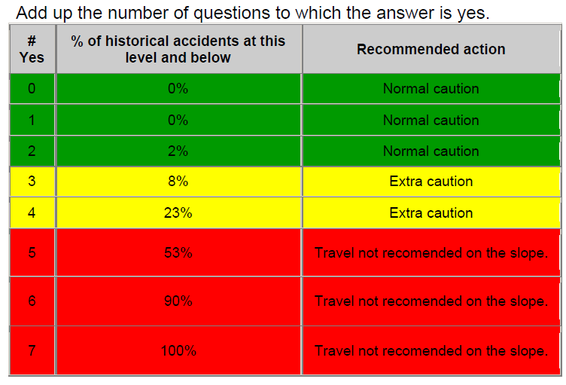
Notes:
Topic 5: Personal Safety
Overview
This topic brings together different aspects of personal safety in avalanche terrain. It introduces advance-planning principles, travel techniques and procedures that build in safety and act as a counterpoint to rash decision making. Students should also understand that plans and travel formulas are not perfect; decision making in the field is still essential for safe and efficient travel. Familiarization with the use of decision-making tools helps us to objectify the process and increases the likelihood that these tools will be used in the field. One also needs techniques for improving survival chances if risk management fails and he/she becomes caught in an avalanche.
If there are snowmobilers in the class, be sure to discuss how the principles and practices covered in this topic apply to that mode of travel.
5C: Decision Making in the Field
(Minimum duration: 40 minutes)
Overview
Advance plans are the foundation of a continuous decision-making process, but plans then need frequent modification based on realities of the environment. Emphasize that this is where people most often make decisions that get them into trouble.
Decision-making aids help to objectify the process—another safeguard against the potentially harmful effects of human factors. At least half of the allotted time for this session should be devoted to familiarization and practice with a variety of decision-making aids, which then need to be put to use in the field (thus encouraging likely use).
Mock scenarios in the classroom will help students to become familiar with decision-making aids but follow-up in the field is necessary to make this content stick.
Concluding Objectives—students should be able to:
List pertinent data for decision-making.
Integrate multiple types and sources of information when making decisions
Prioritize evidence of hazard
Use a variety of decision-making aids.
Key Terms
(None)
Sample Set
As the safety evaluation process begins with initial trip plans, it continues with the ride from home to the resort or trailhead. This is where the plan can begin calibration with reality.
Content
Data Gathering
Approach to departure site (What can you see from the car?)
Weather
Avalanche activity
At the departure site
Gather baseline snowpack data
Use decision making aids (demonstrate)
Information-Based
Avalanche Center Advisory information (interpretation and application)
Where/how to access
North American Public Avalanche Danger Scale
What categories mean
Limitations
Snow profiles
Danger Roses
Commentaries
Avalanche Problems/Concerns
Travel advisories
Prioritizing the clues—bull’s eye approach
Outer ring—general data (Class III)
Weather reports
Avalanche center bulletins
Inner ring—local interpolated data (Class II)
Weather
Snowpack
Terrain
Bull’s eye—direct data (Class I)
Observed avalanches
Shooting cracks
Hollow, drum-like sounds underfoot
“Whumpfing” underfoot
Recognizing/evaluating human factors
Unexpected changes
Physical and mental condition of your party members
Acceptance of risk and vulnerability
Rule based decision making aids
Examples
Obvious Clues (ALPTRUTh)
Green/Yellow/Red light checklist (Fredston/Fesler)
NSP Hazard Evaluation Checklist
Avaluator
Options indicated
No-go
Route, destination or activity modification
Planned route, extra caution
Go as planned
Decision to go
Constant reevaluation of factors en route
Weather
Snowpack
Terrain
Human
Alert to the heuristics acting on others
Others watch for those acting on you
Alternatives if conditions indicate increased danger
Continue on original route
Alternate route
Wait until conditions improve
Same route back
Precautions if a suspect avalanche slope must be crossed
Consider alternatives again
Route the least skilled member can traverse without falling
Identify the point of no return
Choose an escape route
Bundle up (especially parka hood, waist drawcord and cuffs)
Snug pack straps
Remove pole/ski/board straps
Avalung® mouthpiece in mouth, if so equipped
Access to avalanche air bag triggering system
Cross high and fast
From identified safe point to safe point
One at a time
Same tracks
All eyes on person crossing
Bottom line
Quick decisions in the field are usually Type 1
Irrational
Faulty
Decision-making tools help engage Type 2
Conclusions still vulnerable to Type 1 filtering
Decisions must focus on terrain choices
Suggested Demonstrations/Activities
Conduct a decision-making exercise integrating the material from this lesson with that from the human factors lesson.
Draw a bull’s eye and have the students categorize notional data.
Invoke the Alice in Wonderland quote, "I give myself very good advice, but I seldom follow it."
Give notional weather, snowpack, terrain and human factor data. Have students use decision-making aids to make go/no-go decisions.
Suggested Questions for Summary/Evaluation
What did you learn from this presentation? (What else?)
What kinds of information need to be gathered constantly while traveling in the backcountry?
How does the North American Public Avalanche Danger Scale help with decision-making?
What did you learn from this presentation? (What else?)
What kinds of information are used to assess stability?
How is stability information prioritized?
Why is it important to make several test pits and observations on the move?
What is the usefulness of avalanche advisories?
Why does discovery of a relatively small, isolated area of instability outweigh many, widespread findings of stability?
What is a convenient acronym for assessing avalanche potential?
Which decision-making tool do you prefer? Why?
Why might it be useful to have members of a group use more than one type of decision-making tool?
If the data and tools indicate moderate or higher hazard, what are your options?

Slide 21
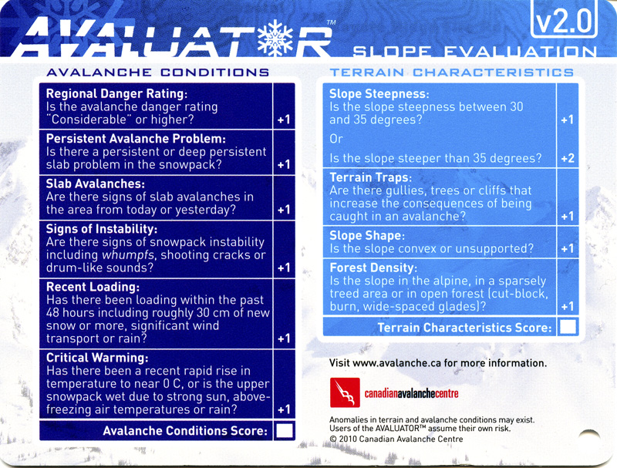
Avaluator Card (front)

Slide 22
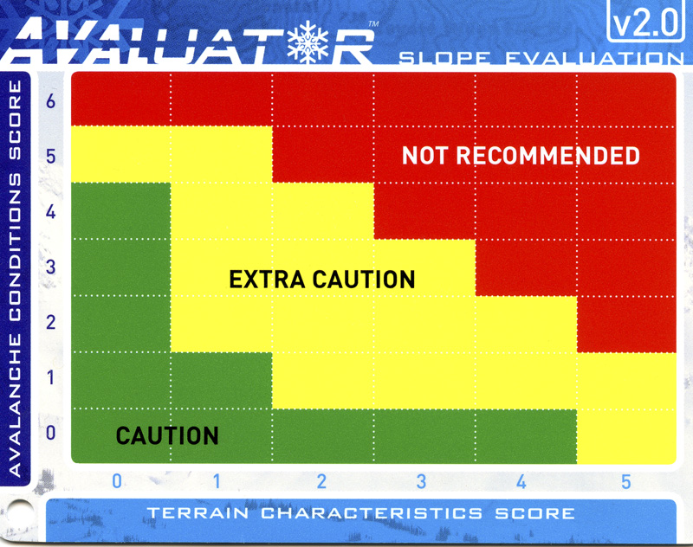
Avaluator Card (back)

Slide 23
Resources
Further reading
Statham et al., 2017: Conceptual model of Avalanche Hazard. Nat. Hazards.
Further listening:
Slide Podcast, S2E1: The Danger Lesson

Slide 24
Topic 5C – Decision Making in the field
Objectives
List pertinent data for decision-making.
Integrate multiple types and sources of information when making decisions
Prioritize evidence of hazard
Use a variety of decision-making aids.
Notes:
Topic 5: Personal Safety
Overview
This topic brings together different aspects of personal safety in avalanche terrain. It introduces advance-planning principles, travel techniques and procedures that build in safety and act as a counterpoint to rash decision making. Students should also understand that plans and travel formulas are not perfect; decision making in the field is still essential for safe and efficient travel. Familiarization with the use of decision-making tools helps us to objectify the process and increases the likelihood that these tools will be used in the field. One also needs techniques for improving survival chances if risk management fails and he/she becomes caught in an avalanche.
If there are snowmobilers in the class, be sure to discuss how the principles and practices covered in this topic apply to that mode of travel.
5C: Decision Making in the Field
(Minimum duration: 40 minutes)
Overview
Advance plans are the foundation of a continuous decision-making process, but plans then need frequent modification based on realities of the environment. Emphasize that this is where people most often make decisions that get them into trouble.
Decision-making aids help to objectify the process—another safeguard against the potentially harmful effects of human factors. At least half of the allotted time for this session should be devoted to familiarization and practice with a variety of decision-making aids, which then need to be put to use in the field (thus encouraging likely use).
Mock scenarios in the classroom will help students to become familiar with decision-making aids but follow-up in the field is necessary to make this content stick.
Concluding Objectives—students should be able to:
List pertinent data for decision-making.
Integrate multiple types and sources of information when making decisions
Prioritize evidence of hazard
Use a variety of decision-making aids.
Key Terms
(None)
Sample Set
As the safety evaluation process begins with initial trip plans, it continues with the ride from home to the resort or trailhead. This is where the plan can begin calibration with reality.
Content
Data Gathering
Approach to departure site (What can you see from the car?)
Weather
Avalanche activity
At the departure site
Gather baseline snowpack data
Use decision making aids (demonstrate)
Information-Based
Avalanche Center Advisory information (interpretation and application)
Where/how to access
North American Public Avalanche Danger Scale
What categories mean
Limitations
Snow profiles
Danger Roses
Commentaries
Avalanche Problems/Concerns
Travel advisories
Prioritizing the clues—bull’s eye approach
Outer ring—general data (Class III)
Weather reports
Avalanche center bulletins
Inner ring—local interpolated data (Class II)
Weather
Snowpack
Terrain
Bull’s eye—direct data (Class I)
Observed avalanches
Shooting cracks
Hollow, drum-like sounds underfoot
“Whumpfing” underfoot
Recognizing/evaluating human factors
Unexpected changes
Physical and mental condition of your party members
Acceptance of risk and vulnerability
Rule based decision making aids
Examples
Obvious Clues (ALPTRUTh)
Green/Yellow/Red light checklist (Fredston/Fesler)
NSP Hazard Evaluation Checklist
Avaluator
Options indicated
No-go
Route, destination or activity modification
Planned route, extra caution
Go as planned
Decision to go
Constant reevaluation of factors en route
Weather
Snowpack
Terrain
Human
Alert to the heuristics acting on others
Others watch for those acting on you
Alternatives if conditions indicate increased danger
Continue on original route
Alternate route
Wait until conditions improve
Same route back
Precautions if a suspect avalanche slope must be crossed
Consider alternatives again
Route the least skilled member can traverse without falling
Identify the point of no return
Choose an escape route
Bundle up (especially parka hood, waist drawcord and cuffs)
Snug pack straps
Remove pole/ski/board straps
Avalung® mouthpiece in mouth, if so equipped
Access to avalanche air bag triggering system
Cross high and fast
From identified safe point to safe point
One at a time
Same tracks
All eyes on person crossing
Bottom line
Quick decisions in the field are usually Type 1
Irrational
Faulty
Decision-making tools help engage Type 2
Conclusions still vulnerable to Type 1 filtering
Decisions must focus on terrain choices
Suggested Demonstrations/Activities
Conduct a decision-making exercise integrating the material from this lesson with that from the human factors lesson.
Draw a bull’s eye and have the students categorize notional data.
Invoke the Alice in Wonderland quote, "I give myself very good advice, but I seldom follow it."
Give notional weather, snowpack, terrain and human factor data. Have students use decision-making aids to make go/no-go decisions.
Suggested Questions for Summary/Evaluation
What did you learn from this presentation? (What else?)
What kinds of information need to be gathered constantly while traveling in the backcountry?
How does the North American Public Avalanche Danger Scale help with decision-making?
What did you learn from this presentation? (What else?)
What kinds of information are used to assess stability?
How is stability information prioritized?
Why is it important to make several test pits and observations on the move?
What is the usefulness of avalanche advisories?
Why does discovery of a relatively small, isolated area of instability outweigh many, widespread findings of stability?
What is a convenient acronym for assessing avalanche potential?
Which decision-making tool do you prefer? Why?
Why might it be useful to have members of a group use more than one type of decision-making tool?
If the data and tools indicate moderate or higher hazard, what are your options?

Slide 25
Suggested Questions for Summary/Evaluation
Suggested Questions for Summary/Evaluation
What did you learn from this presentation? (What else?)
What kinds of information need to be gathered constantly while traveling in the backcountry?
How does the North American Public Avalanche Danger Scale help with decision-making?
What did you learn from this presentation? (What else?)
What kinds of information are used to assess stability?
How is stability information prioritized?
Why is it important to make several test pits and observations on the move?
What is the usefulness of avalanche advisories?
Why does discovery of a relatively small, isolated area of instability outweigh many, widespread findings of stability?
What is a convenient acronym for assessing avalanche potential?
Which decision-making tool do you prefer? Why?
Why might it be useful to have members of a group use more than one type of decision-making tool?
If the data and tools indicate moderate or higher hazard, what are your options?
Notes:
Suggested Demonstrations/Activities
Conduct a decision-making exercise integrating the material from this lesson with that from the human factors lesson.
Draw a bull’s eye and have the students categorize notional data.
Invoke the Alice in Wonderland quote, "I give myself very good advice, but I seldom follow it."
Give notional weather, snowpack, terrain and human factor data. Have students use decision-making aids to make go/no-go decisions.
Suggested Questions for Summary/Evaluation
What did you learn from this presentation? (What else?)
What kinds of information need to be gathered constantly while traveling in the backcountry?
How does the North American Public Avalanche Danger Scale help with decision-making?
What did you learn from this presentation? (What else?)
What kinds of information are used to assess stability?
How is stability information prioritized?
Why is it important to make several test pits and observations on the move?
What is the usefulness of avalanche advisories?
Why does discovery of a relatively small, isolated area of instability outweigh many, widespread findings of stability?
What is a convenient acronym for assessing avalanche potential?
Which decision-making tool do you prefer? Why?
Why might it be useful to have members of a group use more than one type of decision-making tool?
If the data and tools indicate moderate or higher hazard, what are your options?

