Slide 1

ProFACT
Protein FASTA Analysis & Comparison Tool
$ profact --help
> stats | validate
> duplicates | compare
> report
A Python CLI tool for protein FASTA quality control, duplicate detection and dataset comparison
Developed by
Wojciech Laskowski
Wojciech Moryl
Karolina Winczewska

Slide 2
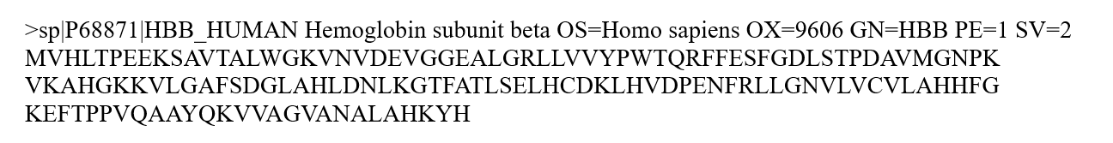

Protein FASTA Files
Proteins are large biomolecules made of amino acids, stored in FASTA text format.
description line
FASTA format
sequence
Common sources: UniProt, RefSeq, and Ensembl/NCBI.

Slide 3
Why ProFACT?
Protein FASTA files often need quality checks before further analysis.
Typical QC questions
Are all sequences valid?
Are there unknown residues?
Are there invalid amino acid characters?
Are there duplicate IDs?
What changed between dataset versions?
Workflow challenge
These checks often require separate tools or custom scripts, leading to fragmented workflows.

Slide 4
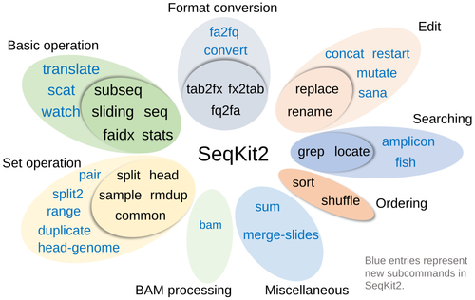
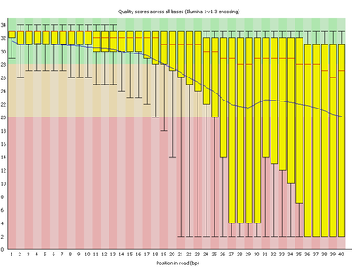

Similar Tools
SeqKit
Fast sequence toolkit; supports filtering, statistics and duplicate detection.
FastQC
Quality control for sequencing reads, mainly nucleotide data.
protfasta
Protein FASTA filtering and validation utilities that filter sequences by length and remove entries containing invalid amino acids.
BioPython
Large general-purpose bioinformatics library.
ProFACT does not replace these tools. Its value is integration: common protein FASTA QC tasks in one small CLI.

Slide 5
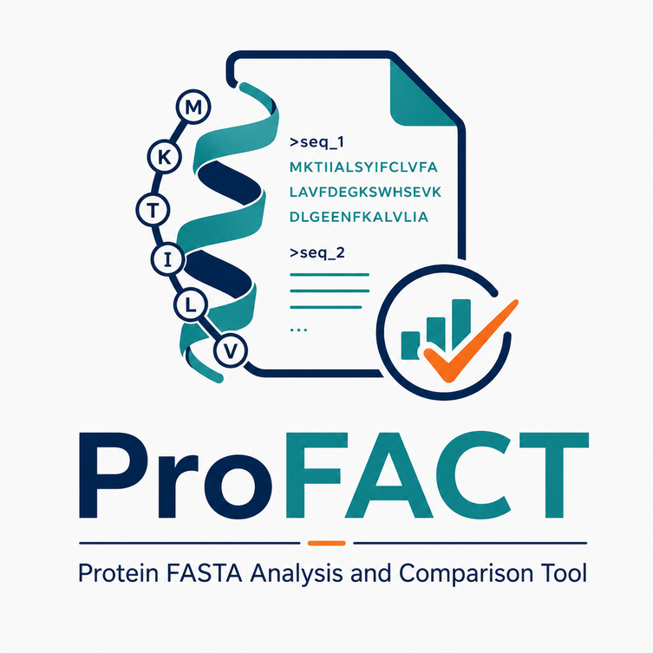
ProFACT Functionality
Inspect
profact stats
Validate
profact validate
Find duplicates
profact duplicates
Compare
profact compare
Report
profact report
One package, five commands, consistent output formats.

Slide 6
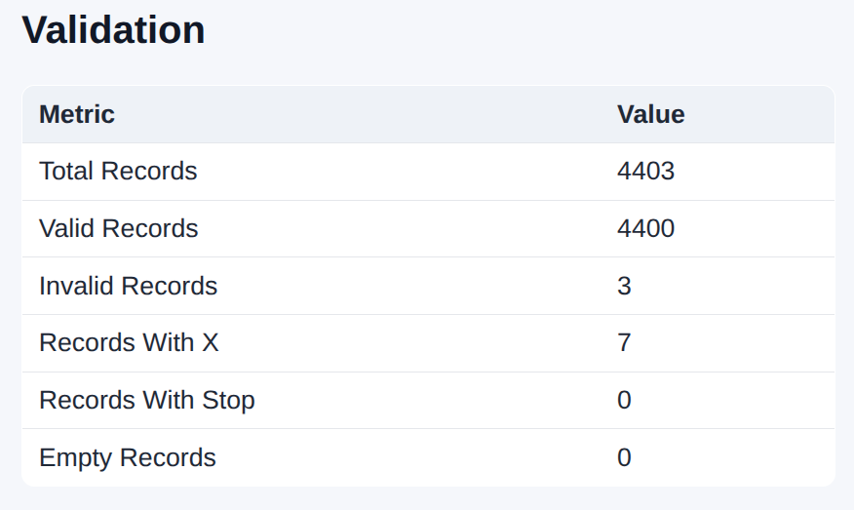
Validation
Command
profact validate
Exit Code 1
Returned when invalid records are found.
Detection Criteria
Errors
Empty sequences
Invalid amino acid characters
Warnings
Unknown residue X
Stop symbol *
Non-standard amino acids (B, Z, J)

Slide 7
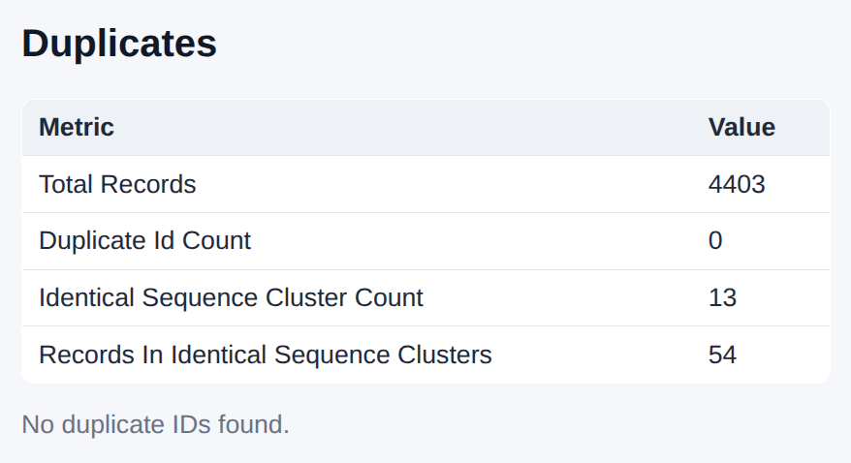
Duplicate Detection
Command
profact duplicates
Detects
Repeated sequence IDs
Identical sequences under different IDs
Exact duplicate sequence clusters
Example Cluster Output
Important Note
Clustering uses exact sequence matching, not similarity search.
Cluster 1
length: 35
records: 2
IDs: LDRA_ECOLI, LDRC_ECOLI

Slide 8
Comparing FASTA Files
Command
profact compare -f1 old.fasta -f2 new.fasta
Exit Code 1
Returned when differences are found.
Identified Differences
Output Formats
Added IDs
Removed IDs
Changed sequences
Changed sequence lengths
Changed duplicate clusters
📄 TXT
📊 TSV
🧩 JSON
🌐 HTML

Slide 9
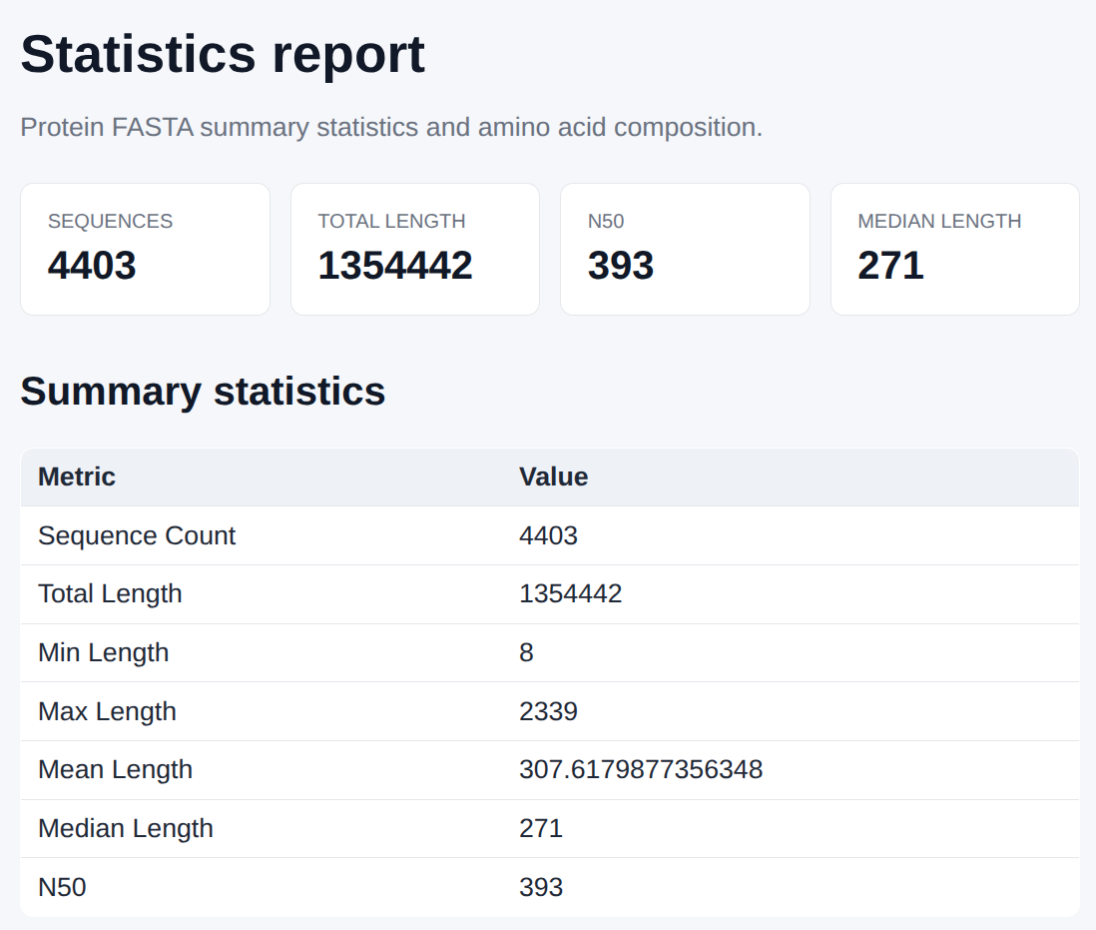
Sequence Statistics
Command
profact stats
Computed Metrics
Output Formats
sequence count
total sequence length
minimum and maximum length
mean and median length
N50
amino acid composition
📄 TXT 📊 TSV 🧩 JSON 🌐 HTML

Slide 10
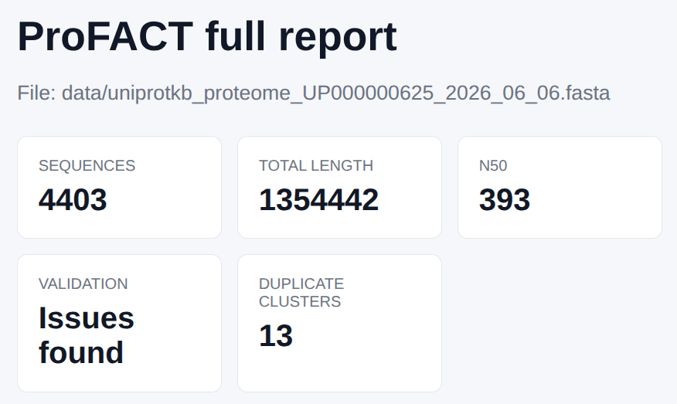
Reports
Command
profact report -i proteins.fasta -fmt html -o output/report.html
HTML Report Includes
Summary cards
Detailed statistics tables
Amino acid composition chart
Validation summary
Duplicate cluster table
Output Formats
📄 TXT 📊 TSV 🧩 JSON 🌐 HTML
Purpose: Readable overview of FASTA quality, statistics and duplicates.

Slide 11
Reproducibility
Reproducible Example
bash scripts/run_examples.sh
33 Automated Tests Passed
What it does
Runs automated tests to ensure software integrity
Analyzes included FASTA datasets for protein sequence checks
Generates comprehensive statistics, validation, and duplicate reports
Compares two sample FASTA files to identify structural differences
Writes all processed outputs directly to the output/directory
Why it matters: The project can be checked and reproduced with one simple command.

Slide 12
Summary
What we built
ProFACT is a Python CLI tool for protein FASTA quality control and dataset comparison.
Main Features
Project Quality
Sequence statistics
Validation of protein FASTA records
Duplicate ID & sequence detection
Comparison of two FASTA datasets
Text, TSV, JSON and HTML reports
Sample FASTA datasets
Reproducible script
30 Automated tests passed
Final message: ProFACT combines common protein FASTA checks into one small, testable and easy-to-run tool.

