Slide 1

Rental Investment Analysis
Author: Wilson Lau
Date: Dec 6th 2016
Mentor: Ryan Rosario

Slide 2

Introduction - Mission
Mission
Detect real estate investment opportunities
Predict zip code appreciation
Stakeholders
Real estate investors
Buyers looking for California properties

Slide 3


Dataset
Home Price Dataset
Zillow Home Price data from Quandl data marketplace
Monthly time series of home price related data such as Home Price, Rent per square foot, Price-to-Rent ratio, etc
Year: 1996 - 2015
IRS Dataset
IRS Income data
Zip code based data such as Adjusted Gross Income, Schedule A deduction, Tax payment, etc
Year: 1998 - 2011
California only
Notes:
The important columns for the home price dataset is the month, home price and the corresponding zip code. In addition, to fully evaluate the potential for rental property investment, few columns indicating rent price and the relationship between rent and home sales price will probably be important for the analysis as well. The home price dataset actually has 22 columns. For example, it has columns for different home size e.g. 1 bedroom, 2 bedroom, 3 bedroom, price per square foot, average listing price, etc. Since it seems that most of these columns are highly correlated to home price, they may not be very helpful for predicting home price.
The IRS dataset provides additional dimensions to the analysis. Job opportunities and income growth are probably the most significant factors to drive profitability for rental properties. The IRS dataset has columns such as AGI which indicates the income level for the corresponding zip codes, and columns like total number of tax return filed which could indicate the job growth in the region. The IRS dataset has columns showing the aggregated number of all tax filers in different zip codes. However, those numbers are by year, so there is no monthly breakdown available.

Slide 4
Analysis Approach
Stage One
Use anomaly detection
Discover which zip codes have success spike of upward price appreciation
Compare new monthly home price with historical price as well as the price change of the surrounding areas.
A zip code is considered to have a spike when it increases significantly over both its previous months and also the average of its entire region.
Stage Two
Collect more data such as IRS income in zip codes that have sudden increase of home price
Figure out which features contribute to the price appreciation
Create a predictive model to predict which zip codes would have extraordinary price appreciation in the near future.

Slide 5
Dataset Collection & Processing
Merging Home Price data and IRS data
based on zip codes and months
Labeling "Hot" and "Cold" Zip Codes
Through a systematic anomaly detection algorithm
“Hot” zip codes - 1.5 unit change in z-score over previous month as well as over the average price of all zip codes
Notes:
A “hot” zip code is defined as a zip code and month such that the house price is much higher than other months and much higher than other zip codes in same month.

Slide 6

Data Exploration and Analysis

Slide 7
"Hot" zip codes with the most number of months
Zip Code | City Name | Counts of Hot Zip Codes
94609 | Oakland | 16
93280 | Wasco | 16
95113 | San Jose | 15
96093 | Weaverville | 14
93501 | Mojave | 13
95811 | Sacramento | 13
94301 | Palo Alto | 13
93426 | Bradley | 13
94022 | Los Altos | 13
95070 | Saratoga | 13
Notes:
It appears that the top hot zip codes are spread throughout northern and southern California and between major metropolitan areas as well as more rural areas
The "hottest" zip codes are 94609 (Oakland, CA) and 93280 (Wasco, CA) with count of "hot" months of 16, followed by 95113 (San Jose, CA) with 15 and 96093 (Weaverville, CA) with 14.

Slide 8
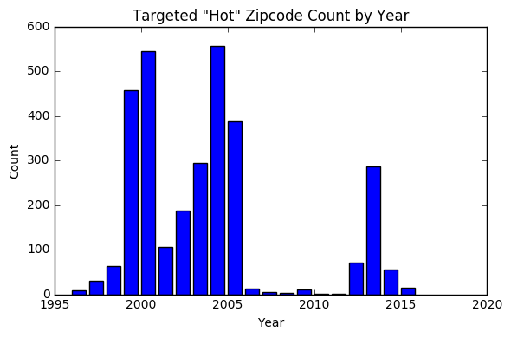
Counting The Number of Hot/Cold Zip Codes by Year
Notes:
The appearance of "hot" zip codes may depend on the general economy, so it may be interesting to know the number of "hot" zip codes in a given year. In the following bar chart, I count the number of identified "hot" zip code by year.
Results:
The highest number of "hot" zip codes occurred in 2004 with 556. Year 2000 has the second highest with 544 followed by Year 1999 with 458. One clear observation is that there are very little or no "hot" zip codes from 2006 to 2012, which happened to be the period that the real estate market collapsed. That economic downturn is known as “The Great Recession".

Slide 9
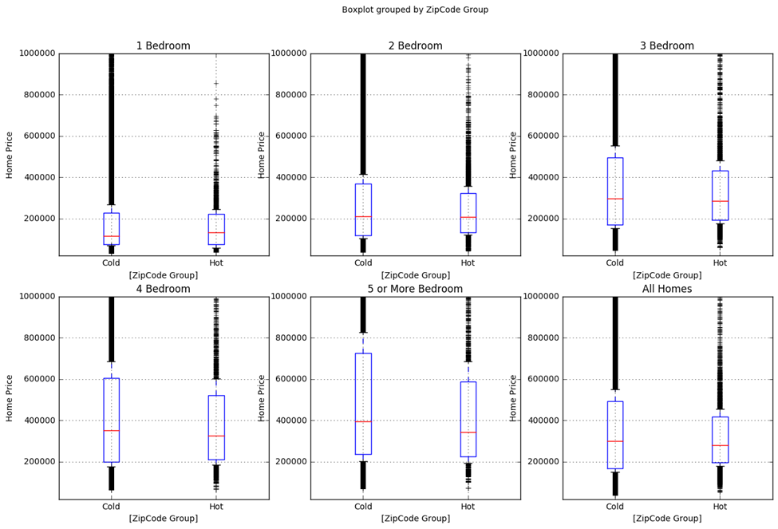
Compare Home Price Grouped by Targeted Zip Code
Notes:
This analysis tries to understand the differences in median home prices between hot zip codes and cold zip codes across different size of home. I used specifically the home price columns for 1, 2, 3, 4 and 5 or more bedroom as well as the overall price and calculate their average price grouped by zip code. Conventional wisdom may expect that "hot" zip codes have higher price because homes in "hot" zip codes may be more desirable. To verify, I created 6 boxplots to examine the median of home price for different home size.
Results
From the observation of all the boxplots, there is only one (the one bedroom) whose hot zip codes’ median price is higher than its cold zip codes'. The rest of the boxplots including the overall home price boxplot have their hot zip code median home price less than cold zip code.
It is not totally clear why one bedroom property in hot zip codes has higher media price than cold zip codes. It is possible that one bedroom properties generally have higher demand compared to the other bedroom groups, especially in today’s “Gig Economy”. Young population tends to change job much more often. One bedroom home allows singles and smaller families to move easily. They may drive up the rental price and median home price as they move to zip code areas with job opportunities.
On the other hand, the difference between hot and cold zip codes median price gets larger as the number of bedroom increases. The 5 bedroom properties’ cold zip code median price is significantly higher than its hot zip code median price. Perhaps the larger (more bedrooms) the house is, the larger the room for price growth, especially for properties with relatively low median price.
This result suggests that for homes larger than one bedroom, hot zip codes generally have relatively lower home price, so investors should not look at high priced area for investment. The lower price base provide more appreciation opportunities for investors.

Slide 10
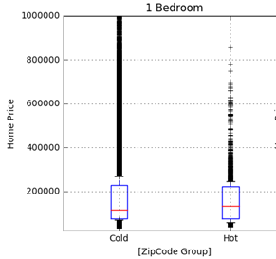
Compare Home Price Grouped by Targeted Zip Code
Only the one bedroom group whose hot zip codes’ median price is higher than its cold zip codes'

Slide 11
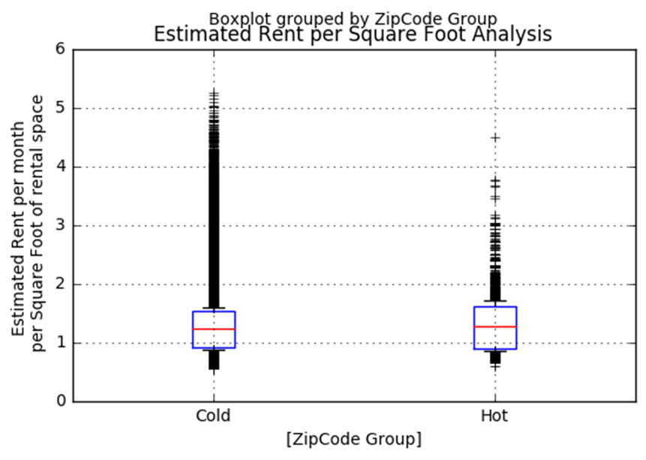
Comparing "Estimated Rent per Square Foot" Between Hot and Cold Zip codes
"Hot" zip codes have higher rent per square foot than "cold" zip codes (1.31 vs 1.27)
Notes:
Rent price is an important factor to determine whether rental property is profitable or not. It will be good to understand the relationship between rent per square foot and hot/cold zip codes. I calculated the mean rent per square foot for both the hot and cold zip code groups.
Results The boxplot shows that the "Hot" zip codes have higher rent per square foot than "cold" zip codes. The estimated rent per square foot for hot and cold zip codes are 1.31 and 1.27 respectively. The difference between hot and cold zip codes are 0.04 which means that for a home with 1,000 square foot, the difference in rent price between hot and cold zip codes is $40 per month. This difference doesn’t seem to make significant impact for investors’ decision making.

Slide 12
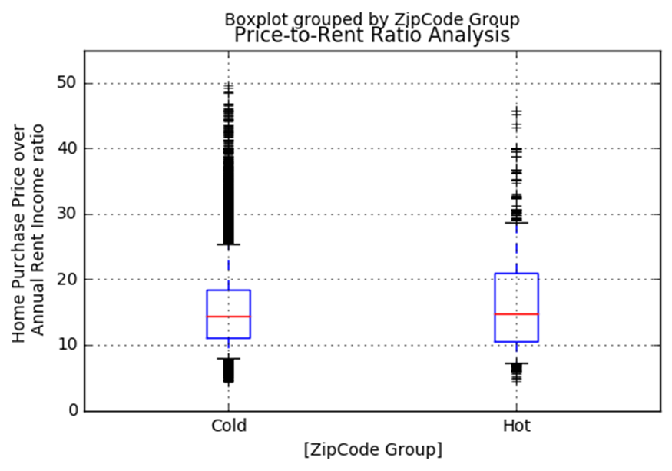
Comparing Price-to-Rent Ratio between hot and cold zip codes
Zip Code Group | Price-to-Rent Ratio
Cold | 15.183392
Hot | 16.311877
Hot zip codes have higher price-to-rent
Notes:
It is also interesting to see the relationship between price, rent and hot/cold zip code group. Price-to-rent ratio is the median home sales price over median annual rent. Price-to-rent ratio indicates the cost for investors to acquire investment properties. High price-to-rent ratio means that investors will need to invest more to generate the same monthly rental income return. Low price-to-rent ratio means that investors will need to put up less initial investment, so their return-on-income will generally be higher.
Results: As I calculate the average price-to-rent ratio between hot and cold zip code group, I found that "hot" zip codes have slightly higher median price-to-rent. The price-to-rent ratio difference between hot and cold zip codes is 1.129 which means that investors will need to pay 1.129 times more of their rentals’ annual income to purchase homes in hot zip codes. This could be significant because that basically means that it may take investors a little more than one additional year on average to get their capital back if they invest in properties at hot zip codes. Investors may need to justify their investment by analyzing both the price appreciation as well as the annual rent income.

Slide 13
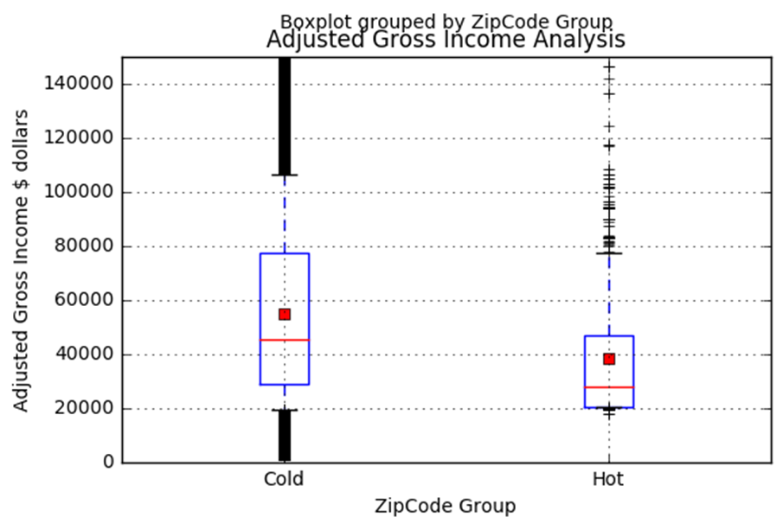
Comparing Adjusted Gross Income between Hot and Cold Zip codes
Average Adjusted Gross Income
Zip code group | Count | Mean | Standard Deviation | 25% Percentile | 50% Percentile | 75% Percentile
Cold | 412370 | $54953 | $47393 | $28902 | $45372 | $77217
Hot | 3095 | $38260 | $23052 | $20294 | $27990 | $46969
Hot zip codes have lower AGI
Notes:
Income level is probably another important factor driving zip codes from "cold" to "hot". Adjusted Gross Income is generally the total income amount of tax payers before tax deduction. When the median AGI in a region increases, that generally means that the economic activities in the region is growing, and people generally can afford more to pay the essentials like rent or other disposable items. I analyzed the relationship between average AGI between "hot" and "cold" zip code groups. I generate a table showing the mean, standard deviation, quantiles, etc between hot and cold zip code groups. Also, I made a boxplot to visually see the differences.
Results: The analysis shows that the mean of the average AGI for hot zip codes is much smaller than cold zip codes. The mean of the average AGI for hot zip is about $38260 while the average AGI for cold zip code is $54952. Also, the standard deviation for average AGI for hot zip codes is smaller than that for cold zip codes.
This result seems to be a bit surprising. One explanation for this result is because lower income zip codes provide relatively low baseline for home price to appreciate and proportional wise their appreciation goes up in higher percentage.
Gentrification could very well be the reason for zip codes to become hot. Older and poor neighborhood could experience sudden price spike after renovation. There could be a high correlation between Gentrification projects and hot zip codes. This analysis doesn’t have data related to gentrification. A follow-up analysis is recommended to further understand how gentrification contributes to zip codes to get “hot”.

Slide 14
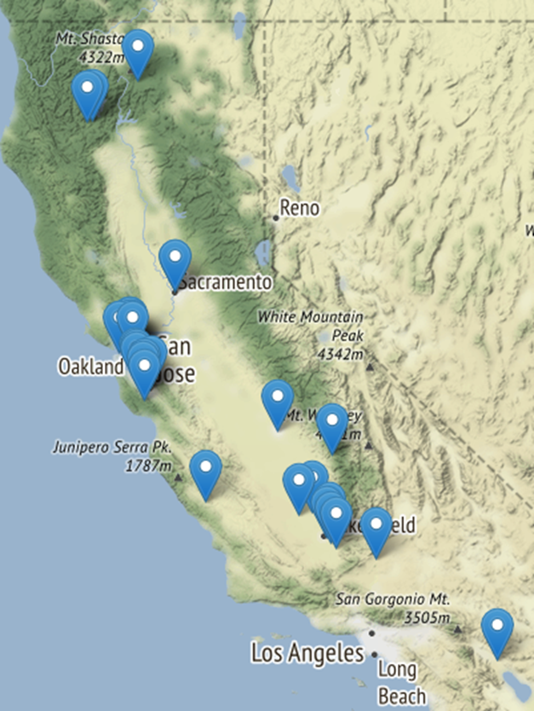
“Top 30 hot zip codes in California”
Spread all over the entirety California
More hot zip codes in the San Francisco Bay Area in North California and around Bakersfield near South California
None in Los Angeles areas
Notes:
Knowing where the hot zip codes are geographically will also be very helpful for investors. The following analysis plots the top hot zip codes with the highest number of months being marked as hot. The top 30 zip codes with highest frequency of being hot is plotted on the following map:
Results: The hot zip codes seem to spread pretty evenly all over the entire California. There seems to have more hot zip codes in the San Francisco Bay Area in North California and around Bakersfield near South California.

Slide 15
Building a Model to Predict Hot/Cold Zip Codes
Generate Balanced Dataset
10,000 samples with replacement from each of the hot and cold zip code
Combine them to generate a 20,000 row dataset
Splitting Training and Testing Dataset
80% training set
20% testing set

Slide 16
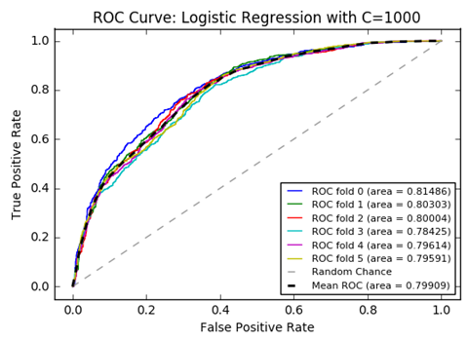
Logistic Regression Training and Evaluation
C =1000 best by grid search
Precision = 0.71063
ROC Ave = 0.79909

Slide 17
Support Vector Classifier Training and Evaluation
Best Hyper Parameters:
C=1
principal component=1
kernel=RBF
original best feature=2
Overall precision score = 0.96
The scores are computed on the full evaluation set
Zipcode | Precision | Recall | F1-score | Support
Cold | 0.92 | 1.00 | 0.96 | 1981
Hot | 1.00 | 0.91 | 0.95 | 2019
avg / total | 0.96 | 0.96 | 0.96 | 4000
Notes:
With the 16,000 training dataset, SVC with RBF kernel takes about two minutes for each hyperparameter combination training to complete. The Sigmoid kernel is also fast, but its performance is quite poor compared to RBF.
Using grid search, the best hyperparameter I found is C=1, one principal component, RBF kernel and two original best feature after the cross validation on the training dataset. The overall precision score I got after applying the model to the testing dataset is 0.97.
Since SVC generates the best performing model comparing to linear regression, I will use the SVC model to find my next investment property.

Slide 18
Overall Conclusion
Unique characteristics of the high potential “hot” zip codes
Spread over Northern and Southern California.
Have slightly higher estimated rent per square foot as well as price-to-rent ratio
Adjusted gross income lower than “cold” zip codes.
Have lower home price than “cold” zip codes for all sizes except those one bedroom homes
Notes:
This analysis tried to use the US housing price data and the IRS data to help investors discover high potential California zip codes for purchasing rental properties. Through the analysis, some unique characteristics of the high potential “hot” zip codes are identified; for example, “hot” zip codes are spread over Northern and Southern California. Also, “hot” zip codes have slightly higher estimated rent per square foot as well as price-to-rent ratio although their adjusted gross income is lower than “cold” zip codes. “Hot” zip codes generally have lower home price than “cold” zip codes for all numbers of bedroom home except those one bedroom homes.

Slide 19
Overall Conclusion
Tried two modeling algorithm to predict “hot” zip codes
Logistic Regression
precision score: 71%
Support Vector Classifier (SVC)
precision score: 96%
Better Model for Rental investors:
Support Vector Classifier (SVC)
Notes:
To develop a prediction model for “hot” zip codes, I tried two modeling algorithm of logistic regression and support vector classifier(SVC). SVC turned out be a better algorithm. The best SVC model delivered a 96% precision score compared to logistic regression model’s 0.71. Rental investors could use my SVC based model to find the right zip codes for their next profitable rental investment.

Slide 20
THANK YOU

