Slide 1

Food Access Program Deployment Plan
N1 Health Analyst Data Challenge
Completed by Winnie Lau

Slide 2
Overview
01
02
03
Areas of Deployment
Demographic Breakdown
Effects of the Program
Where should the food access program be deployed?
Which subgroups are impacted by the program?
What is the projected participation? What are the health and socioeconomic impacts?

Slide 3
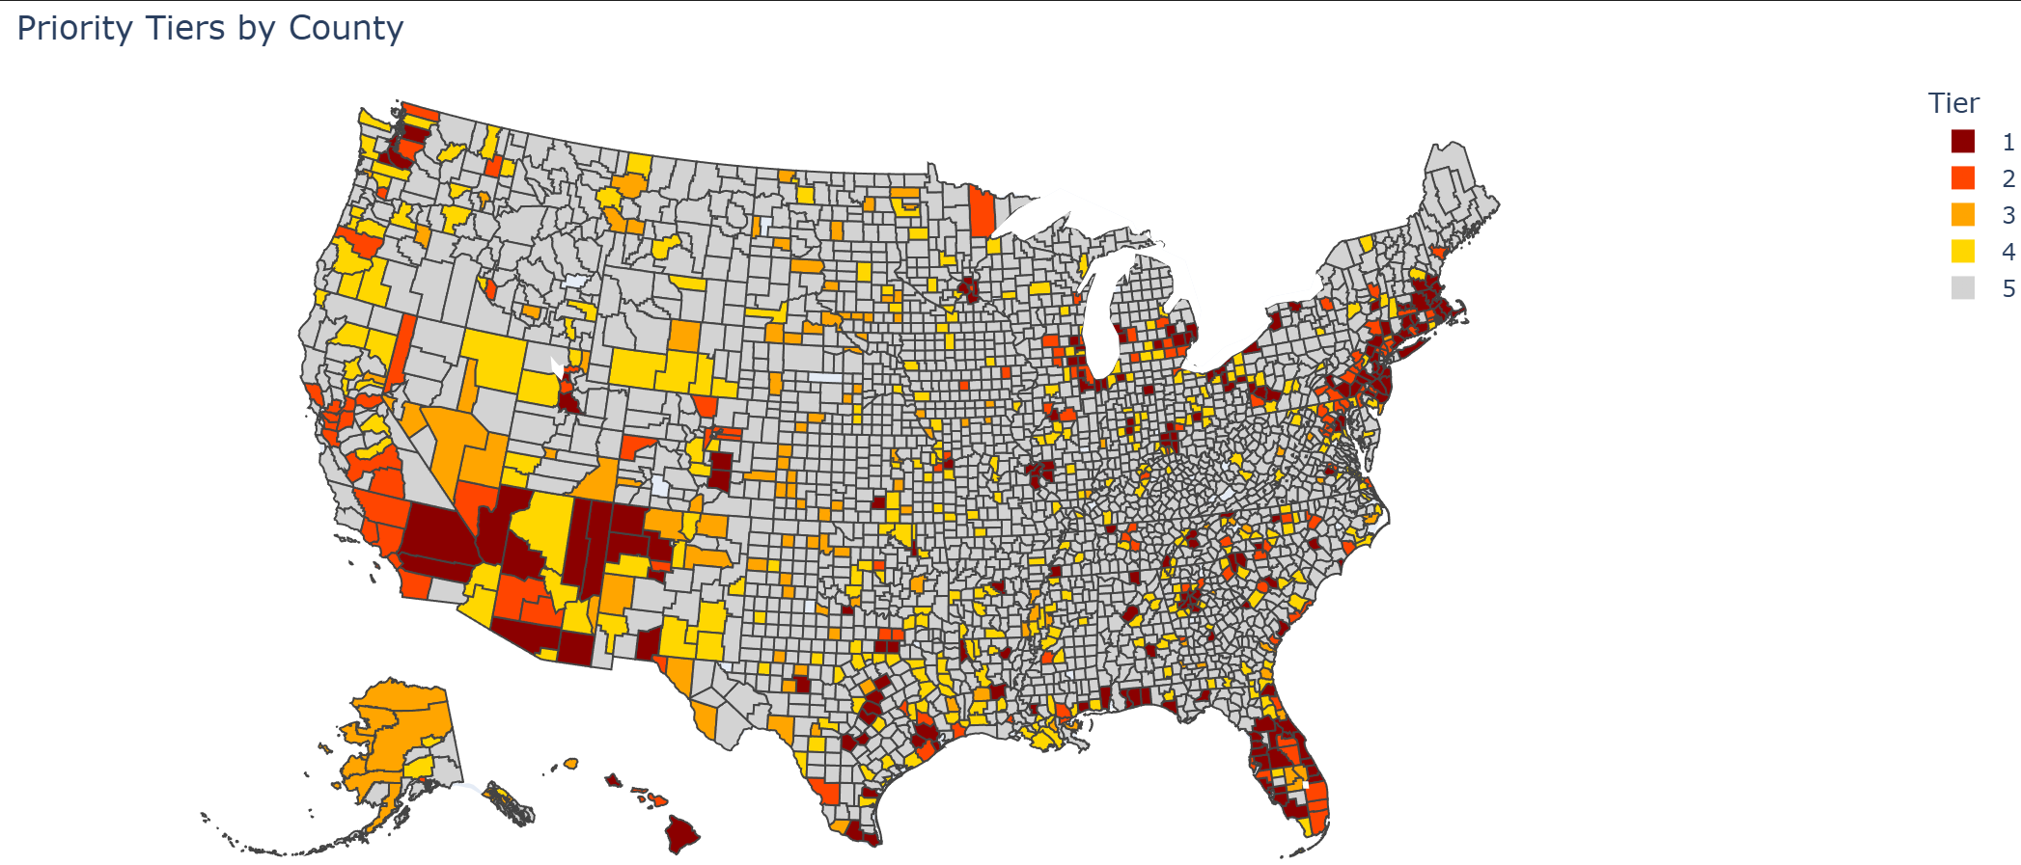

Areas of Deployment
Tier 1: 26.03 M
182 counties
Most urgent intervention needed
Tier 2: 13.2 M
128 counties
Large populations prioritized (urban)
Tier 3: 1.23M
128 counties
High low-access prevalence prioritized (rural)
Tier 4: 7.78 M
330 counties
Populations to monitor
Ranked using Priority Score (high to low):
P: Proportion of population with low access relative to highest low-access population
N: Need index calculated from percentage of vulnerable groups with low access
α: tunable parameter to prioritize either population or percentages
$$Priority Score=P^{α}⋅N^{\left(1−α\right)}$$

Slide 4
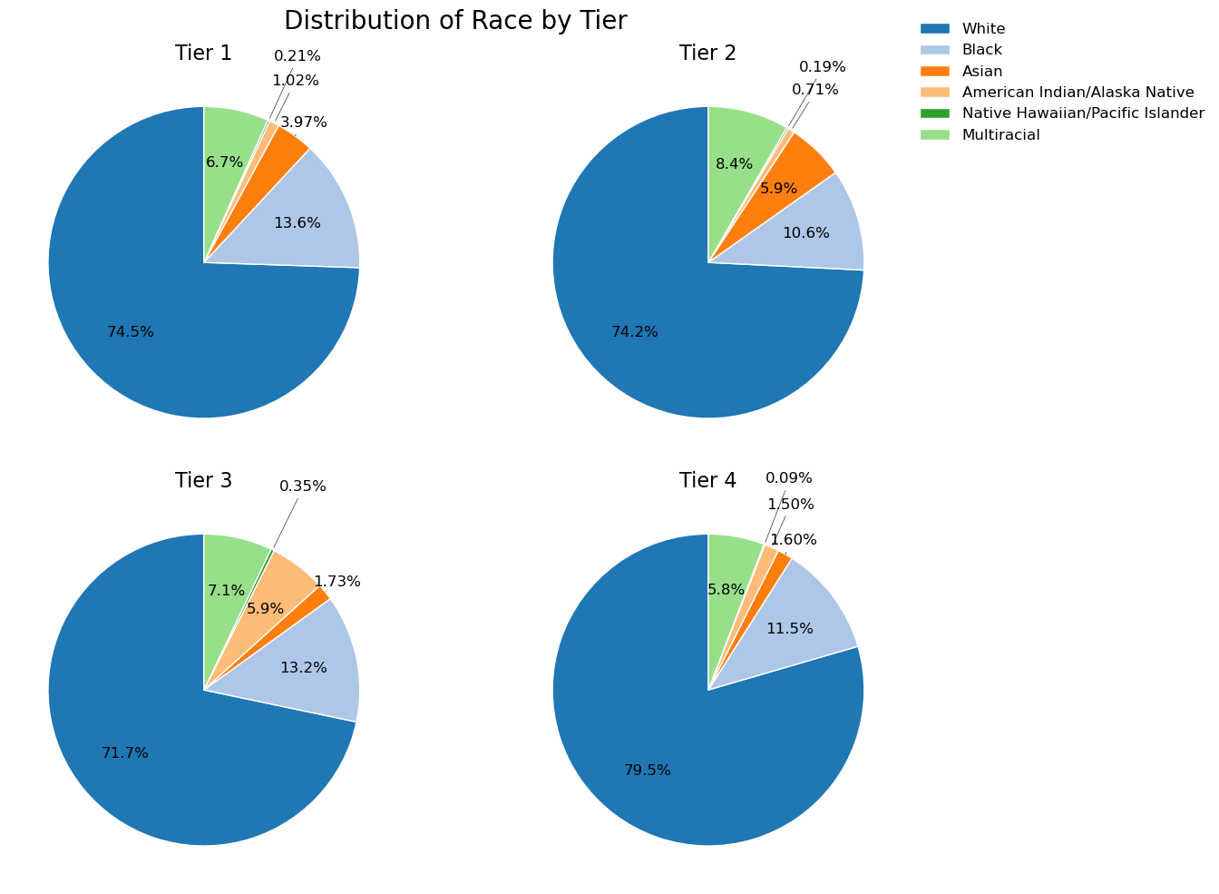
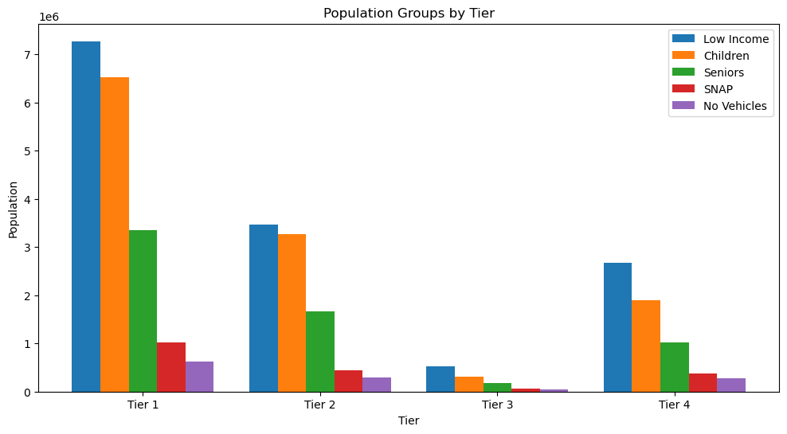
Demographic Breakdown by Tier
Key Notes
Largest population groups supported are low-income individuals, children, and seniors
Tier 3 has a comparatively higher proportion of American Indian/Alaska Natives

Slide 5
Effects of the Program
With over 40 million people in Tiers 1-3, a projected program participation rate of 50-85% (on par with SNAP participation in 2022 for different groups, according to the USDA) would mean 20-34 million people assisted.
Projected Impacts
Reduced Food Insecurity
Healthier Diets
Improved Health Outcomes
Economic Stability
More households becoming food secure with increased access.
Increased fruits and vegetables consumption with availability of fresh food.
Healthier diets may lower risk of chronic diseases (e.g. diabetes and obesity).
Reduced food budget strain, potentially contributes to long-term poverty relief efforts.

