Slide 1

Sprint 2
SPROUTME CAPSTONE PROGRESS
Seth Aguilar · Warren Christian
Quinnlan McCarthy · Itay Shemesh
October 2026
SM

Slide 2
NDA disclosure
We can show the product UI
and summarize our work.
We cannot share private code
or internal documentation.
SM

Slide 3
SPRINT OBJECTIVES
  Complete assigned individual Jira tickets
  Attend bi-weekly stand up with shareholders
SM

Slide 4
REQUIREMENTS GATHERING
  Regular standups with the client
  Team reports progress and receives new work
  Jira items and designs refine requirements
SM

Slide 5
HOW WE TRACKED WORK
  19 Jira items were assigned across the entire group.
  Progress with current work determines what is assigned next.
SM

Slide 6
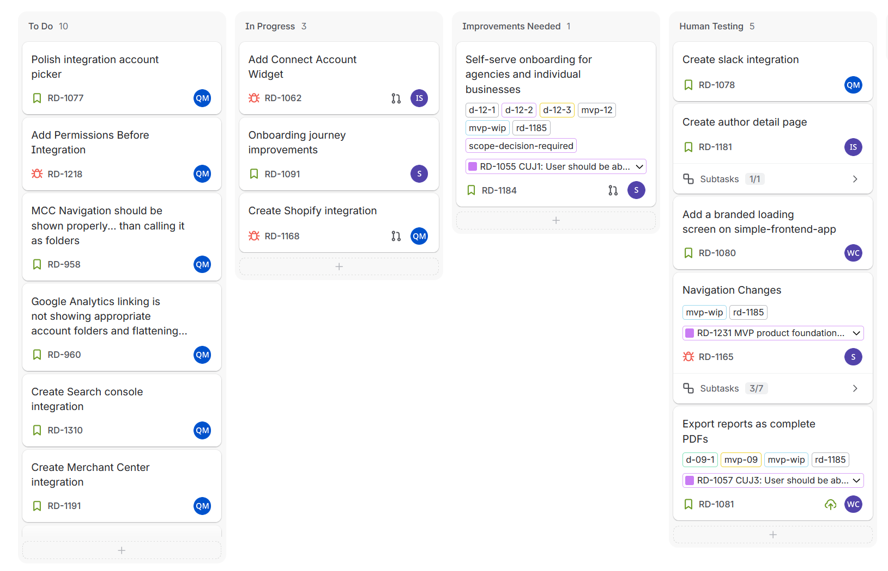
JIRA BOARD
  Note: When items are progressed out of Human Testing, they are removed from the Jira board
SM

Slide 7
OVERALL FEATURES WORKED ON THIS SPRINT
RPC naming refactor​
Improving user onboarding experience​
PDF generation for ad metrics​
Closed out Slack account integration​
Added user profile page​
Added ROAS Score page​
SM

Slide 8
SETH AGUILAR
  Assigned work: overhaul onboarding flow and research RPCs
  Finished changes to onboarding flow
  Created dynamic doc to track RPC research
  Started on system-wide RPC renaming task
  Status: Onboarding overhaul complete and RPC doc built up
  Next: Continue research on RPCs and work on onboarding billing process
SM

Slide 9
WARREN CHRISTIAN
  Finished server-side pdf rendering feature
  Improved pdf design to closer resemble final product
  Implemented download pdf button to trigger pdf creation in new server-side rendering feature
SM

Slide 10
QUINNLAN MCCARTHY
  Slack fishished ; Shopify is about ½ done.
  Google account picker and account hierarchy are queued.
SM

Slide 11
ITAY SHEMESH
  RD-1062: Connect Account Skills Page
    Made top 3 skills Sanity oriented
    Integrated account connection for Google and Meta accounts in the Competitor Skills section
    Made page link back to skills section
  RD-1181: Dynamic Author Profile Page
    Made top 6 blogs per Author be Sanity oriented
    Made profile picture have a gray-scale and luminosity effect
    Added pagination to Author and Blog page
    Added Sanity implementation for Meta, Linkedin, X & Other-external links
  Next: Waiting on next task/improvements
SM

Slide 12
RESPONSIBLE AI USE
  GenAI used extensively during development
  Each change verified in the local environment
  Pull requests receive human review
  CI/CD and AI reviewer agents add checks
SM

Slide 13
ACHIEVEMENTS & CHALLENGES
  Challenge: Each member is assigned their own work and are siloed.
  Challenge: Keeping up with a quick team and evolving code base
  Challenge: Private code limitations for class assignments
  Achievement: More freedom and trust in tasks from the rest of the team
SM

Slide 14
DEMO
SM

