Slide 1
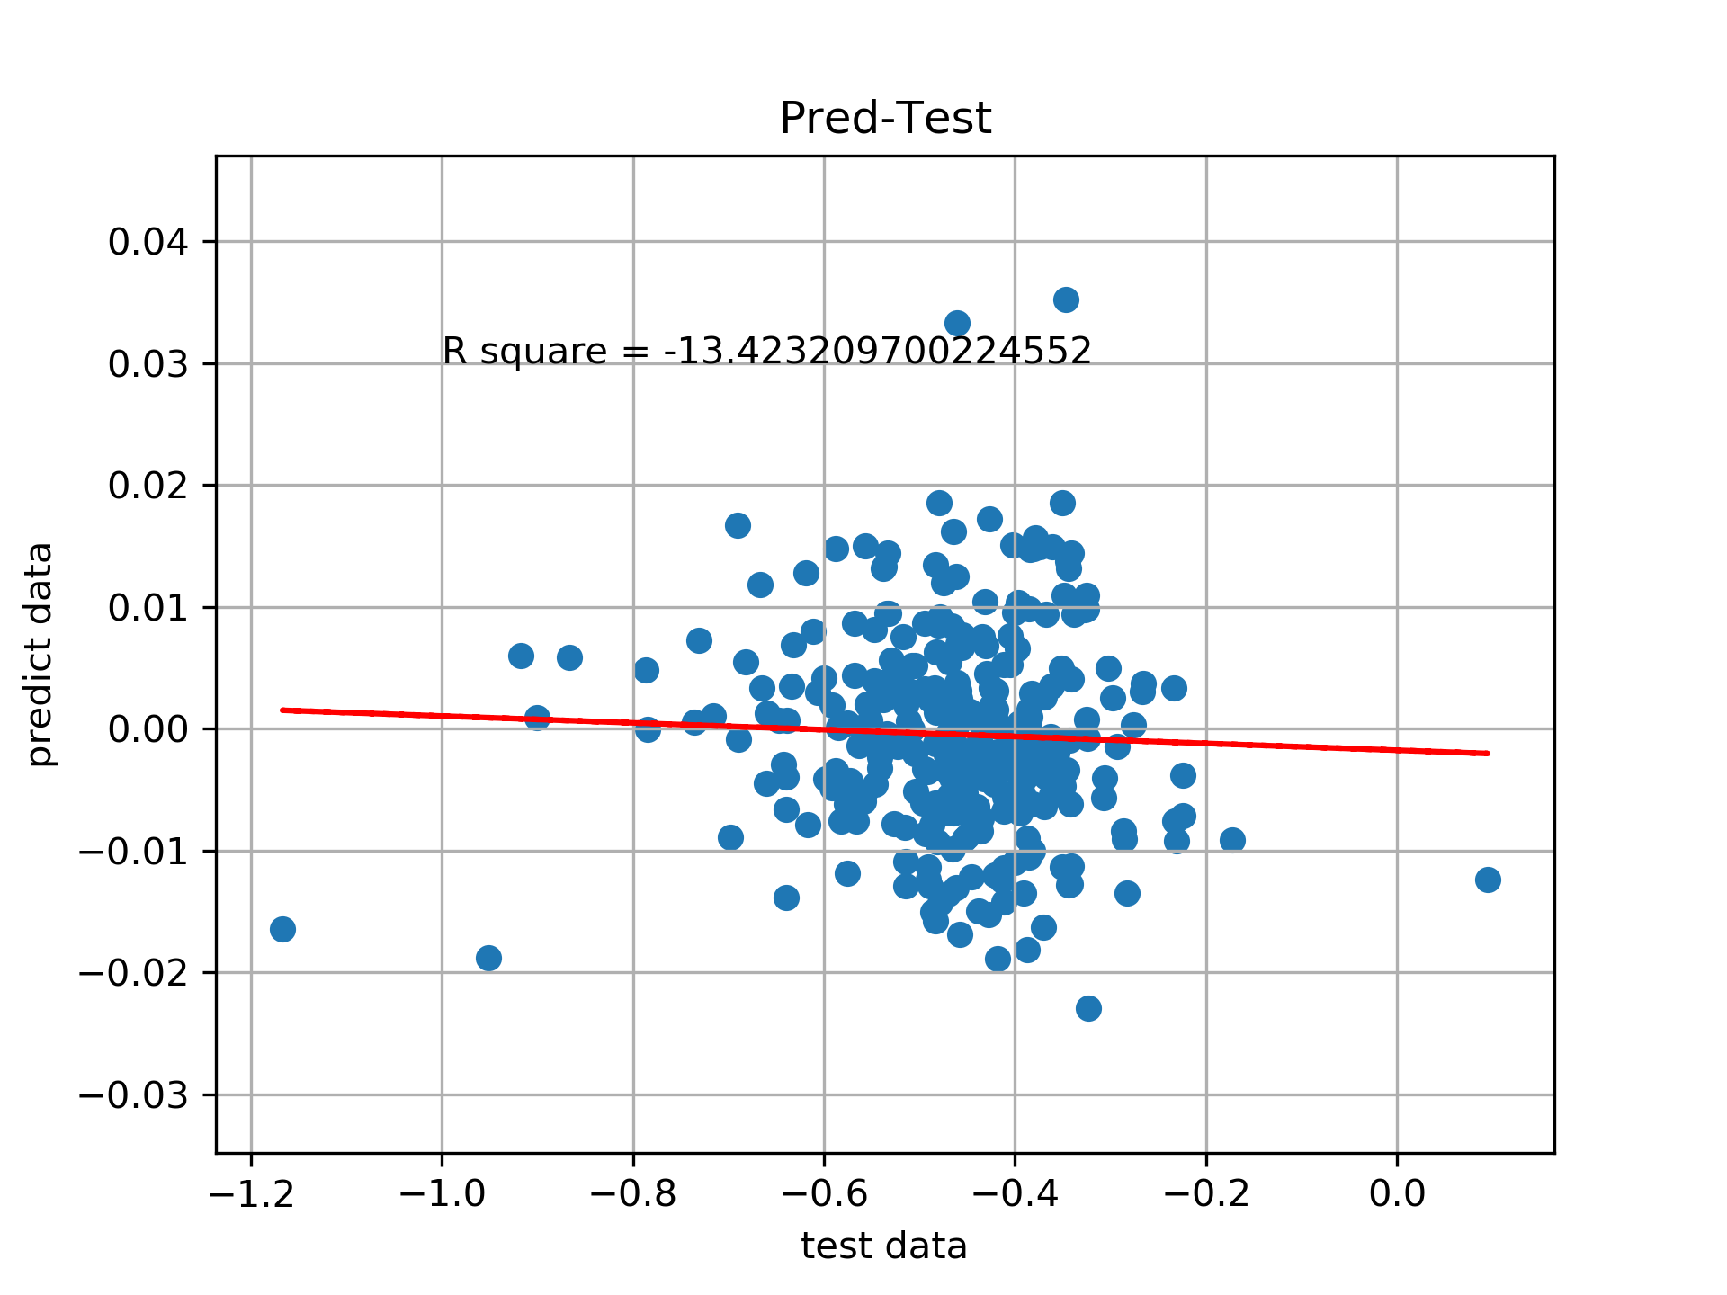
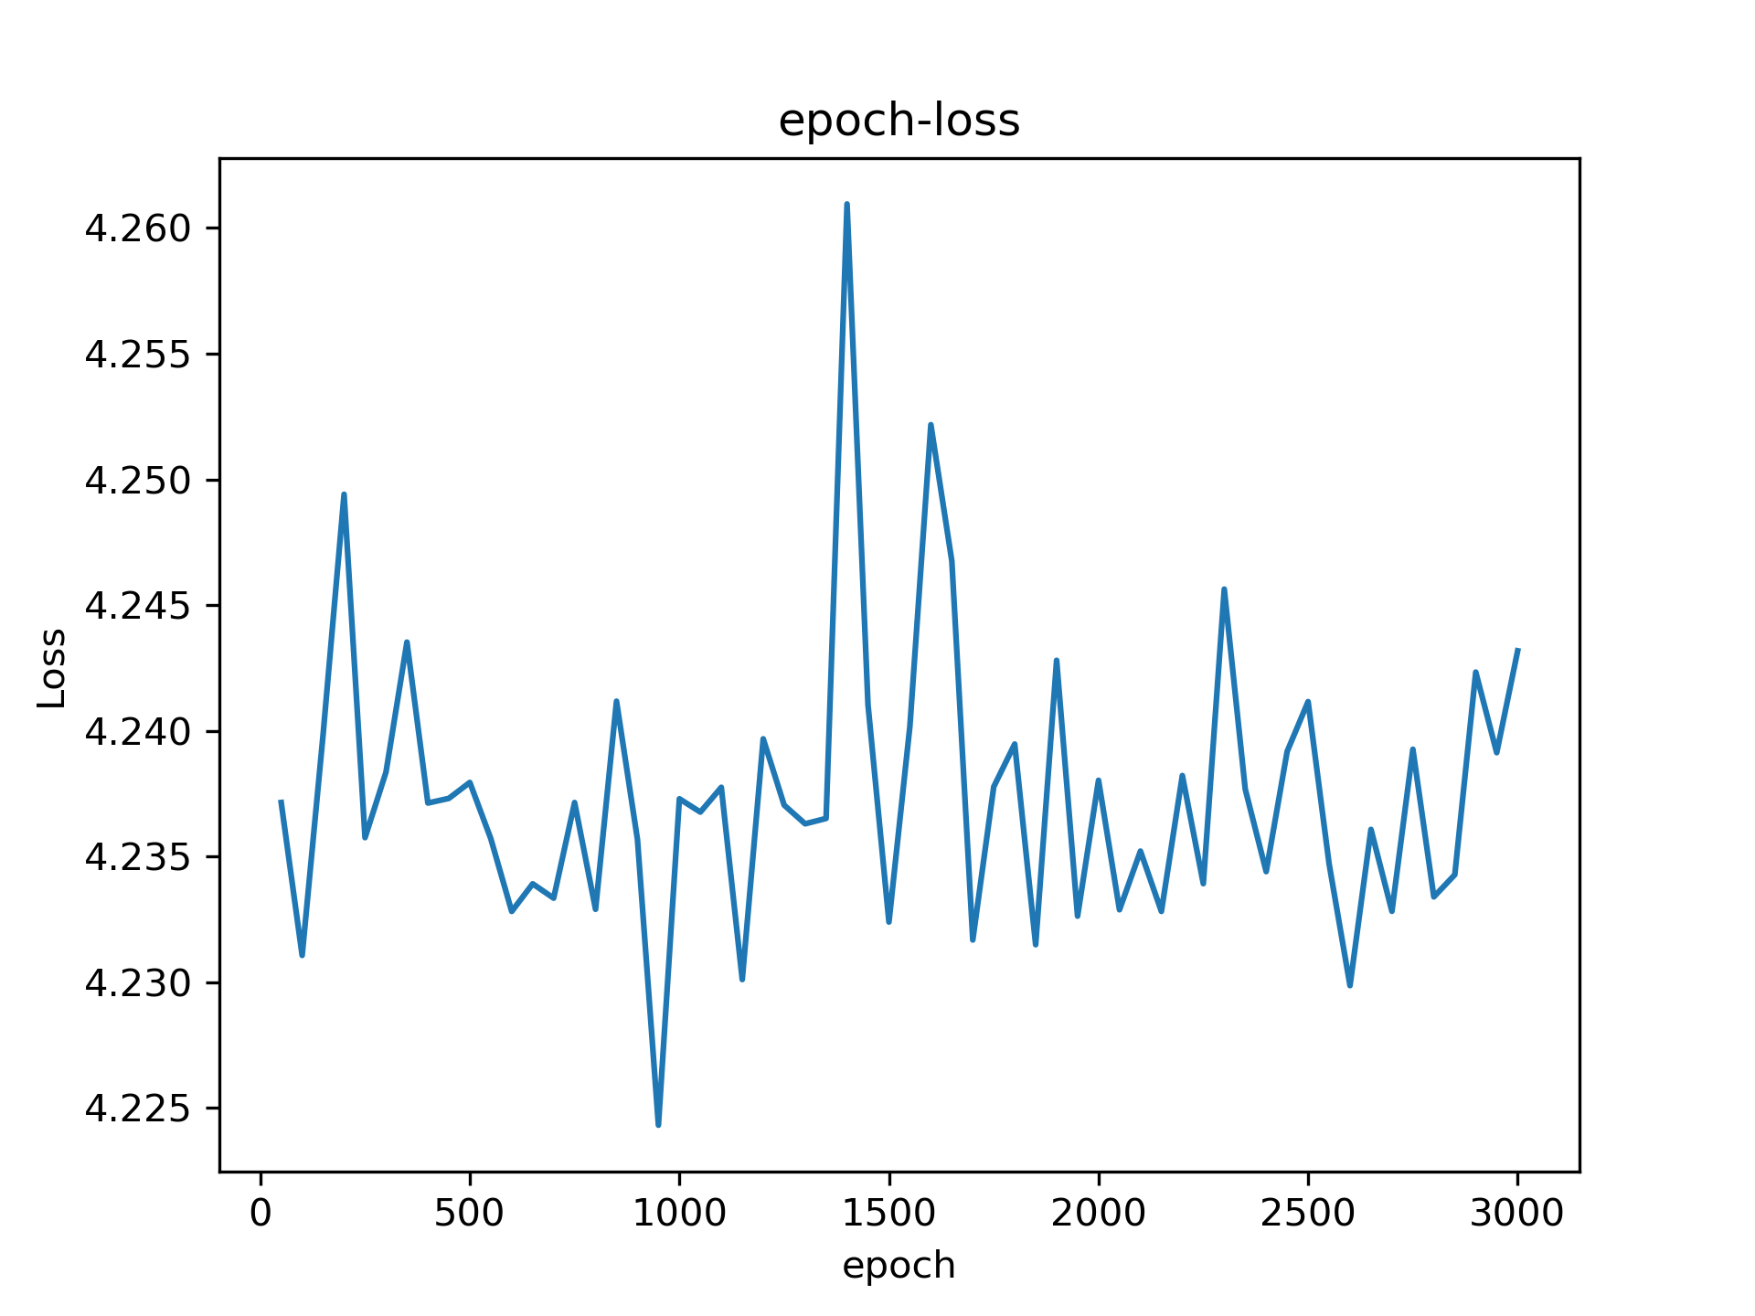
L4(layer 4)-SGD2
lr scheduler (lr = 1.0, factor = 0.99), batch size = 1024, pred = x/100,

Slide 2
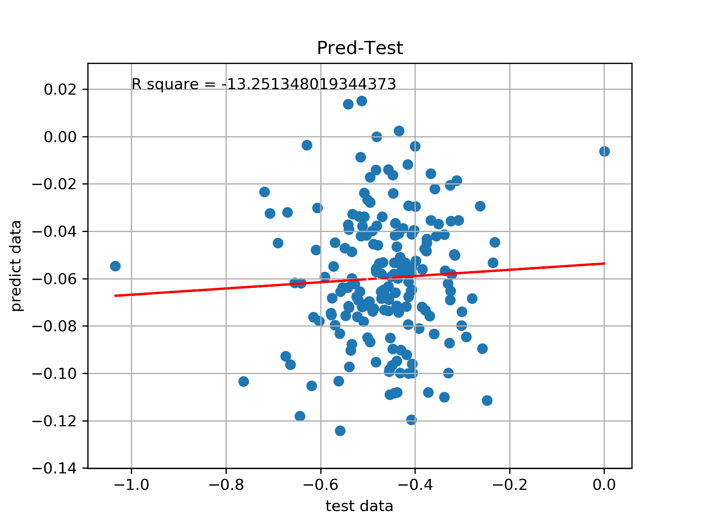
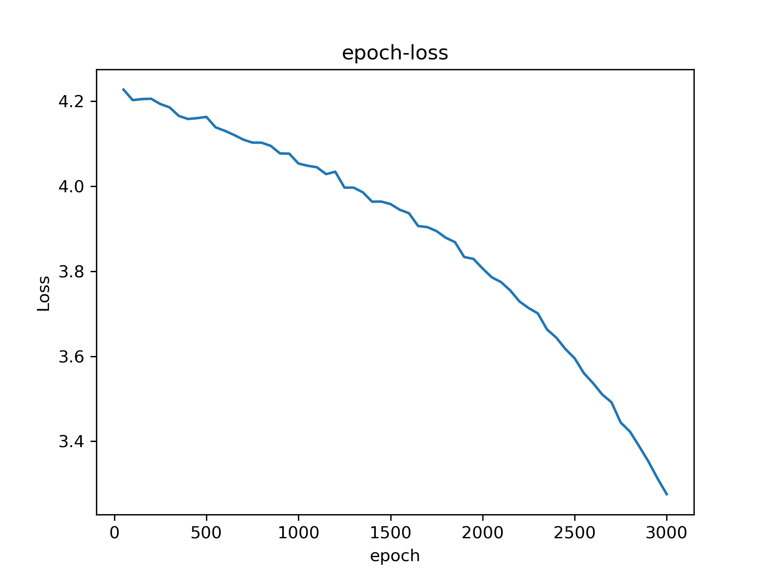
L4(layer 4)-SGD3
lr = 0.001, batch size = 1024, pred = x/100,

Slide 3
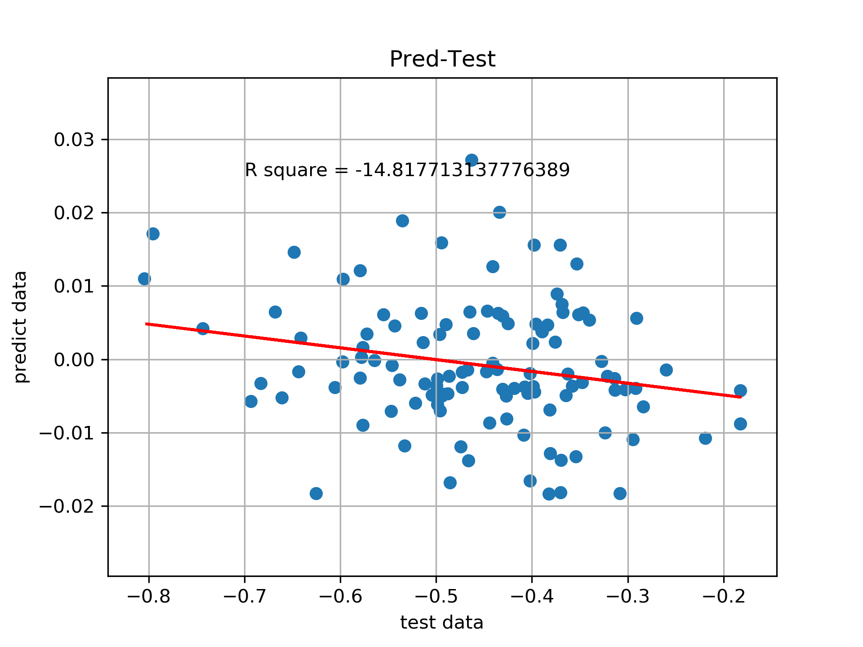
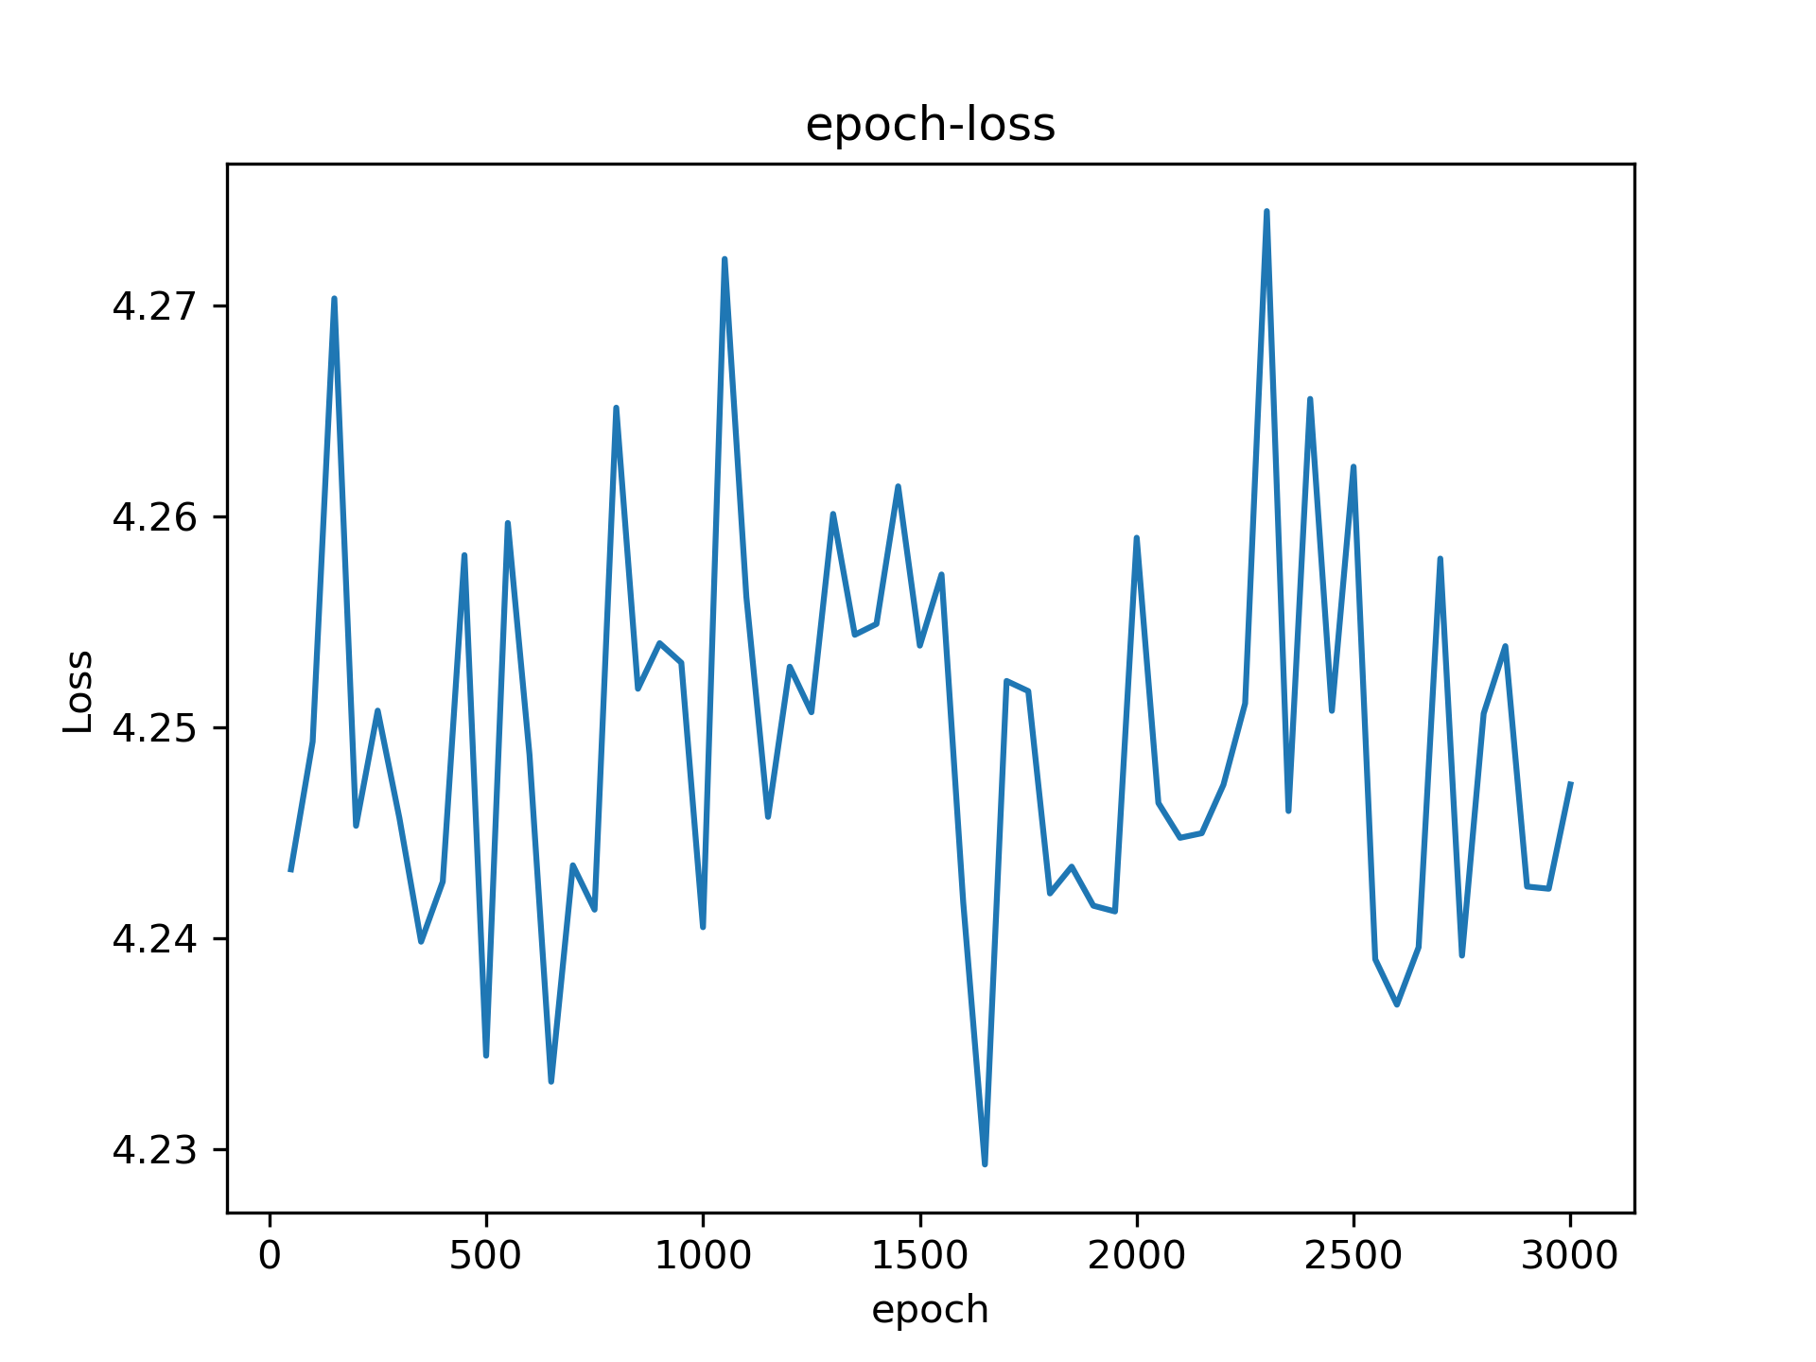
L4-Adam2
lr scheduler (lr = 1.0, factor = 0.99), batch size = 1024, pred = x/100,

Slide 4
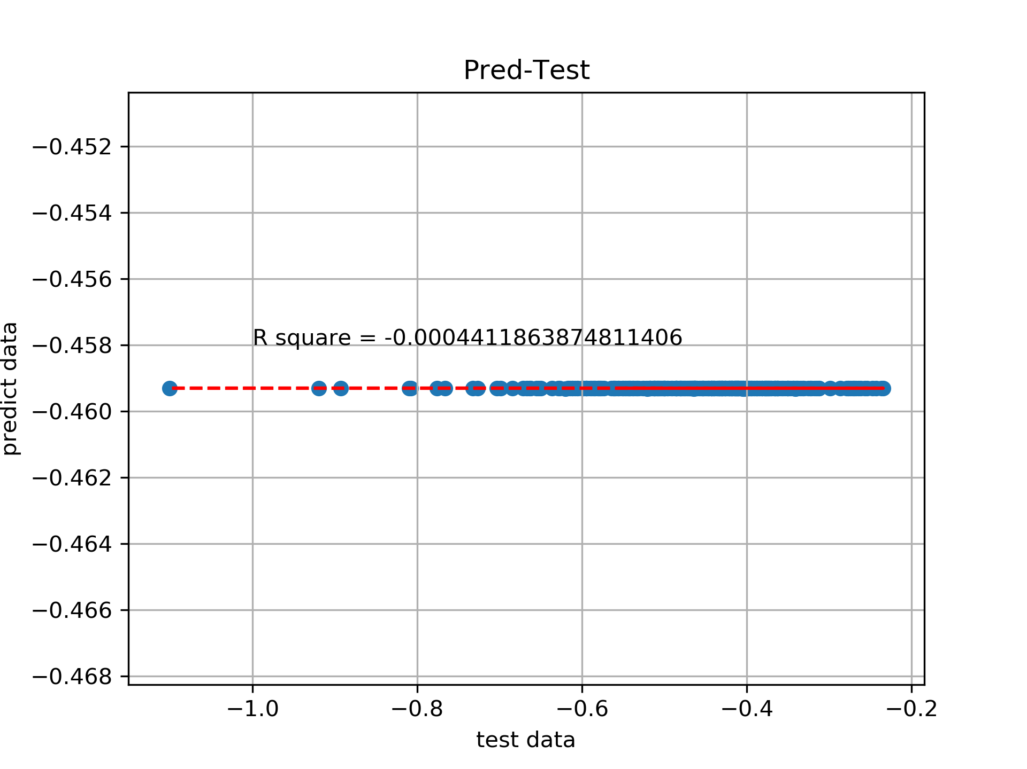
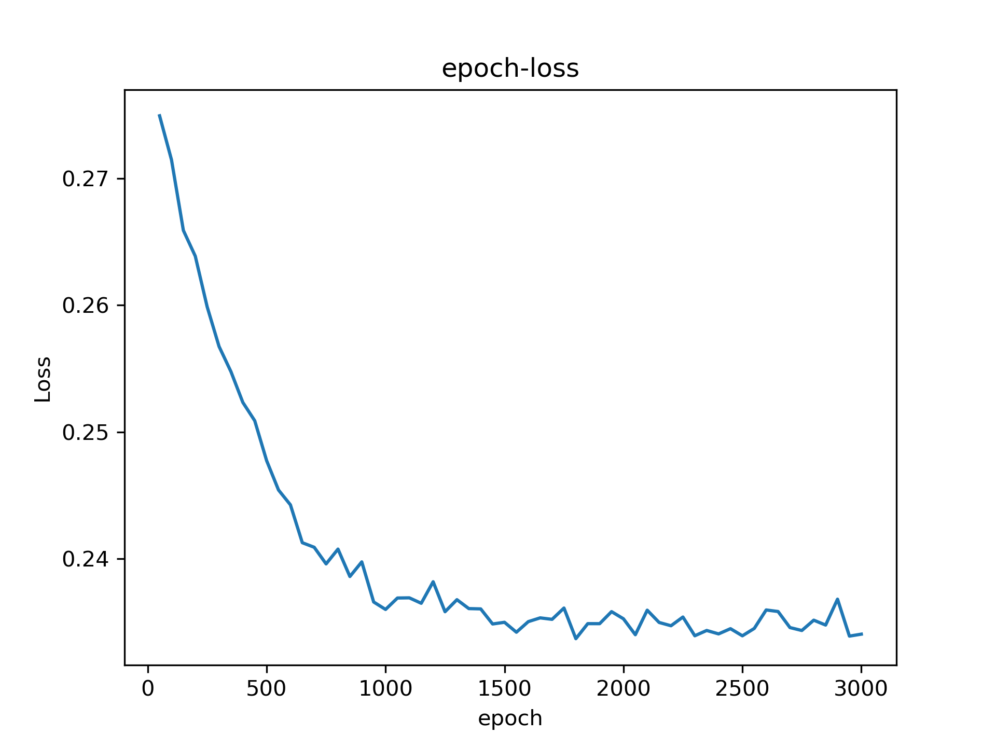
L4-Adam3
lr = 0.001, batch size = 1024, pred = x/100,

Slide 5
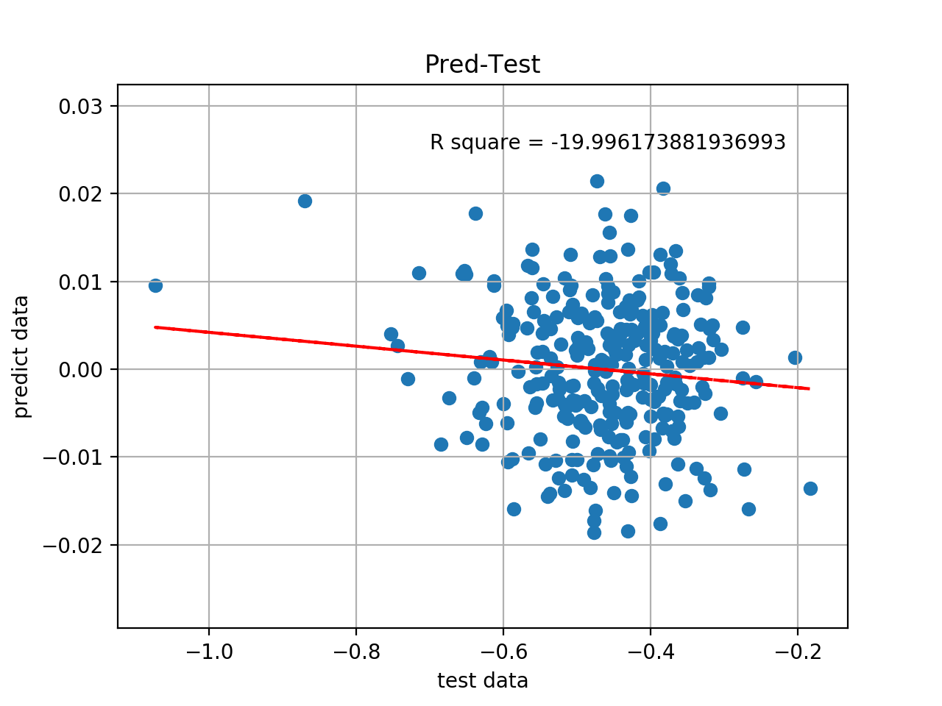
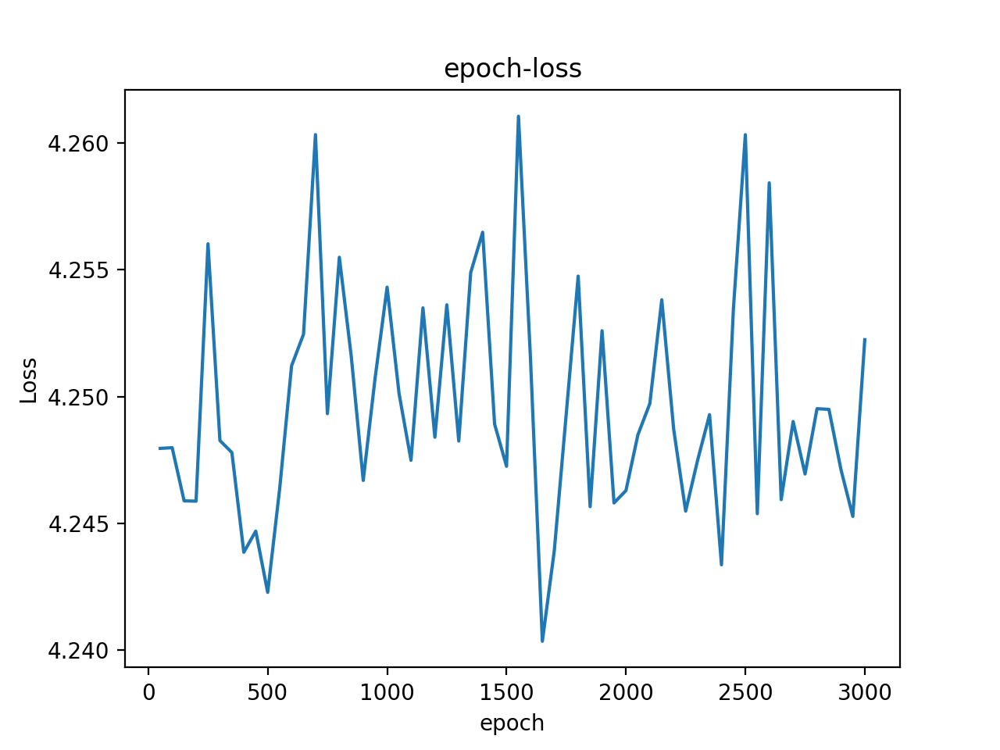
UDL4-SGD2
lr scheduler (lr = 1.0, factor = 0.99), batch size = 1024, pred = x/100,

Slide 6
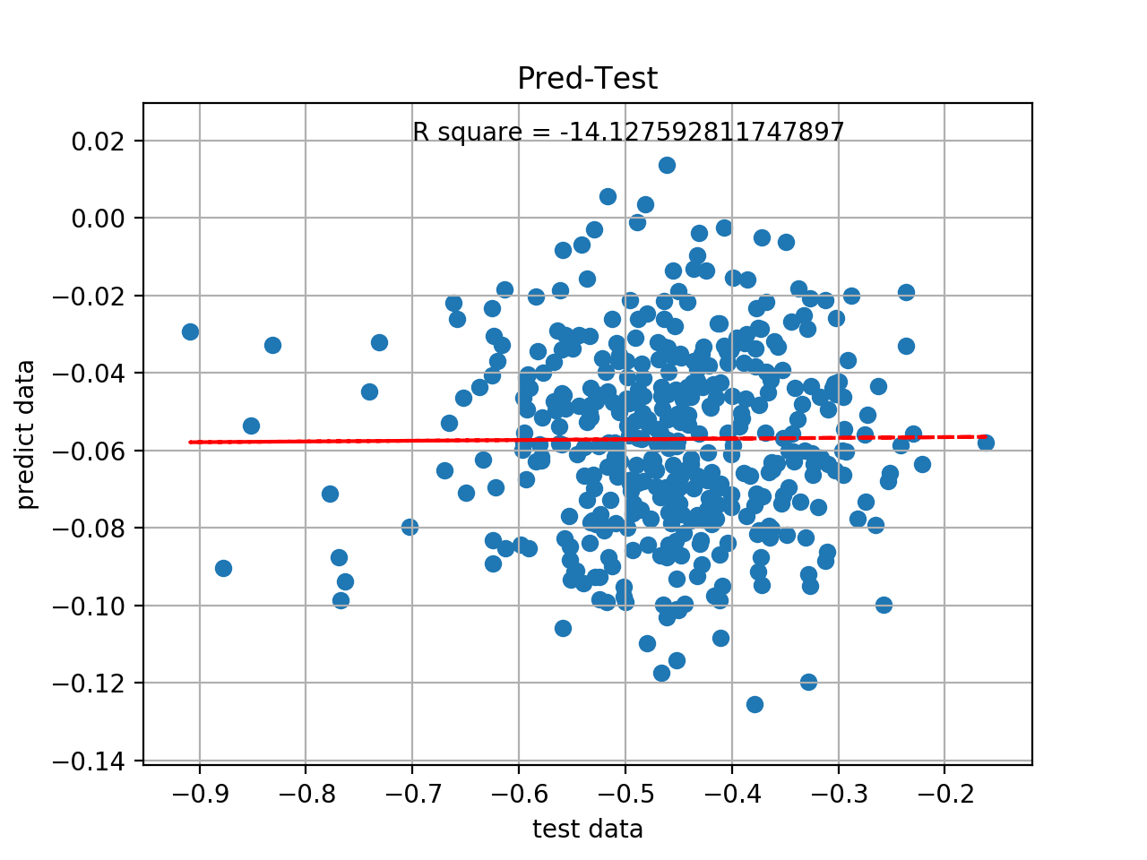

UDL4-SGD3
lr = 0.001, batch size = 1024, pred = x/100,

Slide 7
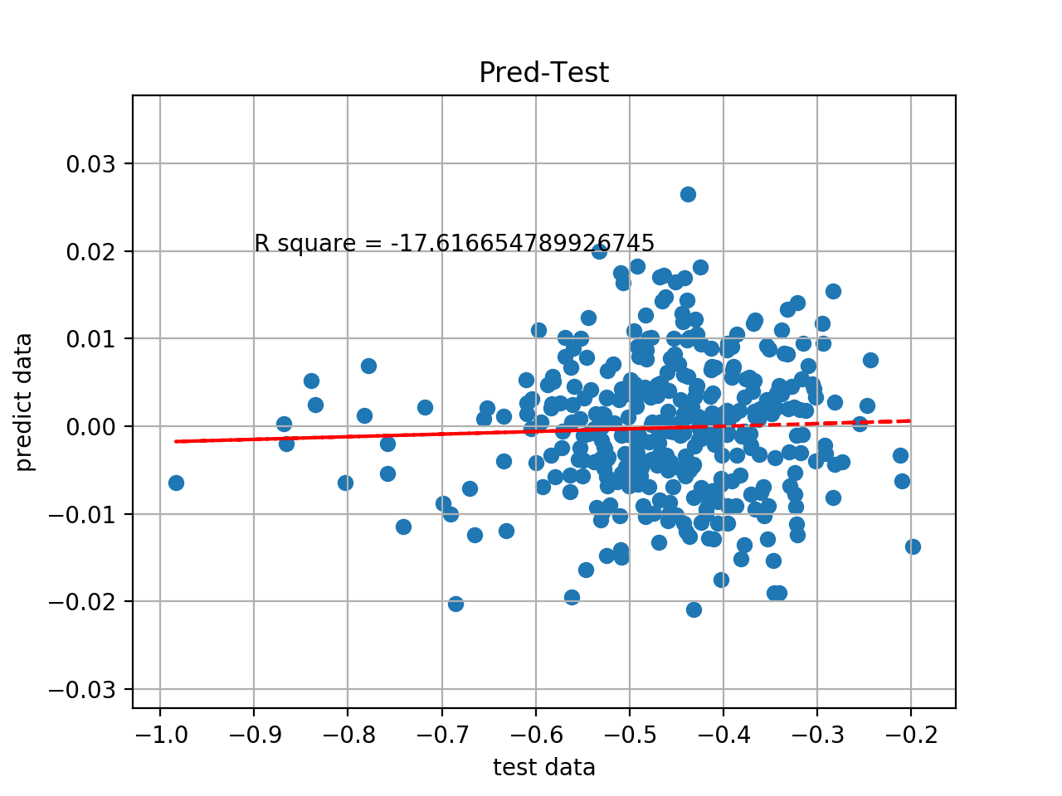
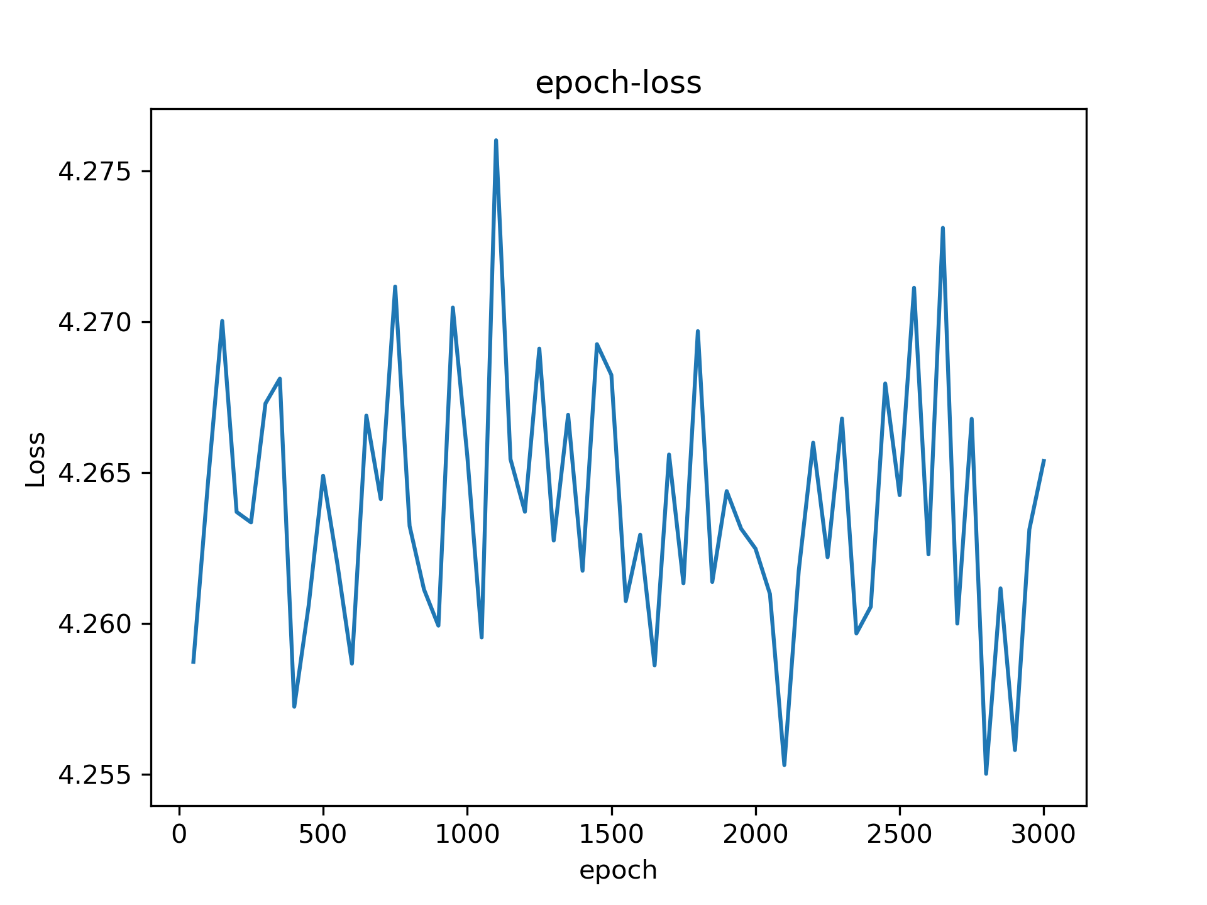
UDL4-Adam2
lr scheduler (lr = 1.0, factor = 0.99), batch size = 1024, pred = x/100,

Slide 8
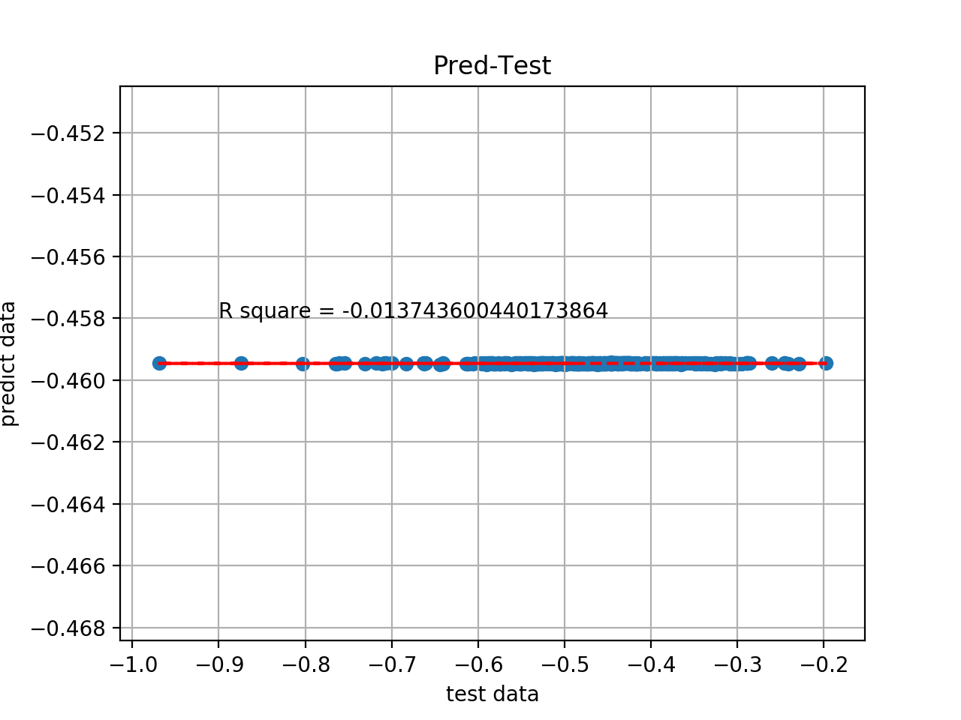
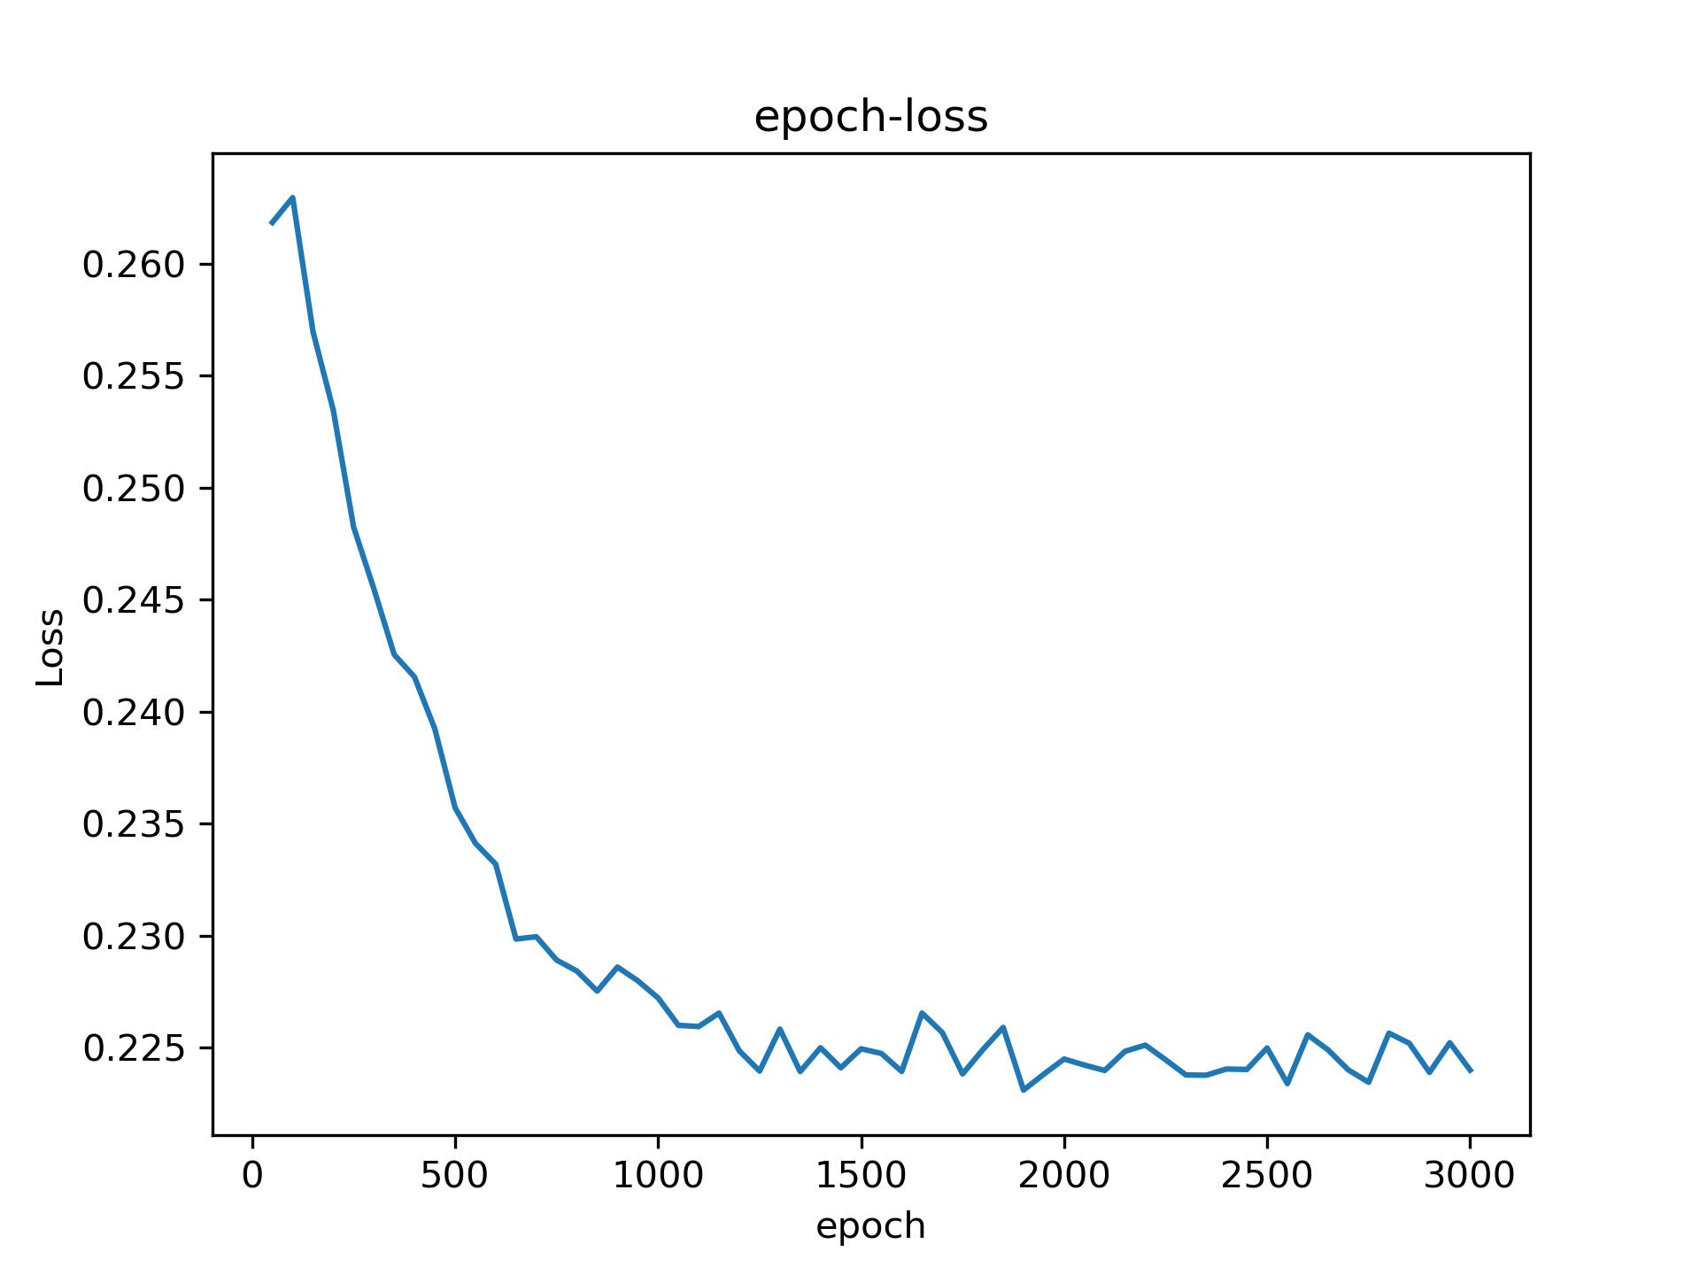
UDL4-Adam3
lr = 0.001, batch size = 1024, pred = x/100,

Slide 9
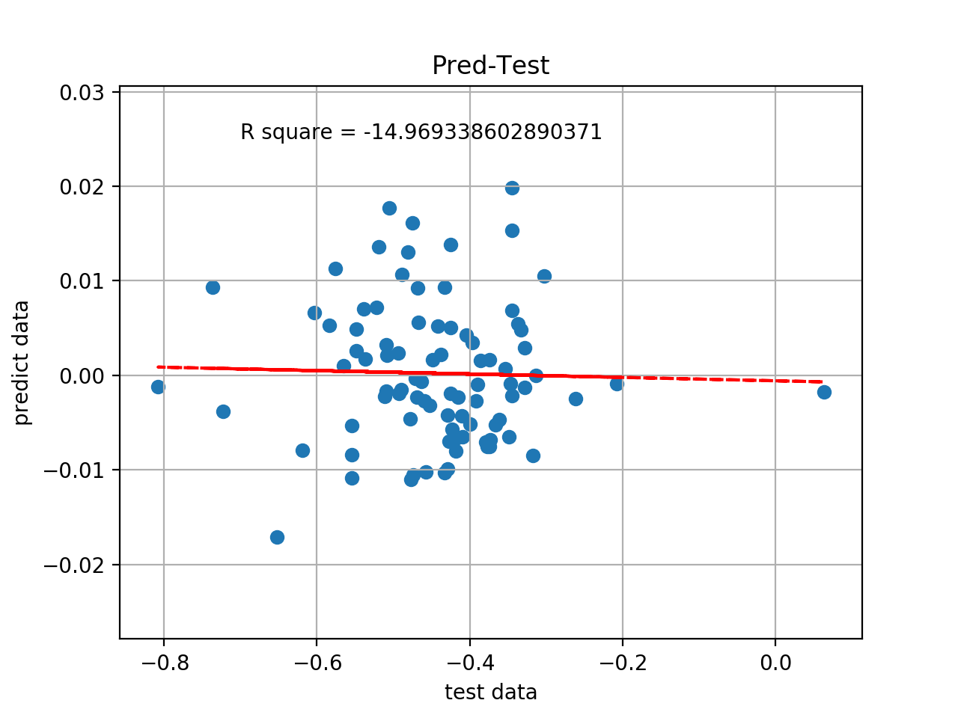
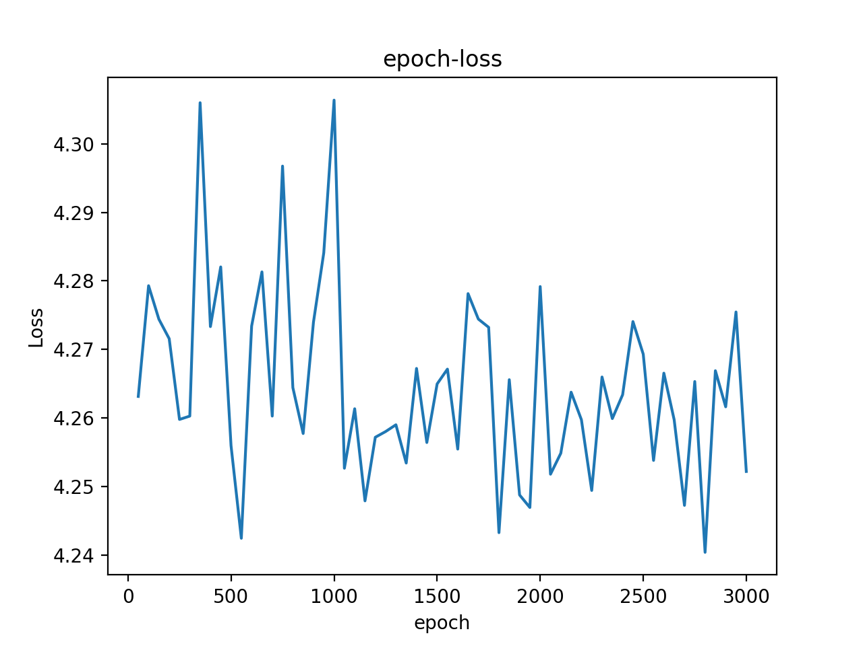
DUL4-SGD2
lr scheduler (lr = 1.0, factor = 0.99), batch size = 1024, pred = x/100,

Slide 10
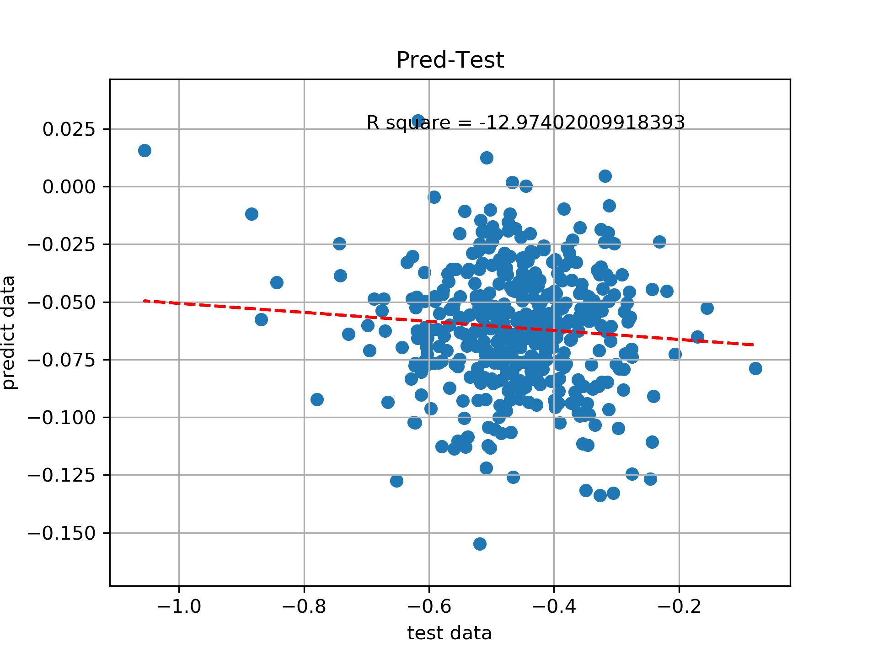

DUL4-SGD3
lr = 0.001, batch size = 1024, pred = x/100,

Slide 11
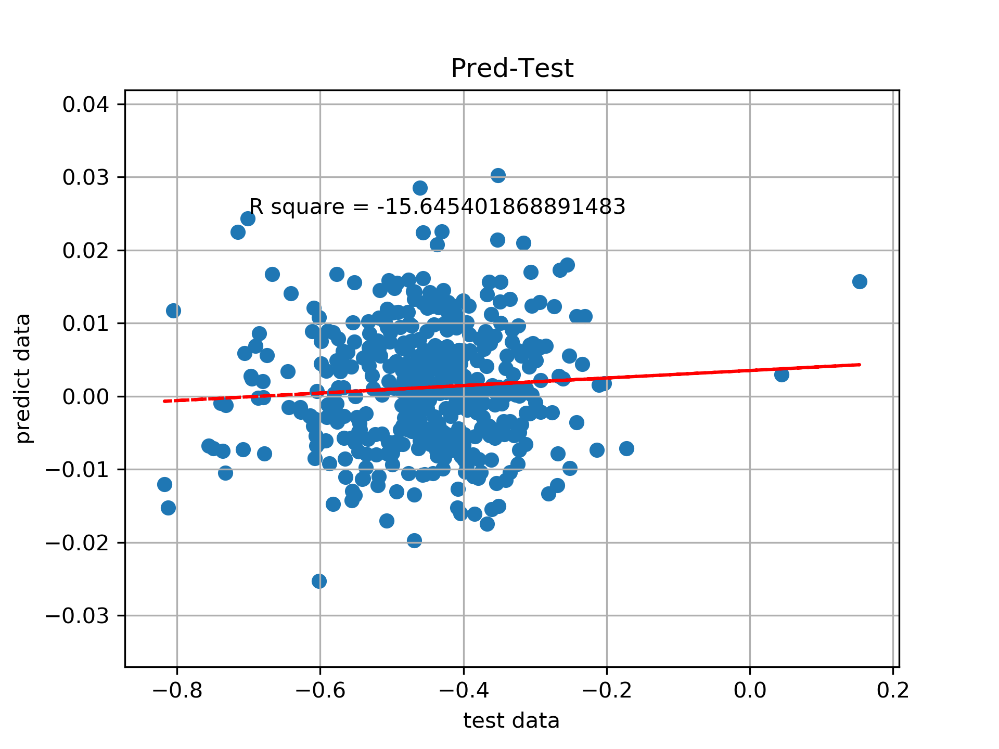
DUL4-Adam2
lr scheduler (lr = 1.0, factor = 0.99), batch size = 1024, pred = x/100,

Slide 12
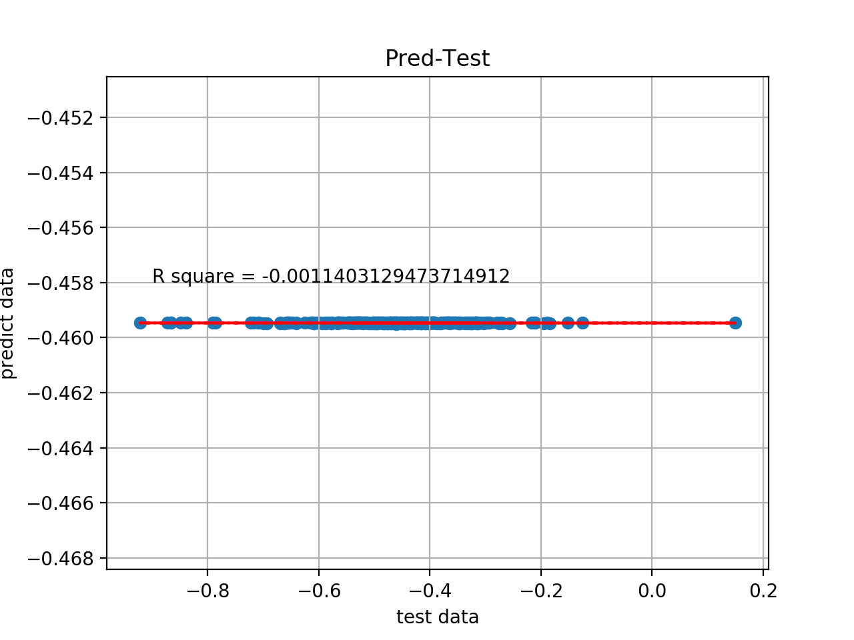
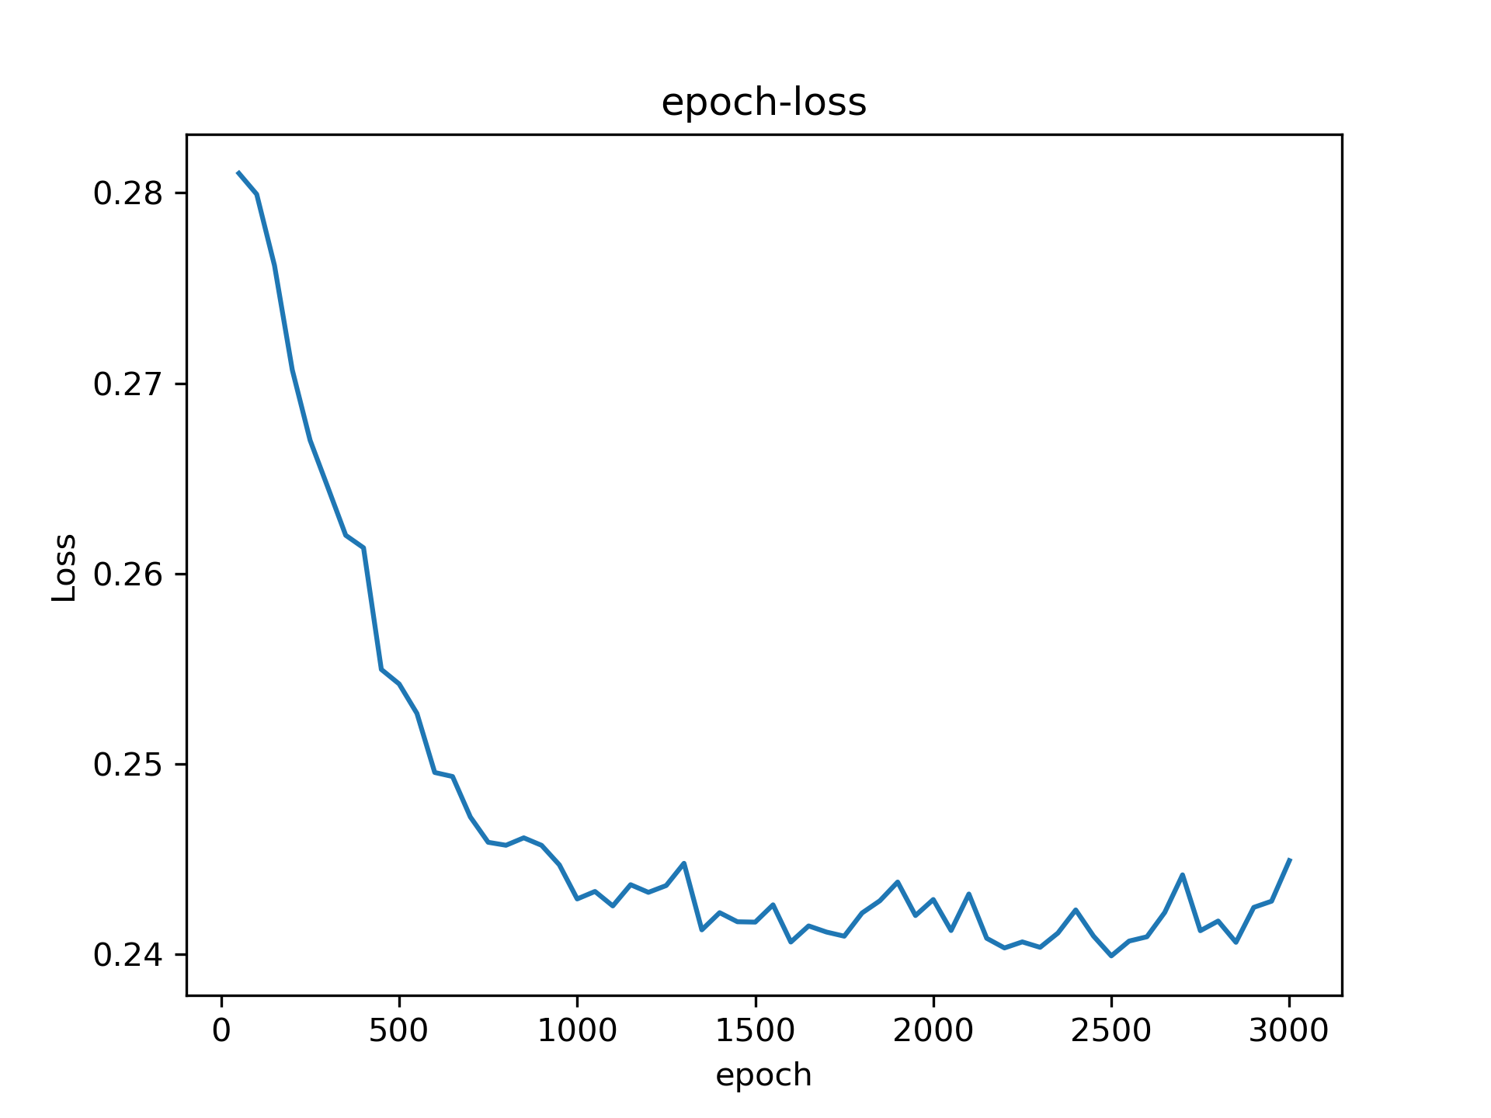
DUL4-Adam3
lr = 0.001, batch size = 1024, pred = x/100,

Slide 13
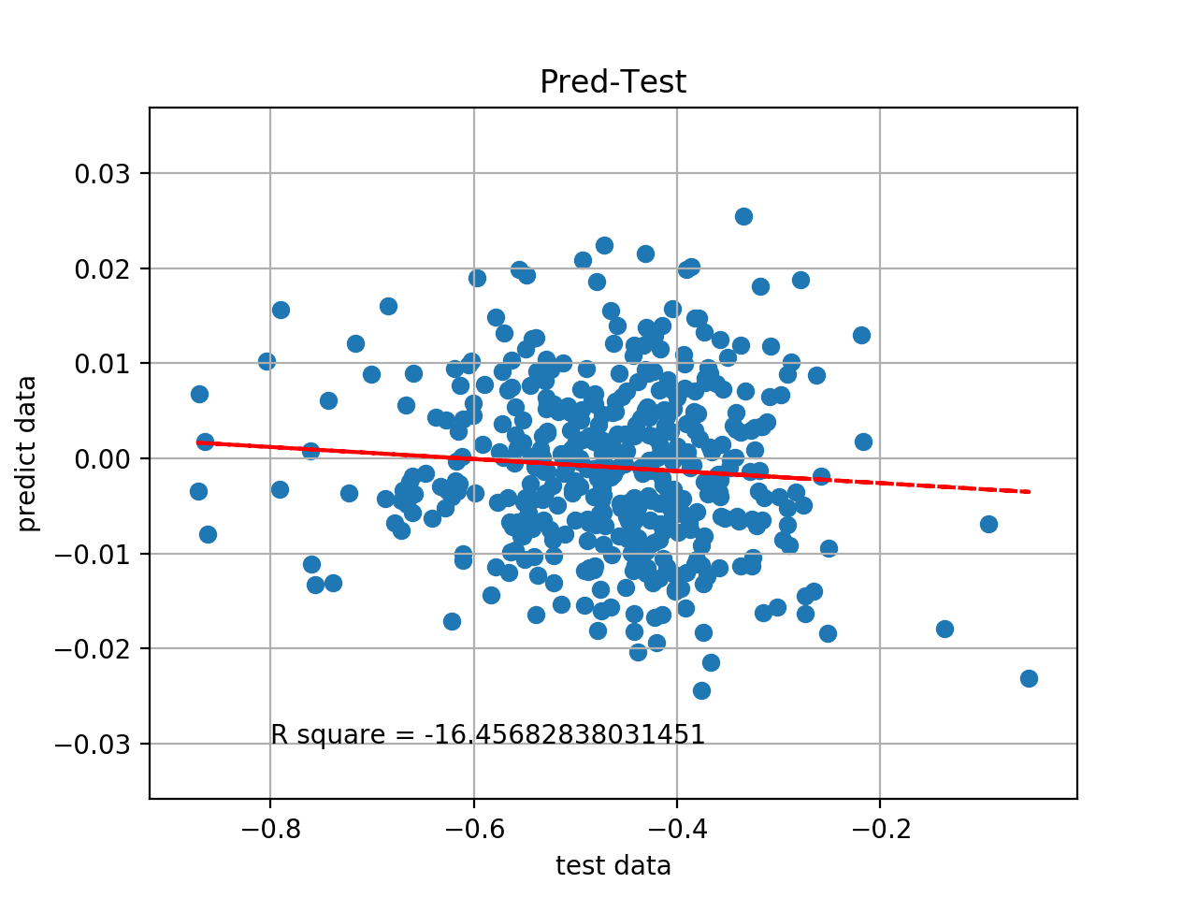
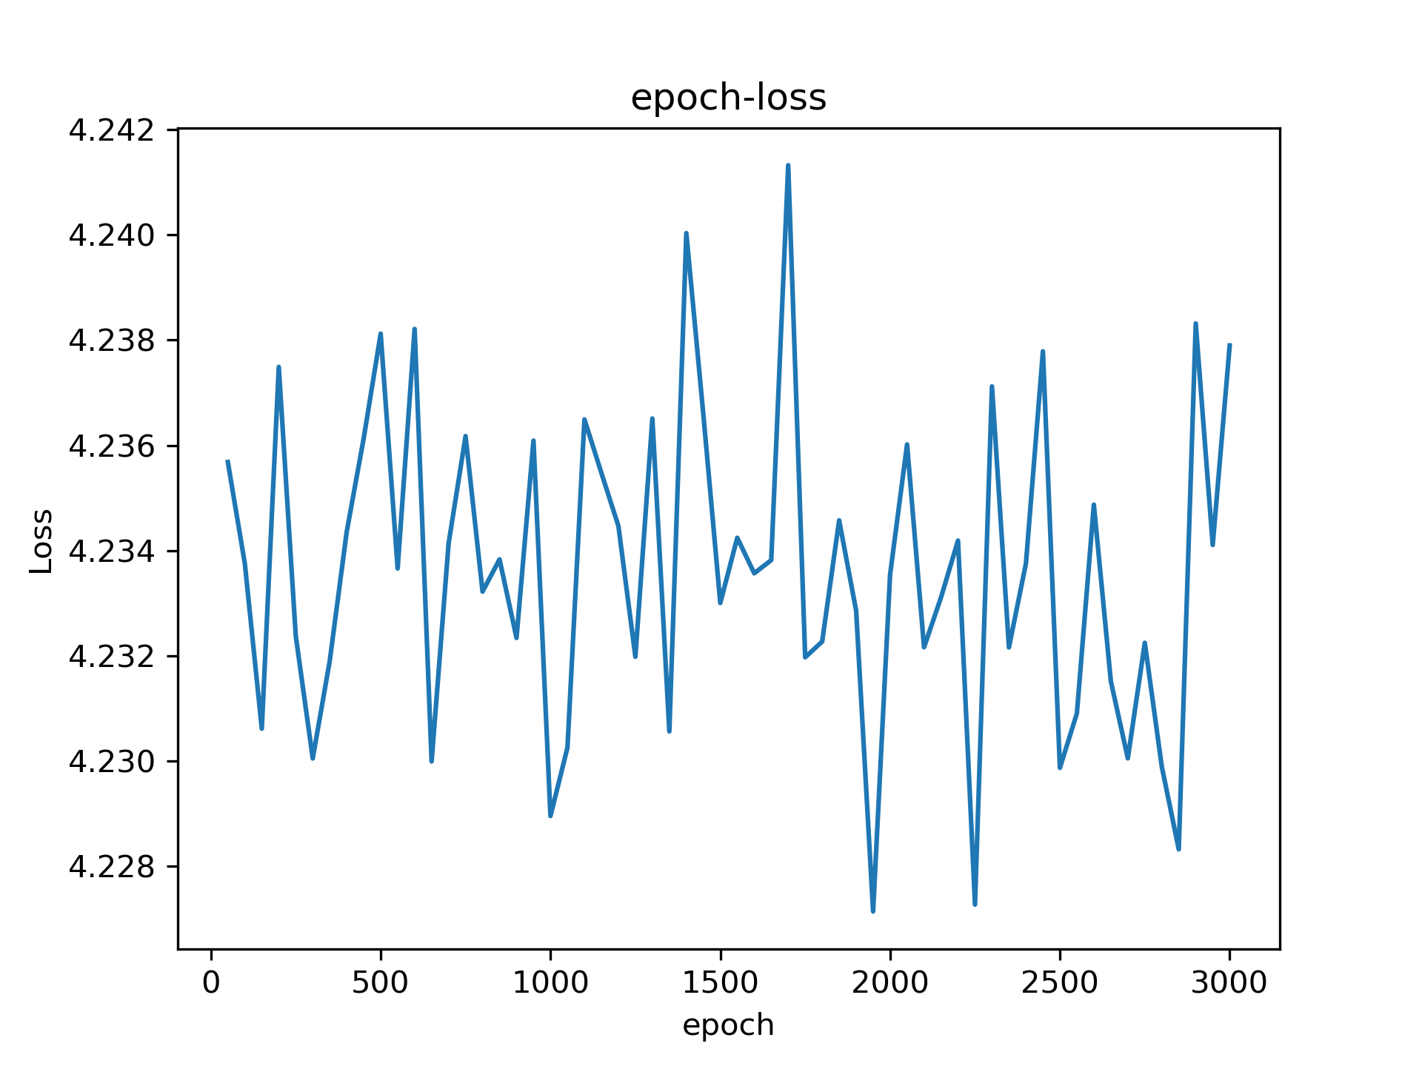
L4-SGD4
lr scheduler (lr = 0.001, factor = 0.99), batch size = 1024, pred = x/100,

Slide 14
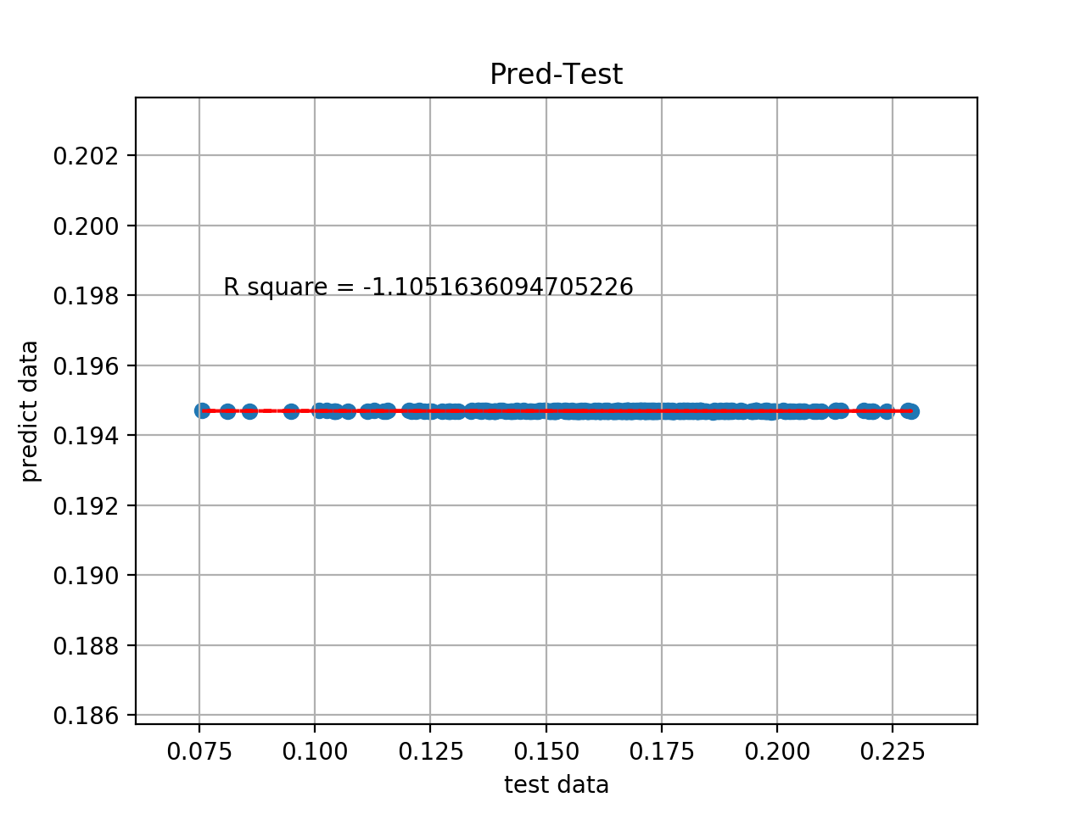
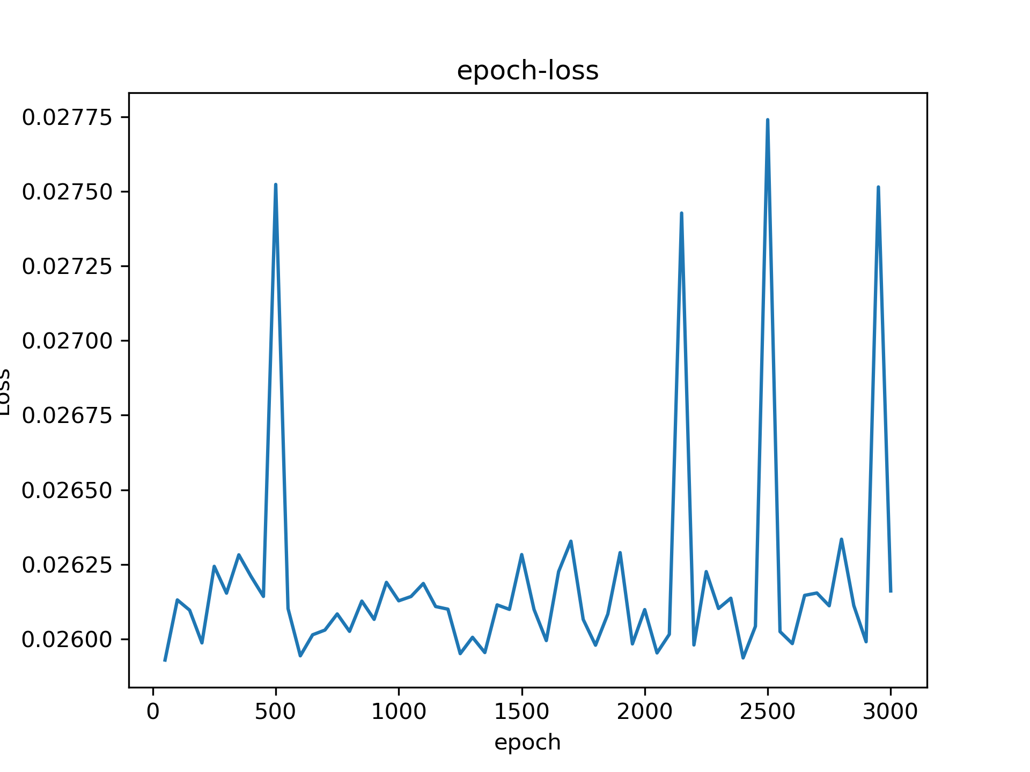
L4-SGD5
lr = 0.01, batch size = 1024, pred = y/100, only fingerprint, dropout = 0.1, ynew

Slide 15
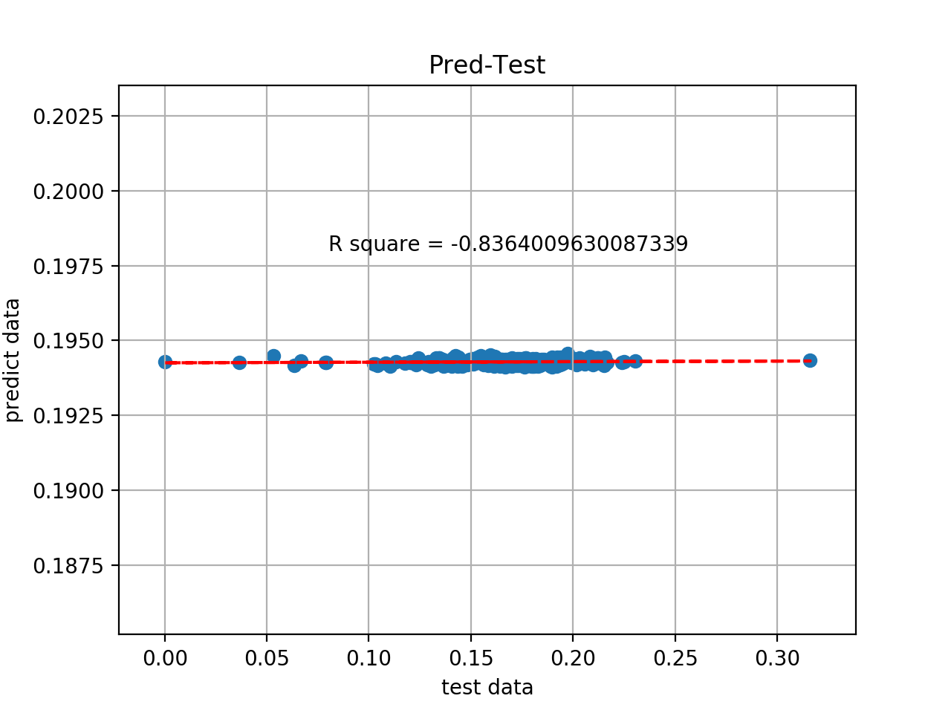
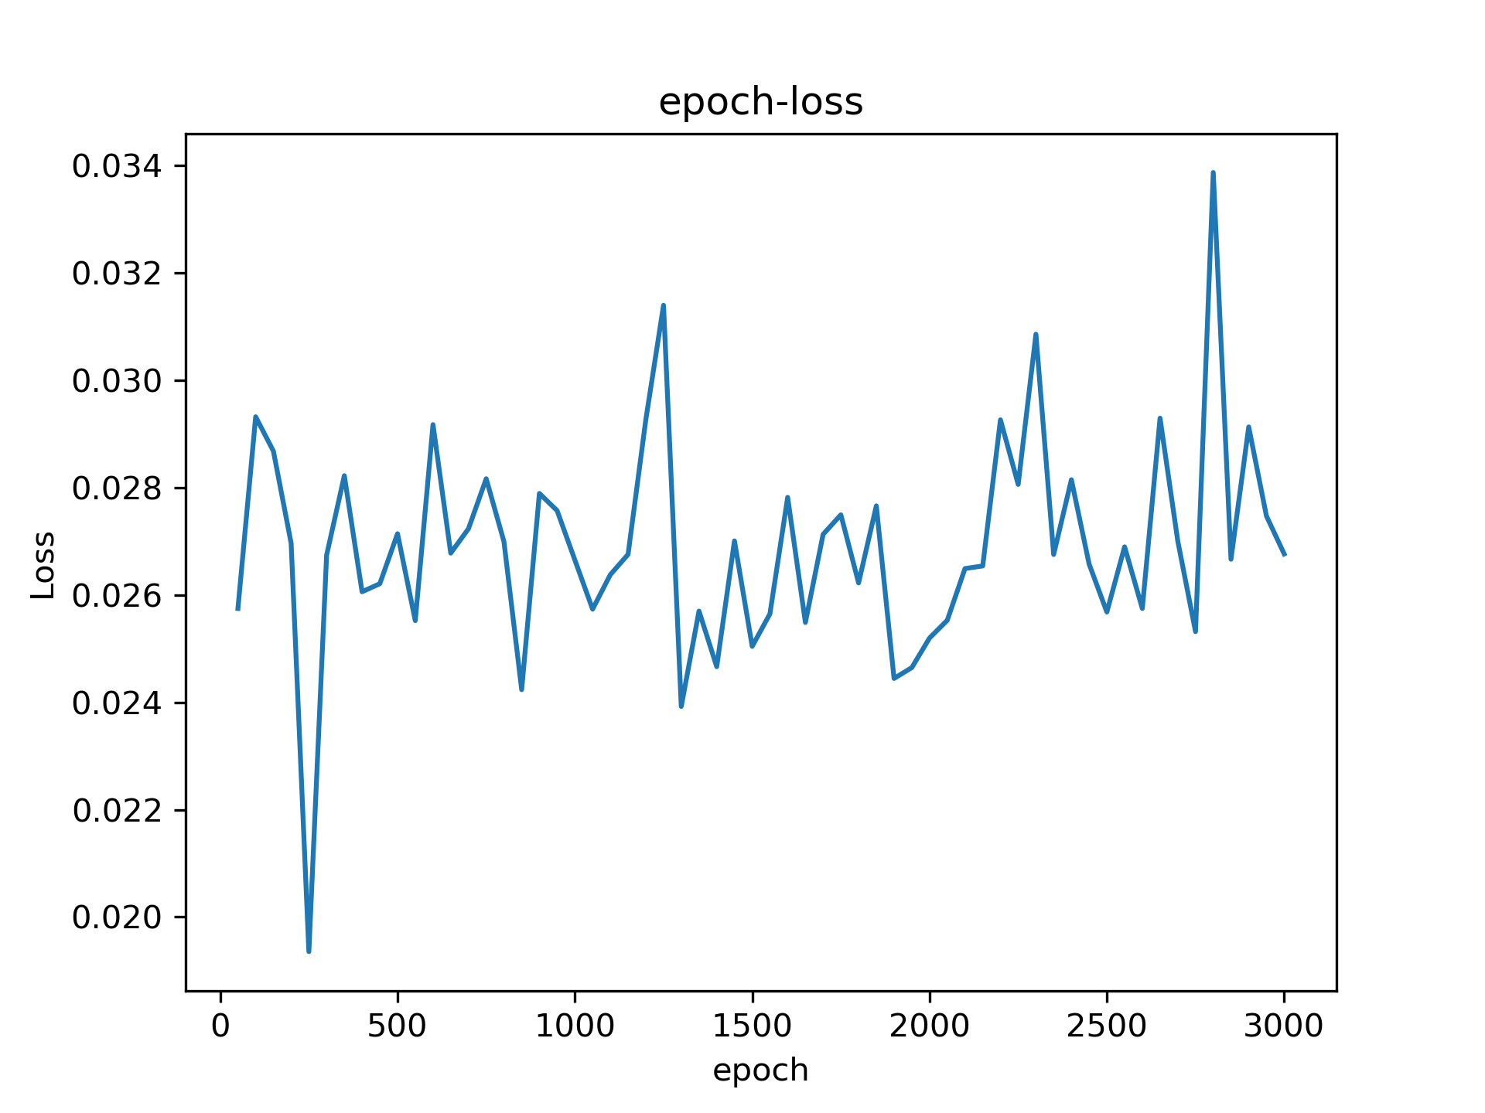
L4-Adam5
lr = 0.01, batch size = 1024, pred = y/100, only fingerprint, dropout = 0.1, ynew = (ytrue-ymin)/(ymax-ymin)

Slide 16
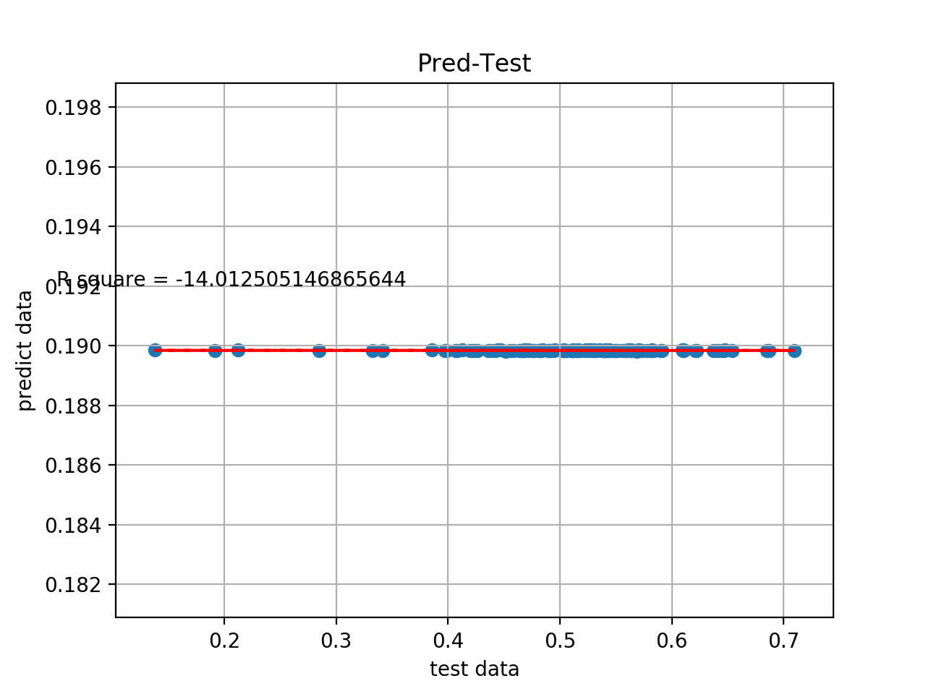
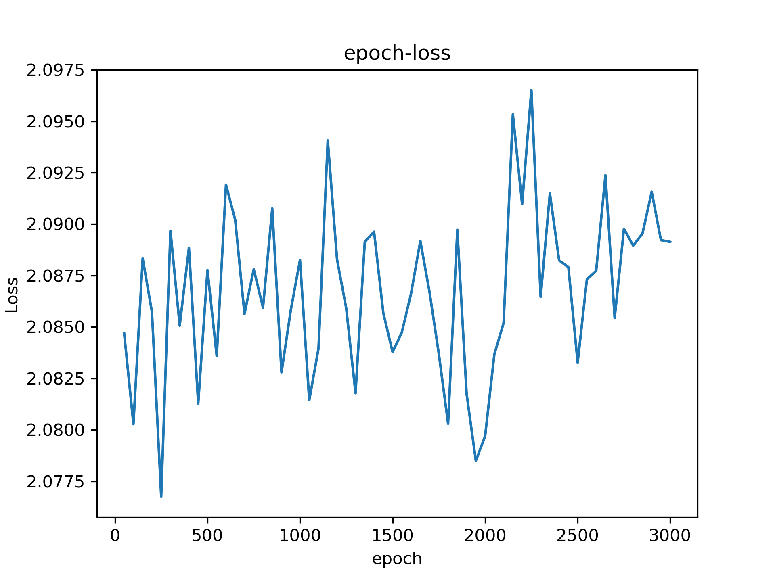
L4-SGD6
lr = 0.01, batch size = 1024, pred = y/100, only fingerprint, dropout = 0.1, ynew = (ytrue-ymin)/(ymax-ymin), act_F = tanh

Slide 17
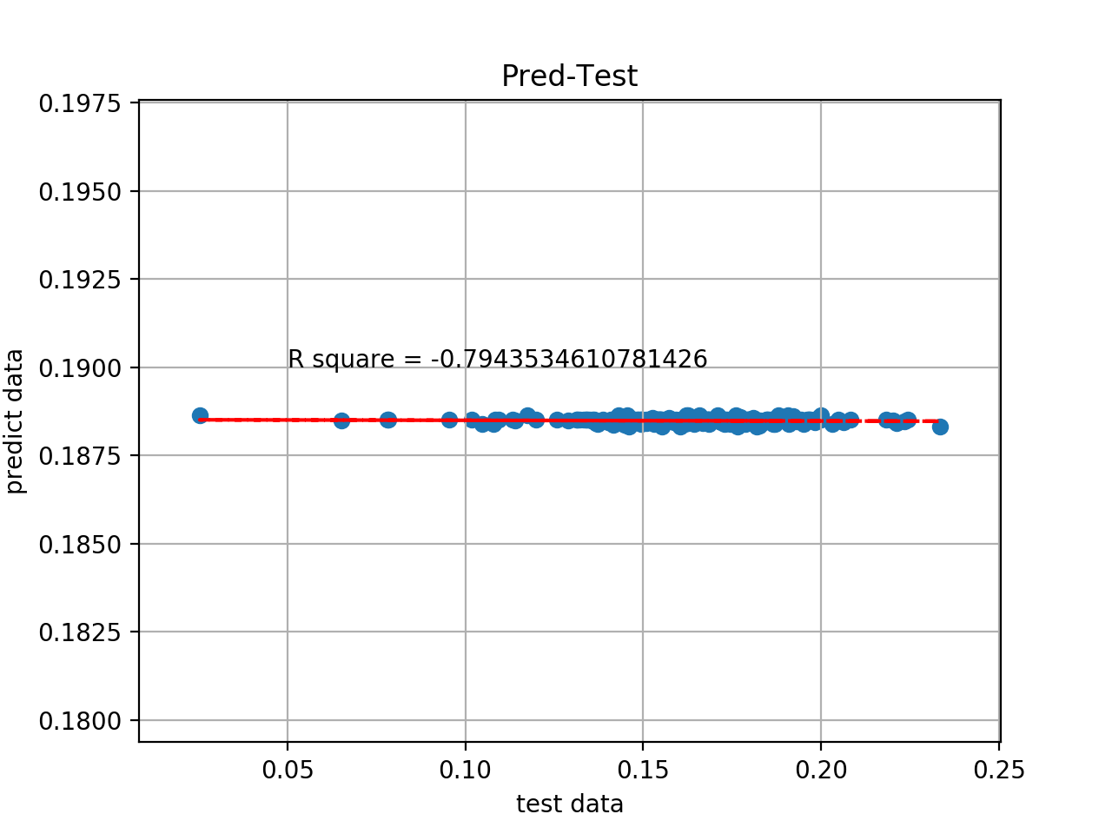
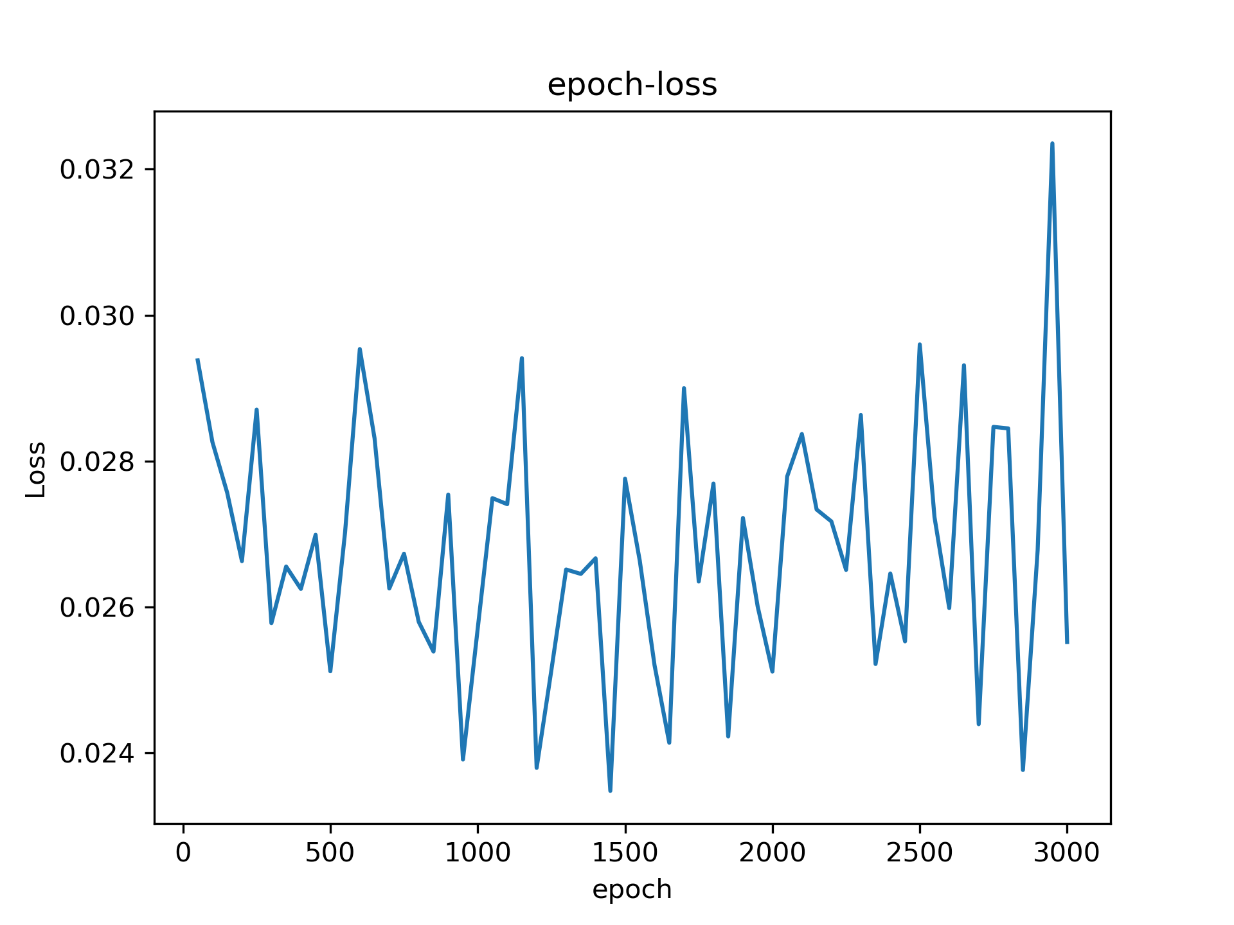
L4-Adam6
lr = 0.01, batch size = 1024, pred = y/100, only fingerprint, dropout = 0.1, ynew = (ytrue-ymin)/(ymax-ymin), act_F = tanh

Slide 18
UDL4-SGD6
lr = 0.01, batch size = 1024, pred = y/100, only fingerprint, dropout = 0.1, ynew = (ytrue-ymin)/(ymax-ymin), act_F = tanh

Slide 19
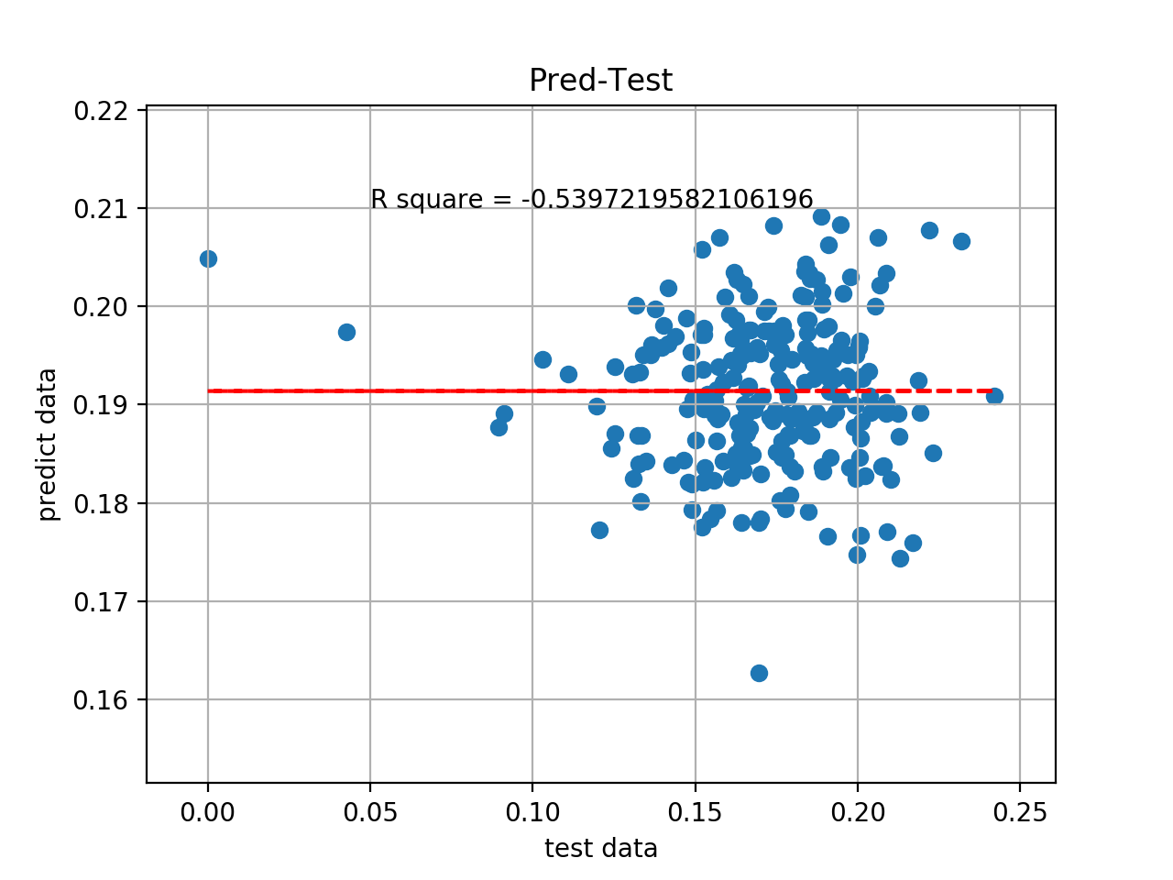
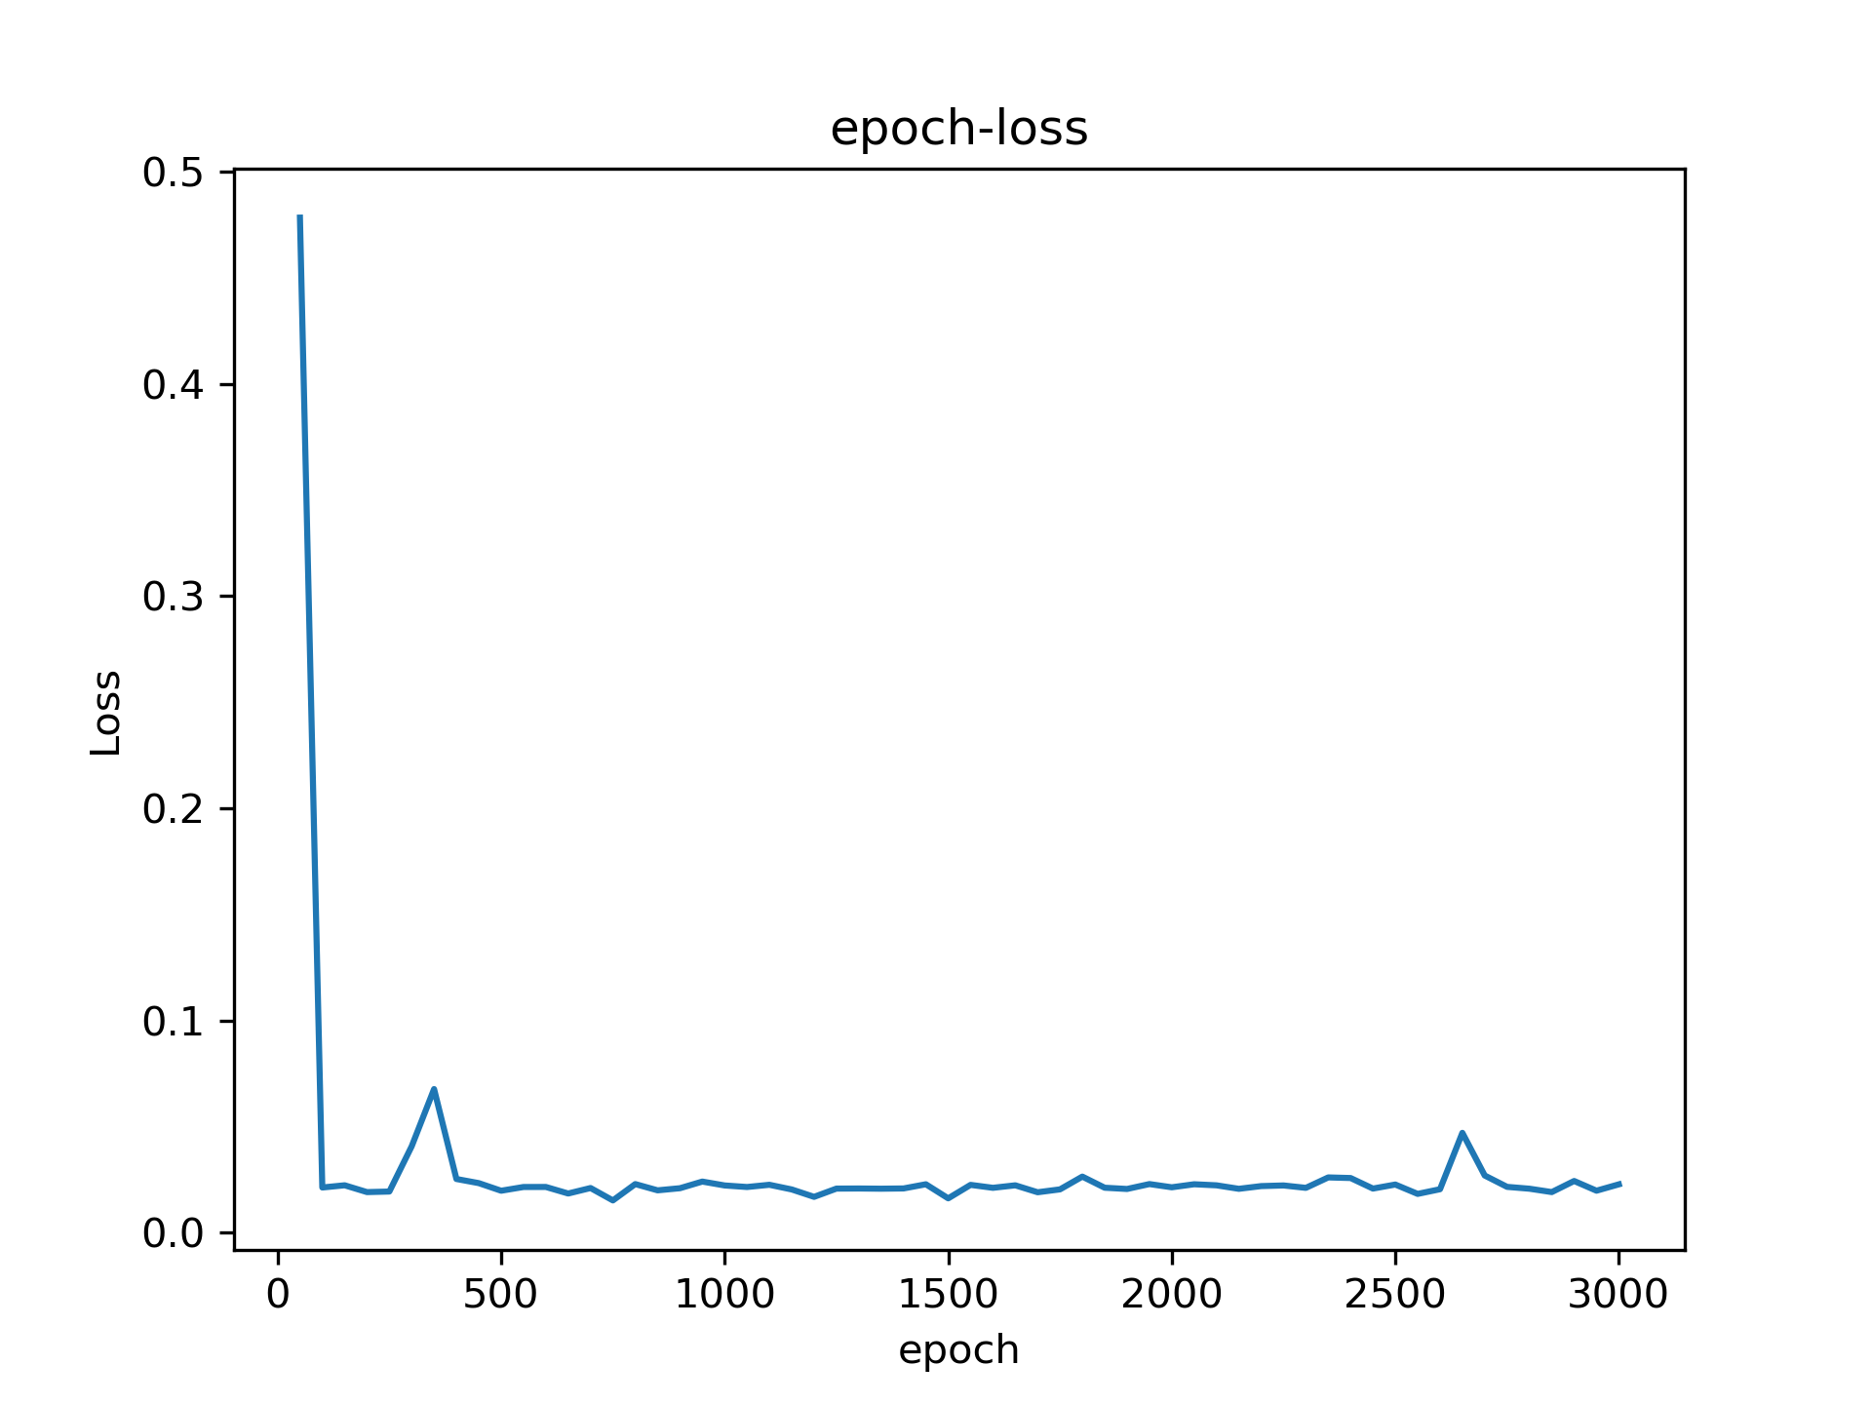
UDL4-Adam6
lr = 0.01, batch size = 1024, pred = y/100, only fingerprint, dropout = 0.1, ynew = (ytrue-ymin)/(ymax-ymin), act_F = tanh

Slide 20
DUL4-SGD6
lr = 0.01, batch size = 1024, pred = y/100, only fingerprint, dropout = 0.1, ynew = (ytrue-ymin)/(ymax-ymin), act_F = tanh

Slide 21
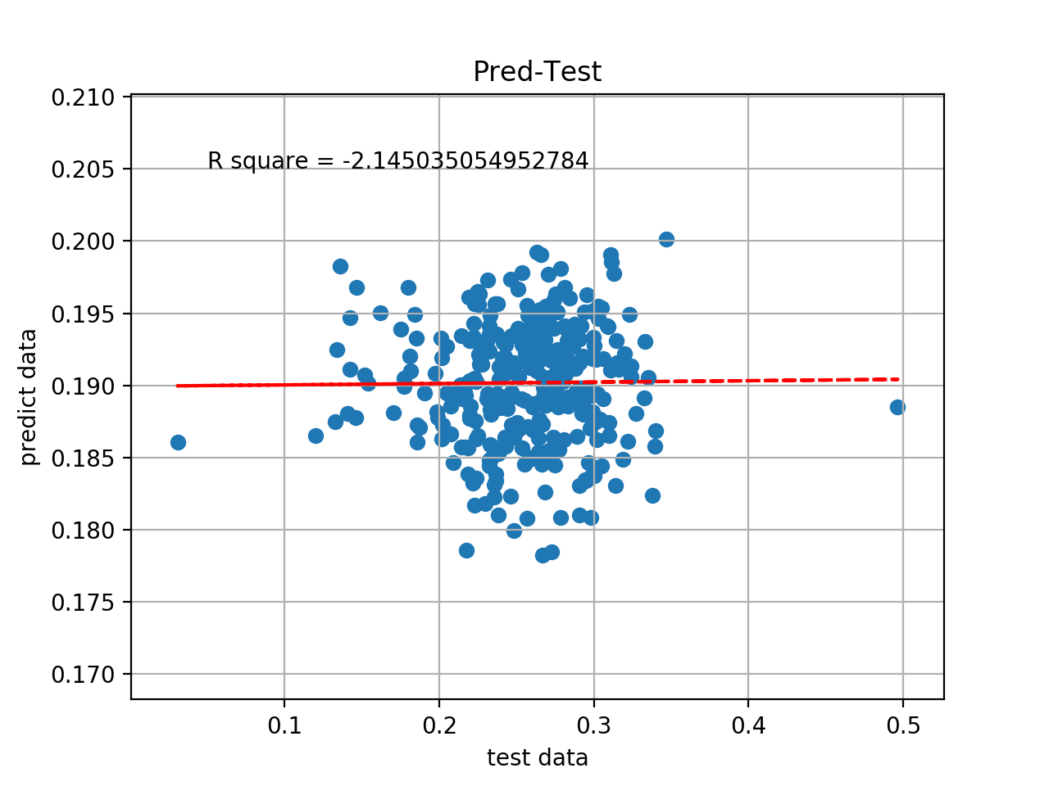
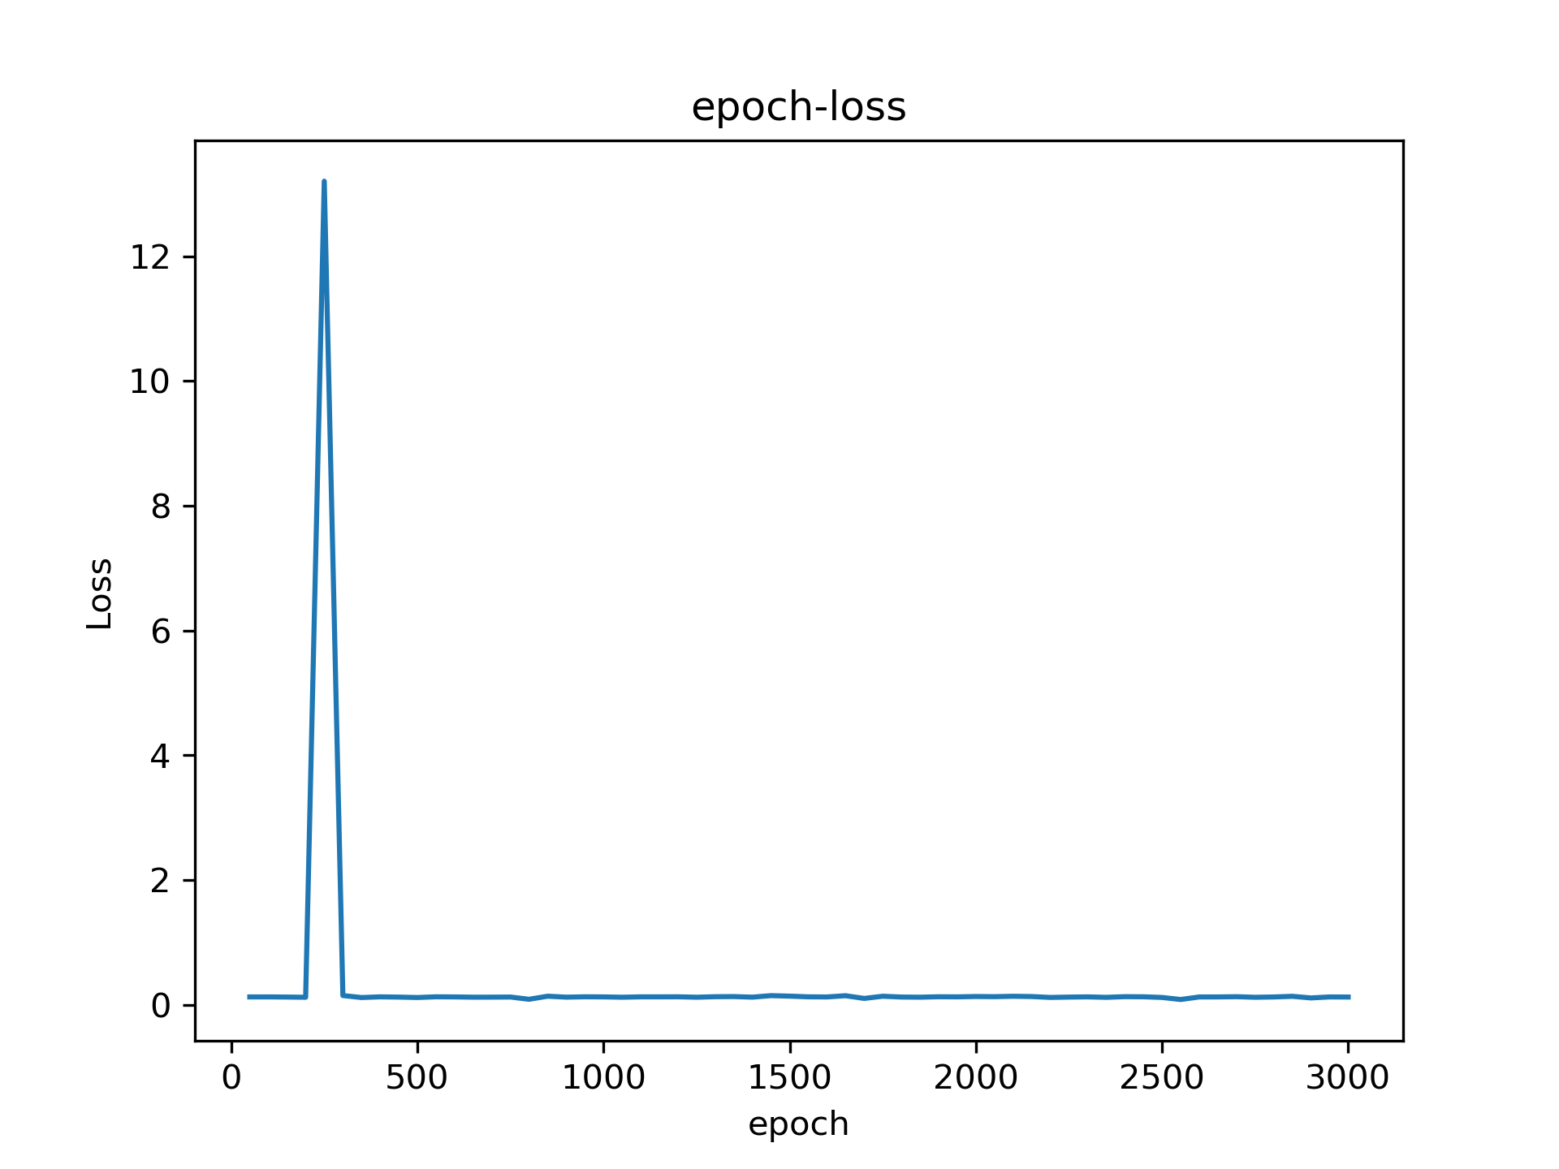
DUL4-Adam6
lr = 0.01, batch size = 1024, pred = y/100, only fingerprint, dropout = 0.1, ynew = (ytrue-ymin)/(ymax-ymin), act_F = tanh

