Slide 1
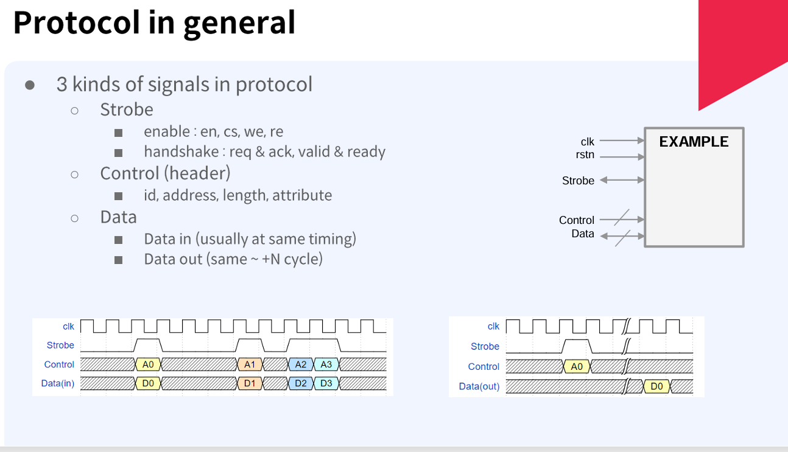

Slide 2
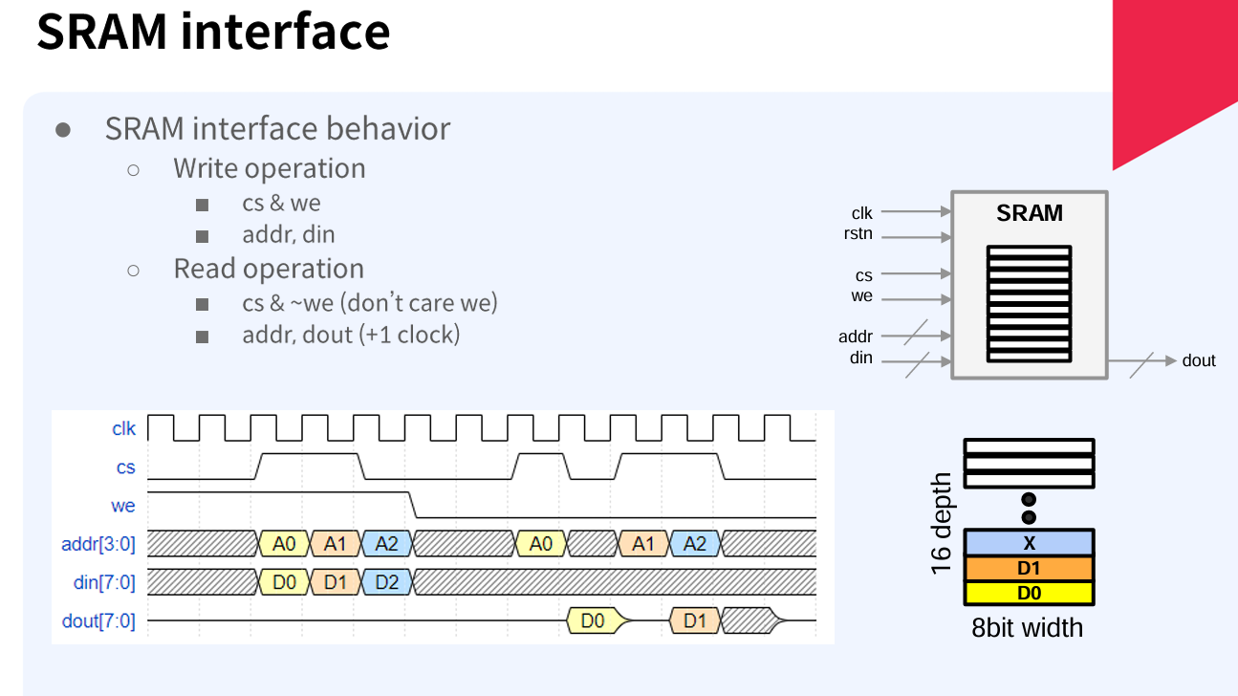

Slide 3
module sram_model #(
parameter DEPTH=8,
parameter WIDTH=16,
parameter DEPTH_LOG=$clog2(DEPTH)
)(
input clk,
input cs, we,
input [DEPTH_LOG-1:0] ad,
input [WIDTH-1:0] din,
output reg [WIDTH-1:0] dout
);
reg [WIDTH-1:0] mem[DEPTH-1:0];
initial begin
for (int i=0;i<DEPTH;i++) mem[i] = 0;
end
always @(posedge clk)
if (cs & we) mem[ad] <= din;
else if (cs & !we)dout <= mem[ad];
endmodule

Slide 4
module tb_sram;
parameter DEPTH =8, WIDTH=16;
parameter DEPTH_LOG = $clog2(DEPTH);
reg clk; reg cs, we;
reg [DEPTH_LOG-1:0] ad; reg [WIDTH-1:0] din;
wire [WIDTH-1:0] dout;
sram_model #(DEPTH, WIDTH) u_sram_8x32 (clk, cs, we, ad, din, dout);
initial begin
clk = 0;
forever #5 clk = ~clk;
end
initial begin
cs <= 0; we <= 0;
@(posedge clk);
for (int i=0;i<8;i++) begin
cs <= 1; we <= 1; ad <= i;
din <= 'h10+i;
@(posedge clk);
end

Slide 5
cs <= 0; we <= 0;
@(posedge clk);
for (int i=0;i<8;i++) begin
cs <= 1;
we <= 0;
ad <= i;
@(posedge clk);
end
repeat (3) @(posedge clk);
$finish;
end
endmodule

