Slide 1
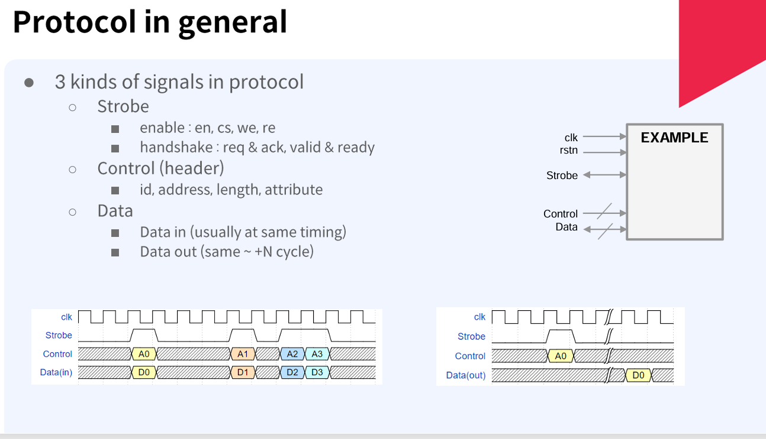

Slide 2
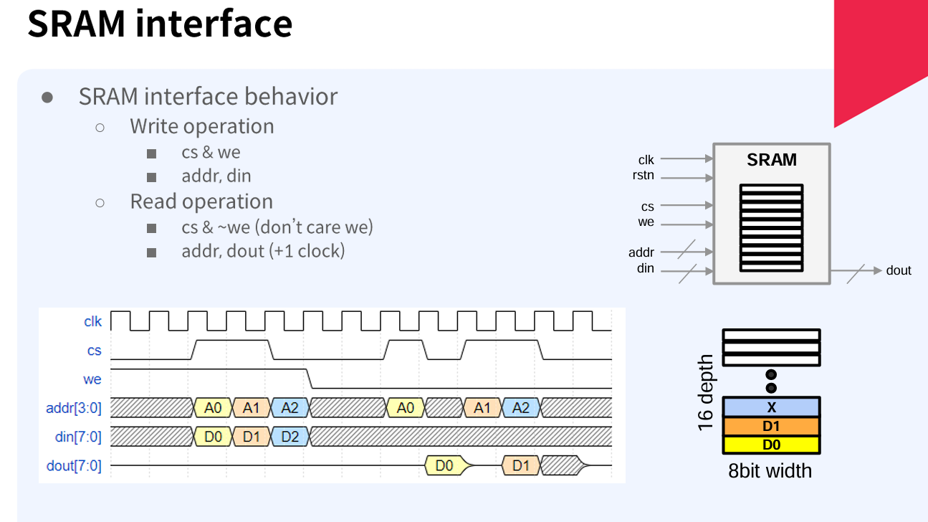

Slide 3
module sram_model #(
parameter DEPTH=8,
parameter WIDTH=16,
parameter DEPTH_LOG=$clog2(DEPTH)
)(
input clk,
input cs, we,
input [DEPTH_LOG-1:0] ad,
input [WIDTH-1:0] din,
output reg [WIDTH-1:0] dout
);
reg [WIDTH-1:0] mem[DEPTH-1:0];
initial begin
for (int i=0;i<DEPTH;i++) mem[i] = 0;
end
always @(posedge clk)
if (cs & we) mem[ad] <= din;
else if (cs & !we)dout <= mem[ad];
endmodule

Slide 4
module tb_sram;
parameter DEPTH =8, WIDTH=16;
parameter DEPTH_LOG = $clog2(DEPTH);
reg clk; reg cs, we;
reg [DEPTH_LOG-1:0] ad; reg [WIDTH-1:0] din;
wire [WIDTH-1:0] dout;
sram_model #(DEPTH, WIDTH) u_sram_8x32 (clk, cs, we, ad, din, dout);
initial begin
clk = 0;
forever #5 clk = ~clk;
end
initial begin
cs <= 0; we <= 0;
@(posedge clk);
for (int i=0;i<8;i++) begin
cs <= 1; we <= 1; ad <= i;
din <= 'h10+i;
@(posedge clk);
end

Slide 5
cs <= 0; we <= 0;
@(posedge clk);
for (int i=0;i<8;i++) begin
cs <= 1;
we <= 0;
ad <= i;
@(posedge clk);
end
repeat (3) @(posedge clk);
$finish;
end
endmodule

Slide 6
module sram_test_top (
input clk,
input rst,
input [15:0] sw,
input btn_write,
input btn_read,
output [7:0] led
);
wire cs;
wire [2:0] ad;
wire [7:0] din;
assign cs = sw[15]; // CS
assign ad = sw[13:11]; // 주소
assign din = sw[10:3]; // 데이터
wire btn_w_clean, btn_r_clean;
debounce db_w (
.clk(clk),
.rst(rst),
.noisy_in(btn_write),
.clean_out(btn_w_clean)
);

Slide 7
debounce db_r (
.clk(clk),
.rst(rst),
.noisy_in(btn_read),
.clean_out(btn_r_clean)
);
// 엣지 검출
wire write_pulse, read_pulse;
edge_detect ed_w (
.clk(clk),
.rst(rst),
.sig(btn_w_clean),
.pulse(write_pulse)
);
edge_detect ed_r (
.clk(clk), .rst(rst), .sig(btn_r_clean), .pulse(read_pulse) );
// SRAM 연결
wire [7:0] dout;
sram_model u_sram (
.clk(clk), .cs(cs), .we(write_pulse), .ad(ad), .din(din), .dout(dout) );

Slide 8
reg [7:0] led_reg;
always @(posedge clk or posedge rst) begin
if (rst)
led_reg <= 0;
else if (read_pulse)
led_reg <= dout;
end
assign led = led_reg;
endmodule
module debounce (
input clk,
input rst,
input noisy_in,
output reg clean_out
);

Slide 9
parameter DEBOUNCE_CNT = 500_000;
reg [19:0] cnt;
reg sync0, sync1;
always @(posedge clk) begin
sync0 <= noisy_in; sync1 <= sync0;
end
always @(posedge clk or posedge rst) begin
if (rst) begin
cnt <= 0; clean_out <= 0;
end else begin
if (sync1 != clean_out) begin
if (cnt < DEBOUNCE_CNT)
cnt <= cnt + 1;
else begin
clean_out <= sync1;
cnt <= 0;
end
end else begin
cnt <= 0;
end
end
end
endmodule

Slide 10
module edge_detect ( input clk, input rst, input sig, output reg pulse );
reg prev;
always @(posedge clk or posedge rst) begin
if (rst) begin
prev <= 0; pulse <= 0;
end else begin
pulse <= sig & ~prev; prev <= sig;
end
end
endmodule

Slide 11
module sram_model #(
parameter DEPTH=8,
parameter WIDTH=8,
parameter DEPTH_LOG=$clog2(DEPTH)
)(
input clk, input cs, we,
input [DEPTH_LOG-1:0] ad, input [WIDTH-1:0] din,
output reg [WIDTH-1:0] dout);
reg [WIDTH-1:0] mem[DEPTH-1:0];
integer i;
initial begin
for ( i=0;i<DEPTH;i=i+1)
mem[i] = 0;
end
always @(posedge clk) begin
if (cs & we) mem[ad] <= din;
else if (cs & !we) dout <= mem[ad];
end
endmodule

