Slide 1
Self introduction
Jie Yong Shin

Slide 2
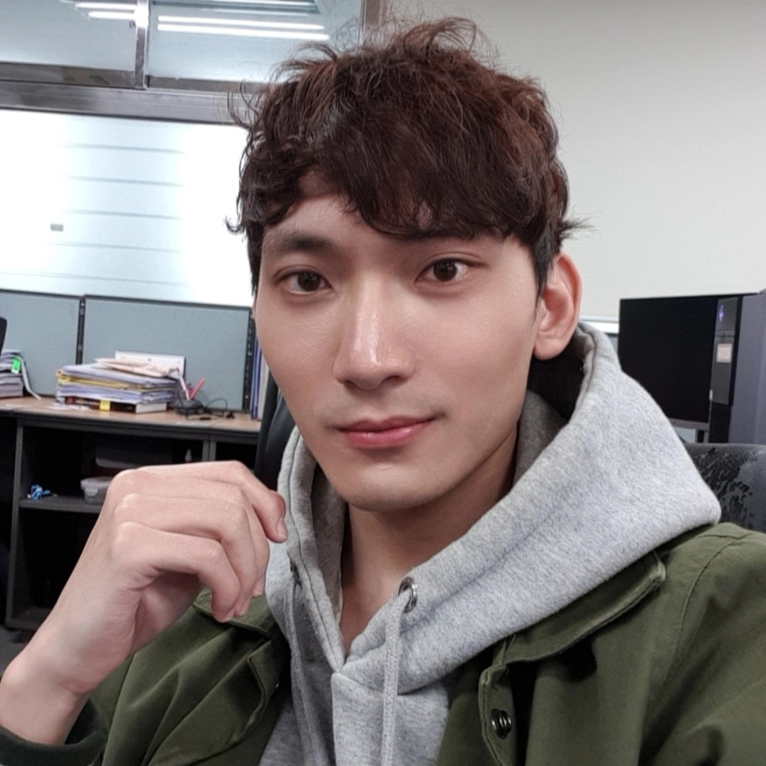
About Me
Jie Yong Shin
Master course in Computer Engineering at DSU (3rd Semester)

Slide 3
Table of Contents
01
02
Self introduction
Language
Timeline
summary
Reaserch Interests
AutoML
DARTS

Slide 4
Communication
Mother tongue
Korean
Other language
English

Slide 5
Timeline
1
2
3
4
2003-2006
2012-2018
2018-2020
2021-2023
Studied English in Phillippines
Majored in Radiology at Gimcheon University
Worked in a hospital as a Radiologist
Master course in Computer Enginnering

Slide 6
Summary
Education
Skills
Radiology
Computer Engineering
Python
Pytorch
Experience
Research
Radiologist
Some Projects
AutoML
HPO and NAS

Slide 7
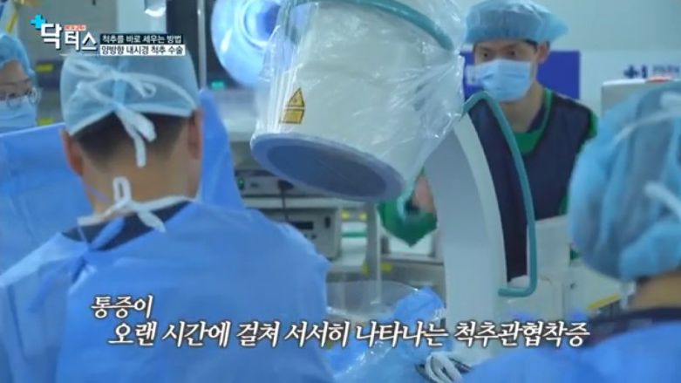

Slide 8

Research Interest

Slide 9

AutoML
Implement
Test
Education

Slide 10
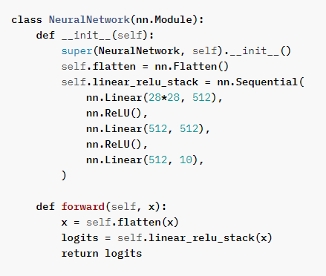
AutoML

Slide 11
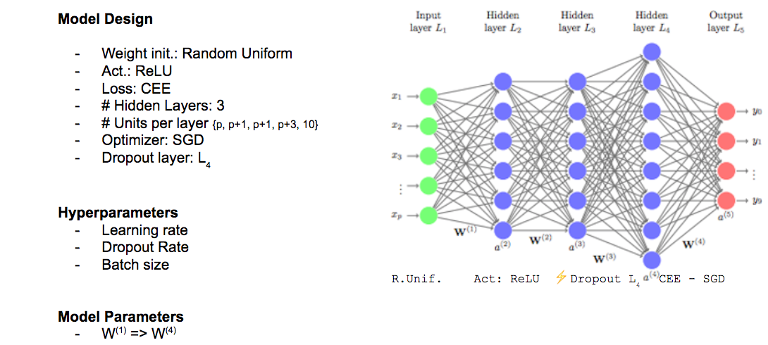
AutoML

Slide 12
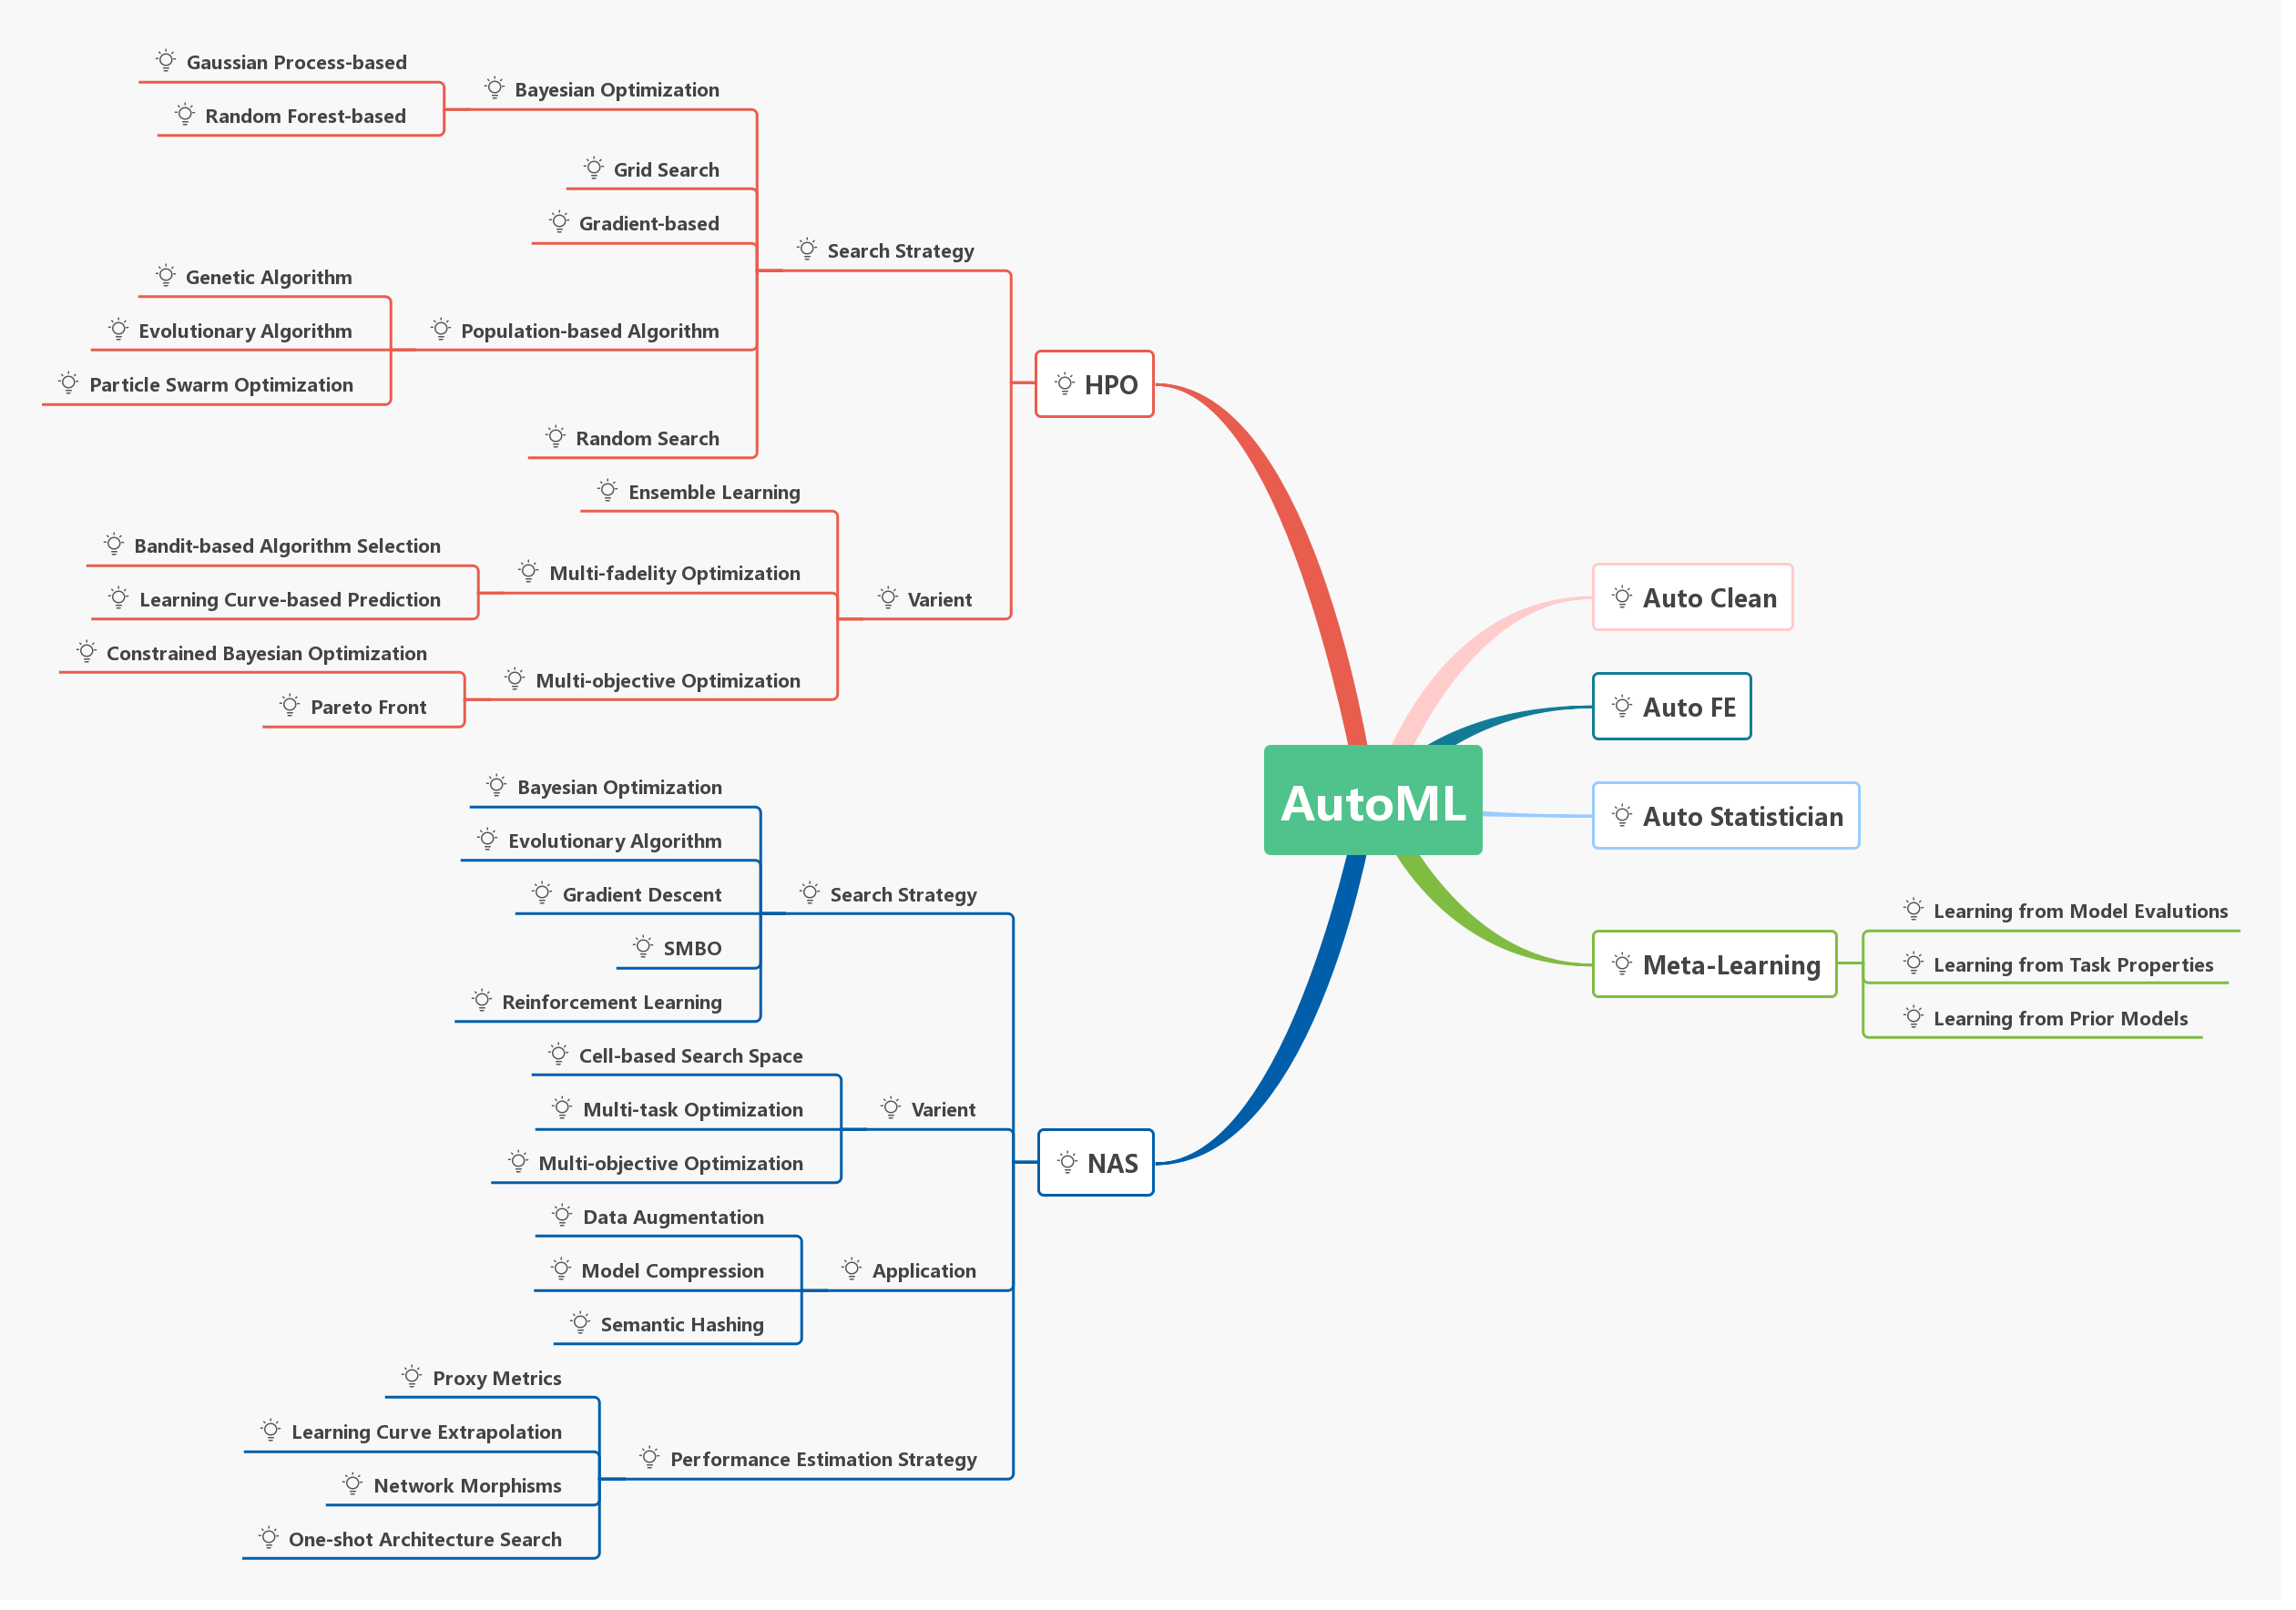
AutoML

Slide 13
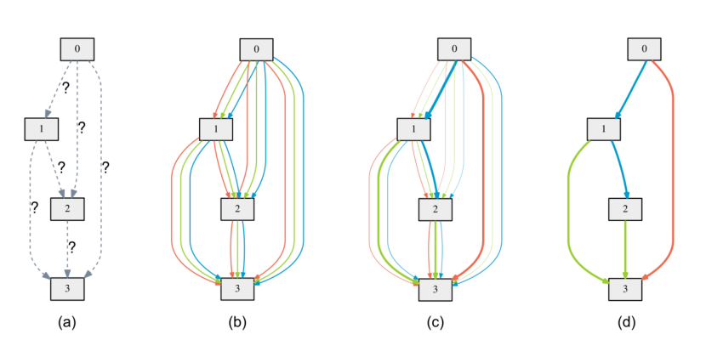
NAS

Slide 14
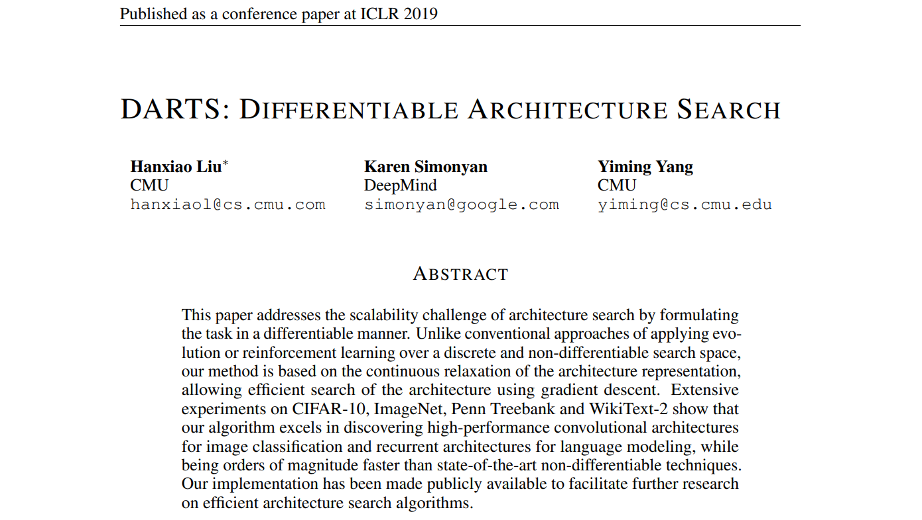
DARTS

Slide 15
DARTS

Slide 16



DARTS
$$α_{1}$$
$$α_{2}$$
$$α_{3}$$

Slide 17
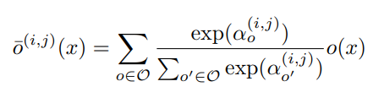

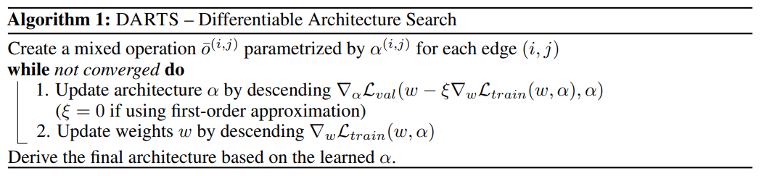
DARTS

Slide 18
Contact
Email | tkwjsup@naver.com
Phone | 010 8713 8099
github | github.com/wldyd920
kakao | wldyd920

Slide 19
Thanks!
Do you have any questions?
tkwjsup@naver.com
010-8713-8099
Please keep this slide for attribution

Slide 20
Thank you !

