Slide 1
PreNAS: Preferred One-Shot Learning Towards Efficient Neural Architecture Search
Haibin Wang, Ce Ge, Hesen Chen, Xiuyu Sun
Alibaba Group
Prepared by Jie Yong Shin
11th Aug 2023

Slide 2
Highlights
One-Shot NAS with Preferred Learning
Isomers: Isomers are the set of model that has same parameter size but with different architecture.
Normalized SNIP: A measure score for various architecture’s connection sensitivity.

Slide 3
Outline
One-Shot NAS with Preferred Learning
Isomers
Normalized SNIP
Experimental Results
Conclusion

Slide 4
Outline
One-Shot NAS with Preferred Learning
Isomers
Normalized SNIP
Experimental Results
Conclusion

Slide 5
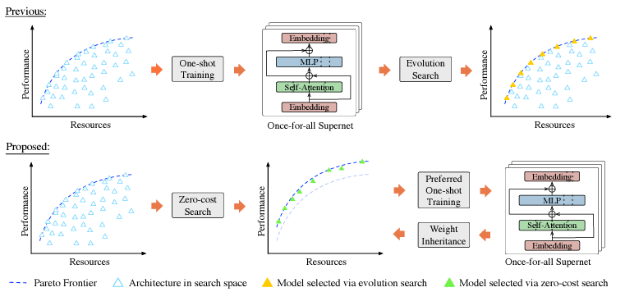
The Whole Process

Slide 6
Outline
One-Shot NAS with Preferred Learning
Isomers
Normalized SNIP
Experimental Results
Conclusion

Slide 7
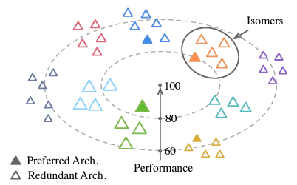
Isomers
For a L-block in a Transformer architecture α := (β1, β2, . . . , βL) with βi the configurations of i-th block, all architectures produced by reordering α are isomers.

Slide 8
Outline
One-Shot NAS with Preferred Learning
Isomers
Normalized SNIP
Experimental Results
Conclusion

Slide 9
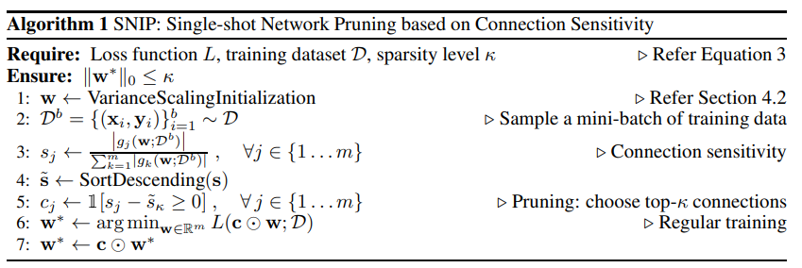
SNIP
“SNIP: SINGLE -SHOT NETWORK PRUNING BASED ON CONNECTION SENSITIVITY”

Slide 10
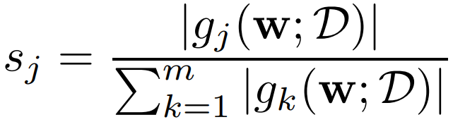
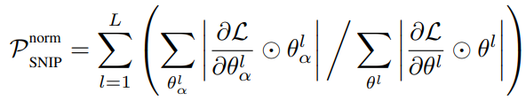
Normalized SNIP
SNIP Sensitivity
Normalized SNIP

Slide 11
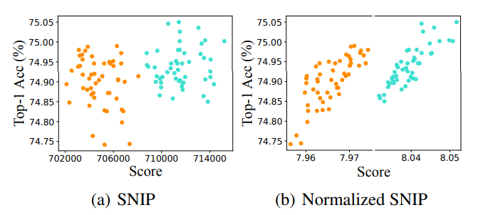
SNIP VS Normalized SNIP

Slide 12
Outline
One-Shot NAS with Preferred Learning
Isomers
Normalized SNIP
Experimental Results
Conclusion

Slide 13
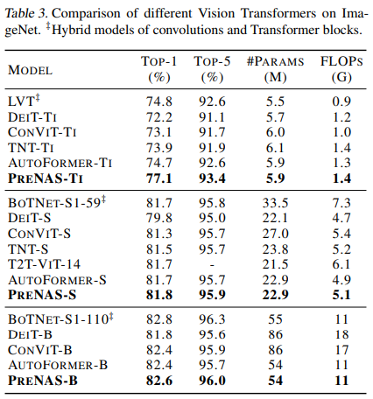
Comparison with Manually Designed Architectures

Slide 14
Outline
One-Shot NAS with Preferred Learning
Isomers
Normalized SNIP
Experimental Results
Conclusion

Slide 15
Conclusion
PreNAS, a new learning paradigm that combines oneshot and zero-shot NAS, is proposed to train and search for optimal architectures within a preferred sample space, aiming to improve search efficiency and training efficacy.
Normalized SNIP improved the representation of architectures, accordingly applied to Zero-Shot NAS for reduction of search space.
Analysis of SNIP and experiments on ImageNet with Transformers verifies the effectiveness of PreNAS.

Slide 16
References
Haibin Wang, “PreNAS: Preferred One-Shot Learning Towards Efficient Neural Architecture Search”, https://arxiv.org/abs/2304.14636
NamhoonLee, “SNIP:SINGLE-SHOTNETWORKPRUNINGBASEDON CONNECTIONSENSITIVITY”, https://arxiv.org/abs/1810.02340

Slide 17
Thank you!
Q & A

