Slide 1
International Players Anthem
(I Choose You)
Identifying value in NBA prospects and players
Jeffrey Fulkerson, Ryan Hoff, Won Lee, Sam Malcolm, Cory Nguyen

Slide 2
Project Statement
Upstart NBA Talent Agents seek a competitive edge in key areas:
Which college basketball players should we attempt to represent?
Everyone wants the stars. Who are the hidden gems?
Which NBA players are being undervalued and may be interested in new representation?
How best to advise clients during contract negotiations?
Should a 29 year old Rebounding specialist seek a longer contract with a lower salary or vice versa?

Slide 3
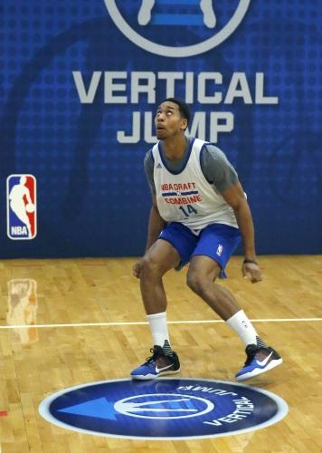
Approach - Data
Datasets (either existing or via Basketball Reference)
NCAA Basketball player statistics
NBA Draft Combine Measurements
NBA Player statistics
NBA Player salaries
Programming Environment
SQL
Database management
Querying, EDA
Python
Data scraping, prep, EDA
Visualization
Potential predictive modeling

Slide 4
Approach - Initial Questions
Pre-NBA
What college statistics and combine measurements lend themselves to:
Players being selected earlier?
Players achieving initial success (minutes-per-game and PER in rookie contract)?
Players having longer careers (aka greater earning potential)?
NBA
What statistics and traits are valued ? Which players demonstrate these?
Are there indicators that a player will begin to sharply lose or gain value?

Slide 5
Approach - Responsibilities
Data Acquisition + Prep - Won “The Shark” Lee
Scraping Basketball Reference, finding existing datasets, expert knowledge
Impute / drop missing values, normalize, etc.
Database Design / Management - Jeffrey “The Shark” Fulkerson
Different data inputs require Relational design and maintenance in SQL
EDA – Ryan “The Shark” Hoff
Initial insights and perspective
Lead Query Artist – Cory “The Shark” Nguyen
All will contribute, but Cory will lead
Topic Expert / Chief Capologist - Sam “The Shark” Malcolm
Leverage existing NBA knowledge to develop hypotheses, interpret results, etc.

Slide 6
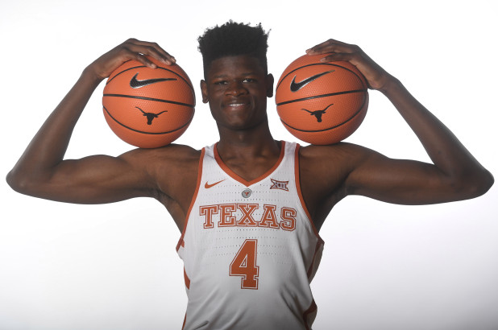
Expected Outcomes
Find key indicators of professional success to identify college players with high earning potential
NCAA Stats + combine measurements
Identify trends in NBA player salaries to help our clients earn more during their careers
Metrics that correlate to higher salaries
How an average player’s salary fluctuates over his career
Is this influenced by our other insights?
Randomly draw 5 players who will be free agents this summer Describe how we would advise them in contract negotiations

Slide 7


Questions?
PICTURED: Agent Jerry Maguire in heated negotiations with child actor Jonathan Lipnicki

