Slide 1


Speaker Verification System
Part A Final Presentation
Performed by: Barak Benita & Daniel Adler
Instructor: Erez Sabbag

Slide 2
The Project Goal:
Implementation of a speaker verification algorithm on a TI 54X DSP

Slide 3
Introduction
Speaker verification is the process of automatically authenticating the speaker on the basis of individual information included in speech waves.
Speaker’s Identity (Reference)
Speaker’s
Voice
Segment
Speaker
Verification
System
Result [0:1]

Slide 4

System Overview:
BT
Base Station
My name is Bob!
LAN
Speaker
Verification
Unit
Server
BT
Base Station
LAN

Slide 5
Project Description:
Part One:
Literature review
Algorithms selection
MATLAB implementation
Result analysis
Part Two:
Implementation of the chosen algorithm
on a DSP

Slide 6
Speaker Verification System – Block Diagram
Analog Speech
Pre-Processing
Feature
Extraction
Reference
Model
Pattern
Matching
Decision
Result [0:1]

Slide 7
Pre-Processing (step 1)
Analog Speech
Windowed PDS Frames
[1, 2, … , N]
Pre-Processing

Slide 8


Pre-Processing module
Analog Speech
Anti aliasing filter to avoid aliasing during sampling. LPF [0, Fs/2]
LPF
Band Limited
Analog Speech
Analog to digital converter with frequency sampling (Fs) of [10,16]KHz
A/D
Digital Speech
Low order digital system to spectrally flatten the signal (in favor of vocal tract parameters), and make it less susceptible to later finite precision effects
First Order FIR
Pre-emphasized
Digital Speech
(PDS)
Frame Blocking
Frame blocking of the sampled signal. Each frame is of N samples overlapped with N-M samples of the previous frame. Frame rate ~ 100 Frames/Sec
N values: [200,300], M values: [100,200]
PDS Frames
Frame
Windowing
Using Hamming (or Hanning or Blackman) windowing in order to minimize the signal discontinuities at the beginning and end of each frame.
Windowed PDS Frames

Slide 9
Feature Extraction (step 2)
Windowed PDS Frames
Set of Feature Vectors
[1, 2, … , N]
[1, 2, … , K]
Feature
Extraction
Extracting the features of speech from each frame and representing it in a vector (feature vector).

Slide 10
Feature Extraction Methods
MFCC
LPC
LPCC
PLP
LFCC
MLPCC
And the Winners are…
LPC
MFCC
Linear Prediction Coeff
Mel Freq Cepstral Coeff
For widely spread in many application and being prototypes for many other variant methods

Slide 11
Feature Extraction Module – MFCC
MFCC (Mel Frequency Cepstral Coefficients) is the most common technique for feature extraction. MFCC tries to mimic the way our ears work by analyzing the speech waves linearly at low frequencies and logarithmically at high frequencies.
The idea acts as follows:
Spectrum
Mel Spectrum
Windowed
PDS Frame
FFT
Mel-frequency
Wrapping
Cepstrum
Mel Cepstrum

Slide 12
MFCC – Mel-frequency Wrapping
Psychophysical studies have shown that human perception of the frequency contents of sounds for speech signals does not follow a linear scale. Thus for each tone with an actual frequency, f, measured in Hz, a subjective pitch is measured on a scale called the ‘mel’ scale. The mel-frequency scale is a linear frequency spacing below 1000 Hz and a logarithmic spacing above 1000 Hz. Therefore we can use the following approximate formula to compute the mels for a given frequency f in Hz:

Slide 13
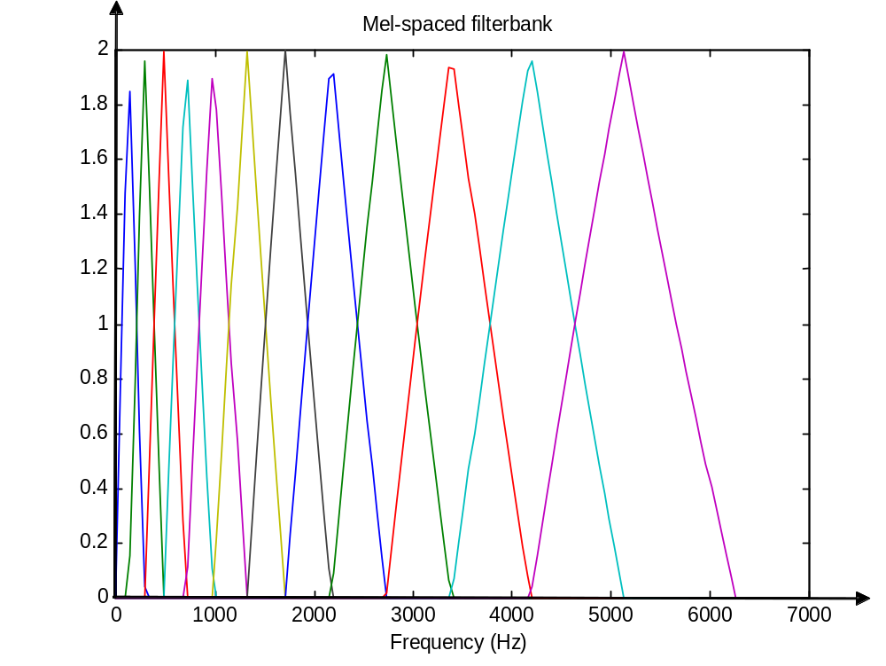
MFCC – Filter Bank
One way to simulating the spectrum is by using a filter bank, spaced uniformly on the mel scale. That filter bank has a triangular bandpass frequency response, and the spacing as well as the bandwidth is determined by a constant mel frequency interval.

Slide 14
MFCC – Cepstrum
Here, we convert the log mel spectrum back to time. The result is called the mel frequency cepstrum coefficients (MFCC). Because the mel spectrum coefficients are real numbers, we can convert them to the time domain using the Discrete Cosine Transform (DCT) and get a featured vector.

Slide 15
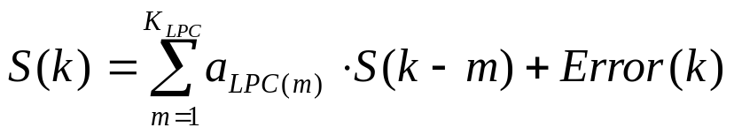
Feature Extraction Module – LPC
LPC (Linear Prediction Coefficients) is a method of extracting the features of speech from a speech signal .LPC encodes a signal by finding a set of weights on earlier signal values that can predict the next signal value:
If values for a[1..k] can be found such that Error[k] is very small for a stretch of speech (say one analysis window), then we can represent the speech features with a[1..k] instead of the signal values in the window. The result of LPC analysis then is a set of coefficients a[1..k] and an error signal Error[k].

Slide 16
Pattern Matching Modeling (step 3)
The pattern matching modeling techniques is divided into two sections:
  The enrolment part, in which we build the reference model of
  the speaker.
  The verifications (matching) part, where the users will be
  compared to this model.

Slide 17
Enrollment part – Modeling
Set of Feature Vectors
[1, 2, … , K]
Modeling
Speaker Model
This part is done outside the DSP and the DSP receives only the speaker model (calculated offline in a host).

Slide 18
Pattern Matching
Set of Feature Vectors
Speaker Model
[1, 2, … , K]
Pattern
Matching
Matching Rate

Slide 19
Pattern Matching - Modeling Methods
The most common methods for pattern matching - modeling in the speaker recognition world
 | VQ | DTW | CHMM variants | VQ + DHMM | Neural Network
Implementation | Simple | Simple | Complex | Complex | Medium
Text Dependent / Independent | TI / TD | TD | TI / TD | TI / TD | TI / TD
Popularity | High | Medium | High | Medium | Low (growing)
* Performance (according to research reports) | Medium / High | Low / Medium | Medium / High | Medium / High | Medium
Challenge | Simple | Simple | High | High | High

Slide 20
Pattern Matching - Modeling Methods Cont.
And the Oscar goes to …
VQ (Vector Quantization)
Model = Codebook
Matching Criteria = Distance between vector and the nearest
codebook centroid.
CHMM (Continuous Hidden Markov Model)
Model = HMM
Matching Criteria = Probability score

Slide 21
Pattern Matching Modeling Module –
Vector Quantization (VQ)
In the enrolment part we build a codebook of the speaker according to the LBG (Linde, Buzo, Gray) algorithm, which creates an N size codebook from set of L feature vectors.
In the verification stage, we are measuring the distortion of the given sequence of the feature vectors to the reference codebook.
Feature Vector
Reference
Model = Codebook
Pattern Matching
=
Distortion measure
Distortion Rate

Slide 22
Pattern Matching Modeling Module –
Hidden Markov Model (HMM)
In the enrolment stage we build an HMM for the specific speaker (this procedure creates the following outputs: A and B matrix, vector). The building of the model is done by using the Baum-Welch algorithm. In the matching procedure, we compute the matching probability of the current speaker with the model. This is done by the Viterbi algorithm.
Feature Vector
Reference
Model = HMM
Pattern Matching
=
Probability Calc
Probability Score

Slide 23
Decision Module (Optional)
In VQ the decision is based on checking if the distortion rate is higher than a preset threshold:
if distortion rate > t, Output = Yes,
else Output = No.
In HMM the decision is based on checking if the probability score is higher than a preset threshold:
if probability scores > t, Output = Yes,
else Output = No.

Slide 24
Experiment Description
The Voice Database:
Two reference models were generated (one male and one female),
each model was trained in 3 different ways:
    repeating the same sentence for 15 seconds
    repeating the same sentence for 40 seconds
    reading random text for one minute
The voice database is compound from 10 different speakers (5
males and 5 females), each speaker was recorded in 3 ways:
    repeating the reference sentence once (5 seconds)
    repeating the reference sentence 3 times (15 seconds)
    speaking a random sentence for 5 seconds

Slide 25
Experiment Description Cont.
The Tested Verification Systems:
  System one: LPC + VQ
  System two: MFCC + VQ
  System three: LPC + CHMM
  System four: MFCC + CHMM

Slide 26
Experiment Description Cont.
Model Parameters:
  Number of coefficients of the feature vector (12 or 18)
  Frame size (256 or 330)
  Offset size (128 or 110)
  Sampling rate is 11025Hz
  Codebook size (64 or 128)
  Number of iterations for codebook creation (15 or 25)

Slide 27
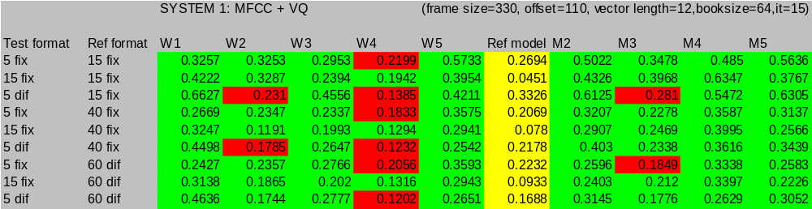
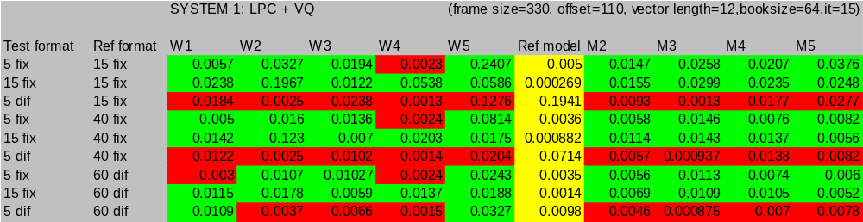
Experiment Description Cont.
Conclusions number 1:
MFCC performs better than LPC

Slide 28
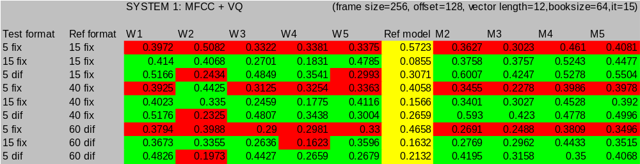
Experiment Description Cont.
Conclusions number 2:
Window size of 330 and offset of 110 samples performs better than window size of 256 and offset of 128 samples

Slide 29
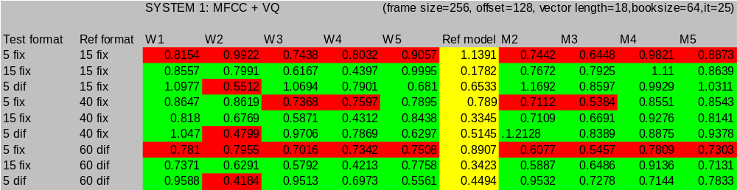
Experiment Description Cont.
Conclusions number 3:
Feature vector of 18 coeffs is better than feature vector of 12 coeffs

Slide 30
Experiment Description Cont.
Conclusions number 4:
Worst combinations:
      5 seconds of fixed sentence for testing with an
      enrolment of 15 seconds of the same sentence.
      5 seconds of fixed sentence for testing with an
      enrolment of 40 seconds of the same sentence.
Best combinations:
      15 seconds of fixed sentence for testing with an
      enrolment of 40 seconds of the same sentence.
      15 seconds of fixed sentence for testing with an
      enrolment of 60 seconds of random sentences.
      5 seconds of a random sentence with an
      enrolment of 60 seconds of random sentences.

Slide 31
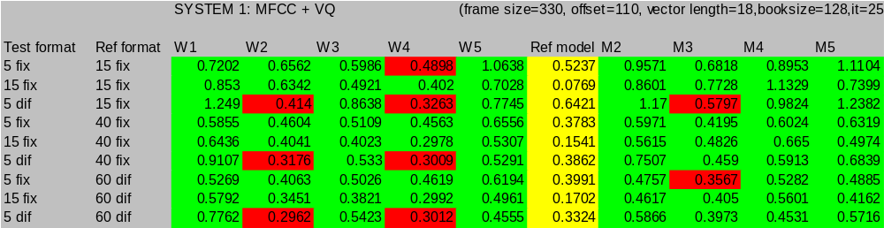
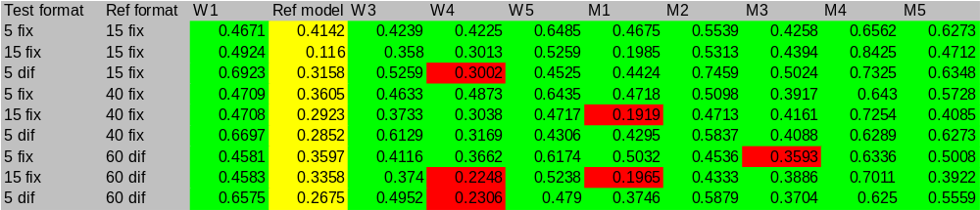
Experiment Description Cont.
The Best Results:

Slide 32
Time Table – First Semester
14.11.01 – Project description presentation
15.12.01 – completion of phase A: literature review and algorithm selection
25.12.01 – Handing out the mid-term report
25.12.01 – Beginning of phase B: algorithm implementation in MATLAB
10.04.02 – Publishing the MATLAB results and selecting the algorithm that will be implemented on the DSP

Slide 33
Time Table – Second Semester
10.04.02 – Presenting the progress and planning of the project to the supervisor
17.04.02 – Finishing MATLAB Testing
17.04.02 – The beginning of the implementation on the DSP
Summer – Project presentation and handing the project final report

