Slide 1
Introduction to audio signal processing
Part 2
Chapter 3: Audio feature extraction techniques
Chapter 4 : Recognition Procedures

Slide 2
Chapter 3: Audio feature extraction techniques
3.1 Filtering
3.2 Linear predictive coding
3.3 Vector Quantization (VQ)

Slide 3
Chapter 3 : Speech data analysis techniques
Ways to find the spectral envelope
  Filter banks: uniform
  Filter banks can also be non-uniform
  LPC and Cepstral LPC parameters
Vector quantization method to represent data more efficiently
Spectral
envelop
energy
spectral
envelop
filter2
output
filter1
output
filter3
output
filter4
output
freq..

Slide 4
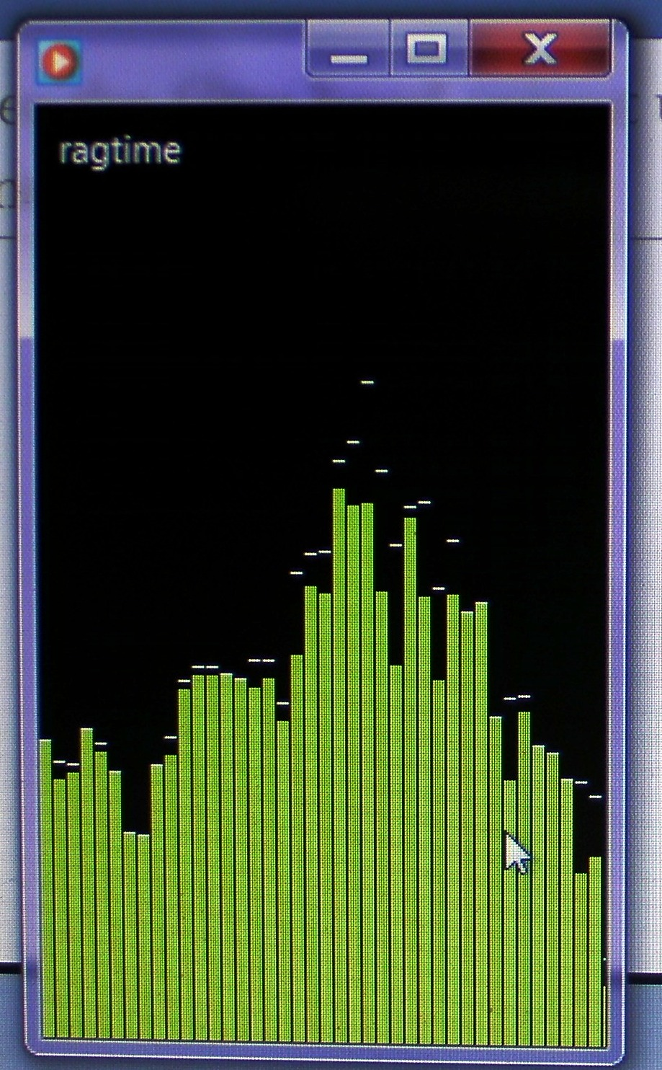
You can see the filter band output using windows-media-player for a frame
Try to look at it
Run
  windows-media-player
  To play music
  Right-click, select
    Visualization / bar and waves
energy
Spectral envelop
Frequency

Slide 5
Speech recognition idea using 4 linear filters, each bandwidth is 2.5KHz
Two sounds with two spectral envelopes SE,SE’
E.g. SE=“ar”, SE’=“ei”
Spectral envelope SE=“ar”
Spectral envelope SE’=“ei”
energy
energy
Spectrum A
Spectrum B
Freq.
Freq.
0
0
10KHz
10KHz
filter 1 2 3 4
filter 1 2 3 4
Filter
out
Filter
out
v1 v2 v3 v4
w1 w2 w3 w4

Slide 6
Difference between two sounds (or spectral envelopes SE SE’)
Difference between two sounds
E.g. SE=“ar”, SE’=“ei”
A simple measure is
Dist =|v1-w1|+|v2-w2|+|v3-w3|+|v4-w4|
Where |x|=magnitude of x

Slide 7
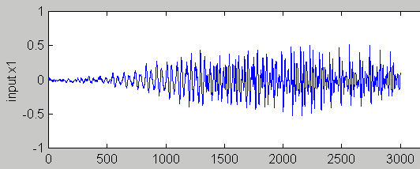
3.1 Filtering method
For each frame (10 - 30 ms) a set of filter outputs will be calculated. (frame overlap 5ms)
There are many different methods for setting the filter bandwidths -- uniform or non-uniform
Input waveform
Time frame i
Filter outputs (v1,v2,…)
30ms
Time frame i+1
Filter outputs (v’1,v’2,…)
30ms
Time frame i+2
Filter outputs (v’’1,v’’2,…)
30ms
5ms

Slide 8
How to determine filter band ranges
The pervious example of using 4 linear filters is too simple and primitive.
We will discuss
  Uniform filter banks
  Log frequency banks
  Mel filter bands

Slide 9
Uniform Filter Banks
Uniform filter banks
  bandwidth B= Sampling Freq... (Fs)/no. of banks (N)
  For example Fs=10Kz, N=20 then B=500Hz
  Simple to implement but not too useful
V
Filter
output
v1
v2
v3
1
2
3
4
5
....
Q
...
freq..
500
1K
1.5K
2K
2.5K
3K
...
(Hz)

Slide 10
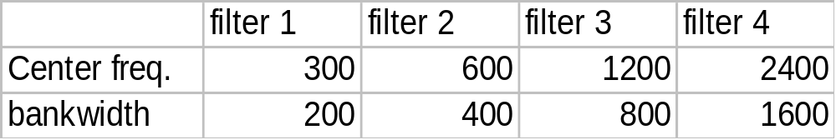
Non-uniform filter banks: Log frequency
Log. Freq... scale : close to human ear
V
Filter
output
v1
v2
v3
200
400
800
1600
3200
freq.. (Hz)

Slide 11
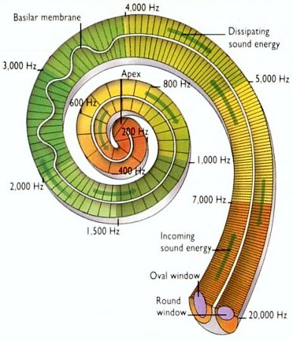
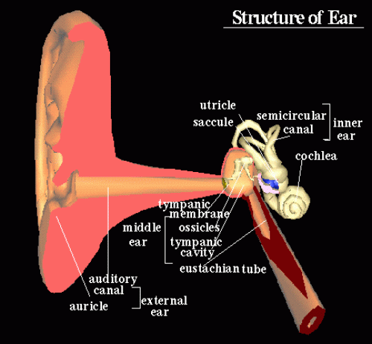
Inner ear and the cochlea
(human also has filter bands)
Ear and cochlea
http://universe-review.ca/I10-85-cochlea2.jpg
http://www.edu.ipa.go.jp/chiyo/HuBEd/HTML1/en/3D/ear.html

Slide 12
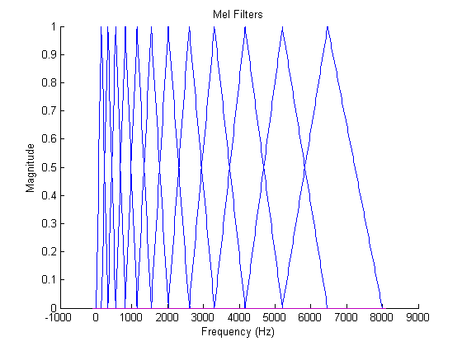
Mel filter bands (found by psychological and instrumentation experiments)
Freq. lower than 1 KHz has narrower bands (and in linear scale)
Higher frequencies have larger bands (and in log scale)
More filter below 1KHz
Less filters above 1KHz
Filter
output
http://instruct1.cit.cornell.edu/courses/ece576/FinalProjects/f2008/pae26_jsc59/pae26_jsc59/images/melfilt.png

Slide 13
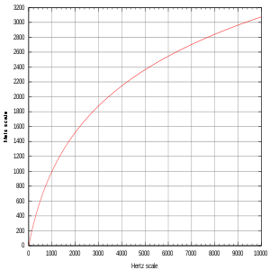
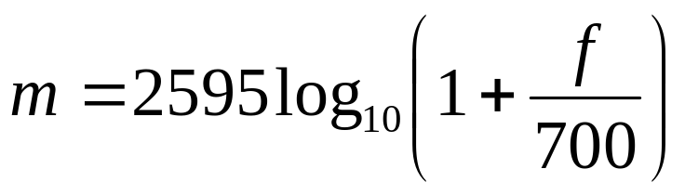
Critical band scale: Mel scale
Based on perceptual studies
  Log. scale when freq. is above 1KHz
  Linear scale when freq. is below 1KHz
popular scales are the “Mel” or “Bark” scales
Mel
Scale
(m)
Δm
(f) Freq in hz
Δf
Below 1KHz, Δf≈Δmf, linear
Above 1KHz, Δf>Δmf, log scale
http://en.wikipedia.org/wiki/Mel_scale

Slide 14
How to implement filter bands
Linear Predictive coding LPC methods

Slide 15
3.2 Feature extraction data flow
- The LPC (Liner predictive coding) method based method
Signal
preprocess -> autocorrelation-> LPC ---->cepstral coef
(pre-emphasis) r₀,r₁,.., r_{p} a₁,.., a_{p} c₁,.., c_{p}
(windowing) (Durbin alog.)

Slide 16
Pre-emphasis
“ The high concentration of energy in the low frequency range observed for most speech spectra is considered a nuisance because it makes less relevant the energy of the signal at middle and high frequencies in many speech analysis algorithms.”
From Vergin, R. etal. ,“"Compensated mel frequency cepstrum coefficients ", IEEE, ICASSP-96. 1996 .

Slide 17
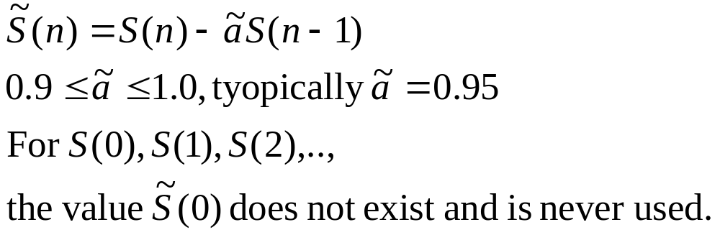
Pre-emphasis -- high pass filtering
(the effect is to suppress low frequency)
To reduce noise, average transmission conditions and to average signal spectrum.

Slide 18
3.2 The Linear Predictive Coding
LPC method
Linear Predictive Coding LPC method
  Time domain
  Easy to implement
  Archive data compression

Slide 19
First let’s look at the LPC speech production model
Speech synthesis model:
  Impulse train generator governed by pitch period-- glottis
  Random noise generator for consonant.
  Vocal tract parameters = LPC parameters
Glottal excitation
for vowel
LPC parameters
Voice/unvoiced
switch
Impulse train
Generator
Time varying
digital filter
Time-varying
X
output
digital filter
Noise
Generator
(Consonant)
Gain

Slide 20
For vowels (voiced sound), use LPC to represent the signal
The concept is to find a set of parameters ie. α₁, α₂, α₃, α₄,.. α_{p=8} to represent the same waveform (typical values of p=8->13)
For example
Input waveform
Can reconstruct the waveform from
these LPC codes
Time frame y
α1, α2, α3, α4,.. α8
30ms
Time frame y+1
α’1, α’2, α’3, α’4,.. α’8
30ms
α’’1, α’’2, α’’3, α’’4,.. α’’8
:
Time frame y+2
30ms
Each time frame y=512 samples
(S₀,S₁,S₂,. S_{n},S_{N-1=511})
512 floating points
Each set has 8 floating points

Slide 21
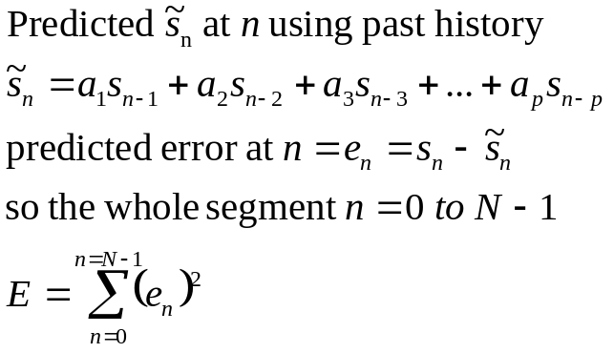


Concept: we want to find a set of a1,a2,..,a8, so when applied to all Sn in this frame (n=0,1,..N-1), the total error E (n=0→N-1)is minimum
Exercise 5
Write the error function e_{n} at N=130, draw it on the graph
Write the error function at N=288
Why e₀= s₀?
Write E for n=1,..N-1, (showing n=1, 8, 130,288,511)
S
Signal level
S_{n-1}
S_{n-2}
S_{n}
S_{n-4}
S_{n-3}
Time n
0
N-1=511

Slide 22
Answers
Write error function at N=130,draw e_{n} on the graph
Write the error function at N=288
Why e₁= 0?
  Answer: Because s₋₁, s₋₂,.., s₋₈ are outside the frame and are considered as 0. The effect to the overall solution is very small.
Write E for n=1,..N-1, (showing n=1, 8, 130,288,511)

Slide 23
LPC idea and procedure
The idea: from all samples s₀,s₁,s₂,s_{N-1=511}, we want to a_{p}(p=1,2,..,8), so that E is a minimum. The periodicity of the input signal provides information for finding the result.
Procedures
  For a speech signal, we first get the signal frame of size N=512 by windowing(will discuss later).
  Sampling at 25.6KHz, it is equal to a period of 20ms.
  The signal frame is (S₀,S₁,S₂,. S_{n}..,S_{N-1=511}).
  Ignore the effect of outside elements by setting them to zero, I.e. S_{-∞} ..=S₋₂ = S₋₁ =S₅₁₂ =S₅₁₃=…= S∞=0 etc.
  We want to calculate LPC parameters of order p=8, ie. α₁, α₂, α₃, α₄,.. α_{p=8}.

Slide 24
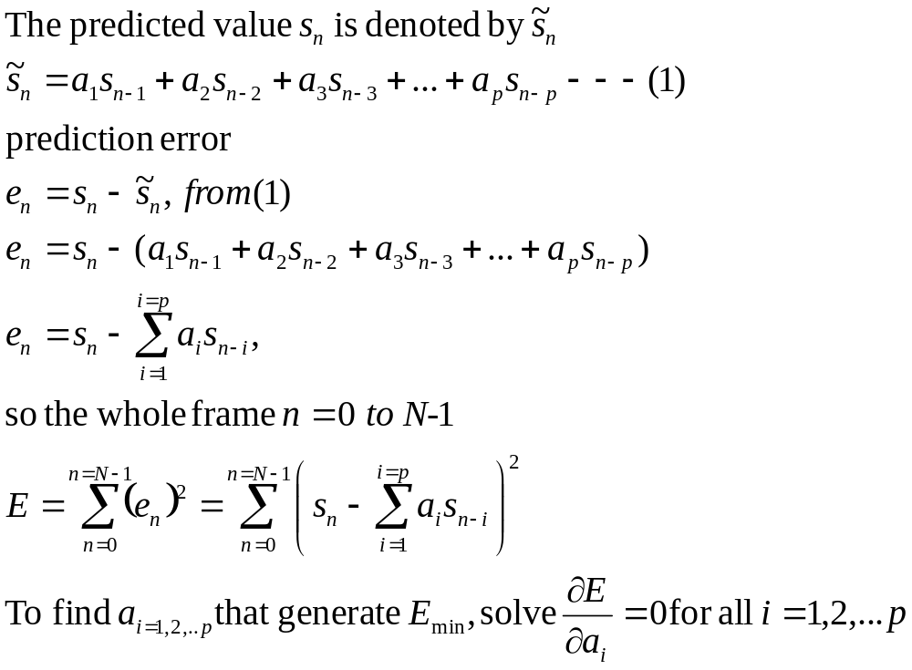
For each 30ms time frame
Input waveform
Time frame y
α1, α2, α3, α4,.. α8
30ms

Slide 25
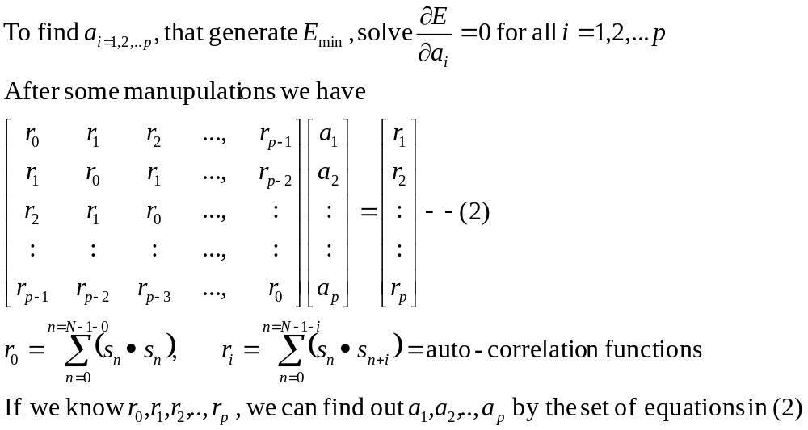
Solve for a_{1,2,…,p}
Input waveform
Time frame y
α1, α2, α3, α4,.. α8
30ms
Derivations can be found at
http://www.cslu.ogi.edu/people/hosom/cs552/lecture07_features.ppt
Use Durbin’s equation
to solve this

Slide 26
The example
For each time frame (25 ms), data is valid only inside the window.
20.48 KHZ sampling, a window frame (25ms) has 512 samples (N)
Require 8-order LPC, i=1,2,3,..8
calculate using r₀, r₁, r₂,.. r₈, using the above formulas, then get LPC parameters a₁, a₂,.. a₈ by the Durbin recursive Procedure.

Slide 27
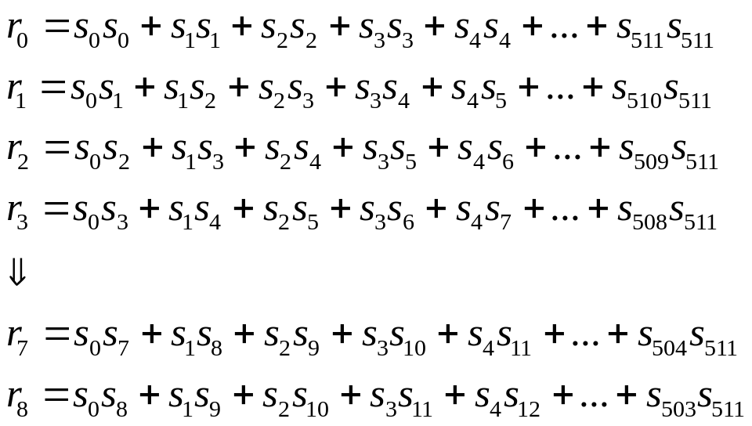
Steps for each time frame to find a set of LPC
(step1) N=WINDOW=512, the speech signal is s₀,s₁,..,s₅₁₁
(step2) Order of LPC is 8, so r₀, r₁,.., s₈ required are:
(step3) Solve the set of linear equations (previous slide)

Slide 28
Program segmentation algorithm for auto-correlation
WINDOW=size of the frame; coeff = autocorrelation matrix; sig = input, ORDER = lpc order
void autocorrelation(float *sig, float *coeff)
{int i,j;
for (i=0;i<=ORDER;i++)
{
coeff[i]=0.0;
for (j=i;j<WINDOW;j++)
coeff[i]+= sig[j]*sig[j-i];
}
}

Slide 29
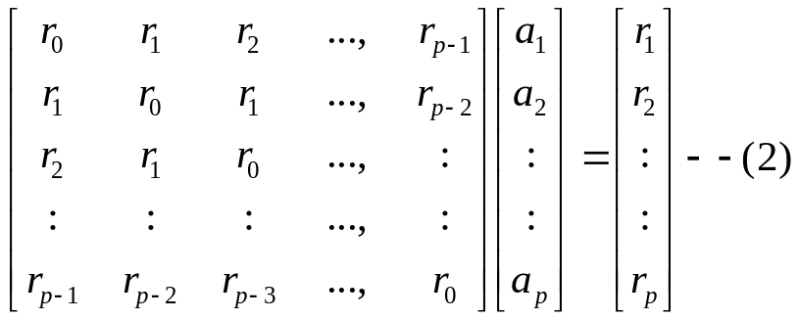
To calculate LPC a[ ] from auto-correlation matrix *coef using Durbin’s Method (solve equation 2)
void lpc_coeff(float *coeff)
{int i, j; float sum,E,K,a[ORDER+1][ORDER+1];
if(coeff[0]==0.0) coeff[0]=1.0E-30;
E=coeff[0];
for (i=1;i<=ORDER;i++)
{ sum=0.0;
for (j=1;j<i;j++) sum+= a[j][i-1]*coeff[i-j];
K=(coeff[i]-sum)/E; a[i][i]=K; E*=(1-K*K);
for (j=1;j<i;j++) a[j][i]=a[j][i-1]-K*a[i-j][i-1];
}
for (i=1;i<=ORDER;i++) coeff[i]=a[i][ORDER];}

Slide 30
Cepstrum
A new word by reversing the first 4 letters of spectrum → cepstrum.
It is the spectrum of a spectrum of a signal

Slide 31
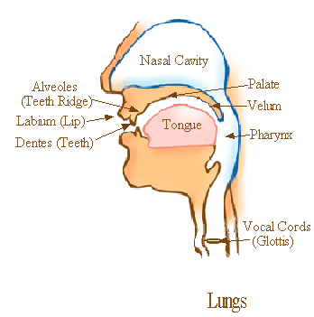
Glottis and cepstrum
Speech wave (X)= Excitation (E) . Filter (H)
(S)
Output
So voice has a
strong glottis
Excitation
Frequency content
In Ceptsrum
We can easily identify and
remove the glottal excitation
(H)
(Vocal tract filter)
(E)
Glottal excitation
From
Vocal cords
(Glottis)
http://home.hib.no/al/engelsk/seksjon/SOFF-MASTER/ill061.gif

Slide 32
Cepstral analysis
Signal(s)=convolution(*) of
  glottal excitation (e) and vocal_tract_filter (h)
  s(n)=e(n)*h(n), n is time index
After Fourier transform FT: FT{s(n)}=FT{e(n)*h(n)}
  Convolution(*) becomes multiplication (.)
  n(time)→ w(frequency),
S(w) = E(w).H(w)
Find Magnitude of the spectrum
|S(w)| = |E(w)|.|H(w)|
log₁₀ |S(w)|= log₁₀{|E(w)|}+ log₁₀{|H(w)|}
Ref: http://iitg.vlab.co.in/?sub=59&brch=164&sim=615&cnt=1

Slide 33
Cepstrum
C(n)=IDFT[log₁₀ |S(w)|]=
IDFT[ log₁₀{|E(w)|} + log₁₀{|H(w)|} ]
In c(n), you can see E(n) and H(n) at two different positions
Application: useful for (i) glottal excitation (ii) vocal tract filter analysis
X(n)
X(w)
Log|x(w)|
S(n)
windowing
DFT
Log|x(w)|
IDFT
C(n)
N=time index
w=frequency
I-DFT=Inverse-discrete Fourier transform

Slide 34
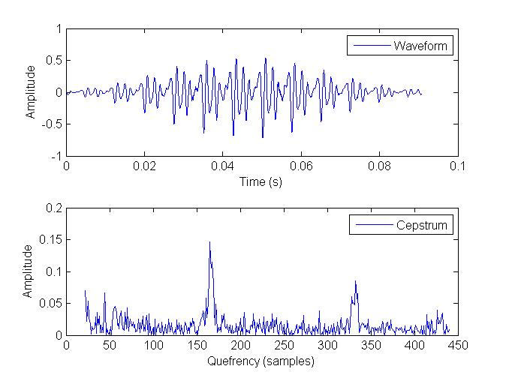
Example of cepstrum using spCepstrumDemo.m on sor1.wav
'sor1.wav‘=sampling frequency 22.05KHz

Slide 35
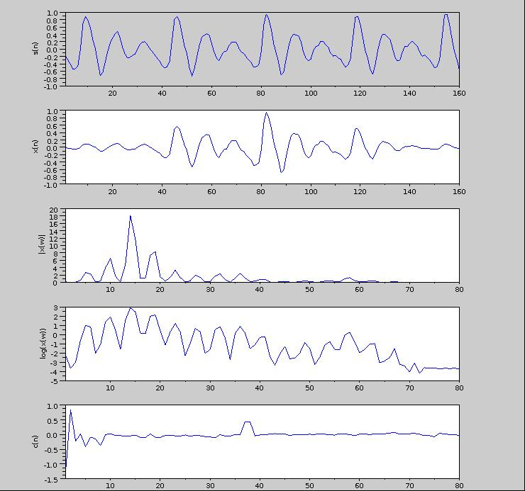
Examples
Vocal track
cepstrum
Glottal excitation cepstrum
http://iitg.vlab.co.in/?sub=59&brch=164&sim=615&cnt=1

Slide 36
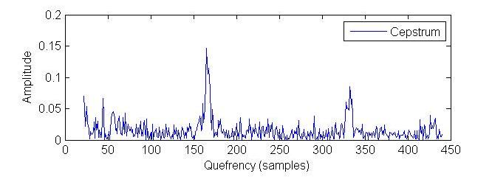
Liftering
Low time liftering:
  Magnify (or Inspect) the low time to find the vocal tract filter cepstrum
High time liftering:
  Magnify (or Inspect) the high time to find the glottal excitation cepstrum (remove this part for speech recognition.
Vocal tract
Cepstrum
Used for
Speech
recognition
Glottal excitation
Cepstrum, useless for
speech recognition,
Cut-off Found
by experiment
Frequency =FS/ quefrency
FS=sample frequency
=22050

Slide 37
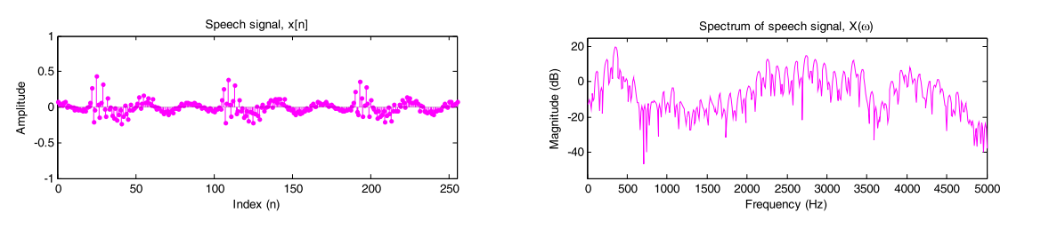
Reasons for liftering
Cepstrum of speech
Why we need this?
  Answer: remove the ripples
  of the spectrum caused by
  glottal excitation.
Too many ripples in the spectrum caused by vocal
cord vibrations.
But we are more interested in
the speech envelope for recognition and reproduction
Fourier
Transform
Speech signal x
Spectrum of x
http://isdl.ee.washington.edu/people/stevenschimmel/sphsc503/files/notes10.pdf

Slide 38
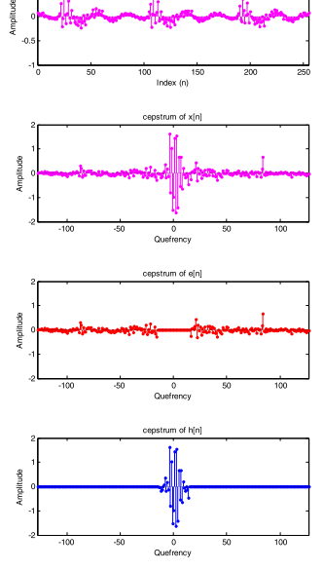
Liftering method: Select the high time and low time liftering
Signal X
Cepstrum
Select high time, C_high
Select low time
C_low

Slide 39
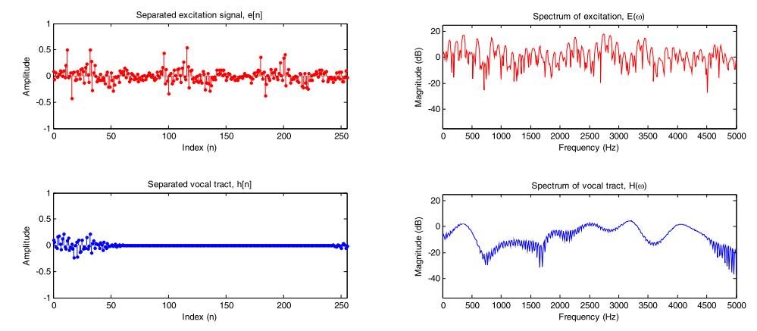
Recover Glottal excitation and vocal track spectrum
Spectrum of glottal excitation
Cepstrum of glottal excitation
C_high
For
Glottal
excitation
C_high
For
Vocal track
Frequency
Spectrum of vocal track filter
Cepstrum of vocal track
Frequency
quefrency (sample index)
This peak may be the pitch period:
This smoothed vocal track spectrum can be used to find pitch
For more information see :
http://isdl.ee.washington.edu/people/stevenschimmel/sphsc503/files/notes10.pdf

Slide 40
Exercise 6
A speech waveform S has the values s0,s1,s2,s3,s4,s5,s6,s7,s8= [1,3,2,1,4,1,2,4,3]. The frame size is 4.
  Find the pre-emphasized wave if ã= is 0.98.
  Find auto-correlation parameter r0, r1, r2.
  If we use LPC order 2 for our feature extraction system, find LPC coefficients a1, a2.
  If the number of overlapping samples for two frames is 2, find the LPC coefficients of the second frame.

Slide 41
3.3 Vector Quantization (VQ)
Vector quantization is a data compression method
  raw speech 10KHz/8-bit data for a 30ms frame is 300 bytes
  10th order LPC =10 floating numbers=40 bytes
  after VQ it can be as small as one byte.
Used in tele-communication systems.
Enhance recognition systems since less data is involved.

Slide 42
Use of Vector quantization for Further compression
LPC=10, is a data in a 10 dimensional space
after VQ it can be as small as one byte.
Example, in LPC2 (2 D space)

Slide 43
3.3 Vector Quantization (VQ)
A simple example, 2nd order LPC, LPC2
We can classify speech sound segments by Vector quantization
Make a table
code |  | a1 | A2
1 | e: | 0.5 | 1.5
2 | i: | 2 | 1.3
3 | u: | 0.7 | 0.8
The standard sound is
the centroid of all
samples of I (a1,a2)=(2,1.3)
The standard sound is
the centroid of all
samples of e: (a1,a2)=(0.5,1.5)
a2
2
e:
i:
Using this table, 2 bits are
enough to encode each sound
1
Feature space and sounds are
classified into three different types
e:, i: , u:
u:
2
a1
The standard sound is the centroid of all samples of u:, (a1,a2)=(0.7,0.8)

Slide 44
Another example LPC8
256 different sounds encoded by the table (one segment which has 512 samples is represented by one byte)
Use many samples to find the centroid of that sound, i. e:, or i:
Each row is the centroid of that sound in LPC8.
In telecomm., the transmitter only transmits the code (1 segment using 1 byte), the receiver reconstructs the sound using that code and the table. The table is only transmitted once.
One segment (512 samples ) compressed into 1 byte
transmitter
receiver
Code (1 byte) | a1 | a2 | a3 | a4 | a5 | a6 | a7 | a8
0=(e:) | 1.2 | 8.4 | 3.3 | 0.2 | .. | .. | .. | ..
1=(i:) | .. | .. | .. | .. | .. | .. | .. | ..
2=(u:)
:
255 | .. | .. | .. | .. | .. | .. | .. | ..

Slide 45
VQ techniques, M code-book vectors from L training vectors
K-means clustering algorithm
  Arbitrarily choose M vectors
  Nearest Neighbor search
  Centroid update and reassignment, back to above statement until error is minimum.
Binary split with K-means clustering algorithm, this method is more efficient.

Slide 46
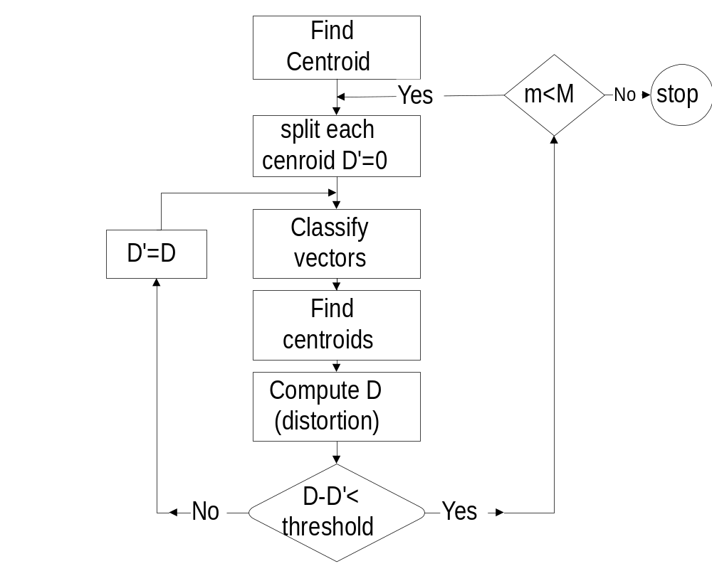
Binary split code-book:(assume you use all available samples in building the centroids at all stages of calculations)
Split function:
new_centroid=
old_centriod(1+/-e),
for 0.01≤e ≤ 0.05
m=1
m=2*m

Slide 47
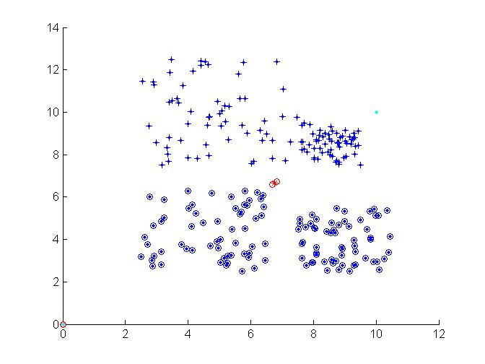
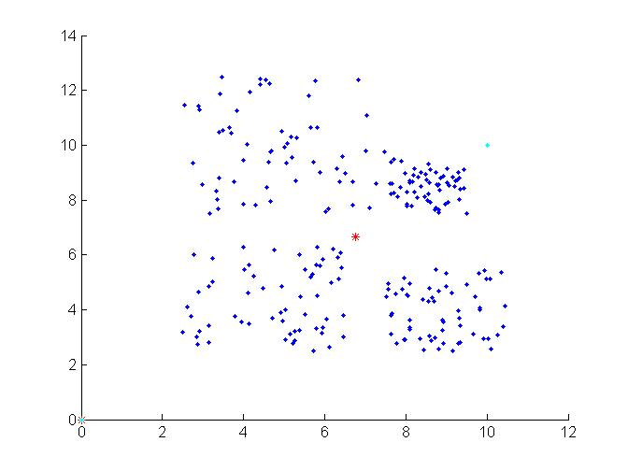
Example: VQ : 240 samples use VQ to split to 4 classes
Steps
Step1: all data find centroid C
C1=C(1+e)
C2=C(1-e)
Step2:
split the centroid into two C1,C2
Regroup data into two classes according to the two new centroids C1,C2

Slide 48
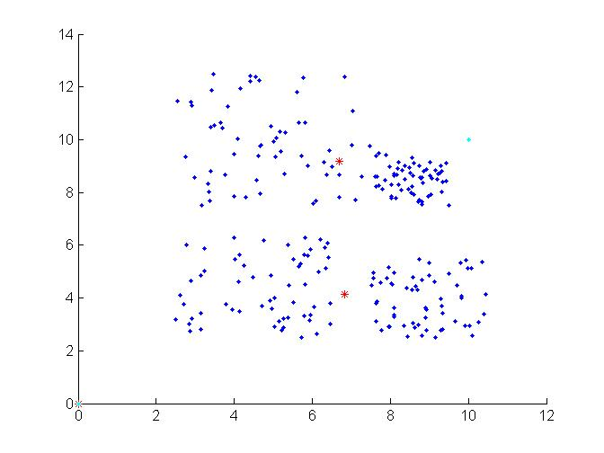
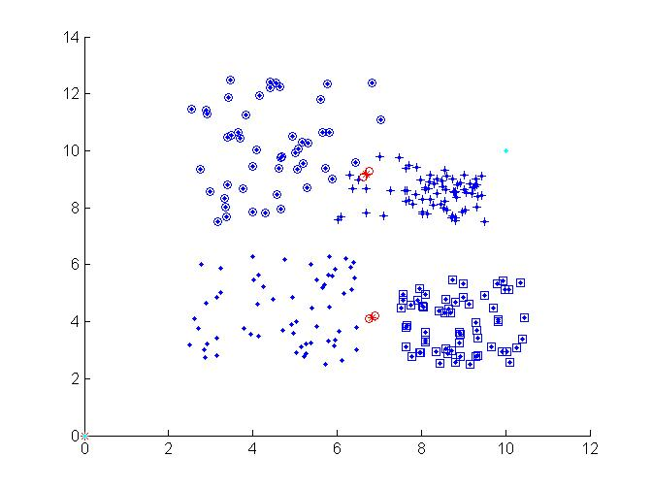
continue
Stage3:
Update the 2 centroids according to the two spitted groups
Each group find a new centroid.
Stage 4: split the 2 centroids again to become 4 centroids

Slide 49
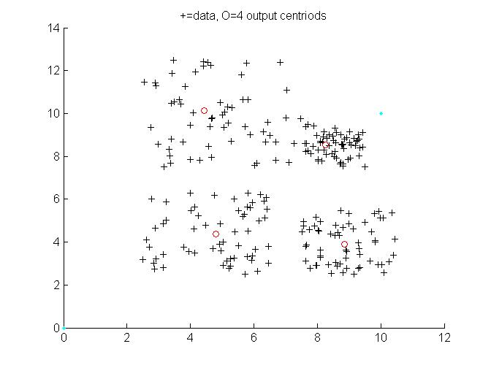
Final result
Stage 5: regroup and update the 4 new centroids, done.

Slide 50
Tutorials for VQ
Given 4 speech frames, each is described by a 2-D vector (x,y) as below.
P₁=(1.2,8.8);P₂=(1.8,6.9);P₃=(7.2,1.5);P₄=(9.1,0.3)
Find the code-book of size two using K-means method. (Answer see Appendix A.1)
Write Pseudo code (or a C program segment) to build the code book of size 4 from 100 2D-vectors, the input vectors (x,y) are stored in int x[100] and int y[100].

Slide 51
Exercise 7
Given 4 speech frames, each is described by a 2-D vector (x,y) as below.
P1=(1.2,8.8); P2=(1.8,6.9); P3=(7.2,1.5); P4=(9.1,0.3).
  Use K-means method to find the two centroids.
  Use Binary split K-means method to find the two centroids. Assume you use all available samples in building the centroids at all stages of calculations
  A raw speech signal is sampled at 10KHz/8-bit. Estimate compression ratio (=raw data storage/compressed data storage) if LPC-order is 10 and frame size is 25ms with no overlapping samples.

Slide 52
Example of speech signal analysis
Speech signal
1st frame
(one set of LPC -> code word)
One frame
=N
=512 samples
2nd frame
(one set of LPC -> code word)
3rd frame
(one set of LPC -> code word)
4th frame
(one set of LPC -> code word)
5th frame
Separated
by n samples

Slide 53
Chapter 4 : Recognition Procedures
Recognition procedure
Dynamic programming
HMM

Slide 54
Chapter 4 : Recognition Procedures
Preprocessing for recognition
  endpoint detection
  Pre-emphasis
  windowing
  distortion measure methods
Comparison methods
  Vector quantization
  Dynamic programming
  Hidden Markov Model

Slide 55
LPC processor for a 10-word isolated speech recognition system
End-point detection
Pre-emphasis -- high pass filtering
Frame blocking and Windowing
Auto-correlation analysis
LPC analysis,
Cepstral coefficients,
Weighting
Temporal cepstral derivation

Slide 56
End point detection
To determine the start and end points of the speech sound
  It is not always easy since the energy of the starting energy is always low.
  Determined by energy & zero crossing rate
s(n)
end-point
detected
n
recorded

Slide 57
A simple End point detection algorithm
At the beginning the energy level is low.
If the energy level and zero-crossing rate of 3 successive frames is high it is a starting point.
After the starting point if the energy and zero-crossing rate for 5 successive frames are low it is the end point.

Slide 58
Energy calculation
E(n) = s(n).s(n)
For a frame of size N,
The program to calculate the energy level: for(n=0;n<N;n++)
{
Energy(n)=s(n) s(n);
}

Slide 59
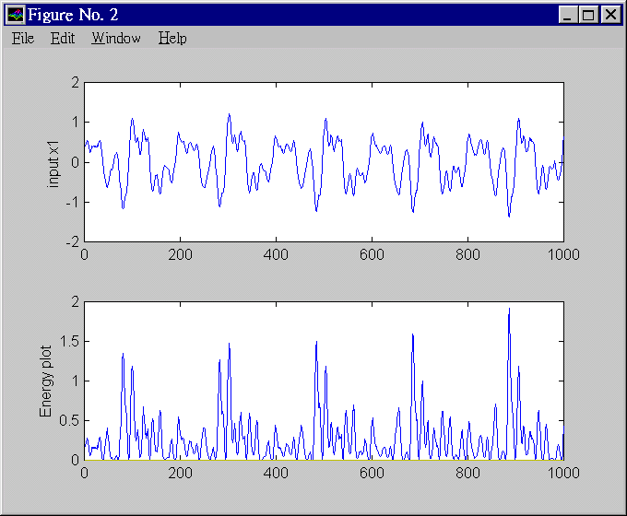
Energy plot

Slide 60
Zero crossing calculation
A zero-crossing point is obtained when
  sign[s(n)] != sign[s(n-1)]
The zero-crossing points of s(n)= 6
s(n)
5
n
4
6
2
1
3

Slide 61
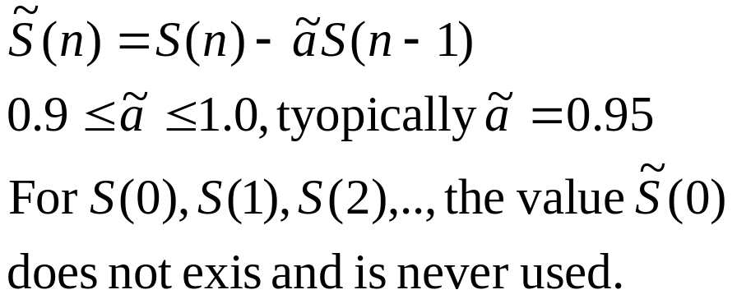
Pre-emphasis -- high pass filtering
To reduce noise, average transmission conditions and to average signal spectrum.
Tutorial: write a program segment to perform pre-emphasis to a speech frame stored in an array int s[1000].

Slide 62
Pre-emphasis program segment
input=sig1, output=sig2
void pre_emphasize(char far *sig1, float *sig2)
{
int j;
sig2[0]=(float)sig1[0];
for (j=1;j<WINDOW;j++)
sig2[j]=(float)sig1[j] - 0.95*(float)sig1[j-1];
}

Slide 63
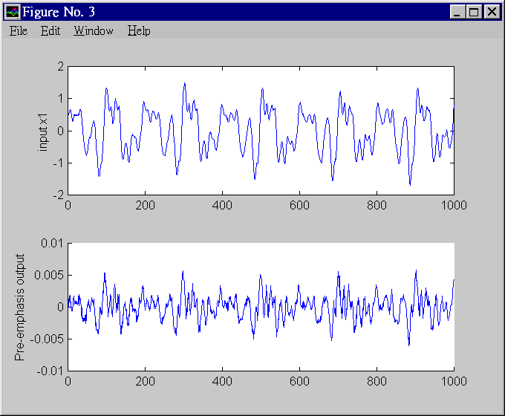
Pre-emphasis

Slide 64
Frame blocking and Windowing
To choose the frame size (N samples )and adjacent frames separated by m samples.
I.e.. a 16KHz sampling signal, a 10ms window has N=160 samples, m=40 samples.
l=2 window, length = N
s_{n}
N
n
m
N
l=1 window, length = N

Slide 65
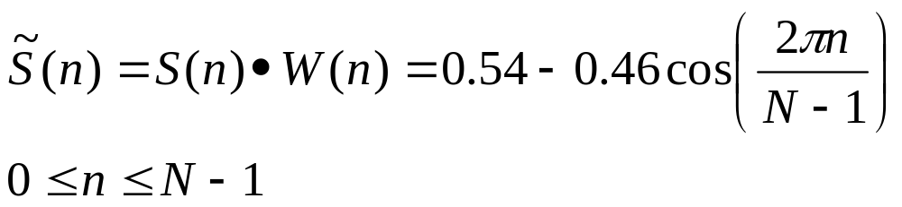
Windowing
To smooth out the discontinuities at the beginning and end.
Hamming or Hanning windows can be used.
Hamming window
Tutorial: write a program segment to find the result of passing a speech frame, stored in an array int s[1000], into the Hamming window.

Slide 66
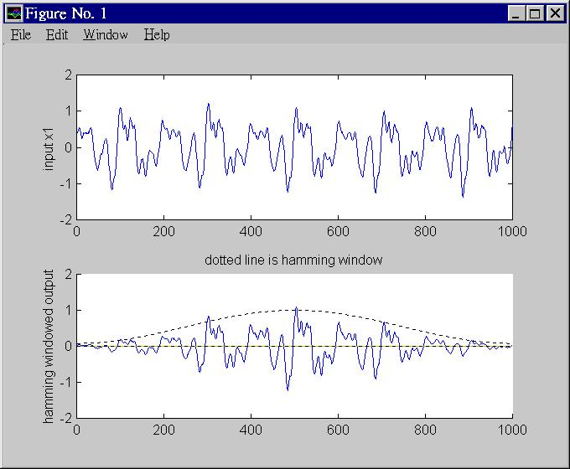



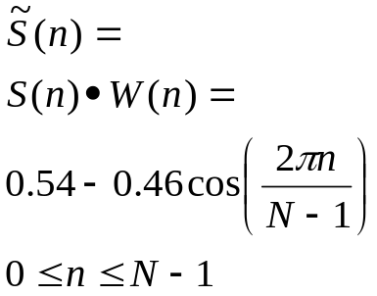


Effect of Hamming window

Slide 67
Matlab code segment
x1=wavread('violin3.wav');
for i=1:N
hamming_window(i)=
abs(0.54-0.46*cos(i*(2*pi/N)));
y1(i)=hamming_window(i)*x1(i);
end

Slide 68
Cepstrum Vs spectrum
the spectrum is sensitive to glottal excitation (E). But we only interested in the filter H
In frequency domain
  Speech wave (X)= Excitation (E) . Filter (H)
  Log (X) = Log (E) + Log (H)
Cepstrum =Fourier transform of log of the signal’s power spectrum
In Cepstrum, the Log(E) term can easily be isolated and removed.

Slide 69
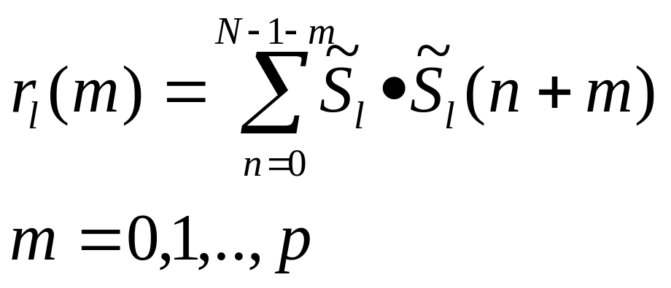
Auto-correlation analysis
Auto-correlation of every frame (l =1,2,..)of a windowed signal is calculated.
If the required output is p-th ordered LPC
Auto-correlation for the l-th frame is

Slide 70
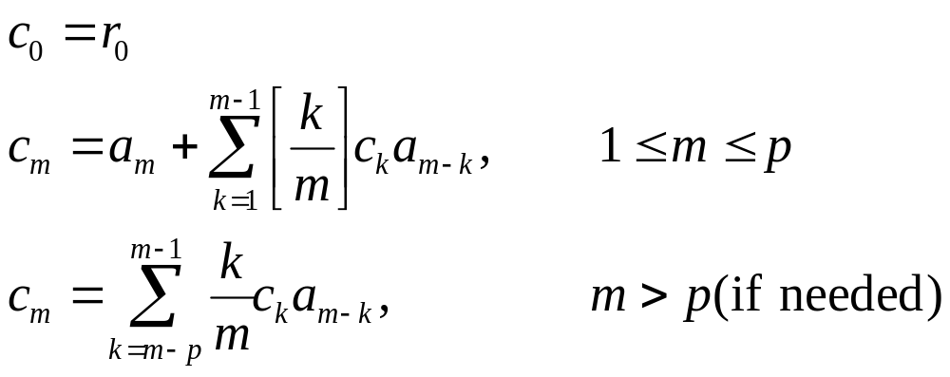
LPC to Cepstral coefficients conversion
Cepstral coefficient is more accurate in describing the characteristic of speech signal
Normally cepstral coefficients of order 1<=m<=p are enough to describe the speech signal.
Calculate c₁, c₂, c₃,.. c_{p} from a₁, a₂, a₃,.. a_{p}
Ref:http://www.clear.rice.edu/elec532/PROJECTS98/speech/cepstrum/cepstrum.html

Slide 71
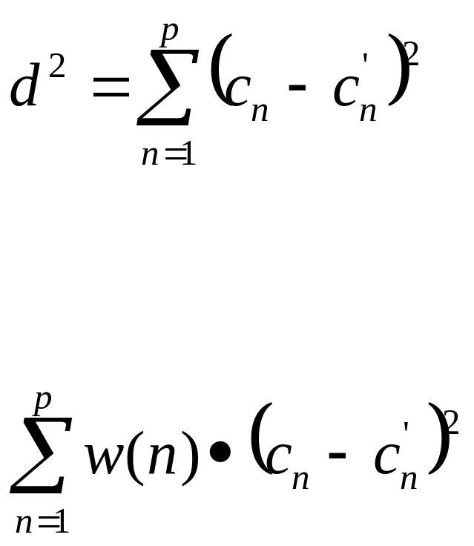
Distortion measure - difference between two signals
  measure how different two signals is:
  Cepstral distances between a frame (described by cepstral coeffs (c₁,c₂…c_{p} )and the other frame (c’₁,c’₂…c’_{p}) is
  Weighted Cepstral distances to give different weighting to different cepstral coefficients( more accurate)

Slide 72
Matching method: Dynamic programming DP
Correlation is a simply method for pattern matching BUT:
The most difficult problem in speech recognition is time alignment. No two speech sounds are exactly the same even produced by the same person.
Align the speech features by an elastic matching method -- DP.

Slide 73
Exercise

Slide 74
Small Vocabulary (10 words) DP speech recognition system
Train the system, each word has a reference vector
For an unknown input, compare with each reference using DP, and the one with the minimum distance is the result.
Training is easy but recognition takes longer time.

Slide 75
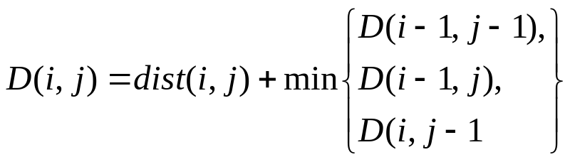
Dynamic programming algo.
Step 1: calculate the distortion matrix dist( )
Step 2: calculate the accumulated matrix
  by using
D( i-1, j)
D( i, j)
D( i-1, j-1)
D( i, j-1)

Slide 76
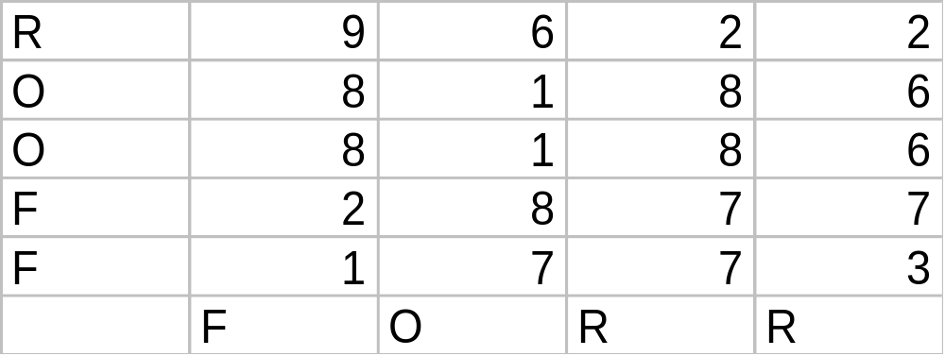
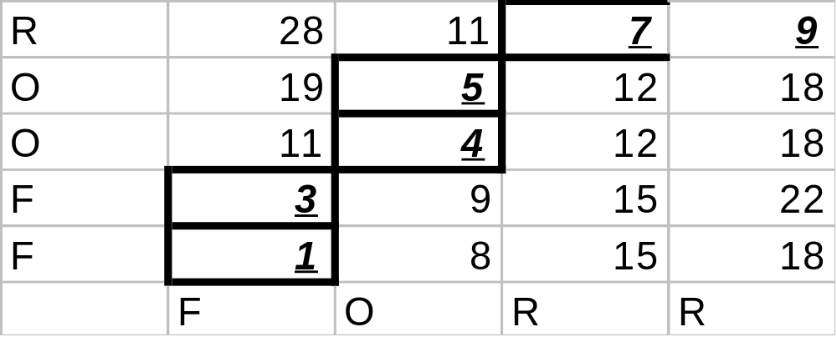
Example in
DP(LEA ,
Trends in speech recognition.)
Step 1 :
distortion matrix
Reference
Step 2:
Reference
unknown input
j-axis
accumulated
score matrix (D)
i-axis

Slide 77
To find the optimal path in the accumulated matrix
Starting from the top row and right most column, find the lowest cost D (i,j)_{t} : it is found to be the cell at (i,j)=(3,5), D(3,5)=7 in the top row.
From the lowest cost position p(i,j)_{t}, find the next position (i,j)_{t-1} =argument_min_i,j{D(i-1,j), D(i-1,j-1), D(i,j-1)}.
E.g. p(i,j)_{t-1} =argument_min_{i,j}{9,11,4)} =(3-0,5-1)=(3,4) that contains 4 is selected.
Repeat above until the path reaches the right most column or the lowest row.
Note: argument_min_i,j{cell1, cell2, cell3} means the argument i,j of the cell with the lowest value is selected.

Slide 78
Optimal path
It should be from any element in the top row or right most column to any element in the bottom row or left most column.
The reason is noise may be corrupting elements at the beginning or the end of the input sequence.
However, in fact, in actual processing the path should be restrained near the 45 degree diagonal (from bottom left to top right), see the attached diagram, the path cannot passes the restricted regions. The user can set this regions manually. That is a way to prohibit unrecognizable matches. See next page.

Slide 79
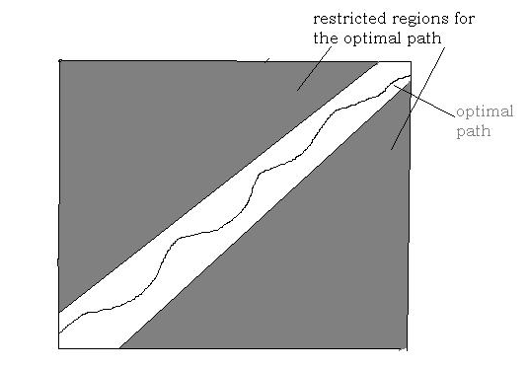
Optimal path and restricted regions.

Slide 80
Example of an isolated 10-word recognition system
A word (1 second) is recorded 5 times to train the system, so there are 5x10 templates.
Sampling freq.. = 16KHz, 16-bit, so each sample has 16,000 integers.
Each frame is 20ms, overlapping 50%, so there are 100 frames in 1 word=1 second .
For 12-ordered LPC, each frame generates 12 LPC floating point numbers,, hence 12 cepstral coefficients C₁,C₂,..,C₁₂.

Slide 81
So there are 5x10samples=5x10x100 frames
Each frame is described by a vector of 12-th dimensions (12 cepstral coefficients = 12 floating point numbers)
Put all frames to train a cook-book of size 64. So each frame can be represented by an index ranged from 1 to 64
Use DP to compare an input with each of the templates and obtain the result which has the minimum distortion.

Slide 82
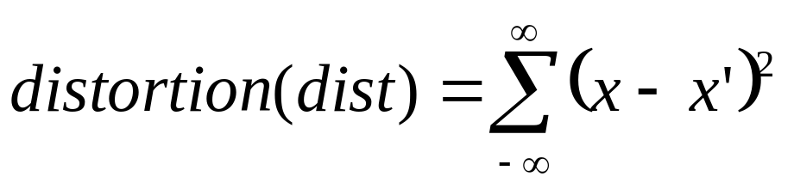
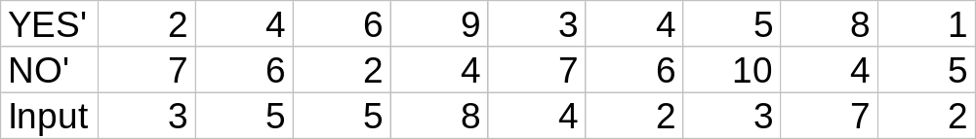
Exercise for DP
The VQ-LPC codes of the speech sounds of ‘YES’and ‘NO’ and an unknown ‘input’ are shown. Is the ‘input’ = ‘Yes’ or ‘NO’? (ans: is ‘Yes’)distortion

Slide 83
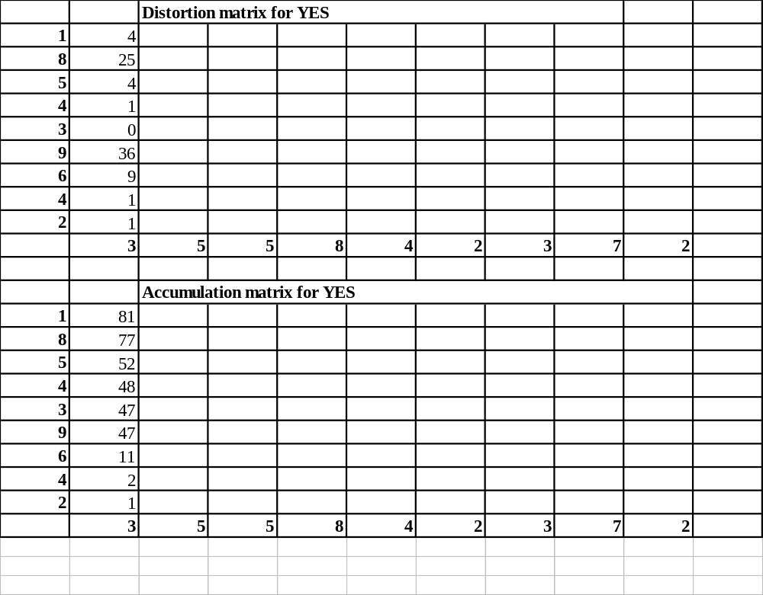

Slide 84
Conclusion
Speech processing is important in communication and AI systems to build more user friendly interfaces.
Already successful in clean (not noisy) environment.
But it is still a long way before comparable to human performance.

Slide 85
Appendix A.1: K-means method to find the two centroids
P₁=(1.2,8.8);P₂=(1.8,6.9);P₃=(7.2,1.5);P₄=(9.1,0.3)
Arbitrarily choose P₁ and P₄ as the 2 centroids. So C₁=(1.2,8.8); C₂=(9.1,0.3).
Nearest neighbor search; find closest centroid
  P₁-->C₁ ; P₂-->C₁ ; P₃-->C₂ ; P₄-->C₂
Update centroids
  C’₁=Mean(P₁,P₂)=(1.5,7.85); C’₂=Mean(P₃,P₄)=(8.15,0.9).
Nearest neighbor search again. No further changes, so VQ vectors =(1.5,7.85) and (8.15,0.9)
Draw the diagrams to show the steps.

Slide 86
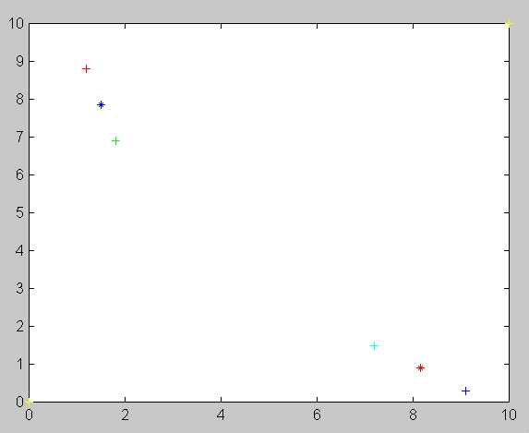
P₁=(1.2,8.8);
K-means method
C’₁=(1.5,7.85)
P₂=(1.8,6.9)
P₃=(7.2,1.5);
C’₂ =(8.15,0.9)
P₄=(9.1,0.3)

Slide 87
Appendix A.2: Binary split K-means method for the number of required contriods is fixed (see binary_split2_a2.m.txt) (assume you use all available samples in building the centroids at all stages of calculations)
P₁=(1.2,8.8);P₂=(1.8,6.9);P₃=(7.2,1.5);P₄=(9.1,0.3)
first centroid C₁=((1.2+1.8+7.2+9.1)/4, 8.8+6.9+1.5+0.3)/4) = (4.825,4.375)
Use e=0.02 find the two new centroids
Step1: CC_{a}= C₁(1+e)=(4.825x1.02,4.375x1.02)=(4.9215,4.4625)
CC_{b}= C₁(1-e)=(4.825x0.98,4.375x0.98)=(4.7285,4.2875) CCa=(4.9215,4.4625)
CCb=(4.7285,4.2875)
The function dist(Pi,CCx )=Euclidean distance between Pi and CCx
points dist to CCa -1*dist to CCb =diff Group to
P1 5.7152 -5.7283 = -0.0131 CCa
P2 3.9605 -3.9244 = 0.036 CCb
P3 3.7374 -3.7254 = 0.012 CCb
P4 5.8980 -5.9169 = -0.019 CCa

Slide 88
Nearest neighbor search to form two groups. Find the centroid for each group using K-means method. Then split again and find new 2 centroids. P1,P4 -> CCa group; P2,P3 -> CCb group
Step2: CCCa=mean(P1,P4),CCCb =mean(P3,P2);
CCCa=(5.15,4.55)
CCCb=(4.50,4.20)
Run K-means again based on two centroids CCCa,CCCb for the whole pool -- P1,P2,P3,P4.
points dist to CCCa -dist to CCCb =diff2 Group to
P1 5.8022 -5.6613 = 0.1409 CCCb
P2 4.0921 -3.8148 = 0.2737 CCCb
P3 3.6749 -3.8184 = -0.1435 CCCa
P4 5.8022 -6.0308 = -0.2286 CCCa
Regrouping we get the final result
CCCCa =(P3+P4)/2=(8.15, 0.9); CCCCb =(P1+P2)/2=(1.5,7.85)

Slide 89
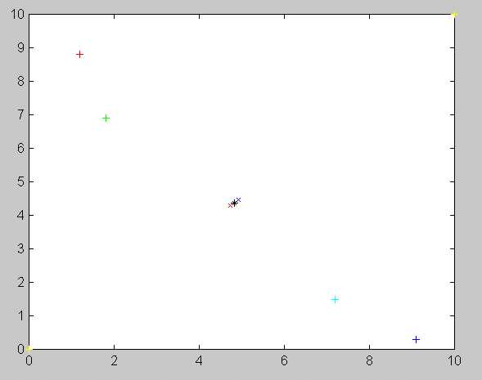
P₁=(1.2,8.8);
Step1:
Binary split K-means method
for the number of required
contriods is fixed, say 2, here.
CC_{a},CC_{b}= formed
P₂=(1.8,6.9)
CC_{a}= C₁(1+e)=(4.9215,4.4625)
C1=(4.825,4.375)
CC_{b}= C₁(1-e)=(4.7285,4.2875)
P₃=(7.2,1.5);
P₄=(9.1,0.3)

Slide 90
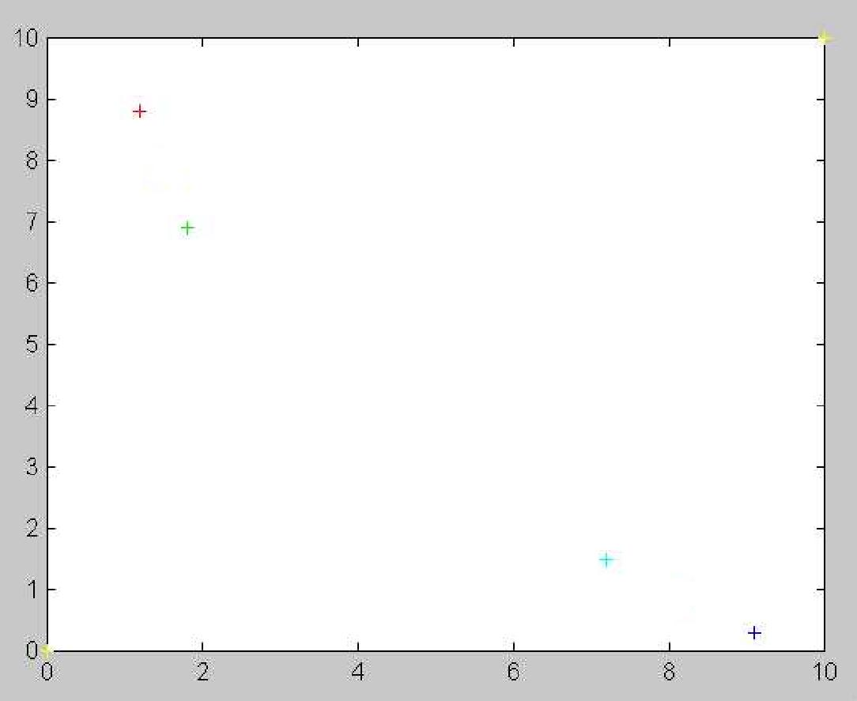
Direction
of the split
P₁=(1.2,8.8);
Step2:
Binary split K-means method
for the number of required
contriods is fixed, say 2, here.
CCC_{a},CCC_{b}= formed
CCCCb=(1.5,7.85)
P₂=(1.8,6.9)
CCCa=(5.15,4.55)
CCCb=(4.50,4.20)
P₃=(7.2,1.5);
CCC_{b} =(8.15,0.9)
CCCCa=(8.15,0.9)
P₄=(9.1,0.3)

Slide 91
Appendix A.3. Cepstrum Vs spectrum
the spectrum is sensitive to glottal excitation (E). But we only interested in the filter H
In frequency domain
  Speech wave (X)= Excitation (E) . Filter (H)
  Log (X) = Log (E) + Log (H)
Cepstrum =Fourier transform of log of the signal’s power spectrum
In Cepstrum, the Log(E) term can easily be isolated and removed.

Slide 92
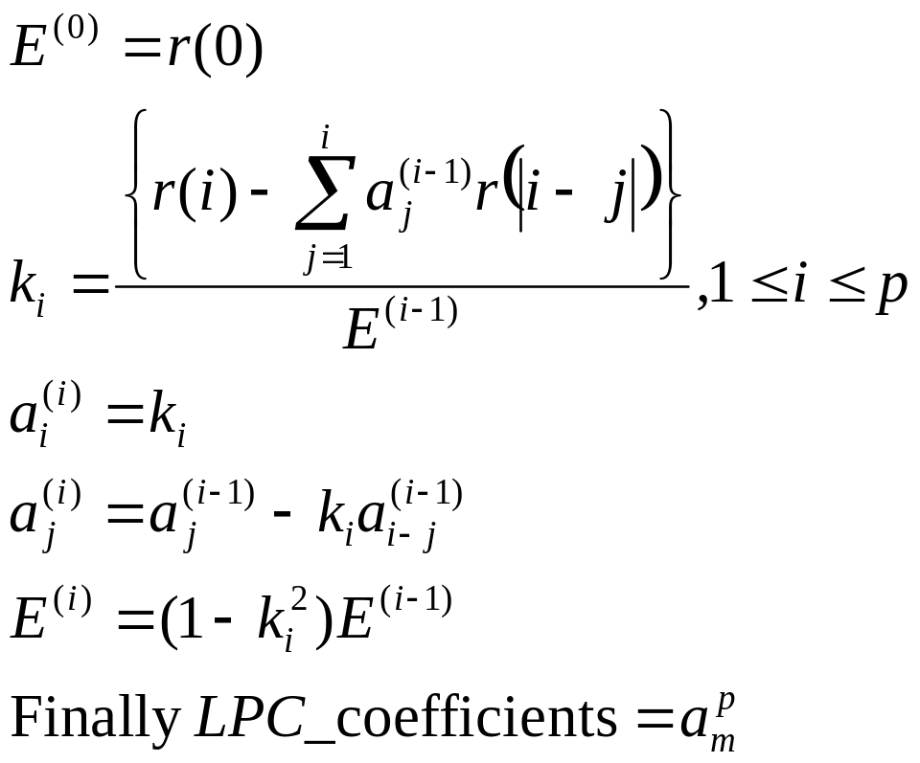
Appendix A4: LPC analysis for a frame based on the auto-correlation values r(0),…,r(p), and use the Durbin’s method (See P.115 [Rabiner 93])
LPC parameters a₁, a₂,..a_{p} can be obtained by setting for i=0 to i=p to the formulas

Slide 93
Program to Convert LPC coeffs. to Cepstral coeffs.
void cepstrum_coeff(float *coeff)
{int i,n,k; float sum,h[ORDER+1];
h[0]=coeff[0],h[1]=coeff[1];
for (n=2;n<=ORDER;n++){ sum=0.0;
for (k=1;k<n;k++)
sum+= (float)k/(float)n*h[k]*coeff[n-k];
h[n]=coeff[n]+sum;}
for (i=1;i<=ORDER;i++)
coeff[i-1]=h[i]*(1+ORDER/2*sin(PI_10*i));}

Slide 94
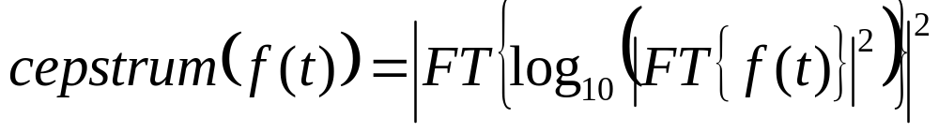
Define Cepstrum: also called the spectrum of a spectrum
“The power cepstrum (of a signal) is the squared magnitude of the Fourier transform (FT) of the logarithm of the squared magnitude of the Fourier transform of a signal” From Norton, Michael; Karczub, Denis (2003). Fundamentals of Noise and Vibration Analysis for Engineers. Cambridge University Press
Algorithm: signal → FT → abs() → square → log₁₀ → FT → abs() → square → power cepstrum
http://mi.eng.cam.ac.uk/~ajr/SA95/node33.html
http://en.wikipedia.org/wiki/Cepstrum

