Slide 1
EARLY DETECTION OF
POLYCYSTIC OVARY SYNDROME (PCOS) BASED ON HORMONE LEVELS: PREDICTIVE MODEL
Chantal Kloth and Will Liu

Slide 2
Overview
Introduction to PCOS
Project Impact
Dataset Overview / Preprocessing
Visualization
Dataset Exploration / Key Findings
Problem Statement
Modeling
Results
Future Plans / Conclusion

Slide 3
INTRODUCTION TO PCOS
Polycystic Ovary Syndrome (PCOS) is a common complex hormonal disorder
Prevalence: Affects millions of women (5-10% of women worldwide) and a leading cause of infertility, and associated with increased risk of other health conditions
Symptoms: Vary from mild to severe - irregular or absent menstrual periods, excessive hair growth, acne, and weight gain
Pathophysiology: Cause not fully understood, but believed to involve genetic, hormonal, and lifestyle factors
Impact: Increased risk of infertility, pregnancy complications, obesity, diabetes, cardiovascular disease, and psychological disorders
Notes:
PCOS is a common hormonal disorder affecting reproductive-age women. PCOS is one of the most common endocrine disorders in women of reproductive age, affecting approximately 5-10% of women worldwide. It is a leading cause of infertility and is associated with an increased risk of other health conditions such as type 2 diabetes, cardiovascular disease, and endometrial cancer. Common symptoms of PCOS include irregular or absent menstrual periods, excessive hair growth (hirsutism), acne, and weight gain.
Symptoms may vary widely among individuals and can range from mild to severe. The exact cause of PCOS is not fully understood but is believed to involve a combination of genetic, hormonal, and lifestyle factors. PCOS can have significant implications for both physical and mental health. It is associated with an increased risk of infertility, pregnancy complications, obesity, diabetes, cardiovascular disease, and psychological disorders such as depression and anxiety.

Slide 4
PROJECT IMPACT
Predictive models that can accurately identify individuals at risk of PCOS or infertility
Early intervention and appropriate treatment, improving patient outcomes
Preventive measures and lifestyle interventions to mitigate the long-term health consequences associated with PCOS
Potential to contribute to advancements in personalized medicine and women's health
Notes:
Our project focuses on developing predictive models for the early detection of PCOS and infertility-related issues among women. The project's findings have significant implications for healthcare, particularly in the early detection and management of PCOS and infertility-related issues among women. By developing predictive models that can accurately identify individuals at risk of PCOS or infertility, healthcare providers can intervene early, provide appropriate treatment, and improve patient outcomes. Early detection can also help in implementing preventive measures and lifestyle interventions to mitigate the long-term health consequences associated with PCOS. Overall, the project has the potential to contribute to advancements in personalized medicine and women's health.

Slide 5
DATASET OVERVIEW
Sourced from Kaggle and contains a wide range of physical and clinical parameters related to PCOS and infertility
Data points from individuals diagnosed with PCOS and control subjects
Multiple variables, including age, BMI, hormonal levels, clinical measurements, etc.
Notes:
The dataset used in our analysis was sourced from Kaggle and contains a wide range of physical and clinical parameters related to PCOS and infertility. It comprises data points collected from individuals diagnosed with PCOS as well as control subjects, providing a rich source of information for our analysis. The dataset consists of multiple variables including age, BMI, hormonal levels, and clinical measurements. The dataset serves as the foundation for our predictive modeling efforts, allowing us to explore relationships between different variables and develop models for early detection of PCOS and infertility. By leveraging the information contained in the dataset, we aim to uncover key insights that can inform clinical practice and improve patient care

Slide 6
DATASET PREPROCESSING
Exploring hormone levels
Data cleaning, handling missing values, and identifying outliers to ensure the quality and integrity of data
Removed leading and trailing spaces, renaming columns, ect.
Calculated Z-Scores with a threshold = 3 for outlier detection (z-score > 3)
Dropped outliers, calculate the IQR, and define lower and upper bonds
Notes:
We decided to look more closely at the hormone levels. Our initial step involved thorough exploration of the dataset to understand its structure, features, and characteristics. We performed tasks such as data cleaning, handling missing values, and identifying outliers to ensure the quality and integrity of the data. We renamed columns for easier access, defined a threshold for outlier detention of z-score > 3 and removed them from the dataframe, calculated the interquartile range, and then plotted the dataframes now without the outliers.

Slide 7
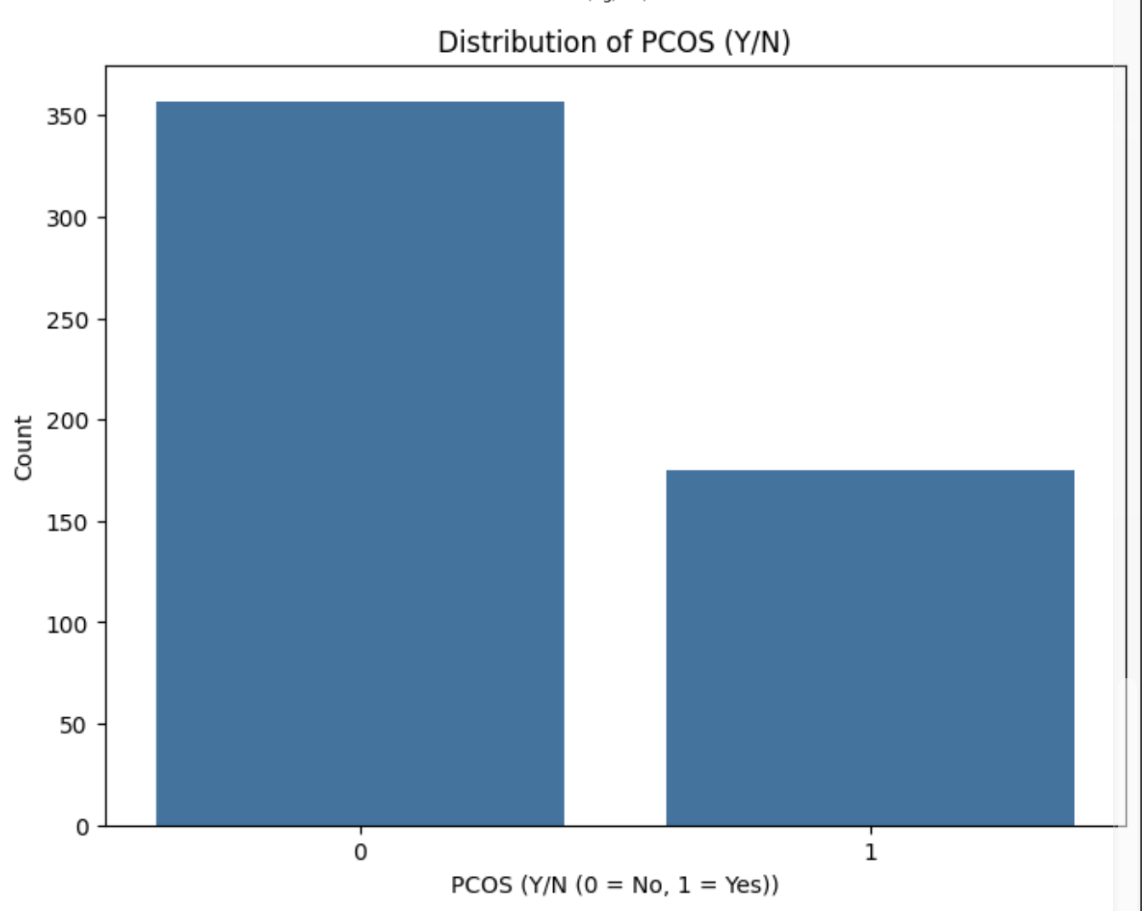
TARGET VARIABLE VISUALIZATION - PCOS (Y/N)
More in “No” cohort than “Yes” (350 “No” vs “175” yes)
Notes:
PCOS: There are more “No” (about 350) to PCOS than “Yes” (about 175) - aka there are more data points were no PCOS is present

Slide 8
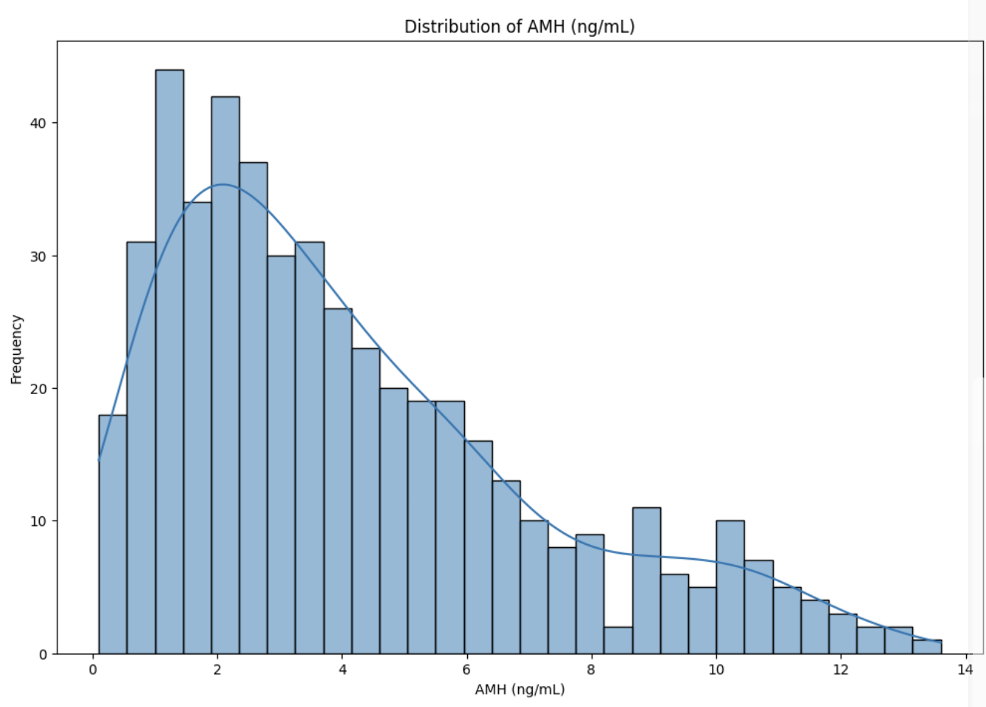
NUMERIC FEATURES VISUALIZATION
- AMH LEVELS
Peak frequency (~30-35) is around 1-3 ng/mL
Frequency slowly decreases from 3 ng/mL until 8 ng/mL
Plateaus 8-10 ng/mL
Steadily decreases again from 10 ng/mL until 13.5 ng/mL
Notes:
AMH: Peak frequency (~30-35) is around 1-3 ng/mL and slowly decreases steadily until around 8-10 ng/mL where it plateaus, before steadily decreasing again to about 13.5 ng/mL

Slide 9
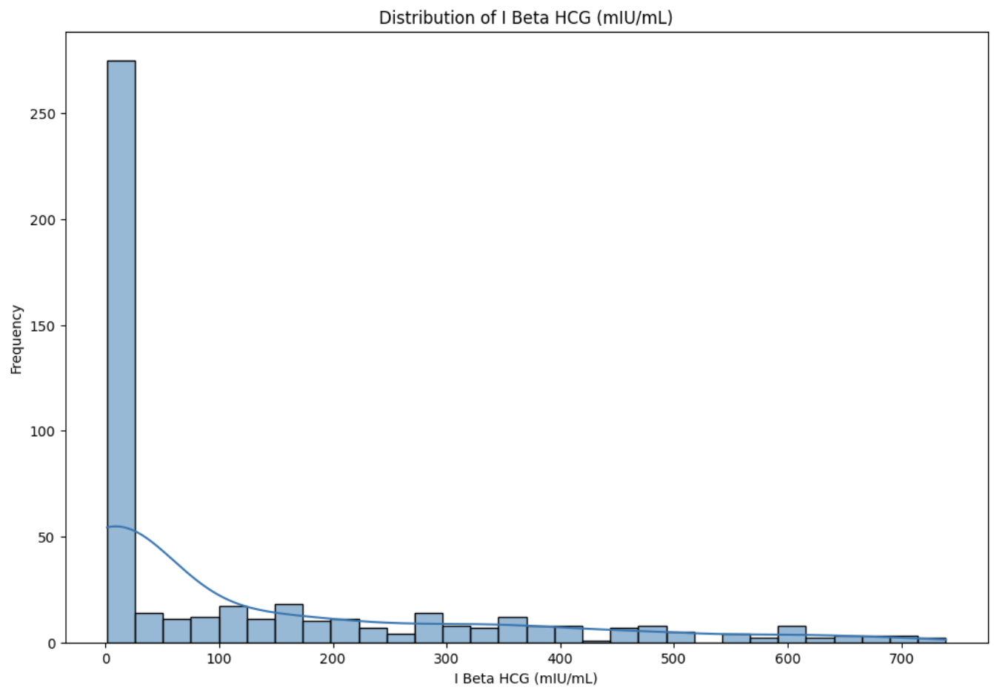
NUMERIC FEATURES VISUALIZATION
- I BETA HCG LEVELS
Peak frequency (~275) is around 0-25 mIU/mL
Frequency immediately decreases to ~0-25 until ~725 mIU/mL
Notes:
I Beta HCG: Highest frequency (around 275) at 0-25 mIU/mL and decreases nearly instantly from there to frequency of ~0-25 until ~725 mIU/mL

Slide 10
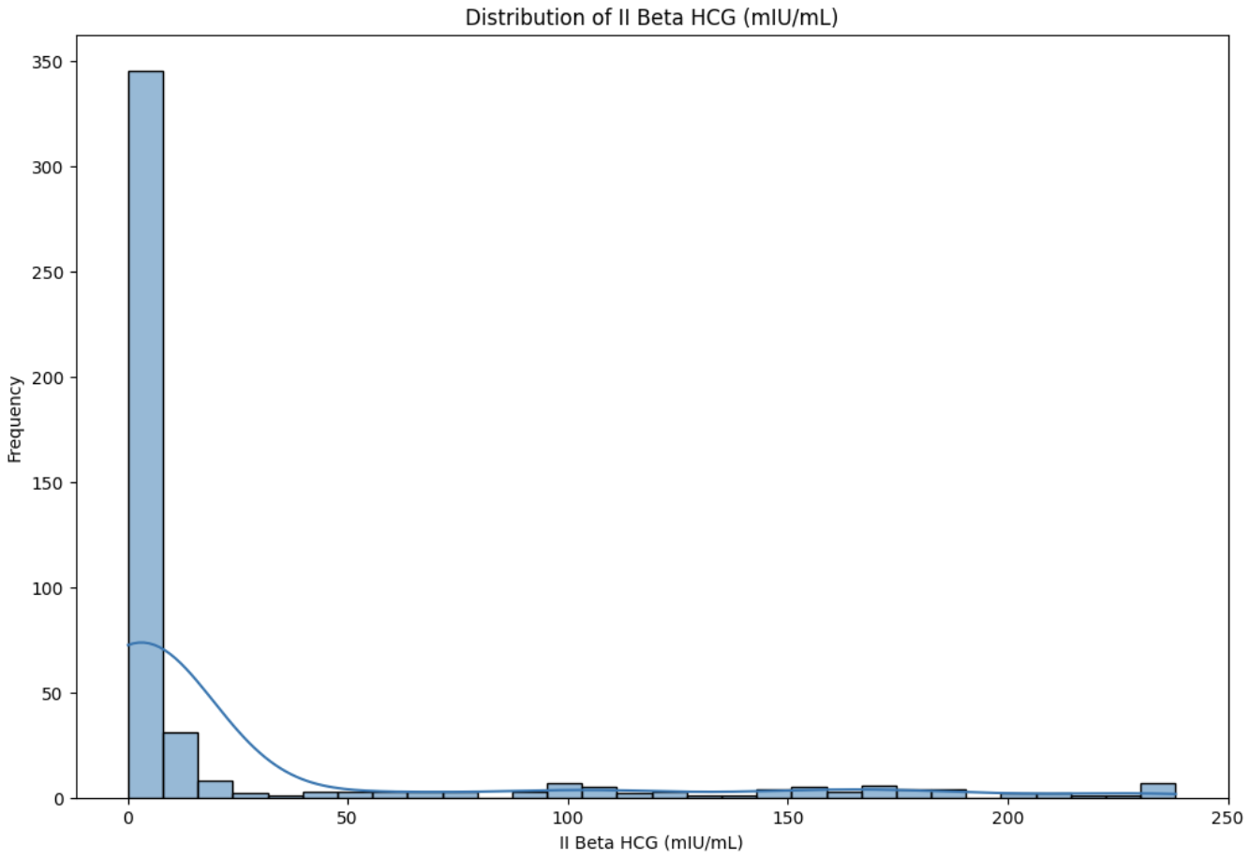
NUMERIC FEATURES VISUALIZATION
- II BETA HCG LEVELS
Similar trend to I Beta HCG
Peak frequency (~345) is around 0-15 mIU/mL
Frequency immediately decreases to ~0-15 until ~250 mIU/mL
Notes:
II Beta HCG: Similar trend with the highest frequency (around 345) at ~0-15 mIU/mL and decreases nearly instantly from there to frequency of ~0-15 until ~250 mIU/mL

Slide 11
DATASET EXPLORATION
Overall: Twice as many PCOS = “No” data points, higher frequencies of lower hormone levels, and frequency decreases as hormone level increases
Next: Compare AMH, I Beta HCG, and II Beta HCG independently to PCOS diagnosis
Using Boxplots to visualize
Notes:
Overall, there twice as many PCOS “No” than “Yes”, the frequencies are higher lower levels of all the hormones overall, and decrease in frequency as the concentrations increase
We then used our dataframes to compare each of the hormone levels to the diagnosis of PCOS. We used boxplots to visualize this data and to see if we can find any significant differences.

Slide 12
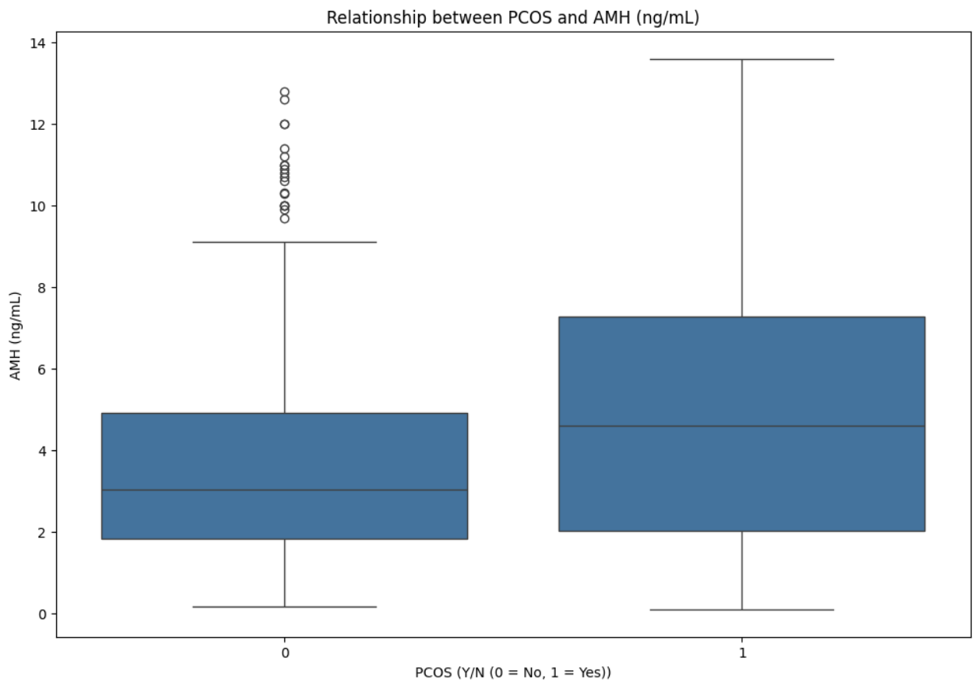
INITIAL DATA EXPLORATION KEY FINDINGS - AMH AND PCOS
PCOS = “Yes” shows higher median, 3rd quartile, and maximum
PCOS = “Yes” has larger interquartile range and no outliers (when compared to “No” cohort)
Potentially a significant difference between cohorts
Notes:
Where PCOS = “Yes”, the box plot shows a higher median, 3rd quartile, and maximum compared to the other cohort. The “Yes” cohort also has a larger interquartile range. Both cohorts have approx. the same 1st quartile (around 2 ng/mL) and same minimum (0 ng/mL). There are no outliers in the “Yes” cohort, however the “No” cohort has several high outlier data points. There is potentially a significant difference between cohorts

Slide 13
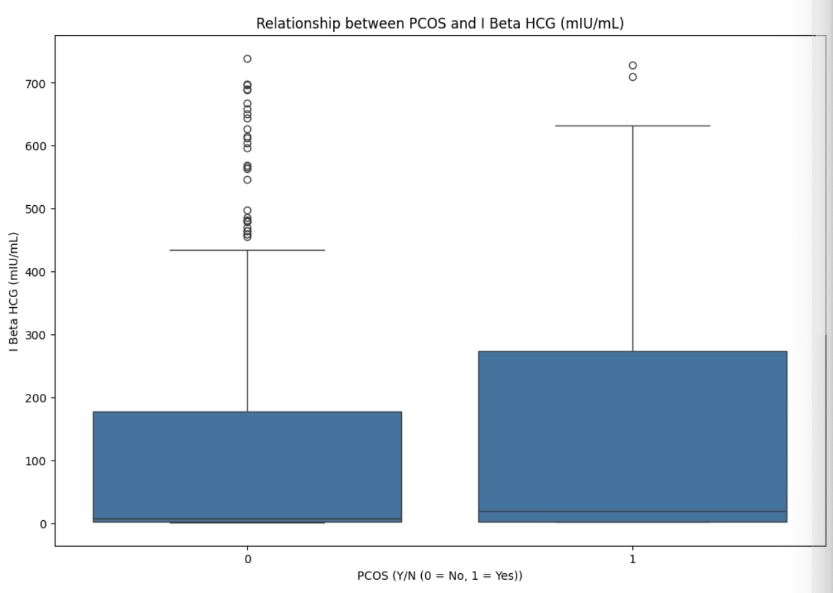
INITIAL DATA EXPLORATION KEY FINDINGS - I BETA HCG AND PCOS
PCOS = “Yes” shows higher median, 3rd quartile, and maximum
The minimum and 1st quartile same in both cohorts (0)
Potentially a significant difference between cohorts
Notes:
Similar to AMH, I Beta HCG had the PCOS = “Yes” box plot show a higher median and 3rd quartile, as well as a higher maximum. The minimum and 1st quartile seem to be the same in both cohorts (0). There are a several higher outliers in the PCOS = “No” cohort, and two in the other cohort. Again, there is potentially a significant difference between cohorts

Slide 14
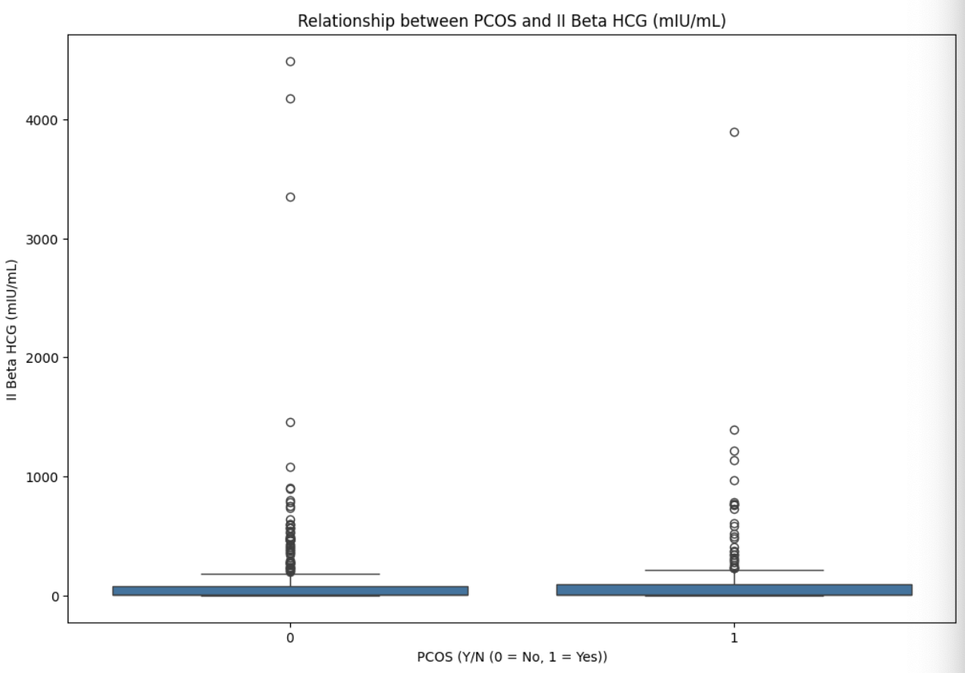
INITIAL DATA EXPLORATION KEY FINDINGS - II BETA HCG AND PCOS
PCOS = “Yes” has a slightly higher median and 3rd quartile, however it is likely not significant
The minimum and 1st quartile same in both cohorts (0)
The maximum is approximately the same in both cohorts
Both cohorts have several outliers
Likely not a significant difference between cohorts
Notes:
Where PCOS = “Yes”, the box plot might have a very slightly higher median and 3rd quartile, however it seems to be less drastic than the I Beta HCG variable comparison. Again, the minimum and 1st quartile are the same (0), and the maximum is also approx. the same in both cohorts. There are several extremely high data outliers in both cohorts, but especially the “No” cohort with 3 points above 3000 mlU/mL (whereas the other cohort has 1 point). They both have several outliers up to around 1500 mlU/mL. Overall, the difference it the two does not look significant when visually analyzing the data, especially compared to the I Beta HCG and AMH graphs.

Slide 15
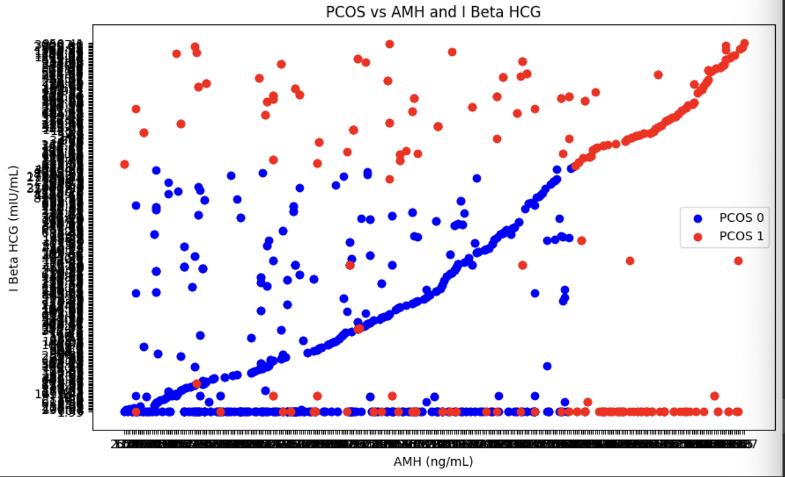
AMH AND I BETA HCG VS PCOS
Merged the two DataFrames (no outliers) into one DataFrame
Clear threshold where PCOS = 1 (Yes) is at a certain AMH and I Beta HCG levels
Keep in mind potential false negatives (and false positives)
Notes:
We merged the AMH and I Beta HCG dataframes without outliers into one dataframe moving forward. A clear threshold where PCOS = 1 (Yes) is seen that at a certain AMH and I Beta HCG levels. From this we can infer that once a certain level of I Beta HCG or AMH is reached, PCOS diagnosis will be positive. Furthermore, there is a likely chance if hormone levels are both below that threshold the PCOS will be negative. However, we will need to keep in mind that there is a higher chance of false negatives, opposed to false positives, due to a several PCOS = 1 (Yes) individuals having lower AMH and I Beta HCG levels.

Slide 16
PROBLEM STATEMENT
Given patient data containing measurements of AMH and I Beta HCG, we hypothesize that elevated levels at a certain threshold of both AMH and/or I Beta HCG indicate a positive PCOS result
Our Objective: Develop a predictive model that can accurately classify whether a patient is likely to have PCOS or not based on their hormone measurements of AMH and I Beta HCG
Notes:
Given patient data containing measurements of AMH and I Beta HCG, we aim to predict the likelihood of PCOS. Our hypothesis suggests that elevated levels of both AMH and I Beta HCG indicate a positive result for PCOS. Conversely, if both hormone levels are below a certain threshold, PCOS is likely to be negative, although there may be a higher risk of false negatives. By developing a predictive model based on these hormone measurements, we seek to enhance early detection and improve the accuracy of PCOS diagnosis

Slide 17
INITIAL MODELING
Consists of AMH and I Beta HCG hormone levels
The X training set consisted of AMH levels and PCOS detection results
The Y training set consisted of I Beta HCG
Fit the X and Y data set into 3 training models
Linear regression
Ridge Regression
Random Forest Regression

Slide 18
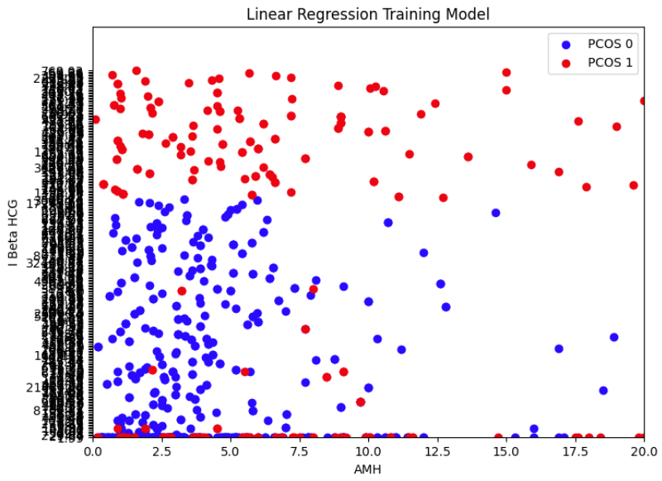
LINEAR REGRESSION MODEL
In 100 trial runs:
The average R^2 = 0.2874

Slide 19
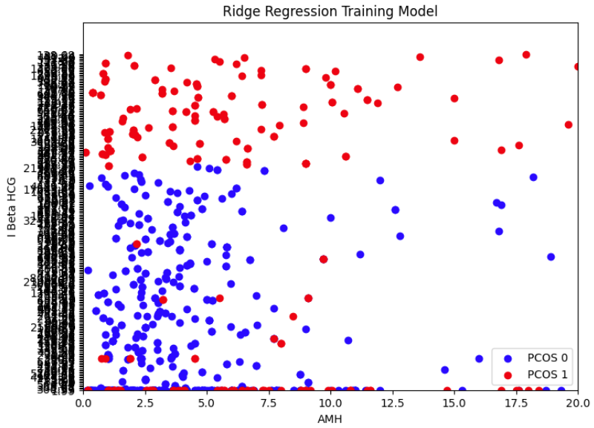
RIDGE REGRESSION MODEL
In 100 trial runs:
The average R^2 = 0.3326

Slide 20
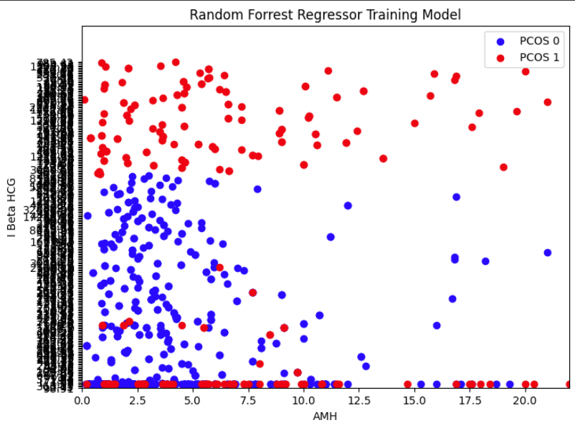
RANDOM FOREST REGRESSION MODEL
In 100 trial runs:
The average R^2 = 0.4509

Slide 21
RESULTS / INSIGHTS
The average mean squared error (MSE) = ~10^6 range
Highlights the model’s ability to minimize prediction errors
The average mean absolute error (MAE) =~100 range
Indicates relatively low average prediction deviations
As R^2 reaches closer to 1, the MSE and MAE decreases closer to 0
Closer approximation to 1 correlates with decreased MSE and MAE, indicating enhanced model accuracy
The Random Forest Regression Model yields the best/highest R^2 value out of the 3 training models

Slide 22
FUTURE PLANS / IMPROVEMENTS
The models may be overfitted, therefore removing certain outliers may improve them along with the MSE and MAE values
Use other measuring metrics that provides better feedback of the models
Use other modeling techniques

Slide 23
CONCLUSION
The Random Forest Regression Model approach offers promising utility in determined PCOS likelihood based on AMH and I Beta HCG hormone measurements
Further refinement and validation hold potential to augment its clinical applicability for PCOS diagnosis based on hormone measurements
Notes:
In conclusion, the insights gleaned from model performance underscore its alignment with the project’s original objective, offering tangible advancements in PCOS diagnosis and laying the groundwork for future research and clinical implementation

Slide 24
ACKNOWLEDGEMENTS
Dataset Source: Kaggle PCOS Dataset
PCOS Background Sources: Mayo Clinic American College of Obstetricians and Gynecologists (ACOG) The American Society for Reproductive Medicine (ASRM)

