Slide 1
Input (h×w)
Conv₁
Concatenate
Conv₃(m×n)-BN-ReLu
DoubleConv(m×n)
F
Avg_{k}^{s}
CARAFE
D
sum
Number of plants
Encoder
Decoder
1/2
1/4
Density mapper
F₂
1/8
1/16
F₁
C
1/32
Counter

Slide 2
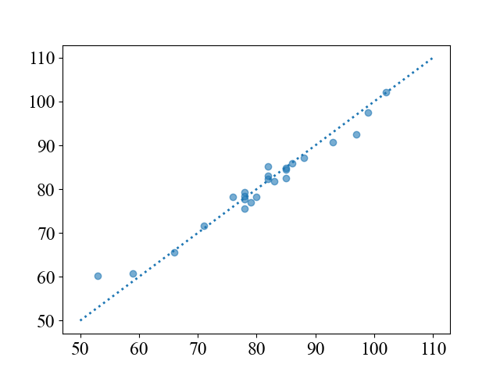
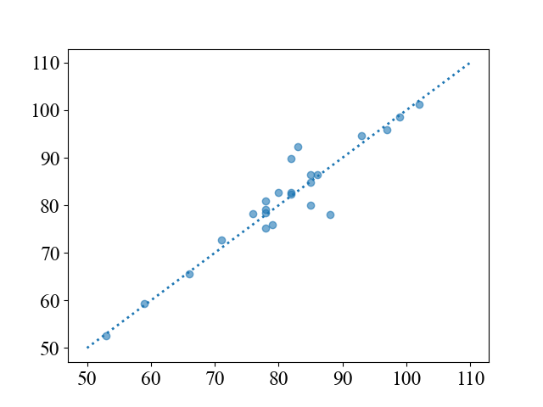
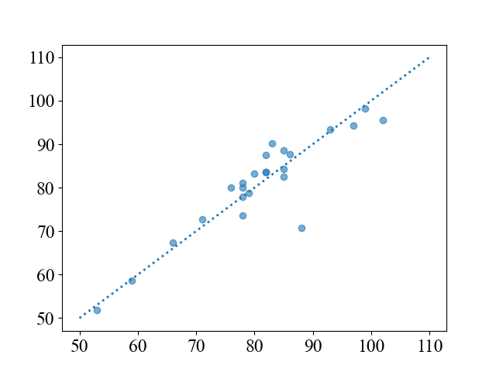
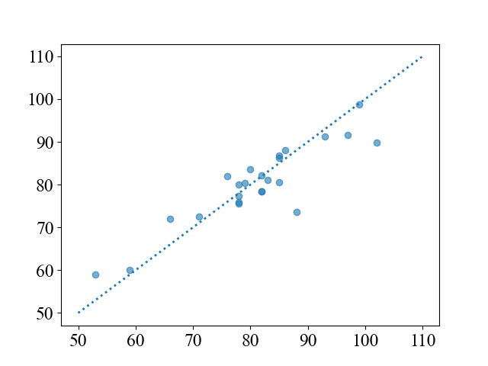
IntegrateNet
TasselNetV3-Lite
MAE: 1.62
RMSE: 2.28
R²: 0.9578
MAE: 2.39
RMSE: 3.69
R²: 0.8893
Predicted count
TasselNetV3-seg†
TasselNetV3-Seg‡
MAE: 3.50
RMSE: 4.56
R²: 0.7948
MAE: 3.06
RMSE: 4.64
R²: 0.8248
MAE: 3.56
RMSE: 4.93
R²: 0.8027
Predicted count
Ground-truth count
Ground-truth count

Slide 3
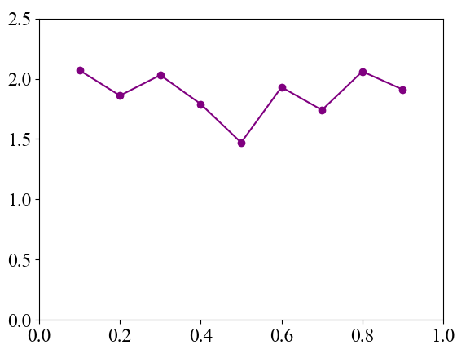

MAE
Weight on the loss of density map $λ$

Slide 4
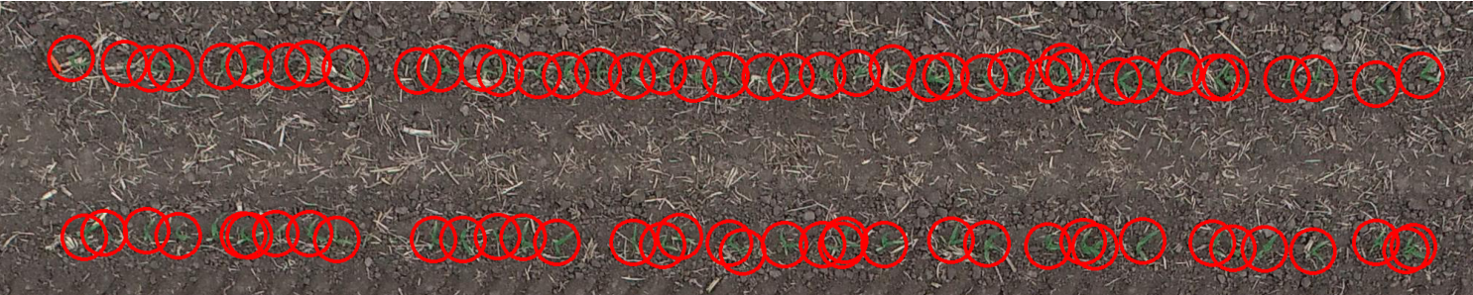
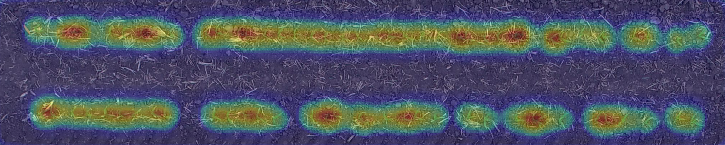
(a)
(b)

Slide 5
