Slide 1
Mid-term Presentation Guidelines DSC 383W / 483: Data Science Capstone

Slide 2
Mid-term Presentation
Please be on-time
Plan your presentation for no more than 15-17 minutes (leaving 2-3 min or so for questions and change-over)
Prepare a professional presentation
Dress in a professional attire
Rehearse the presentation within your team
Remember, you are telling a story about your project
Check your presentation on a projector to make sure resolution and font size are adequate (e.g. you can use Wegmans 1201 for checking this)
The time limit for each presentation will be strictly enforced

Slide 3
Mid-term Presentation
Plan for each of your team members to present
For Master’s students: A successful presentation meets the requirements to pass the Plan B exam
Plan for no more than about 10-15 slides (depending on your pace) so you have enough time to explain each slide
You are expected to attend all other team presentations (this is an integral part of the learning experience)

Slide 4
Mid-term Presentation
Please make sure the figures are professional
Labels on both axis (with units)
Visible
Yes, you can change the figure appearance in all programs manually or via code, the default doesn’t work well always !! (e.g. modify default of “matplotlib”, “seaborn”)
Do not clutter a figure or graph with multiple plots
Instead, use multiple graphs situated next to each other
Make sure the graphs are visible even from a distance (at least 20 ft away!)

Slide 5
Mid-term Presentation
During the presentation, speak loudly and clearly in full sentences and make eye contact with your audience
Use a pointer to point to images/graphs/diagrams projected on the screen.

Slide 6
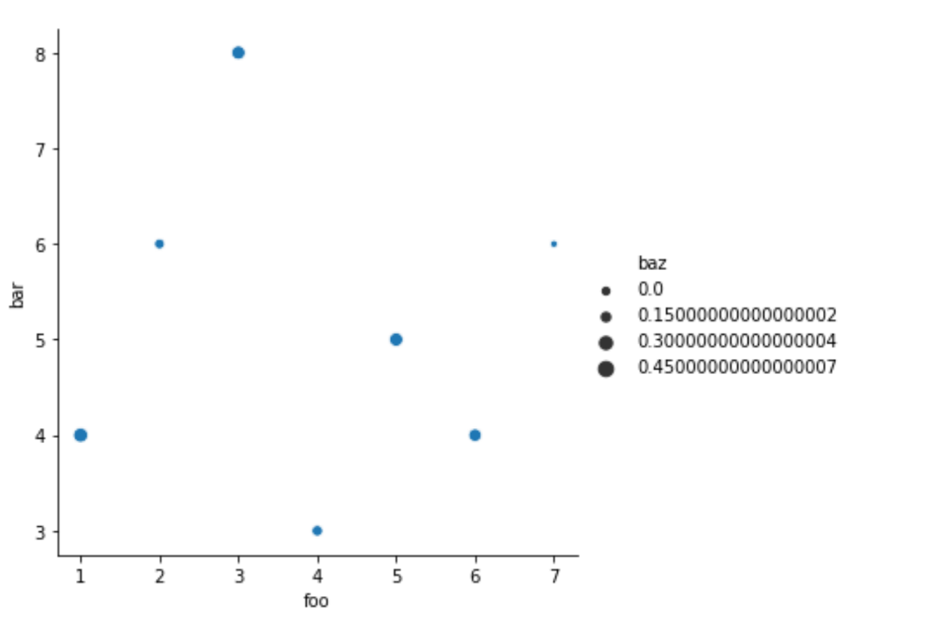
Mid-term Presentation
With every graph or figure, add a bullet or two summarizing what is the take-away
No need to show numerical values with more than 2 or 3 decimals at most !
On a graph with multiple lines or bars, highlight the one that is important to the point you are trying to make
Drop an arrow or highlight interesting data points on the graphs
Distracting

Slide 7
Mid-term Presentation
Use thick lines for plots (especially important for virtual presentations shown via Zoom !!)
Avoid clutter on your graphs with too many data points … change the scale or skip alternate points for easy visualization
Be prepared to explain key technical definitions and concepts relevant to your project / what you present on a slide
(e.g. accuracy, recall, precision, F1-score)

