Slide 1
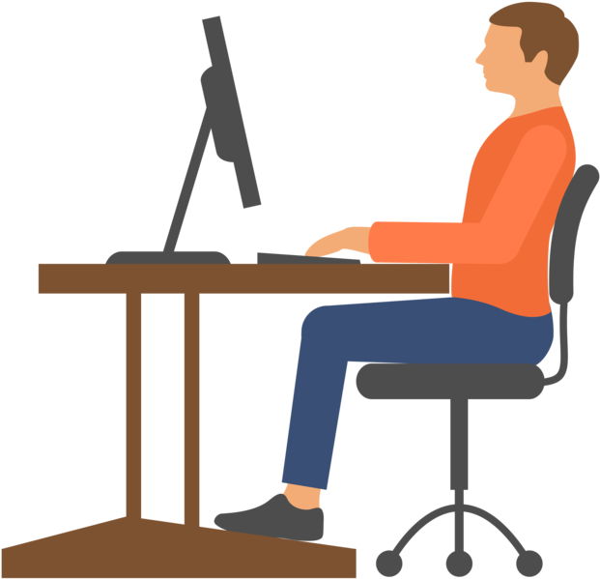
Please maintain a good posture while we gather some information about your current seating position.
Don’t worry, this will only take a few moments.

Slide 2
Welcome.
Pose Malone is here to help you maintain a good working posture in your temporary workspace. We’re using AI to keep track of your current working position and we will notify you if you start slacking off.
Start our application here

