Slide 1
Lab04-SmallWorld Artifacts
Team: CritFail
Kylie Arnett
William Locklier
Jeremy Quijano
Team: X
Notes:
1

Slide 2
Vision
SmallWorld is envisioned to be a fun text-oriented adventure.
  The Colossal Cave Adventure game, produced in the '70s, was the historic first “interactive fiction” game, in which the computer would simulate and describe a situation and the user would type in what to do next, in simple English.
Business Opportunity:
  Retro games are all the rage—SmallWorld, a data-driven text-based exploration game, will allow us to:
    Provide a retro game product
    Develop an active “mod” community
    Provide an interactive text-based environment to the player
    Provide a point system to the player
Notes:
2

Slide 3
Summary of System Features - Updated
Ability to create and explore diverse and fantastic alternative worlds
Ability to save (or load) the game at any point during play
Ability to pick up/drop items places in the world
Ability to list the inventory of the player
Ability to solve riddles and explore various rooms
Support for multiple types of computers and operating systems
Notes:
3

Slide 4
Use Case Model
SmallWorld
Team: X
Notes:
4

Slide 5
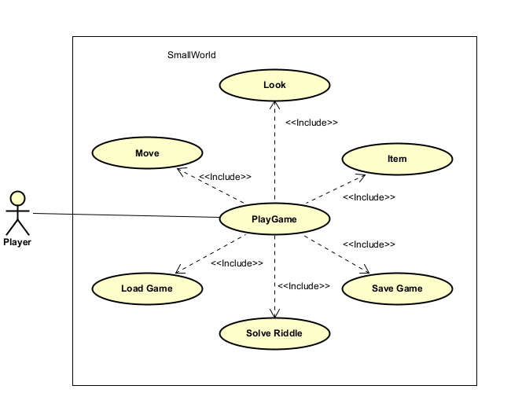

Notes:
5

Slide 6
UC1: Play Game
Scope: SmallWorld game
Level: user-goal
Primary Actor: User
Precondition: User is on a computer with the game installed.
Main Success Scenario:
  1. User starts the game
  2. Game initializes the default simulated world
  3. Player enters command
  4. Game executes command
  If player picks up items/drop, or use items points are added to the system
  Player repeats steps 3-4 until game ends or player quits the game
  5. Game exits
Extensions:
  4a. Move command: Include Move
  4b. Look command: Include Look
  4c. Save command: Include Save Game
  4d. Load command: Include Load Game
  4e. Pick up command: Include Item
  4f. Drop command: Include Item
  4g: Use command: Include Item
  4e. Unrecognized command: display a polite error message to the user
Special Requirements:
  Game response to a player command should be within half a second.
  The entire definition of a game world should be held in data—none of it should be hard-coded within the software. This is necessary to enable a thriving “mod” community to develop around the game.
Technology & Data Variations List:
  The game should run on Windows, Mac, Linux.
Open Issues:
  None
Notes:
6

Slide 7
UC2: Move
Scope: SmallWorld game
Level: subfunction
Precondition: User must have the item needed to enter the room and chose to move his or her player in a specified direction.
Main Success Scenario:
  1. Game determines place that is in the specified direction of the player’s current location
  2. Game moves player to the new location
  3. Game reports the player’s new location with a description that includes the new location’s contents
  4. Game checks to see if player has the item required to enter room
  5. Game checks to see if room is labeled with win condition tag
  6. Game displays the game has been won to player
Extensions:
  1a. If the player can’t go that way, an error message is displayed and the use case terminates
  2a. If the player does not have the item required to enter the room, a message will display indicating the player needs an item to enter
  3a. If the new location is a winning location, system reports player wins and ends game
Special Requirements:
  Room is to be labeled with a win tag
  Room is labeled with item required tag
  Room is labeled with Riddle tag
Technology and Data Variations List:
  The UI may prohibit extension 1a from occurring.
Open Issues:
  None
Notes:
7

Slide 8
UC3: Look
Scope: SmallWorld game
Level: subfunction
Precondition: User chose to look at the current location of the player.
Main Success Scenario:
  1. Game reports the player’s current location with a description
  2. Game reports any items in the area that can be picked up or used
Extensions:
  None
Special Requirements:
  None
Technology and Data Variations List:
  The UI may provide a constant view of information about the player’s current location so this command may not be needed.
Open Issues:
  None
Notes:
8

Slide 9
UC4: Save Game
Scope: SmallWorld game
Level: subfunction
Precondition: User chose to save the current state of the game.
Main Success Scenario:
  1. User specifies the name and location for the saved game
  2. System saves the entire game state to the specified name and location
  3. System saves the inventory state of player
  4. System informs the user the game has been saved
Extensions:
  2a. If the save fails for any reason, a diagnostic error message is presented to the user
Special Requirements:
  The entire definition of a game world should be held in data—none of it should be hard-coded within the software. This is necessary to enable a thriving “mod” community to develop around the game.
Technology and Data Variations List:
  The saved game will go into a file and use XML and be portable across all supported operating systems.
Open Issues:
  None
Notes:
9

Slide 10
UC5: Load Game
Scope: SmallWorld game
Level: subfunction
Precondition: User chose to load a previously saved game into the game
Main Success Scenario:
  1. User specifies the name and location for the saved game state to load
  2. System loads the entire game state to the game (discards the current game state)
  3. System loads the inventory state of the player, and updates players inventory
  4. System informs the user the load has completed
Extensions:
  2a. If the load fails for any reason, a diagnostic error message is
  presented to the user and the current world state is maintained
Special Requirements:
  The entire definition of a game world should be held in data—none of it should be hard-coded within the software. This is necessary to enable a thriving “mod” community to develop around the game.
Technology and Data Variations List:
  The saved game will go into a file and use XML and be portable across all supported operating systems.
Open Issues:
  None
Notes:
10

Slide 11
UC5: Item- Pick Up
Scope: SmallWorld game
Level: subfunction
Precondition: User picks up an item
Main Success Scenario:
  1. User picks up an item
  2. System updates the Users inventory to show said item
  3. System updates users point score
Extensions:
  1a. If the item pick up fails in anyway, System should prompt user an error has occurred
Special Requirements:
  none
Technology and Data Variations List:
  The saved game will go into a file and use XML and be portable across all supported operating systems.
Open Issues:
  None
Notes:
11

Slide 12
UC5: Item- Drop
Scope: SmallWorld game
Level: subfunction
Precondition: User picks up an item
Main Success Scenario:
  1. User drops an item
  2. System updates the Users inventory to show item is no longer in players hand
  3. System updates users point score
Extensions:
  1a. If the item drop fails in anyway, System should prompt user an error has occurred
Special Requirements:
  none
Technology and Data Variations List:
  The saved game will go into a file and use XML and be portable across all supported operating systems.
Open Issues:
  None
Notes:
12

Slide 13
UC5: Solve Riddle
Scope: SmallWorld game
Level: subfunction
Precondition: User must enter the solve riddle state (Will be triggered when user tries to enter a certain room labeled riddle)
Main Success Scenario:
  1. User tries to enter a specific room (Labeled Riddle)
  2. System prompts a riddle to the User
  3. User enters the answer to riddle
  4. System informs the user riddle has been solved and allows user to enter the room
Extensions:
  3a. If the riddle is answered incorrectly System will prompt the user to try again, and the current world state is maintained
Special Requirements:
  None
Technology and Data Variations List:
  None
Open Issues:
  None
Notes:
13

Slide 14
Glossary
SmallWorld
Team: X
Notes:
14

Slide 15
Glossary - Updated
Direction—the direction of travel. Limited to north, south, east, and west.
Item—A text-based object the player can pick up, drop, and use to enter a place
Place—A place in the virtual world. Places are linked to other places, allowing travel. The player is always located at some place
Player—The user’s avatar within the computer.
Riddle—A text based problem (thought), The player must solve to enter the room
User—The individual playing the game on the computer.
World—A complete virtual “small world” within the computer.
XML—Extensible Markup Language (http://www.xml.org)
Notes:
15

Slide 16
Domain Model
Small World
Team: X
Notes:
16

Slide 17
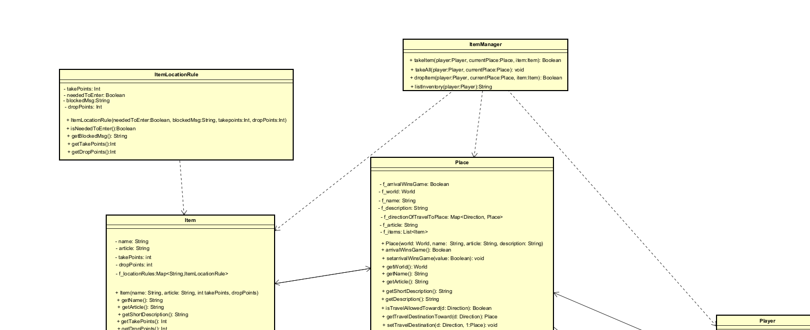
Domain Class Diagram - Example
Notes:
17

Slide 18
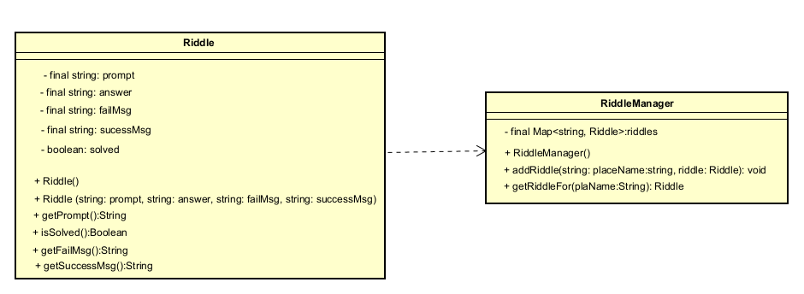
Domain Class Diagram -Updated Riddle Class
Notes:
18

Slide 19
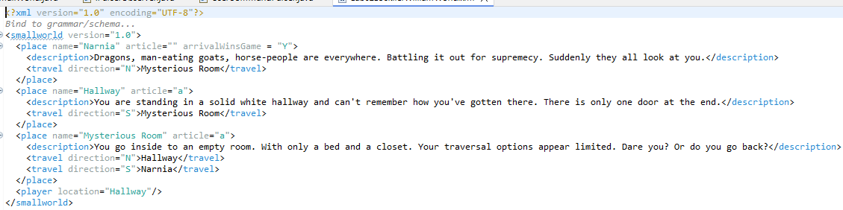
Example World (XML file)
Notes:
19

Slide 20
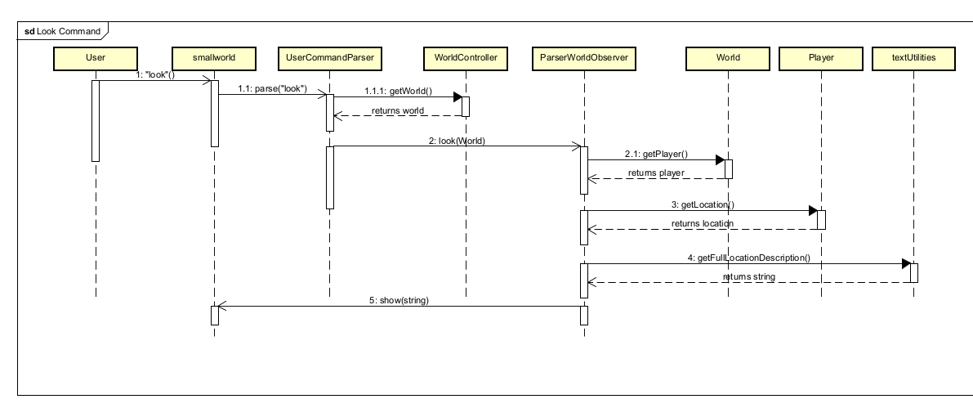
Sequence Diagram
Figure 1: “Look” Command Sequence Diagram
Notes:
20

Slide 21
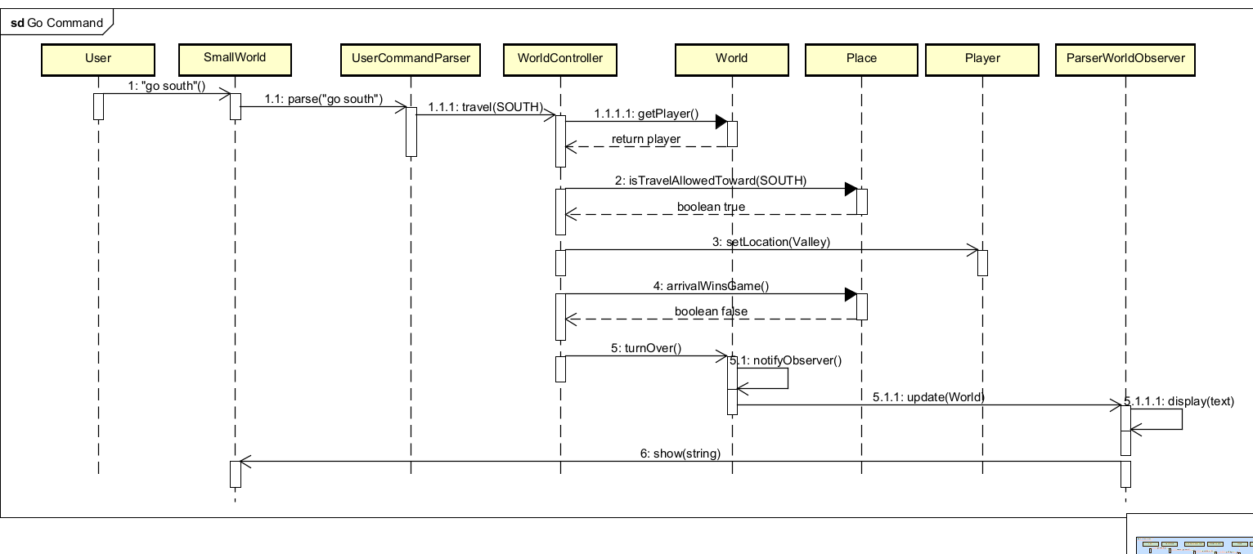
Sequence Diagram Cont.
Figure 2: “Go” Command Sequence Diagram
Notes:
21

Slide 22
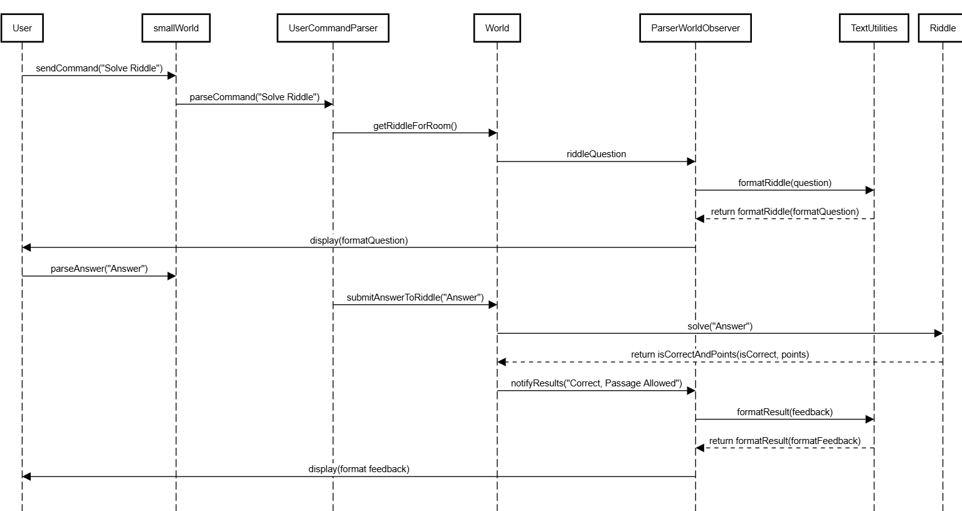
Sequence Diagram Cont.
Figure 3: Riddle Sequence Diagram
Notes:
22

Slide 23
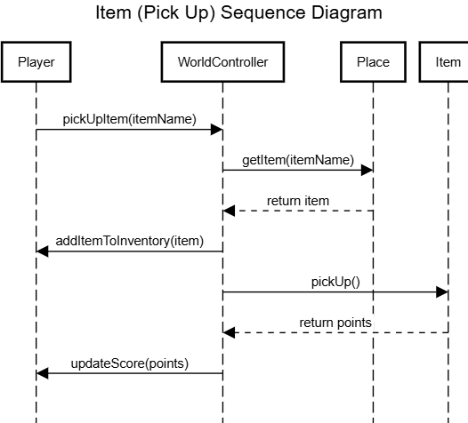
Sequence Diagram Cont.
Notes:
23

Slide 24
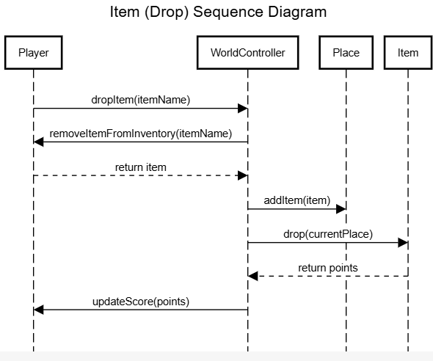
Sequence Diagram Cont.
Notes:
24

Slide 25
Supplemental Specification
SmallWorld
Team: X
Notes:
25

Slide 26
Functionality
Saved games will be placed in XML files.
Saved game files must be portable across all supported operating systems.
Notes:
26

Slide 27
Usability
Multiple UIs are supported for the game
  Text
  Graphical
  Web
All failures should be clearly reported to the user in a form they (not a programmer) will understand.
Deployment to users should not require any development tools
Notes:
27

Slide 28
Reliability
Intermittent or random failures will make the game far less “fun” and hamper development of a “mod” community.
Notes:
28

Slide 29
Supportability
All source code will have detailed Javadoc
  See http://java.sun.com/j2se/javadoc/index.jsp
All Documentation has been stored and updated with each iteration
All code has been updated through Github
Notes:
29

Slide 30
Libraries and Frameworks
JDOM (http://www.jdom.org)
  This free library will be used to simplify creating and reading XML files. Development will require a jdom.jar file, but because source code is available, we can “embed” JDOM within our source code for the shipping product.
  No runtime license fees for this library
AWT/SWING (http://java.sun.com/products/jfc/tsc/index.html)
  Sun’s standard graphical user interface framework will be used for any graphical user interfaces created for the game.
  No runtime license fees for use of this library. It is included as part of the standard Java library within a Java Runtime Environment (JRE).
Notes:
30

Slide 31
Development Tools
Programming Language:
  All software will be written in Java (http://java.sun.com)
Source Code Control System
  CVS (http://www.cvshome.org)
Documentation and Models
  Google Docs
  Google Slides
  Astah
IDE:
  Eclipse (http://www.eclipse.org)
Notes:
31

Slide 32
UI Mockups
SmallWorld
Team: X
Notes:
32

Slide 33
Riddle Examples
I am small and smelly, rotten to the core. bring me one of these to pass through this door
  Item needed: Skunk Carcass
This door is sealed, for it has no key. But green and round will set you free
  Item needed: Green Mushroom
The door is sealed, no knob in sight. But Golden glint will make it right
  Item needed: Gold coin
No password here, no magic lore. Just silver's touch to cross the door
  Item needed: Silver coin
Notes:
33

