Slide 1
The Madelbrot Fractal
Created by Austin Crapo
Collaborator: Kristen Newbury
Supervisor: J. Nelson Amaral

Slide 4
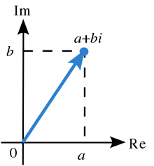
Complex Numbers
Image source: https://en.wikipedia.org/wiki/Complex_number

Slide 5
The Mandelbrot Set
Notes:
----- Meeting Notes (17-08-21 11:23) -----

Slide 6
Example: is in the Mandelbrot Set?
We need to know if the following expression is true
To avoid computing the square root, we can evaluate
this expression instead:

Slide 7
Example: is in the Mandelbrot Set?

Slide 8
Example: is in the Mandelbrot Set?
…

Slide 9

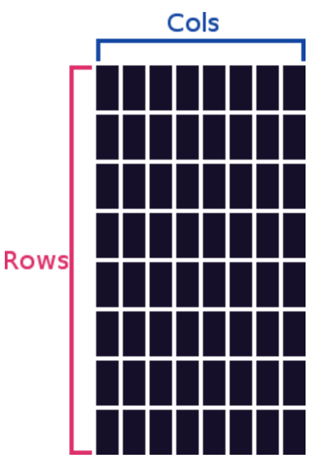
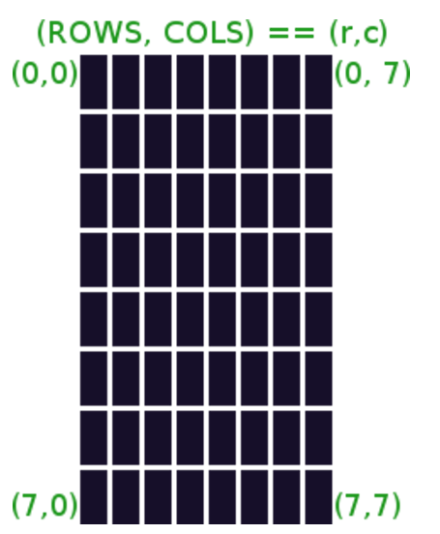
GLIM Graphics LIbrary for MIPS
Created by Austin Crapo
CMPUT229 Winter 2017 student

Slide 10
Mapping a screen tile to a point in the complex plan

Slide 11
Position:
(0,0)
(0,1)
(0,2)
(1,0)
(2,3)
Im
row
column
2.0
0
1
2
3
4
5
6
7
max_i
0
1.0
1
(1.0,0.5)
2
(-0.25,0.05)
3
-2.0
-1.0
1.0
2.0
gameRows
Re
4
min_r
max_r
5
-1.0
6
(-1.0,-1.3)
7
step_i
step_r
min_i
-2.0
gameColumns

Slide 12
Position:
(0,7)
(7,7)
(0,0)
(7,0)
(2,3)
Im
row
column
2.0
0
1
2
3
4
5
6
7
max_i
0
x_0
y_0
1.0
1
(1.0,0.5)
2
(-0.25,0.05)
3
-2.0
-1.0
1.0
2.0
gameRows
Re
4
max_r
5
min_r
-1.0
6
(-1.0,-1.3)
7
min_i
-2.0
gameColumns

Slide 13
max_r-min_r
step_r =
GameCols
setSizes
max_i-min_i
step_i =
GameRows
min_r
max_i
step_r
step_i
row
x_0
render
map_coords
col
y_0
calculate_escape

Slide 14
MIPS Floating Point Coprocessor

Slide 15
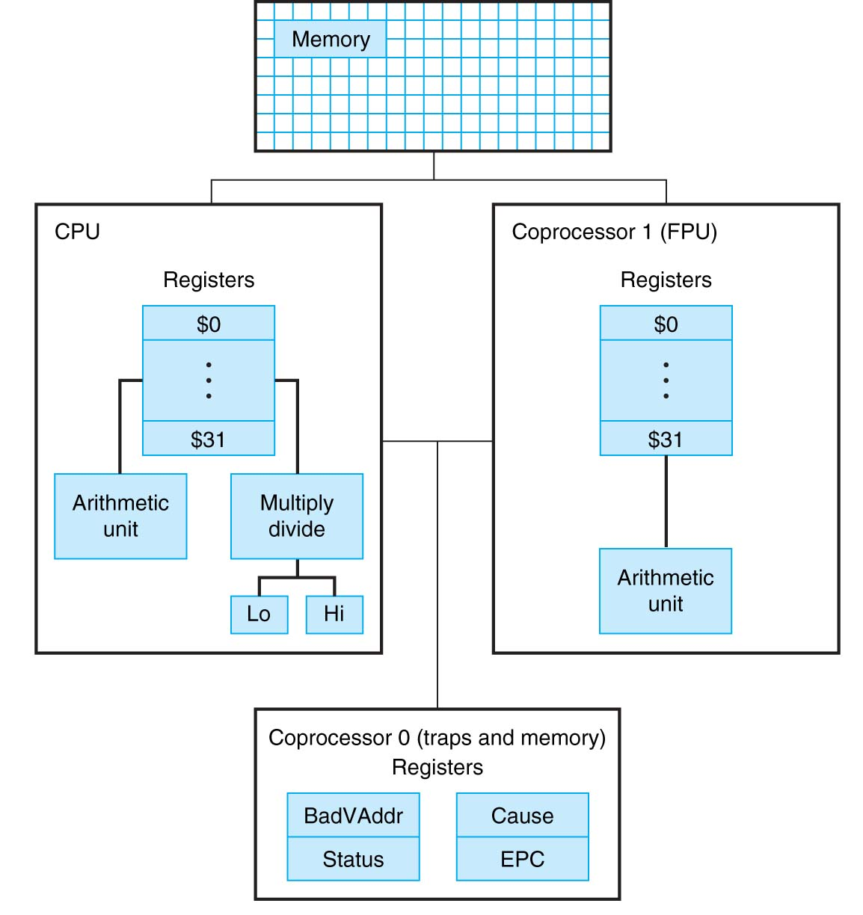
Registers $f0 to $f31

Slide 16
MIPS Floating Point Registers
32-bit Single Precision
each individual $f register stores a value
instructions have a .s suffix:
add.s, sub.s, mul.s, div.s
64-bit Double Precision
each pair of $f registers stores a value
$f0-$f1, $f2-$f3 …
only even registers can be used
Instructions have a .d suffix:
add.d, sub.d, mul.d, div.d

Slide 17
l.d
loads from memory into
$f register pair.
s.d
stores from
$f register pair
to memory
li.d
places
immediate value in
$f register pair.

Slide 18
mtc1 $R, $F
copy content of $R
into $F.
mfc1
copy content
of $F into $R

Slide 19
cvt.d.w $Fdest, $Fsrc
convert integer (word) to double
cvt.w.d $Fdest, $Fsrc
convert double to integer (word)

Slide 20
c.eq.d $f0, $f2
c.le.d $f0, $f2
c.lt.d $f0, $f2
set conditions based on values
bclt label
branch if condition is true
bclf label
branch if condition is false

Slide 21
Visualizing FP values in SPIM

Slide 22
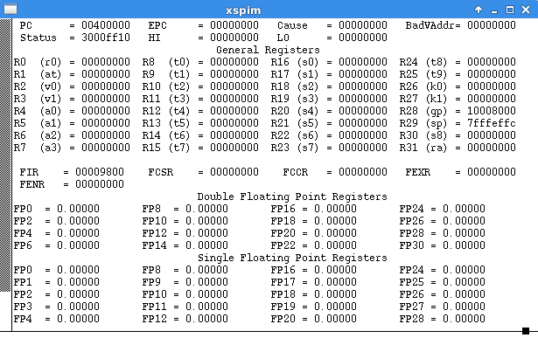

Slide 23
Assignment

Slide 24
max_r-min_r
step_r =
$f12 = max_i
GameCols
$f14 = min_i
$f16 = max_r
set_size
max_i-min_i
step_i =
$f18 = min_r
GameRows
$a0 = GameRows
$a1 = GameCols
min_r
step_r
max_i
step_i
Memory locations, each containing a double value

Slide 25
$a0 = max_interations
x_0
calculate_escape
y_0
Memory locations,
each containing a double value
$v0
$v1
$v0 = 1 if escaped
0 otherwise
$v1 = number of iterations before stopping

Slide 26
$a0 = GameRows
$a1 = GameCols
render
$a2 = max_interations
Render uses the following pre-defined data structures:
paletteSize
number of colors (and symbols) used
symbols
list of null-terminated strings containing a symbol each
colors
list of color codes
inSetColor
color for tiles that are in the set
inSetSymbol
symbol for tiles that are in the set

Slide 27
render
for each tile (row,col) in the display
(x_0,y_0) ← map_coords(row,col)
(escape,iterations) ← calculate_escape(maxNumIter,x_0,y_0)
if escape is false
select inSetColor
select inSetSymbol
else
position = iterations % paletteSize
select color at position in list of symbols
select symbol at position in list of symbols
setColor # a GLIM function
printString # a GLIM function

Slide 28
