Slide 1
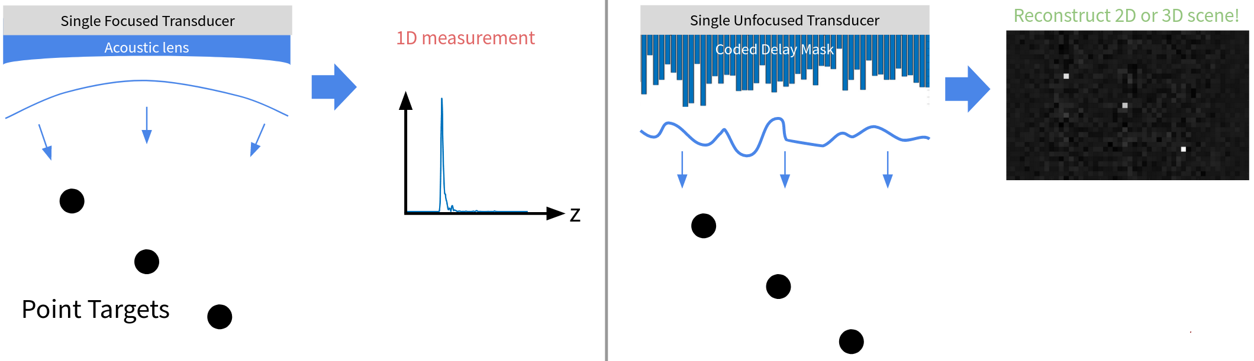
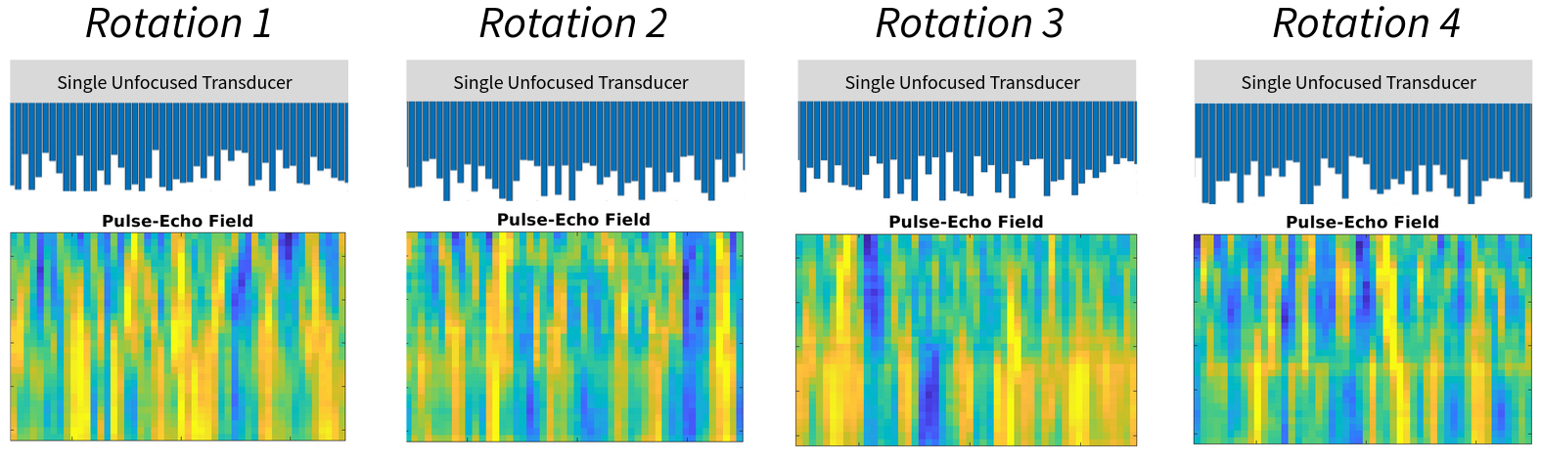
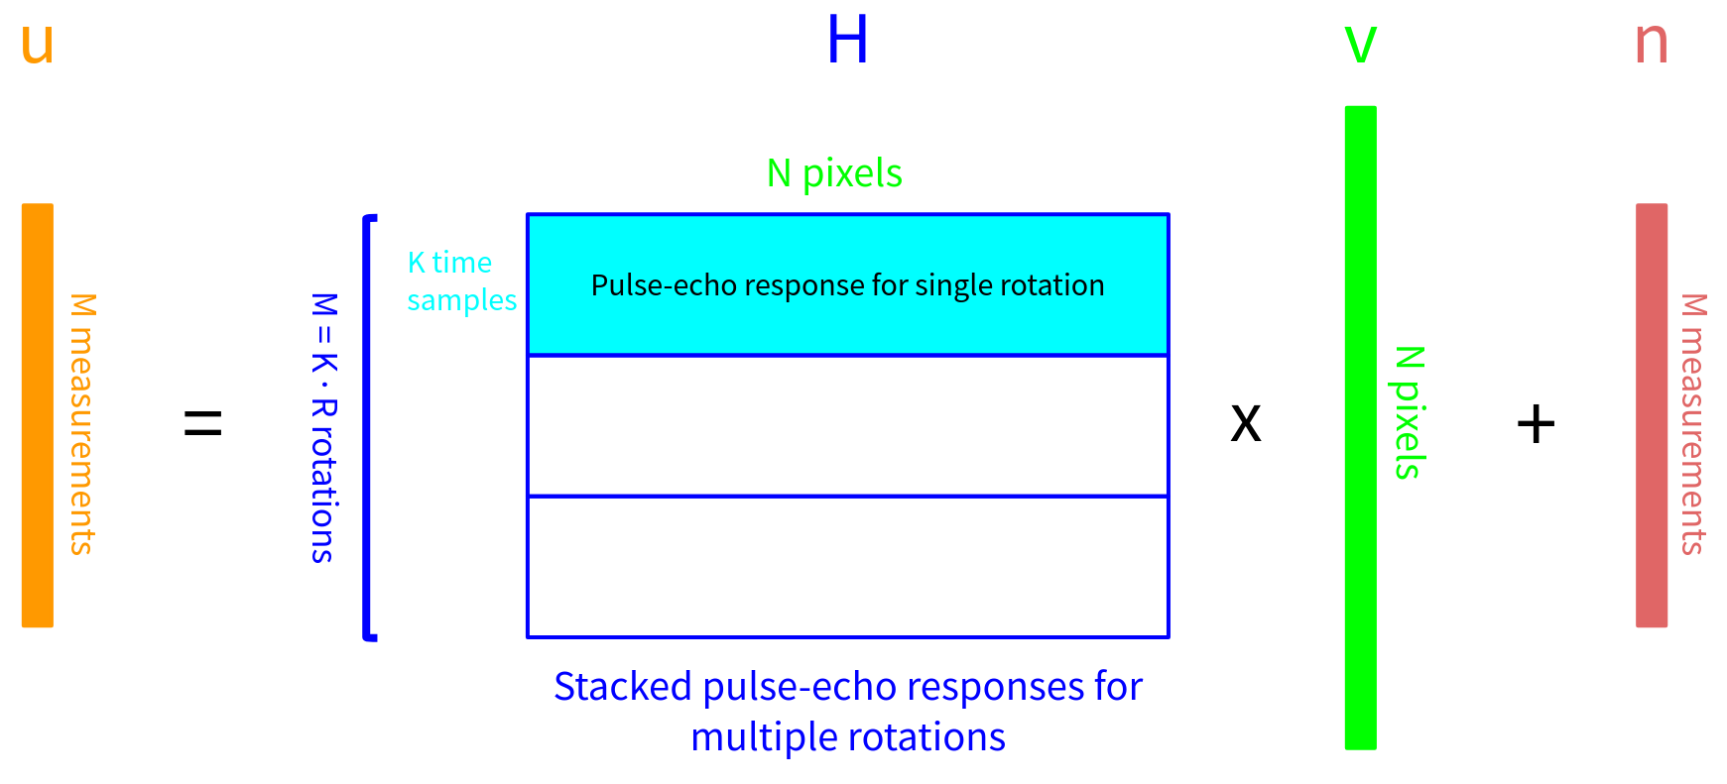
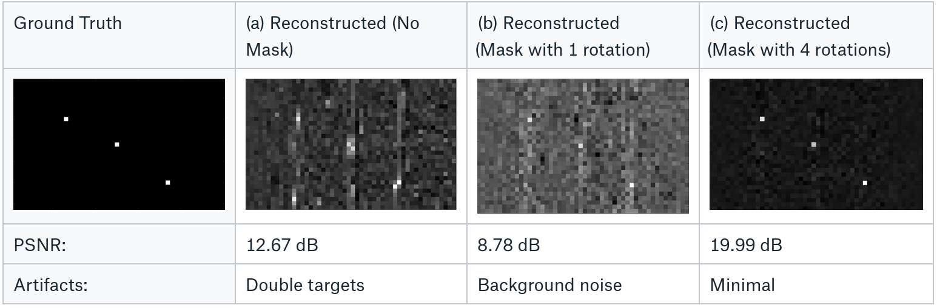
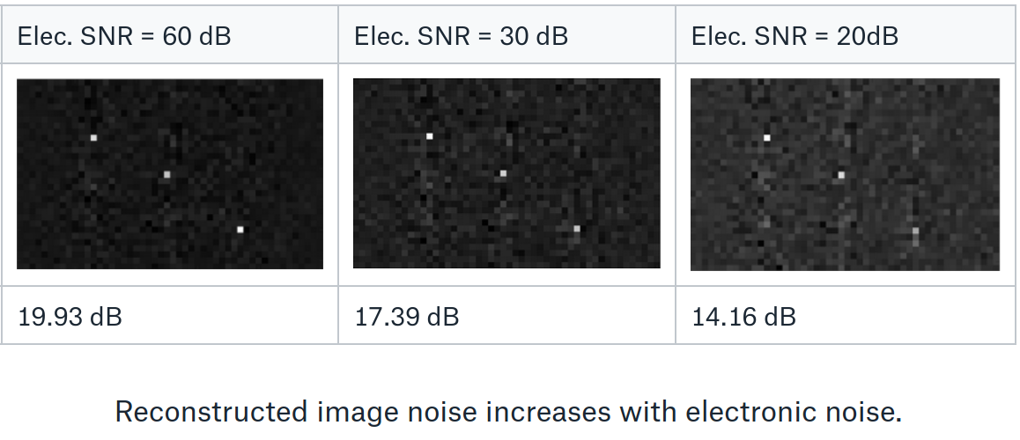
Single Element Ultrasound Imaging with Compressed Sensing
William Meng
wlmeng@stanford.edu
EE 367 Final Project, Winter 2021
Motivation
Methodology
Conventionally, a single ultrasound transducer can only capture 1D depth data, unless it is mechanically scanned.
A coded aperture can encode lateral information into a single temporal signal to perform 2D or 3D imaging [1, 2, 3].
Approximate physical mask as a delay profile
Linear image formation model based on pulse-echo temporal response at each pixel
Multiple mask “rotations” provide additional measurements
Reconstruct image with Least Norm or ADMM
Related Work
Simulated Results
2D/3D ultrasound imaging is typically done with ultrasound arrays consisting of many elements, but this requires greater hardware complexity and cost.
Other coded aperture techniques for ultrasound imaging use a 3D printed delay mask [1], Hadamard-encoded amplitude mask [2], or a scattering layer [3].
Generated synthetic data with 90 dB electronic SNR based on 3 point targets.
Reconstructed with Least Norm (PCG) and ADMM for: (a) No mask (b) R=1 (c) R=4
Characterized degradation of Least Norm (PCG) image reconstruction vs electronic SNR for R=4.
References
[1] P. Kruizinga, et al, “Compressive 3D ultrasound imaging using a single sensor”, Science Advances, Vol. 3, No. 12, December 2017.
[2] E. Hahamovich, A. Rosenthal, “Ultrasound Detection Arrays Via Coded Hadamard Apertures”, IEEE Transactions on Ultrasonics, Ferroelectrics, and Frequency Control, Vol. 67, Issue 10, Oct. 2020.
[3] X. Luís Deán-Ben, et al, “Acoustic Scattering Mediated Single Detector Optoacoustic Tomography”, Physical Review Letters, Vol. 123, Iss. 17, 25 October 2019.

