Slide 1
2、软件过程及过程模型 Software Process and Process Model
张天
软件工程组
ztluck@nju.edu.cn
2017年秋季

Slide 2
解释软件过程和过程模型
用一个案例来介绍，给出感性认识
进一步解释案例中所涉及到的过程和模型
再展开介绍其他的过程和模型

Slide 3
Questions：
What is a software process?
What is a software life-cycle model?
What are the generic framework activities that are present in every software process?
What are the prescriptive process models and what are their strengths and weaknesses?
注：这里有一个难点，就是理解过程模型和生命周期模型两个概念的区别
Notes:
prescriptive process models：一些常用的模型，如瀑布模型等
讲解过程模型和生命周期模型的方式：
先简单介绍一下两个概念，不要深入展开，只是建立一个基本概念，然后简单比较一下
使用Winburg案例给出对软件开发过程的一个感性认识
基于案例再深入对比两者的差异性，解释为什么它们会混用，以及如何准确地运用两种不同的模型

Slide 4
Software Process
What is Software Process
The software process is the way we produce software.
Software engineering practice is a broad array of principles, concepts, methods, and tools that you must consider as software is planned and developed.
注：各种书中给出的定义都不尽相同，但意思是一致的
Notes:
软件过程的基本概念，这里涉及到“软件生命周期”概念
注：一开始先不要强求理解过程模型和声明周期模型的区别，先建立一个基本概念，然后用实例给出具体感性认识，然后回头再讨论从过程模型和生命周期模型两个不同的视角理解“软件开发”这个目标的时候，两种模型的本质是什么、特点是什么、差异在哪里？

Slide 5
Definition using SLCM
It incorporates the methodology with its underlying software life-cycle model and techniques, the tools we use, and most important of all, the individuals building the software.
注：也有专家通过软件生命周期的概念来解释过程，此时生命周期模型的概念是更基本的概念，但也有很多地方是两者混用的。

Slide 6
Software Life-cycle Model
A life-cycle model is a description of the steps that should be performed when building a software product.
the series of steps performed on a specific software product, from concept exploration through final retirement, is termed the life cycle of that product.
注意：这里的概念也是将开发过程和软件自身演化阶段都混在一起看待了，说明过程模型和生命周期模型确实在概念上有很大的交叉

Slide 7
PM vs SLCM
Process Model vs Software Life-Cycle Models
Also known as Software Life-Cycle Models
Describe how software products are developed in practice
Such as
waterfall life-cycle model
evolution-tree life-cycle model
Incremental Process Models
Notes:
过程模型和生命周期模型是初学者特别容易混淆的概念，两者都是为了对软件过程进行更好地理解和把握，但两者的侧重点不同：前者以人为主体，从开发过程来看，后者则从软件自身来看。

Slide 8
Life-cycle model
waterfall life-cycle model
evolution-tree life-cycle model
incremental life-cycle models
Also known as Process Model
waterfall model
evolution(-tree) model
incremental models
Notes:
这是很多软工书中出现的混用现象，那么背后的差异到底何在呢？

Slide 9
Winburg Mini Case Study
Winburg public transportation system
Each bus is to have a fare machine that accepts only dollar bills.
Passengers insert a bill into the slot as they enter the bus.
Sensors inside the fare machine scan the bill, and the software in the machine uses an image recognition algorithm
An average response time of less than 1 second and an average accuracy of at least 98 percent.
Notes:
贯穿这部分课程内容的小案例：在印第安纳州的Winburg市区建立一个公共交通系统。
以上这些需求都是经过一些裁剪之后的精简版
注：最好将该案例打印出来，上课时分发到人手一份！

Slide 10
Development and Evolution
Software development and evolution in 6 episodes:
Episode 1 The first version of the software is implemented.
Episode 2 Tests show that the required constraint of an average response time of 1 second for deciding on the validity of a dollar bill is not achieved.
Episode 3 …
Episode 4 …
Epilogue …

Slide 11
Episode 2 (in detail)
In fact, on average, it takes 10 seconds to get a response.
Senior management discovers the cause.
It seems that, to get the required 98 percent accuracy, a programmer has been instructed by her manager to use double-precision numbers for all mathematical calculations.
As a result, every operation takes at least twice as long as it would with the usual single-precision numbers.
Calculations then show that the stipulated 98 percent accuracy can be attained even if single-precision numbers are used.
The programmer starts to make the necessary changes to the implementation.

Slide 12
Episode 3
Before the programmer can complete her work, further tests of the system show that, even if the indicated changes to the implementation were made, the system would still have an average response time of over 4.5 seconds, nowhere near the stipulated 1 second.
The problem is the complex image recognition algorithm.
Fortunately, a faster algorithm has just been discovered, so the fare machine software is redesigned and reimplemented using the new algorithm.
This results in the average response time being successfully achieved.

Slide 13
Episode 4
By now, the project is considerably behind schedule and way over budget.
The mayor asks the software development team to try to increase the accuracy of the dollar bill recognition component of the system as much as possible
To meet this new requirement, a new design is adopted that improves the average accuracy to over 99.5 percent.

Slide 14
Epilogue
A few years later, the sensors inside the fare machine become obsolete and need to be replaced by a newer model.

Slide 15
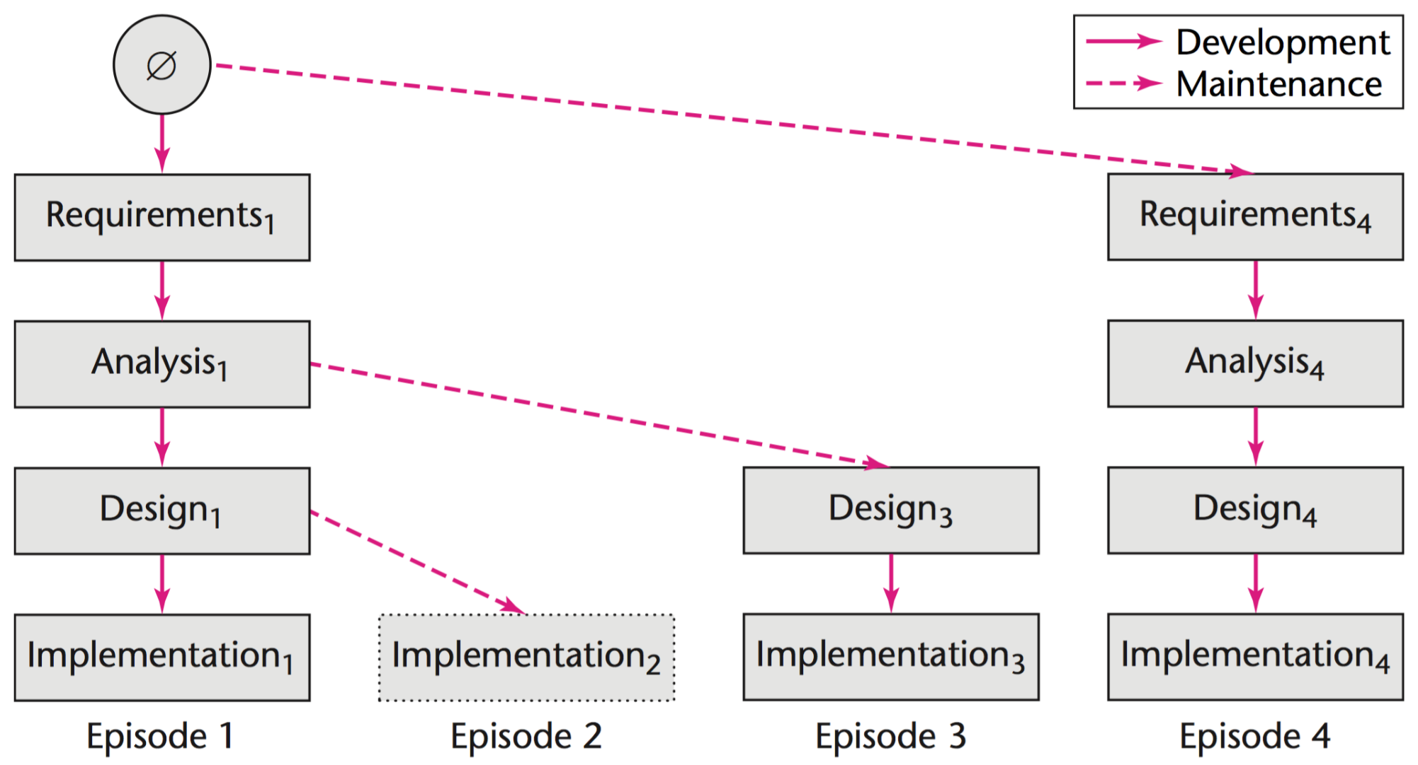
The evolution-tree life-cycle model for the Winburg mini case study

Slide 16
The evolution-tree life-cycle model for the Winburg mini case study
The leftmost boxes represent Episode 1.
the system was developed from scratch
The requirements (Requirements1), analysis (Analysis1), design (Design1), and implementation (Implementation1) followed in turn.
Next, as previously described, trials of the first version of the software showed that the average response time of 1 second could not be achieved and the implementation had to be modified.
The modified implementation appears as Implementation2.

Slide 17
The evolution-tree life-cycle model for the Winburg mini case study
The Episode 2:
The modified implementation appears as Implementation2.
However, Implementation2 was never completed.
That is why the rectangle representing Implementation2 is drawn with a dotted line.

Slide 18
The evolution-tree life-cycle model for the Winburg mini case study
The Episode 3:
the design had to be changed.
Specifically, a faster image recognition algorithm was used.
The modified design (Design3) resulted in a modified implementation (Implementation3).

Slide 19
The evolution-tree life-cycle model for the Winburg mini case study
The Episode 4:
Finally, the requirements were changed (Requirements4) to increase the accuracy.
This resulted in modified specifications (Analysis4), modified design (Design4), and modified implementation (Implementation4).

Slide 20
In the figure, the solid arrows denote development and the dashed arrows denote maintenance.
For example, when the design is changed in Episode 3, Design3 replaced Design1 as the design of Analysis1.
Notes:
到目前为止，已经将Winbug小型案例的进化树生命周期模型讲完了，但其它模型也可以展示该开发过程，尽管未必严格遵循其生命周期模型

Slide 21
Baseline
At the end of each episode we have a baseline, that is, a complete set of artifacts
An artifact is a constituent component of a software product.
There are four baselines in the case: At the end of Episode 1: Requirements1, Analysis1, Design1, Implementation1 At the end of Episode 2: Requirements1, Analysis1, Design1, Implementation2 At the end of Episode 3: Requirements1, Analysis1, Design3, Implementation3 At the end of Episode 4: Requirements4, Analysis4, Design4, Implementation4
Notes:
增量和迭代模型是非常重要的基本模型，对很多现在正在使用的过程和生命周期模型都产生巨大影响

Slide 22
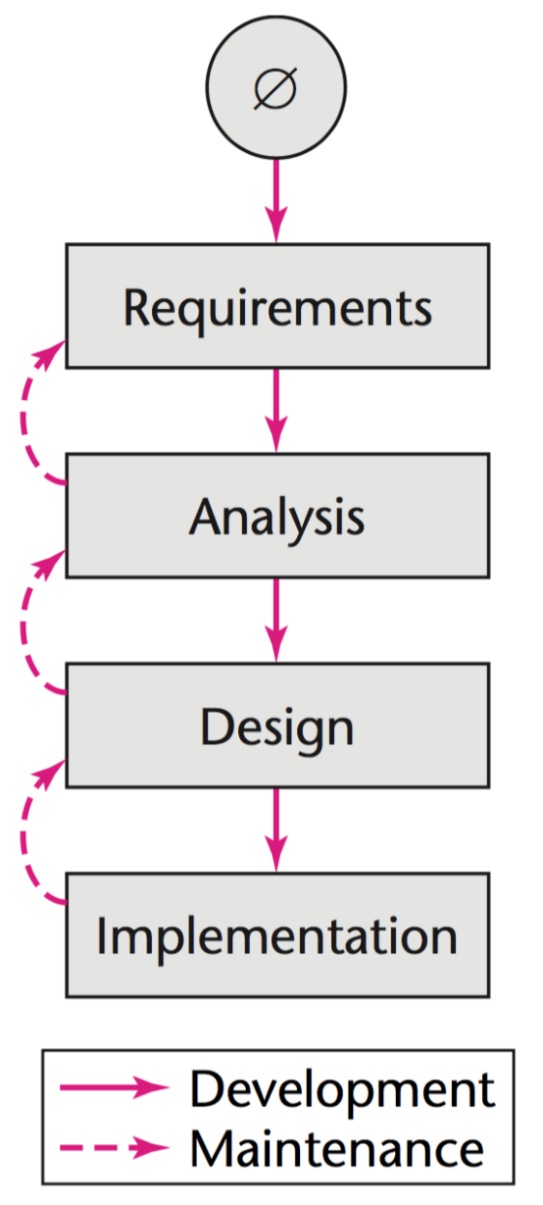
Winburg in waterfall life-cycle model
A simplified version of the waterfall life-cycle model
This classical life-cycle model can be viewed as the linear model with feedback loops.
If a fault is found during the design that was caused by a fault in the requirements, following the dashed upward arrows, the software developers can backtrack from the design up to the analysis and hence to the requirements and make the necessary corrections there.

Slide 23
Limitation of waterfall
The waterfall model can certainly be used to represent the Winburg mini case study
But, unlike the evolution-tree model, it cannot show the order of events.
Note：Simplified discussion only

Slide 24
Iteration and Incrementation
Why
Miller’s Law （米勒法则）：At any one time, we humans are capable of concentrating on only approximately seven chunks. 在任何时候，人类最多可以将注意力集中在7件事情上
One way we humans handle this restriction on the amount of information we can handle at any one time is to use stepwise refinement（逐步求精）.
George Miller
The Magical Number Seven

Slide 25
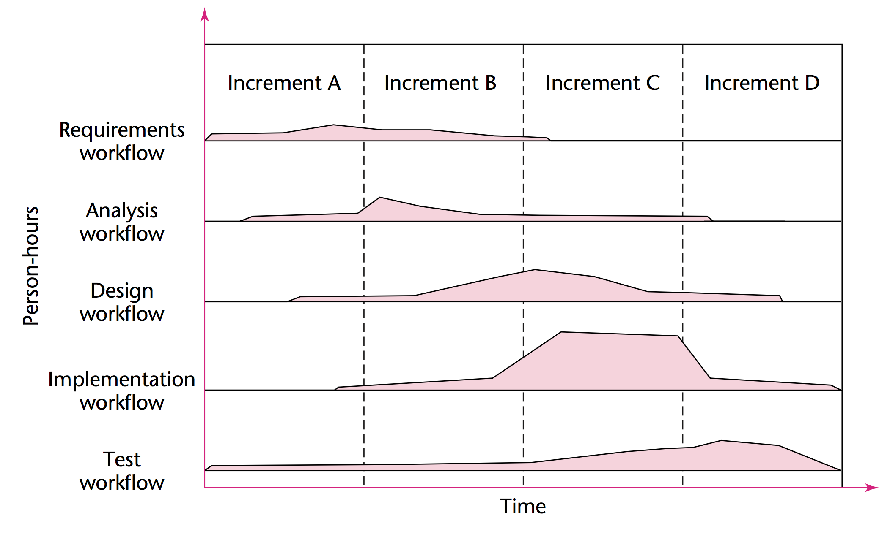
Iterative-and-incremental Life-cycle Model
The construction of a software product in four increments
baseline
Notes:
这个图重点要理解横向和纵向两个维度上划分的具体含义，增量指增加了需求或功能模块等，工作流方向上对应不同的活动和对应的任务。
其中虚线尤其要强调，基线是每一个增量版本的结尾，要产生出一套完整的软件制品

Slide 26
Note that
这里的迭代和增量的概念跟目前软件开发中所使用的概念略微有些出入，直观上讲
增量（Incrementation）：指对于产品的功能上、模块上的增加
迭代（Iteration）：指增量部分仍然使用相同的流程来开发

Slide 27
Five Core Workflows
There are five core workflows (activities) performed over the entire life cycle.
Requirements workflow
Analysis workflow
Design workflow
Implementation workflow
Test workflow
注：在后面的过程框架部分还要再细讲
Notes:
工作流的概念和开发阶段的概念是不一样的，尽管在一些开发模型中，关键字如需求、分析、设计等都是相同的

Slide 28
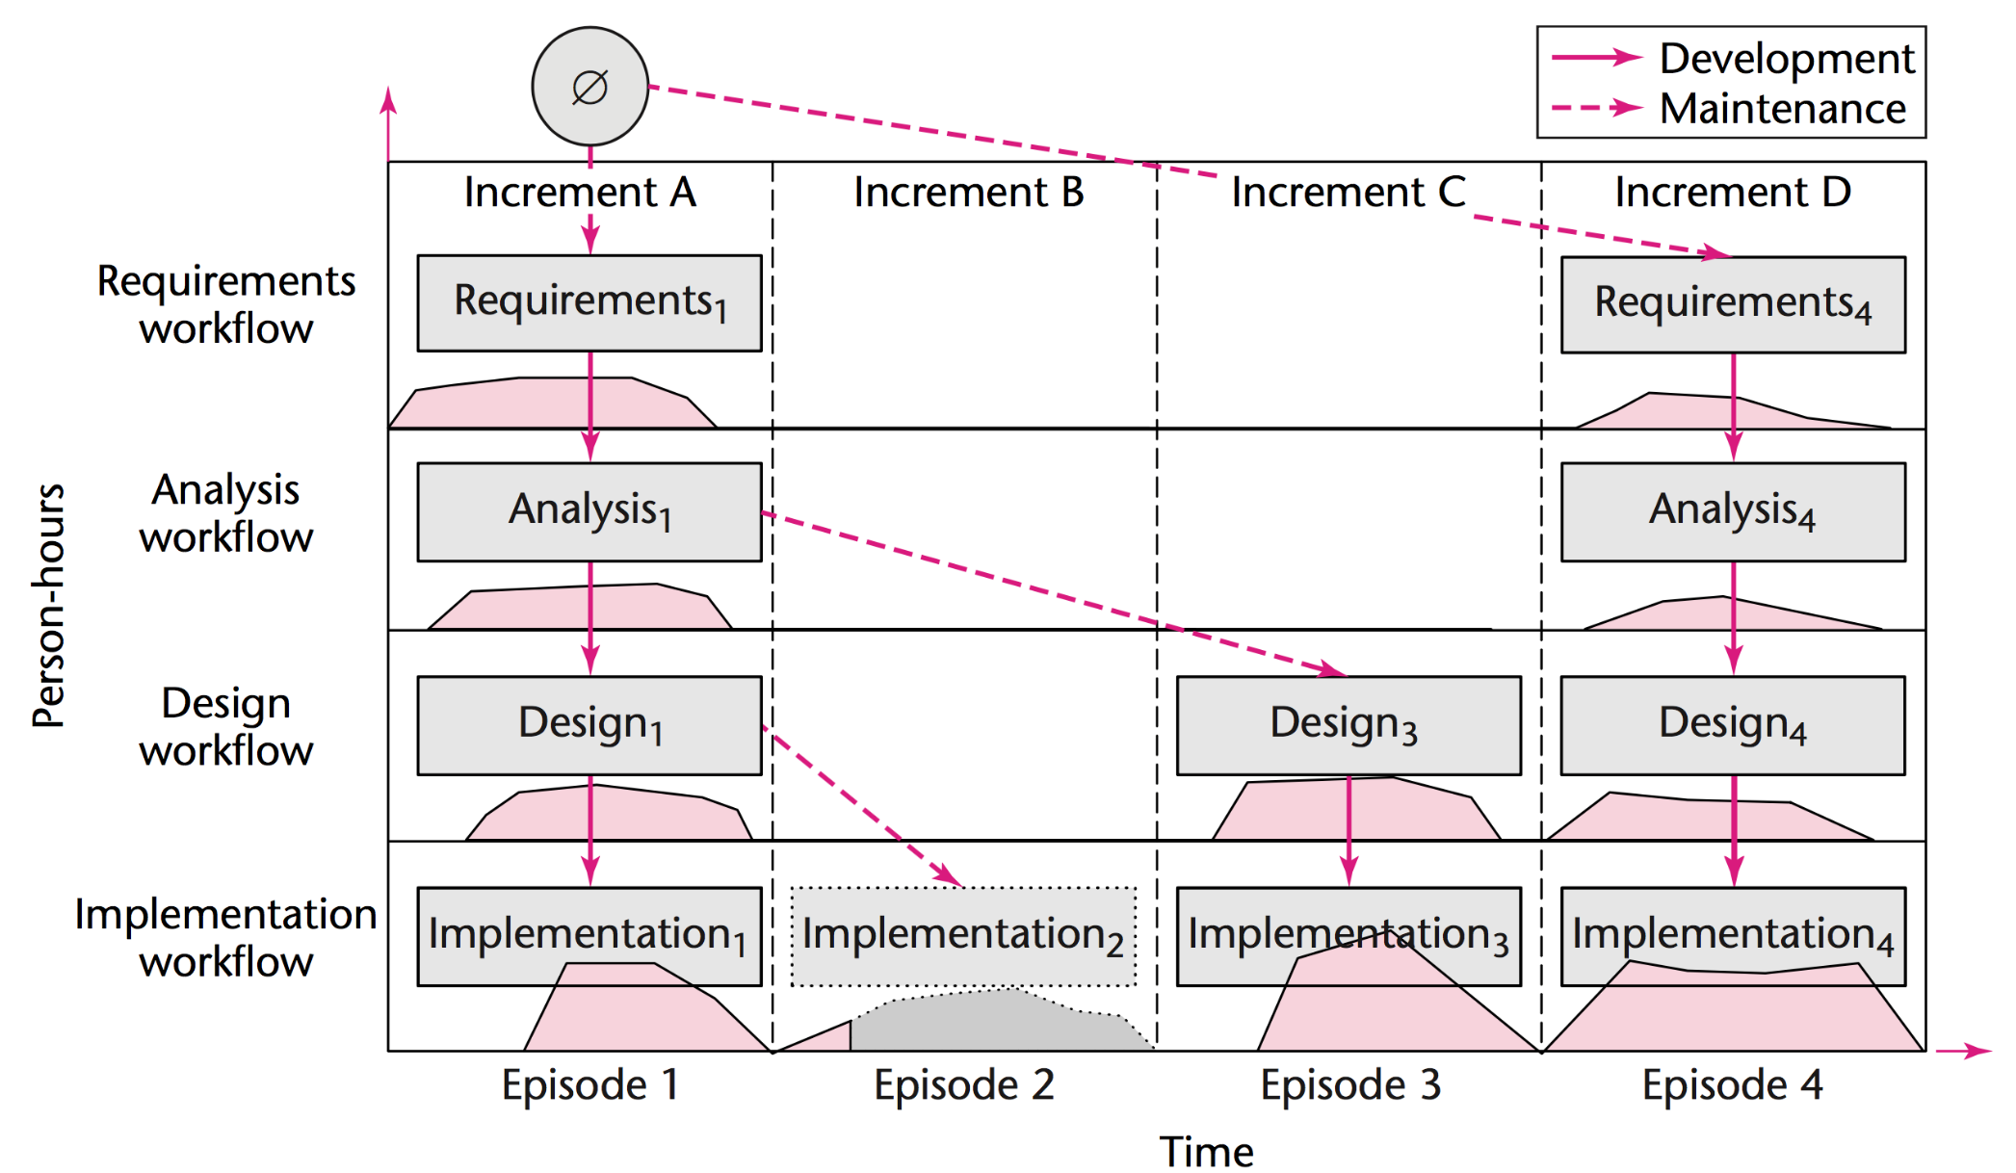
The evolution-tree life-cycle model for the Winburg mini case study superimposed on the iterative-and-incremental life-cycle model.
Notes:
注意：这是一个叠加起来的模型，一些信息是将两个模型的内容重叠起来展示的，如Increment A 、Increment B、Increment C和Increment D。
要从模型本身的目的来理解这些案例模型，他们的存在是为了更好地开发，而不是为了建模而建模。这个模型就比较完整地刻画出两个维度的重要信息，更容易度量和对过程的把控。

Slide 29
The above model shows the evolution-tree model of the Winburg mini case study superimposed on the iterative-and-incremental model
Increment A corresponds to Episode 1, Increment B corresponds to Episode 2, and so on.
The three dashed arrows of the evolution-tree model show that each increment constitutes maintenance of the previous increment.

Slide 30
Discussion 1
根据上面的Winburg小案例，讨论一下软件过程和模型
关于模型的维度问题
关于不同模型的易用性
模型对问题进行刻画的能力
Notes:
到这个地方要理一下思路，把几种模型串起来看看各自侧重在什么视角上展示过程，能展示哪些信息，能力侧重的特点是什么？
不要简单地给个结论说谁好谁差，要弄明白各自擅长于做什么事情。

Slide 31
Discussion 2
根据上面的Winburg小案例，讨论一下软件过程和模型
关于模型的维度问题
关于不同模型的易用性
模型对问题进行刻画的能力
Notes:
到这个地方要理一下思路，把几种模型串起来看看各自侧重在什么视角上展示过程，能展示哪些信息，能力侧重的特点是什么？
不要简单地给个结论说谁好谁差，要弄明白各自擅长于做什么事情。

Slide 32
A generic process model
A generic process framework for software engineering defines five framework activities:
Communication
Planning
Modeling
Construction
Deployment
In addition, a set of umbrella activities are applied throughout the process
Notes:
framework activities：这5个都是框架层面的活动
umbrella activities：普适性活动，是所有框架性活动都会涉及到的

Slide 33
Umbrella Activities
Typical umbrella activities:
project tracking and control
risk management
quality assurance
configuration management
technical reviews
Notes:
这个章节只要知道有这些普适性活动就可以了，不需要展开

Slide 34
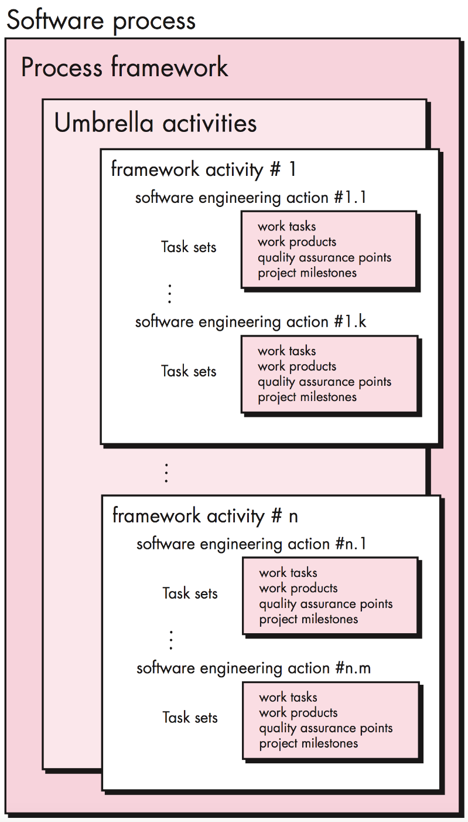
A software process framework
Key concepts:
framework activity
software engineering action
task sets
software engineering work tasks
work products
quality assurance points
project milestones
Notes:
通过这个框架图，重在理解不同部分的作用

Slide 35
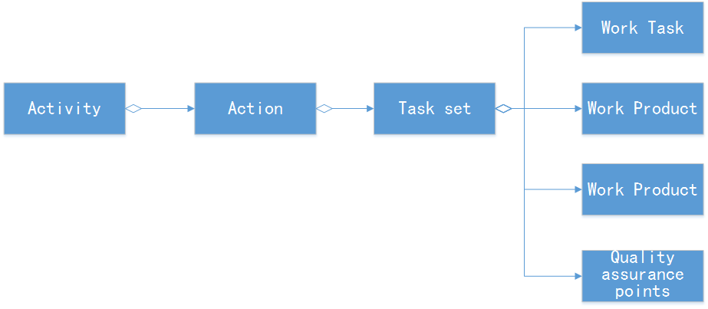
Relationship
Relationships between them are:
Notes:
任务集的概念可以再展开具体介绍，一建立感性认识。
后面5张slice都是围绕这个概念具体介绍的。

Slide 36
Task Set
A task set defines the actual work to be done to accomplish the objectives of a software engineering action.
For example
Requirements gathering is an important software engineering action that occurs during the communication activity.
Notes:
对任务集的概念有必要稍微展开多介绍一下

Slide 37
A small, relatively simple project
The task set for requirements gathering might look like this:
Make a list of stakeholders for the project.
Invite all stakeholders to an informal meeting.
Ask each stakeholder to make a list of features and functions required.
Discuss requirements and build a final list.
Prioritize requirements.
Note areas of uncertainty.
Notes:
一个简单的需求获取案例

Slide 38
A larger, more complex software project
It might encompass the following work tasks:
Make a list of stakeholders for the project.
Interview each stakeholder separately to determine overall wants and needs.
Build a preliminary list of functions and features based on stakeholder input.
Schedule a series of facilitated application specification meetings.
Conduct meetings.
Produce informal user scenarios as part of each meeting
Notes:
一个复杂一点儿的需求获取案例

Slide 39
Refine user scenarios based on stakeholder feedback.
Build a revised list of stakeholder requirements.
Use quality function deployment techniques to prioritize requirements.
Package requirements so that they can be delivered incrementally.
Note constraints and restrictions that will be placed on the system.
Discuss methods for validating the system.

Slide 40
Comparing two above
Both of these task sets achieve “requirements gathering”
they are quite different in their depth and formality
The software team chooses the task set that will allow it to achieve the goal of each action and still maintain quality and agility.
Notes:
depth and formality，在深度和形式化方面的差别其实是非常重要的，UML书中曾用搭建狗窝和构建摩天大楼的区别来说明UML规约的重要性

Slide 41
Prescriptive Life-Cycle Models
Code-and-Fix Life-Cycle Model
Waterfall Life-Cycle Model
Rapid-Prototyping Life-Cycle Model
Notes:
一些常见的生命周期模型

Slide 42
Code-and-Fix Life-Cycle Model
The product is implemented without requirements or specifications, or any attempt at design.
Instead, the developers simply throw code together and rework it as many times as necessary to satisfy the client.

Slide 43
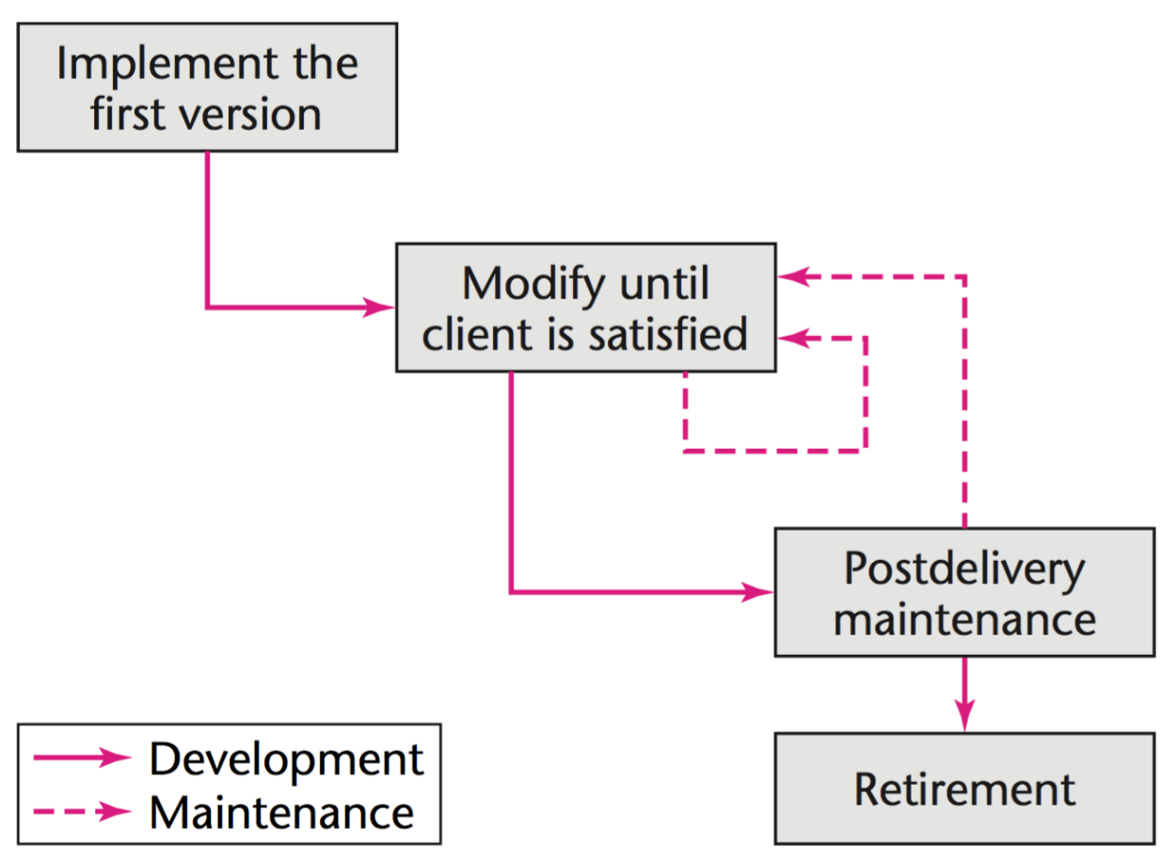
simple
absence of requirements, specifications, and design
high cost
The code-and-fix model is the easiest way to develop software—and by far the worst way.

Slide 44
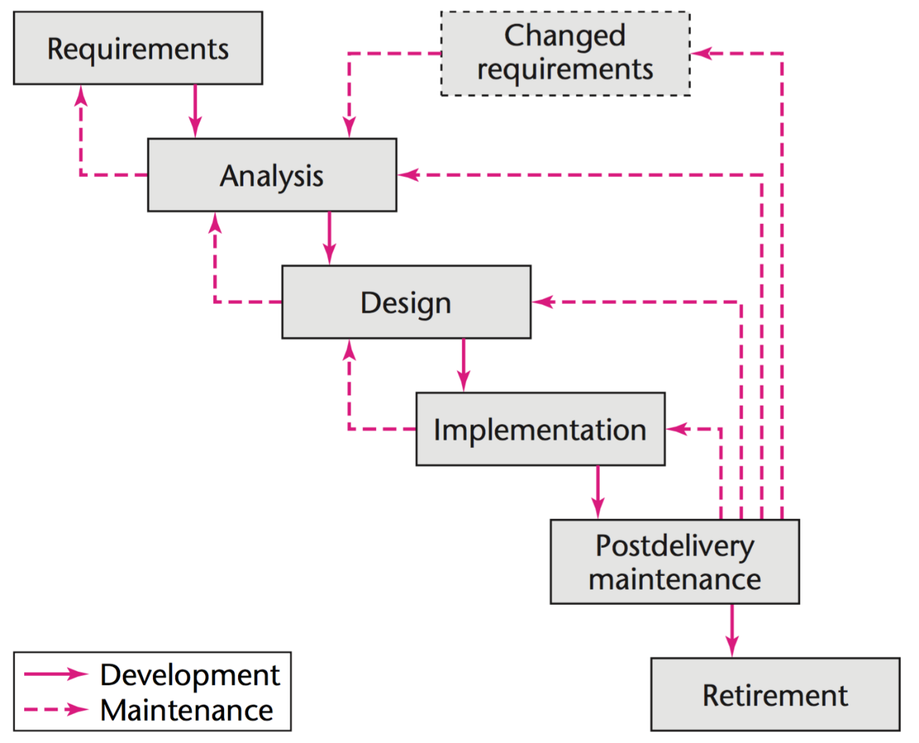
Waterfall Life-Cycle Model Waterfall Life-Cycle Model
Put forward by Royce [1970]

Slide 45
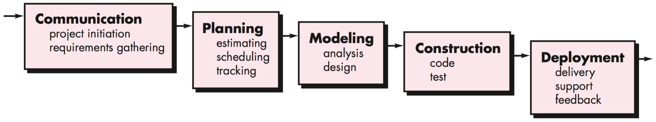
Waterfall Process Model
The waterfall model, sometimes called the classic life cycle, suggests a systematic, sequential approach
begins with customer specification of requirements and progresses through planning, modeling, construction, and deployment

Slide 46
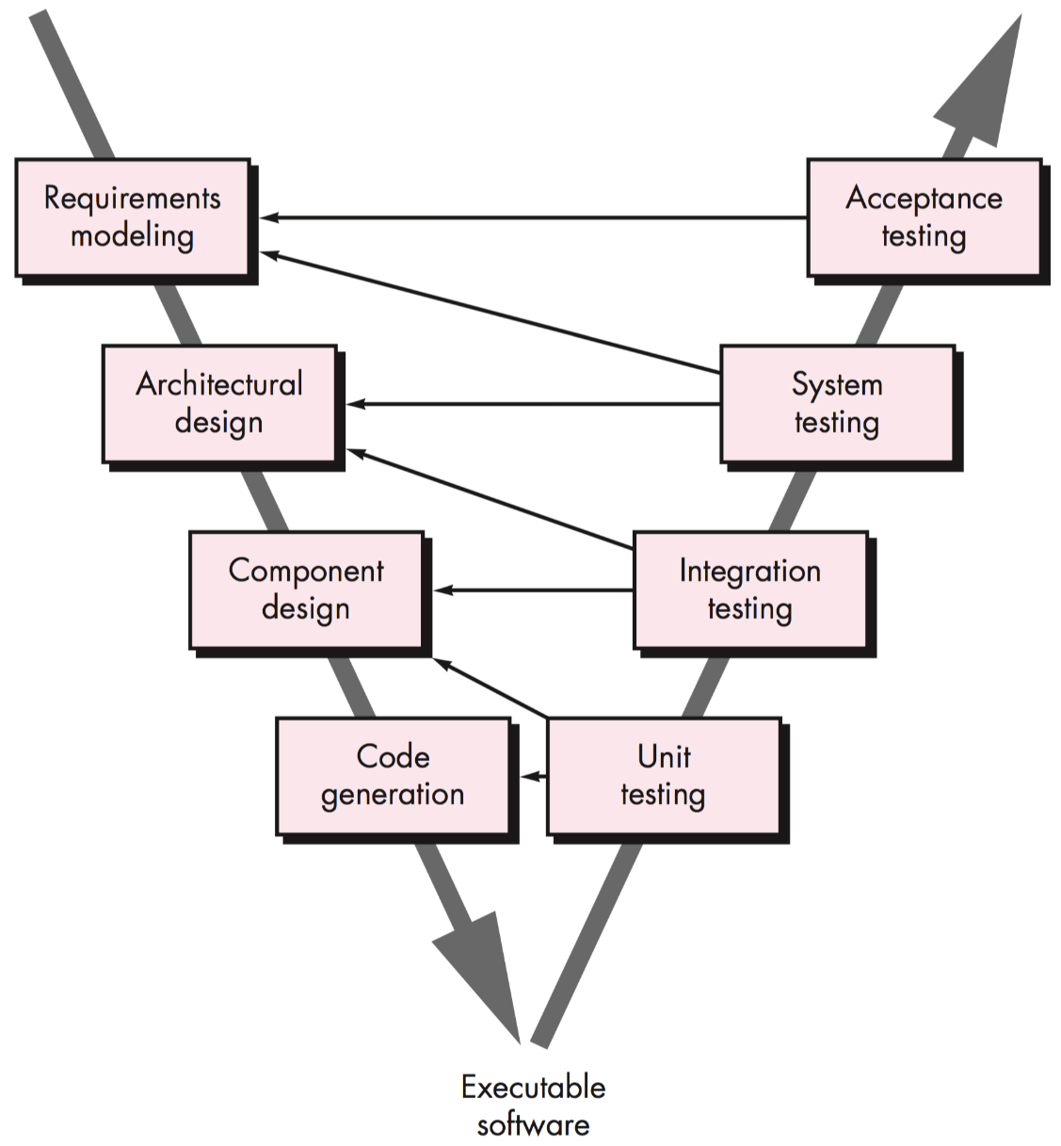
The V-model
A variation of the waterfall model is called the V-model [Buc99].
Performing a series of tests (quality assurance actions) that validate each of the models created as the team moved down the left side.
No fundamental difference
The V-model provides a way of visualizing how verification and validation actions are applied.

Slide 47
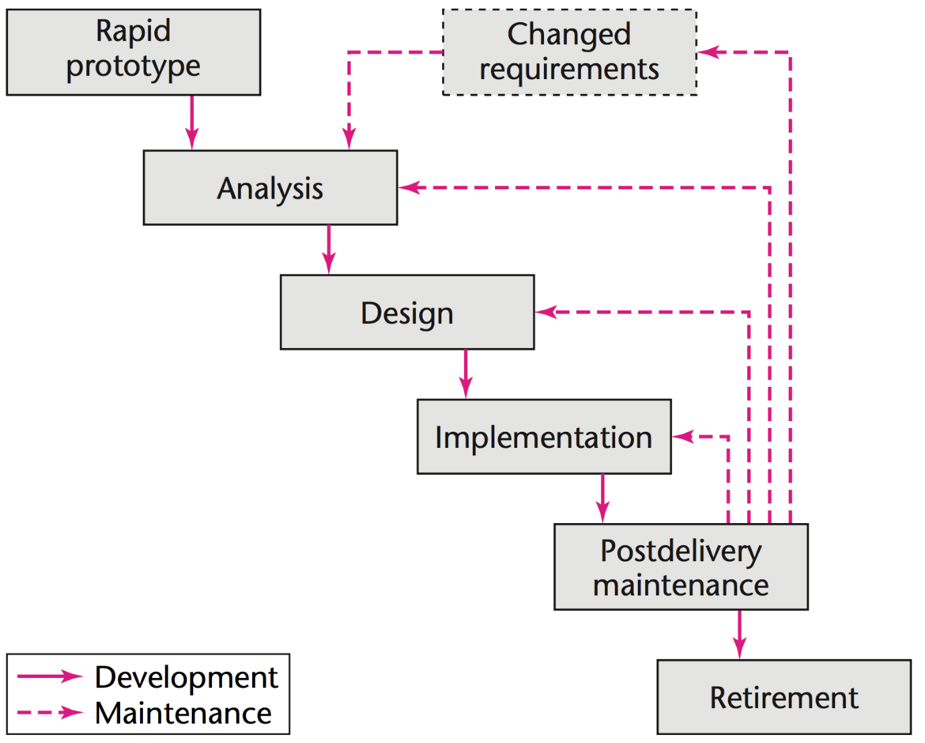
Rapid-prototyping Life-cycle Model
The feedback loops are less needed
An essential aspect of a rapid prototype is embodied in the word rapid.
Notes:
反馈环在这里就不是那么必要了，因为原型可以获得较为正确的需求
快速原型强调的是一个“快”字

Slide 48
The first step is to build a rapid prototype and let the client and future users interact and experiment with the rapid prototype.
Once the client is satisfied, the developers can draw up the specification document with some assurance that the product meets the client’s real needs.

Slide 49
Spiral Life-Cycle Model
The idea of minimizing risk via the use of prototypes and other means is the idea underlying the spiral life-cycle model [Boehm, 1988].
A simplified way of looking at this life-cycle model is as a waterfall model with each phase preceded by risk analysis
Spiral Model ≈ Prototyping Model + Waterfall Model

Slide 50
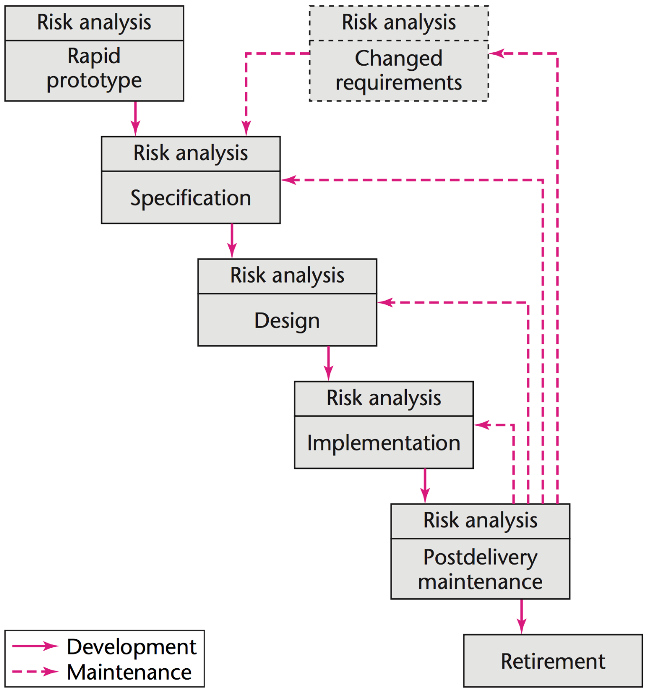
核心思想就是利用阶段性瀑布模型，再控制每个阶段瀑布开始时的风险（用原型）
Notes:
核心思想就是利用阶段性瀑布模型，再控制每个阶段瀑布开始时的风险（用原型）

Slide 51
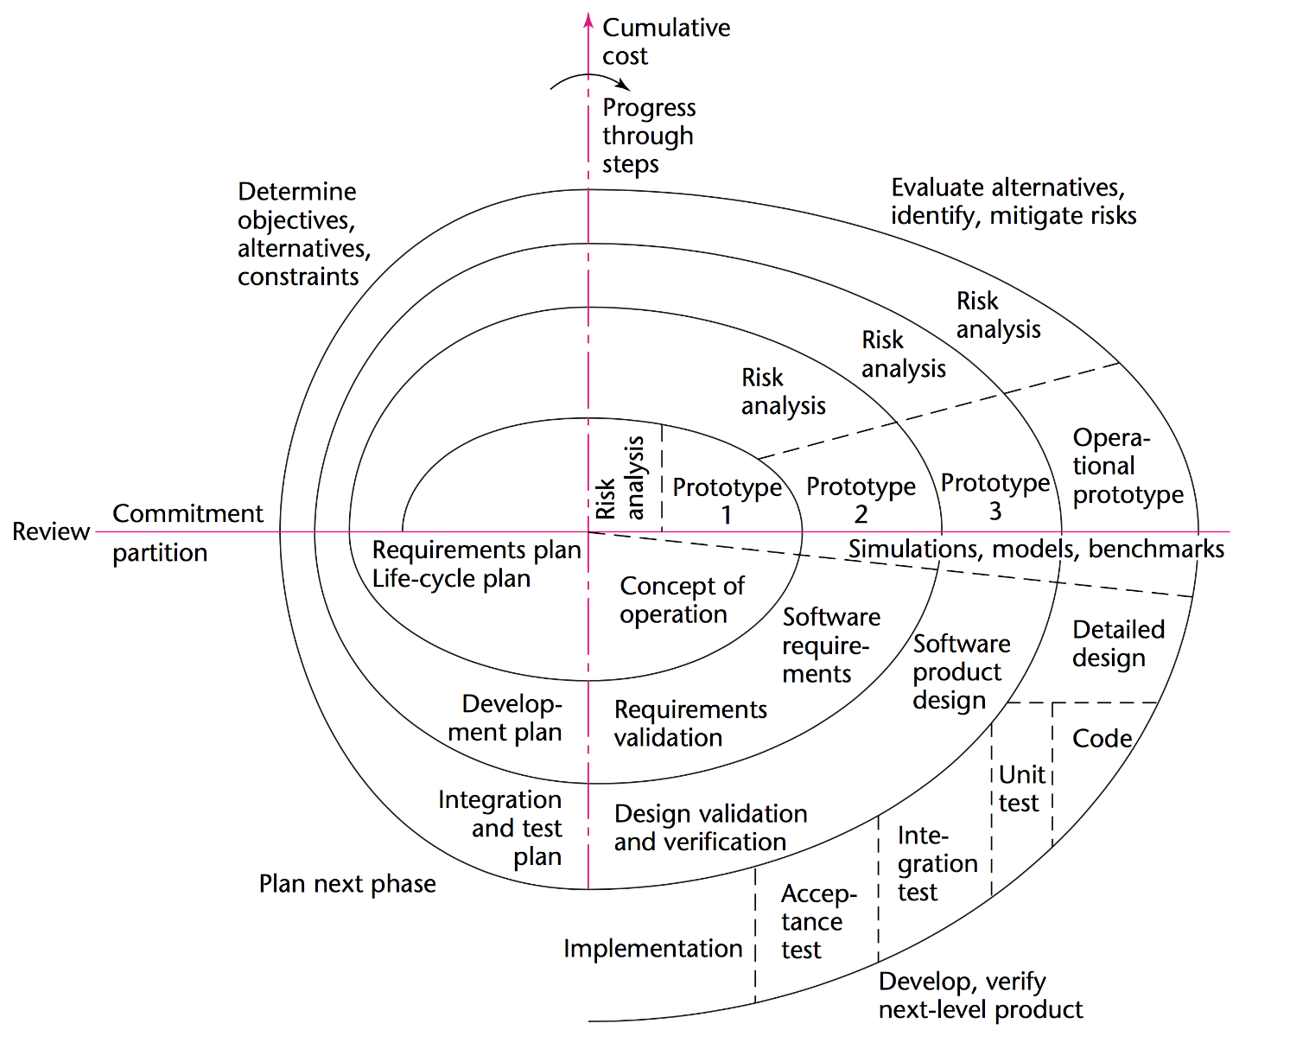
Full spiral life-cycle model
Incrementation
旋转的半径代表了增量
思考：
将这个螺旋拉平之后会是什么样子？
Notes:
这本质上是为了将迭代和增量都体现在同一个平面图上而采用的图形设计技巧

Slide 52
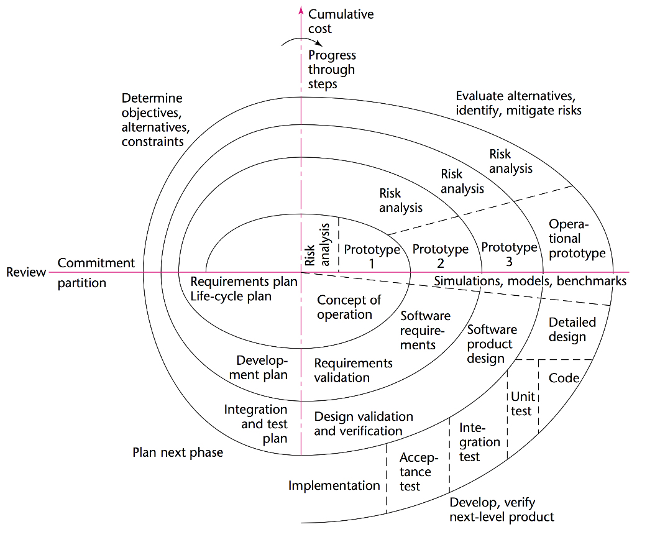
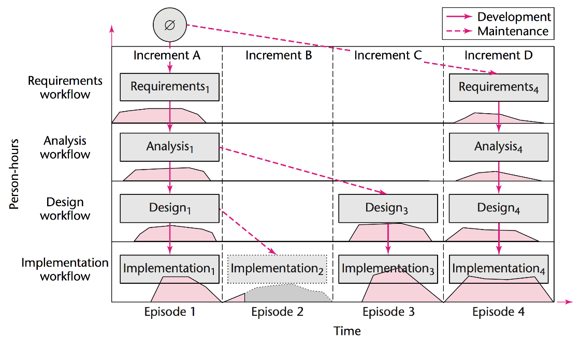
Understanding Spiral Model
Two dimensions：
Incrementation & Iteration
Notes:
螺旋模型其实是一种将两个维度巧妙展示在同一个平面图上的技巧，其实将这两个维度展开之后，就跟前面提到的 “进化树+迭代-增量模型” 非常相似了

Slide 53
Reference
Object-Oriented and Classical Software Engineering (8 edition), Stephen Schach, McGraw-Hill Education, 2010
Software Engineering: A Practitioner's Approach (8 edition), Roger S. Pressman, McGraw-Hill Education, 2014

