Slide 1
Flowchart Diagrams
Wenhui Zhang
http://lcs.ios.ac.cn/~zwh/

Slide 2
Integer Square Root
BEG
(y1,y2,y3):=(0,1,1)
s1
s2
Y
y3<=x
N
END
(y1,y2):=(y1+1,y2+2)
BEG: (y1,y2,y3):=(0,1,1); goto S1
S1: if (y3<=x) goto S2 else goto END
S2: (y1,y2):=(y1+1,y2+2); goto S3
S3: (y3):=(y3+y2); goto S1
s3
(y3):=(y3+y2)

Slide 3
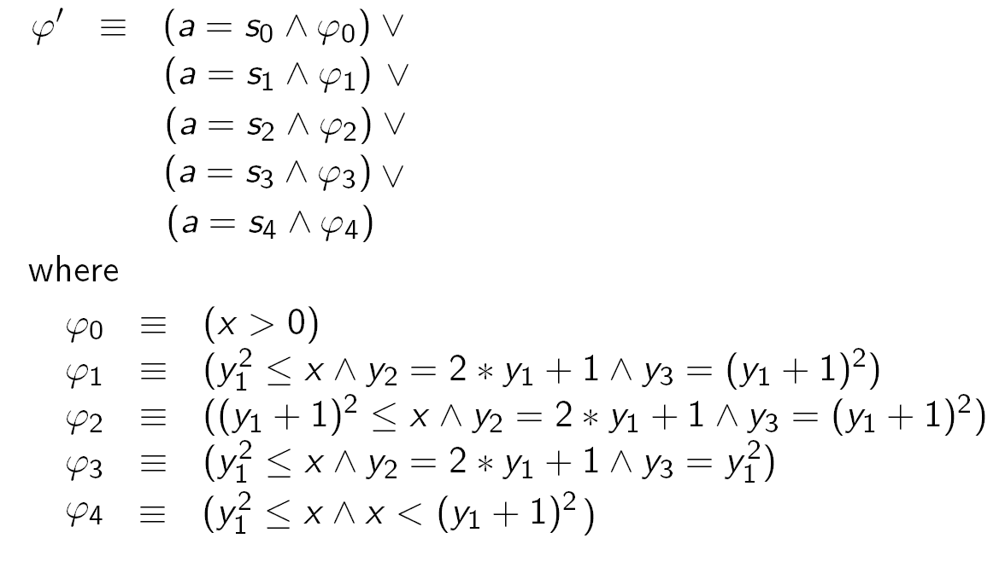
Inductive Invariant

Slide 4
Flowchart Diagrams
B=(F,P)
V
I=(D,I₀)
Σ
I: Term → (Σ→D)
I: WFF → (Σ→ {0,1})
M: a set of commands

Slide 5
Contents
Correctness
  Partial Correctness
  Termination
  Total Correctness (Partial Correctness + Termination)
Assertions
  Preconditions/Postconditions
  Weakest Liberal Preconditions
Verification
  Partial Correctness
  Total Correctness

Slide 6
Correctness (1)
Partial Correctness
DEF
|= _{I} {ϕ} M {ψ}
iff
I(ϕ)(σ) → ((BEG,σ) →* (END,σ’)) → I(ψ)(σ’))

Slide 7
Correctness (2)
Termination
DEF
|= _{I} [ϕ] M [true]
iff
I(ϕ)(σ) → ((BEG,σ) →* (END,σ’))

Slide 8
Correctness (3)
Total Correctness
DEF
|= _{I} [ϕ] M [ψ]
iff
I(ϕ)(σ) → ((BEG,σ) →* (END,σ’)) ∧ I(ψ)(σ’))

Slide 9
Correctness
Total Correctness = Partial Correctness + Termination
Proposition:
|= _{I} [ϕ] M [ψ]
iff
|= _{I} {ϕ} M {ψ} and |= _{I} [ϕ] M [true]

Slide 10
Proof based on Semantics
例子

