Slide 1
Flowchart Diagrams
Wenhui Zhang
http://lcs.ios.ac.cn/~zwh/

Slide 2
Proof based on assertions
  Assertions:
  Preconditions/Postconditions
  Weakest Liberal Preconditions
  Verification:
  Partial Correctness
  Termination

Slide 3
Paths
A path is a sequence of labels, denoted
(L0,L1,L2,…,Lk).
LETα= (L0,L1,L2,…,Lk).
DEF
(L0,σ₀) →^{α} (Lk,σ_{k}) iff
there are σ1,…,σk-1 such that
((L0,σ0 ) → (L1,σ1)) ∧……∧ ((L(k-1),σk-1) → (Lk,σk))

Slide 4
Assertions (Pre-Post-Conditions), Paths
|= _{I} {ϕ} (L0,…,Lk) {ψ}, iff
I(ϕ)(σ) ∧ ((L0,σ) →^{(L0,…,Lk)} (Lk,σ’)) → I(ψ)(σ’)
A special case:
|= _{I} {ϕ} (L,L’) {ψ}, iff I(ϕ)(σ) → (((L,σ) → (L’,σ’)) → I(ψ)(σ’))
ϕ’→ϕ {ϕ} (L0,…,Lk) {ψ} ψ→ψ ’
---------------------------------------
{ϕ’} (L0,…,Lk) {ψ’}

Slide 5
Composition of Paths
|= _{I} {ϕ} (L0,…,La) {ϕ’} |= _{I} {ϕ’} (La,…,Lk) {ψ}
------------------------------------------------------------------
|= _{I} {ϕ} (L0,…,Lk) {ψ}

Slide 6
Examples: Paths
BEG: (y1,y2,y3):=(0,1,1); goto s1
s1: if (y3<=x) goto S2 else goto s4
s2: (y1,y2):=(y1+1,y2+2); goto s3
s3: (y3):=(y3+y2); goto s1
s4: (r):=(y1); goto END
Path: (s1,s4,END)
Path: (s1,s2,s3,s1)

Slide 7
Weakest Liberal Pre-Condition

Slide 8
Weakest Liberal Pre-Condition
DEF ϕ=wlp( α,ψ):
I(ϕ)(σ) ↔ ((L,σ) →^{α} (L’,σ’)) → I(ψ)(σ’)
Theorem
ϕ=wlp(α,ψ), if and only if
|= {ϕ} α {ψ} and, if |= {ϕ’} α {ψ} then (ϕ’→ ϕ)
Theorem
|= {ϕ} α {ψ} iff ϕ → wlp(α ,ψ)

Slide 9
Weakest Liberal Pre-Condition, α
Theorem
wlp((L0,…Lk),ψ) ≡ wlp((L0,L1), wlp((L1,…Lk),ψ)),

Slide 10
Computation of wlp

Slide 11
WLP
DEF
L: (x₁,…,x_{n}):=(e₁,…,e_{n}); goto L’ ∈ M
[L,L’]ψ = ψ(e₁ /x₁,…, e_{n} /x_{n})
(2) L: if (c) goto L’ else goto L’’ ∈ M
[L,L’]ψ = c→ψ;
[L,L’’]ψ = ¬c→ψ.
(3) [L0,…,Lk]ψ = [L0,L1][L1,…Lk]ψ

Slide 12
WLP
Lemma:
wlp( α,ψ) ≡ [α]ψ

Slide 13
Proof of the lemma (1), α=(L,L’)
(1) L: (x₁,…,x_{n}):=(e₁,…,e_{n}); goto L’ ∈ M
ϕ=wlp((L,L’),ψ), iff
|= {ϕ} (L,L’){ψ} and, if |= {ϕ’} (L,L’) {ψ} then (ϕ’→ ϕ)
[L,L’]ψ = ψ(e₁ /x₁,…, e_{n} /x_{n})
I([L,L’]ψ)(σ) → (((L,σ) → (L’,σ’)) → I(ψ)(σ’))
(I(ϕ’)(σ) → (((L,σ) → (L’,σ’)) → I(ψ)(σ’)))
    → I(ϕ’)(σ) → I([L,L’]ψ)(σ)

Slide 14
Proof of the lemma (2a), α=(L,L’)
(2a) L: if (c) goto L’ else goto L’’ ∈ M
ϕ=wlp((L,L’),ψ), iff
|= {ϕ} (L,L’){ψ} and, if |= {ϕ’} (L,L’) {ψ} then (ϕ’→ ϕ)
[L,L’]ψ = c→ψ
I([L,L’]ψ)(σ) → (((L,σ) → (L’,σ’)) → I(ψ)(σ’))
(I(ϕ’)(σ) → (((L,σ) → (L’,σ’)) → I(ψ)(σ’)))
    → I(ϕ’)(σ) → I([L,L’]ψ)(σ)

Slide 15
Proof of the lemma (2b), α=(L,L’)
(2b) L: if (c) goto L’’ else goto L’ ∈ M
ϕ=wlp((L,L’),ψ), iff
|= {ϕ} (L,L’){ψ} and, if |= {ϕ’} (L,L’) {ψ} then (ϕ’→ ϕ)
[L,L’]ψ = ¬c→ψ
I([L,L’]ψ)(σ) → (((L,σ) → (L’,σ’)) → I(ψ)(σ’))
(I(ϕ’)(σ) → (((L,σ) → (L’,σ’)) → I(ψ)(σ’)))
    → I(ϕ’)(σ) → I([L,L’]ψ)(σ)

Slide 16
Proof of the lemma (3), α=(L0,L1,…,Lk)
(3) [L0,…,Lk]ψ = [L0,L1][L1,…Lk] ψ
ϕ=wlp(α,ψ), iff
|= {ϕ} α{ψ} and, if |= {ϕ’} α {ψ} then (ϕ’→ ϕ)
By induction:
[L0,L1][L1,…Lk]ψ ≡ (ind)
[L0,L1] wlp((L1,…Lk),ψ) ≡ (ind)
wlp((L0,L1), wlp((L1,…Lk),ψ) ≡ (thm)
wlp((L0,…Lk),ψ)

Slide 17
Examples: wlp
BEG: (y1,y2,y3):=(0,1,1); goto s1
s1: if (y3<=x) goto S2 else goto s4
s2: (y1,y2):=(y1+1,y2+2); goto s3
s3: (y3):=(y3+y2); goto s1
s4: (r):=(y1); goto END
[s1,s4,END]( x<(r+1)*(r+1) ) = ?
[s1,s2,s3,s1] ( y3=(y1+1)*(y1+1) ) = ?

Slide 18
Examples: wlp
BEG: (y1,y2,y3):=(0,1,1); goto s1
s1: if (y3<=x) goto S2 else goto s4
s2: (y1,y2):=(y1+1,y2+2); goto s3
s3: (y3):=(y3+y2); goto s1
s4: (r):=(y1); goto END
[s1,s4,END]( x<(r+1)*(r+1) ) =
[s1,s4] ( x<(y1+1)*(y1+1) ) =
(¬ (y3<=x) → x<(y1+1)*(y1+1))

Slide 19
Examples: wlp
BEG: (y1,y2,y3):=(0,1,1); goto s1
s1: if (y3<=x) goto S2 else goto s4
s2: (y1,y2):=(y1+1,y2+2); goto s3
s3: (y3):=(y3+y2); goto s1
s4: (r):=(y1); goto END
[s1,s2,s3,s1] ( y3=(y1+1)*(y1+1) ) =
[s1,s2,s3] ( y3+y2=(y1+1)*(y1+1) ) =
[s1,s2] ( y3+y2+2=(y1+1+1)*(y1+1+1) ) =
( y3<=x→ y3+y2+2=(y1+1+1)*(y1+1+1) )

Slide 20
Verification
Corollary
|= _{I} {ϕ} α {ψ} iff (ϕ → [α]ψ)
Verification Condition:
ϕ → [α]ψ, also denoted vc( ϕ, α,ψ),
is called a verification condition for |= _{I} {ϕ} α {ψ}

Slide 21
Examples: Verification Condition
BEG: (y1,y2,y3):=(0,1,1); goto s1
s1: if (y3<=x) goto S2 else goto s4
s2: (y1,y2):=(y1+1,y2+2); goto s3
s3: (y3):=(y3+y2); goto s1
s4: (r):=(y1); goto END
|= {y3=(y1+1)*(y1+1)} (s1,s4,END) {( x<(r+1)*(r+1) )}
|= {y3=(y1+1)*(y1+1) ∧y2=2y1+1} (s1,s2,s3,s1) {y3=(y1+1)*(y1+1)}

Slide 22
|= {y3=(y1+1)*(y1+1)} (s1,s4,END) {( x<(r+1)*(r+1) )} (by sem)
Assume (s1,σ1)(s4, σ2)(END,σ3) and σ1|= y3=(y1+1)*(y1+1).
We have to prove σ3|= x<(r+1)*(r+1)
σ1(y3)=(σ1(y1)+1)*(σ1(y1)+1) [a0]
(s1,σ1)→(s4, σ2): σ2= σ1∧¬(σ1(y3)<= σ1(x)) [a1]
(s4,σ2)→(END, σ3): σ3= σ2[r/σ2(y1)] [a2]
Have to prove:
x1. σ3(x)<(σ3(r)+1)*(σ3(r)+1) [by a2]
x2. σ2(x)<(σ2(y1)+1)*(σ2(y1)+1) [by a1]
x3. σ1(x)<(σ1(y1)+1)*(σ1(y1)+1) [ok, by a0 and a1]

Slide 23
|= {y3=(y1+1)*(y1+1)} (s1,s4,END) {( x<(r+1)*(r+1) )} (by vc)
iff
y3=(y1+1)*(y1+1) → [s1,s4,END]( x<(r+1)*(r+1) )
iff
y3=(y1+1)*(y1+1) → [s1,s4] ( x<(y1+1)*(y1+1) )
iff
y3=(y1+1)*(y1+1) → (¬ (y3<=x) → x<(y1+1)*(y1+1))
iff
true

Slide 24
|= { y3=(y1+1)*(y1+1) ∧y2=2y1+1} (s1,s2,s3,s1){y3=(y1+1)*(y1+1) }
iff
y3=(y1+1)*(y1+1) ∧y2=2y1+1→ [s1,s2,s3,s1] (y3=(y1+1)*(y1+1))
iff
……
iff
y3=(y1+1)*(y1+1) ∧y2=2y1+1→ (y3<=x→ y3+y2+2=(y1+1+1)*(y1+1+1) )
iff
true

Slide 26
Complete Paths
A path (L0,L1,L2,…,Lk) is a complete path, if
L0=BEGIN and Lk=END.
Lemma:
|= _{I} {ϕ} M {ψ}, iff
for every complete path α, we have |= _{I} {ϕ} α {ψ}

Slide 27
Examples: Complete Paths
BEG: (y1,y2,y3):=(0,1,1); goto s1
s1: if (y3<=x) goto S2 else goto s4
s2: (y1,y2):=(y1+1,y2+2); goto s3
s3: (y3):=(y3+y2); goto s1
s4: (r):=(y1); goto END
Complete Path: (BEGIN, s1,s4,END)
Complete Path: (BEGIN,s1,s2,s3,s1,s4,END)

Slide 28
Partial Correctness
Corollary
|= _{I} {ϕ} M {ψ}, iff
for every complete path α, we have |= _{I} ϕ → [α]ψ

Slide 29
Partial Correctness (M0) |= _{I} {ϕ}M{ψ}
Select a set of labels C such that {BEG,END} ⊆ C and
C contains at least one label of every cycle.
Select a formula q_{L} for every label of C, such that
q_{BEG} = ϕ and q_{END} =ψ.
If for every path (l0,…,lk) such that
{l0,lk} ⊆C and {l1,…,l(k-1)}∩C=∅, |=q_{l0}→[l0,…,lk]q_{lk} holds,
Then {ϕ} M {ψ}.

Slide 30
Proof
Need:
For every complete path α, we have |= _{I} ϕ→[α]ψ
Prove the following general conclusion by induction:
For every (l0,…,lk) such that {l0,lk} ⊆C,
we have |= _{I} q_{l0} →[l0,…,lk]q_{lk}
n=2: ok.
n=i+1: Suppose that (l0,…,lk) = (l0,…,la,…,lk)

Slide 31
The path (l0,…,lk) = (l0,…,la,…,lk) is split to 2 parts:
(l0,…,la) and (la,…,lk)
we have |= _{I} q_{la}→ [la,…,lk]q_{lk} and |= _{I} q_{l0}→ [l0,…,la]q_{la}
I(q_{l0})(σ) ∧ ((L0,σ) →^{(L0,…,La)} (La,σ’)) → I(q_{la})(σ’)
I(q_{la})(σ’) ∧ ((La,σ’) →^{(La,…,Lk)} (Lk,σ’’)) → I(q_{lk})(σ’’)
I(q_{l0})(σ) ∧ ((L0,σ) →^{(L0,…,Lk)} (Lk,σ’)) → I(q_{lk})(σ’)

Slide 32
Therefore:
For every (l0,…,lk) such that {l0,lk} ⊆C,
we have |= _{I} q_{l0}→[l0,…,lk]q_{lk}
Therefore:
For every complete path α, we have |= _{I} ϕ→[α] ψ
例子

Slide 34
Termination (M1) |= _{I} [ϕ] M [true]
Select a set of labels C such that {BEG} ⊆ C and
C contains at least one label of every cycle.
Select a formula q_{L} for every label of C, such that q_{BEG} = ϕ.
Select a set of labels C’ ⊆ C such that
C contains at least one label of every cycle.
Select a function g_{L}: Σ→W (a WFS) for every label L of C’.

Slide 35
Termination (M1) |= _{I} [ϕ] M [true]
If
for every path (l0,…,lk) such that
({l0,lk} ⊆C and {l1,…,l_{k-1}}∩C=∅, |=q_{l0}→[l0,…,lk] q_{lk} holds,
for every path α=(l0,…,lk) such that
{l0,lk} ⊆C’ and {l1,…,l_{k-1}}∩C’=∅,
I (q_{l0})(σ)∧ (σ →^{α} σ’) → g_{lk}(σ) < g_{l0}(σ’)
Then [ϕ] M [true]
例子

Slide 36
Termination (M2) |= _{I} [ϕ] M [true]
Select a set of labels C such that {BEG} ⊆ C and
C contains at least one label of every cycle.
Select a formula q_{c} for every label c of C, such that q_{BEG} = ϕ.
Select a set of labels C’ ⊆ C such that
C contains at least one label of every cycle.
Select a formula w for a WFS W.
Select a term t_{c} for every label c of C’, such that qc→w(tc/x)

Slide 37
Termination (M2) |= _{I} [ϕ] M [true]
If
for every path (l0,…,lk) such that
({l0,lk} ⊆C and {l1,…,l_{k-1}}∩C=∅, |= q_{l0}→[l0,…,lk] q_{lk} holds,
for every path α=(l0,…,lk) such that
{l0,lk} ⊆C’ and {l1,…,l_{k-1}}∩C’=∅,
|=q_{l0}∧t_{l0}=v → [l0,…,lk] t_{lk}<v) holds,
Then [ϕ] M [true]
例子

Slide 39
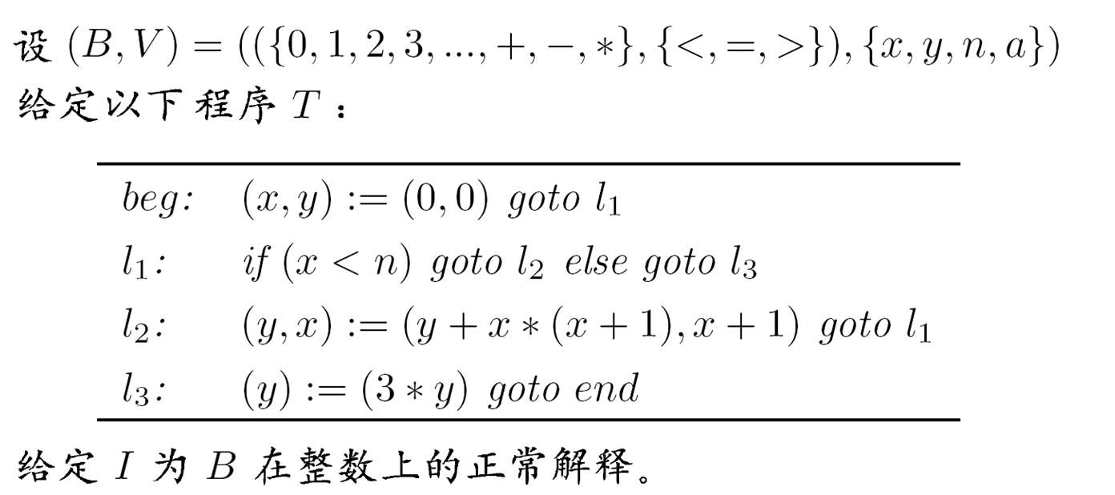
练习题1：
计算最弱宽松前断言 [l1,l3,end](y=n*n*n-n)
并证明 |= {(x<=n)∧3y=x*x*x-x} (l1,l3,end) {(3y=n*n*n-n) }

Slide 40
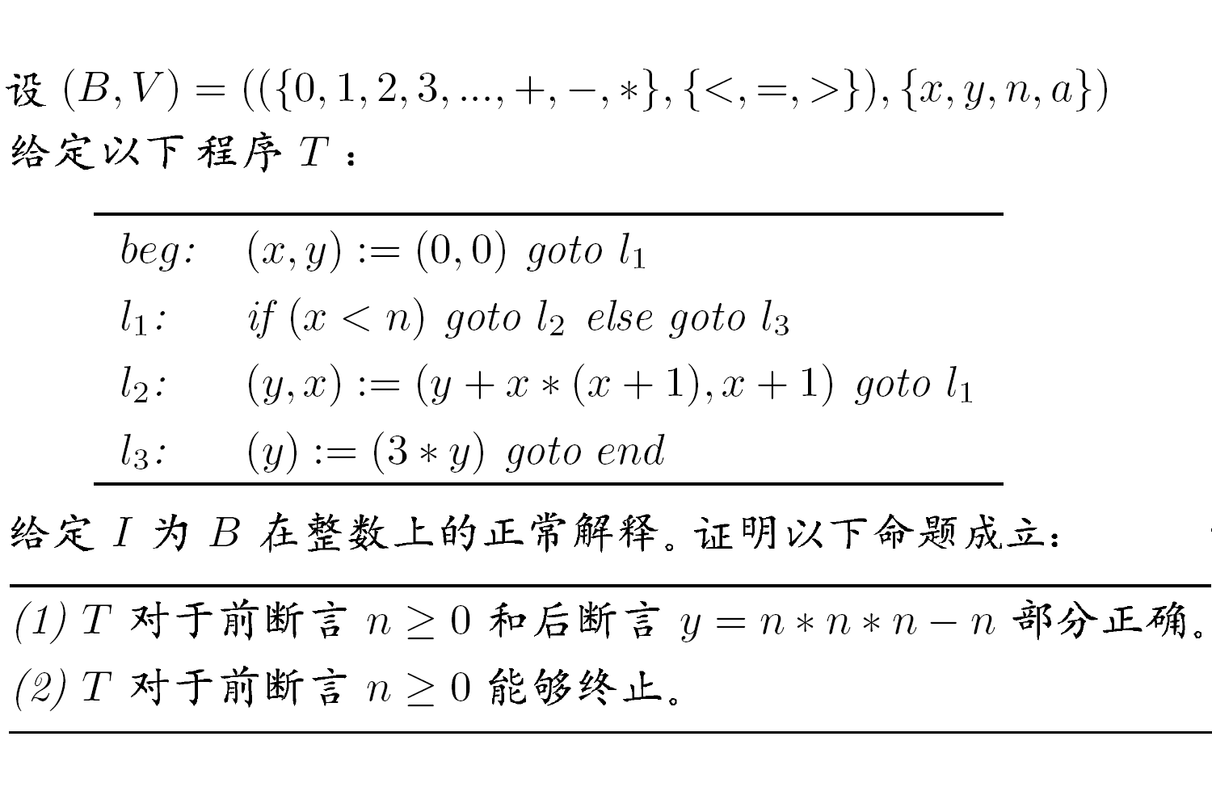
练习题2：

