Slide 1
程序推理辅助工具XYZ/VERI-II
Wenhui Zhang
State Key Laboratory of Computer Science
Institute of Software, Chinese Academy of Sciences
http://lcs.ios.ac.cn/~zwh/

Slide 2
程序推理辅助工具XYZ/VERI-II
功能：
给定简单程序和性质以及不变式，
生成验证条件、进行验证条件的化简
下载：
lcs.ios.ac.cn/~zwh/veri2/veri2.tar.gz

Slide 3
Example
{x=c}
y1:=0; y2:=1; y3:=1;
while (y3<=x) {
y1:=(y1+1); y2 := (y2+2);
y3:=(y2+y3);
{ x=c∧ y1*y1<=x∧y3=(y1+1)*(y1+1)∧
y2=2*y1+1}
}
{ y1*y1<=c ∧ c<=(y1+1)*(y1+1) }
Pre-Condition
Invariant
Post-Condition

Slide 4
Program in XYZ/SE
{x=c}
%PROC wl(%INP/x:INT;%IOP/y1:INT)==
%LOC [y2,y3:INT]
%STM [
LB=START => $Oy1=0 /\ $Oy2=1 /\ $Oy3=1 /\ $OLB=l2;
*[ LB=l2 /\ (le(y3,x)) => ($OLB=l3 | $OLB=END);
  LB=l3 => $Oy1=+(y1,1) /\ $Oy2 = +(y2,2) /\ $OLB=l4;
  LB=l4 => $Oy3=+(y2,y3) /\ $OLB=l2;
  { x=c /\ le(*(y1,y1),x) /\ y3=*(+(y1,1),+(y1,1)) /\ y2=+(*(2,y1),1) }
  ] ]
{ le(*(y1,y1),c) /\ lt(c,*(+(y1,1),+(y1,1))) }

Slide 5
XYZ/VERI-II:
User-Interface and Functionalities
The next page is the initial interface created by typing the command “veri2”.
The rest is a demonstration of the interaction of the user and the program.

Slide 6
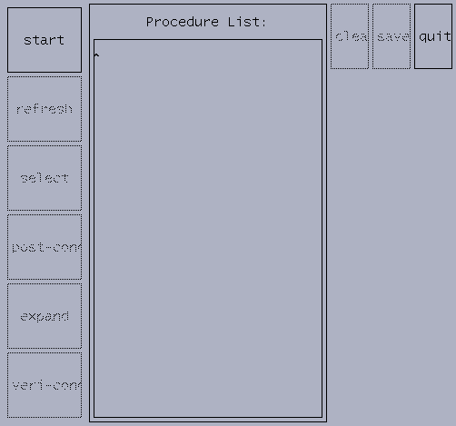

Slide 7
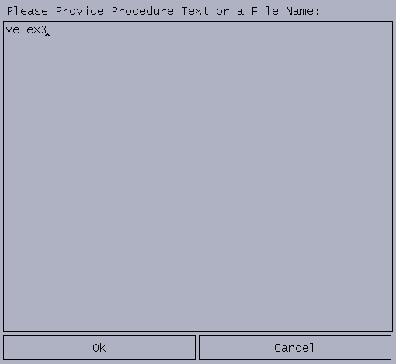

Slide 8
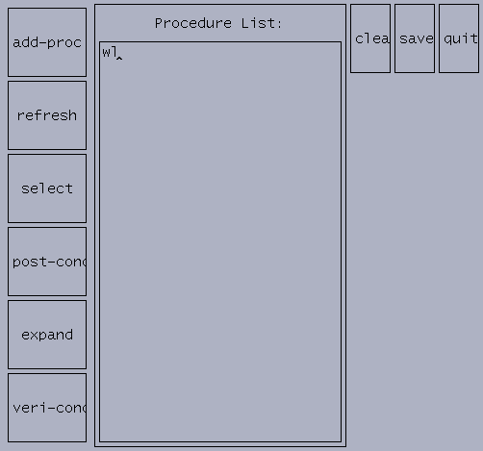

Slide 9
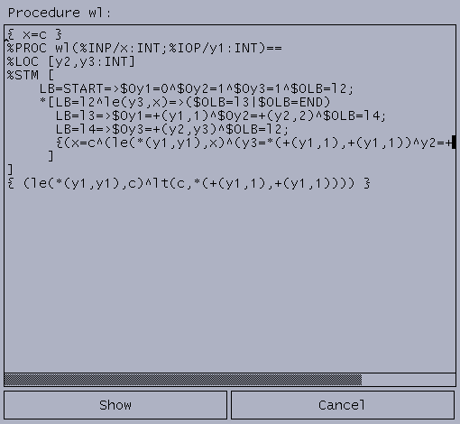

Slide 11
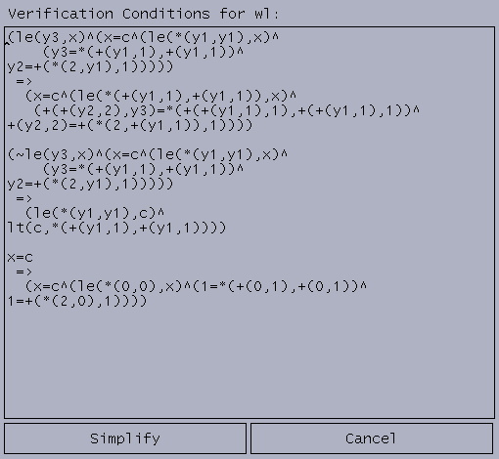

Slide 12
Verification Conditions
y3 <=x ∧ x=c ∧ y1*y1<=x ∧ y3=(y1+1)*(y1+1) ∧ y2=2*y1+1
x=c ∧ (y1+1)*(y1+1)<=x ∧
(y2+2)+y3=((y1+1)+1)*((y1+1)+1) ∧ y2+2=2*(y1+1)+1
¬y3<=x ∧ x=c ∧ y1*y1<=x ∧ y3=(y1+1)*(y1+1) ∧ y2=2*y1+1
y1*y1<=c ∧ c<(y1+1)*(y1+1)
x=c
→ x=c ∧ 0*0<=x ∧ 1=(0+1)*(0+1) ∧ 1=2*0+1

Slide 13
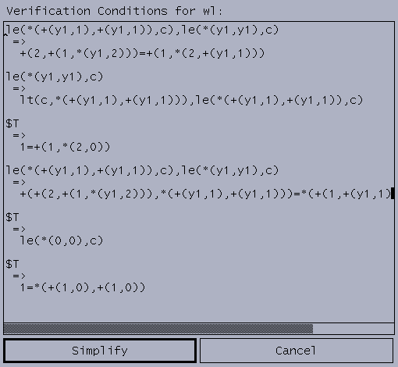

Slide 14
Simplified Verification Conditions
(y1+1)*(y1+1)<=c, y1*y1<=c → 2+(1+y1*2) = 1+2*(y1+1)
y1*y1<= c → c < (y1+1)*(y1+1), (y1+1)*(y1+1)<= c
T → 1=1+2*0
(y1+1)*(y1+1) <= c, y1*y1<= c
→ (2+(1+y1*2))+(y1+1)*(y1+1)=(1+(y1+1))*(1+(y1+1))
T → 0*0<=c
T →1=(1+0)*(1+0)

Slide 15
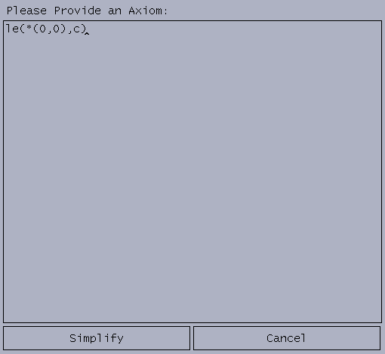

Slide 16
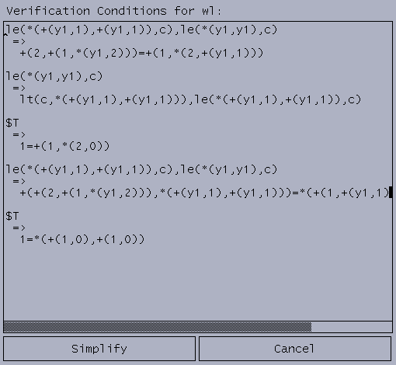

Slide 17
Simplified Verification Conditions
(y1+1)*(y1+1)<=c, y1*y1<=c → 2+(1+y1*2) = 1+2*(y1+1)
y1*y1<= c → c < (y1+1)*(y1+1), (y1+1)*(y1+1)<= c
T → 1=1+2*0
(y1+1)*(y1+1) <= c, y1*y1<= c
→ (2+(1+y1*2))+(y1+1)*(y1+1)=(1+(y1+1))*(1+(y1+1))
T →1=(1+0)*(1+0)

Slide 18
References
Wenhui Zhang.
Verification of XYZ/SE programs.
Chinese Journal of Advanced Software Research 2(4):364-373, 1995.

Slide 19
Questions?

