Slide 1
Hoare Logic
Wenhui Zhang
http://lcs.ios.ac.cn/~zwh

Slide 2
Hoare Logic
Let SP be the set of programs specified as follows.
SP := x:=t |
P1;P2 |
if (b) { P1 } else { P2 } |
while (b) { P1 }
The set of Hoare logic formulas:
If P ∈ SP and ϕ,ψ ∈QFF, then {ϕ}P{ψ} is a Hoare logic formula (Hoare Triple).

Slide 3
Interpretation
I({ϕ}P{ψ})σ = true, if
I(ϕ)σ implies ((P;ε,σ)→*(ε,σ’) implies I(ψ)σ’)
|=_{I} {ϕ}P{ψ} if
for all σ∈Σ, I({ϕ}P{ψ})σ = true
|= {ϕ}P{ψ} if
for all I, |=_{I} {ϕ}P{ψ}

Slide 4
Logical Consequence
Let W be a set of formulas.
W |= {ϕ}P{ψ} if
for every I,
if |=_{I} W, then we have |=_{I} {ϕ}P{ψ}.

Slide 5
Example (1)
{x>5} x:=2*x {x>20}
Let I be given as usual.
I({x>5} x:=2*x {x>20})σ = true iff σ(x)≤5∨σ>10

Slide 6
Example (2)
{true} while (x≠10) { x:=x+1 } {x=10}
Let I be given as usual.
I({true} while (x≠10) { x:=x+1 } {x=10})σ = true
for all σ.
|=_{I} {ϕ}P{ψ}

Slide 7
Example (3)
{true} x:=y+1 {x>y}
Let I be given as usual. Then |=_{I} {ϕ}P{ψ}
Let W = {y+1>y}.
I({true} x:=y+1 {x>y})(σ) = true
⇔ I(y+1>y)(σ) = true ⇔ I is a model of W
W |= {ϕ}P{ψ}

Slide 8
On Hoare Logic
Hoare logic is a first order logic:
|=_{I} {ϕ} P {ψ} ⇔ th(I) |= {ϕ} P {ψ}

Slide 9
Hoare Logic (1)
Axiom:
{ψ[x/t]} x:=t {ψ}

Slide 10
Hoare Logic (2)
Sequential Composition
{ψ0} P1 {ψ1} {ψ1} P2 {ψ2}
-----------------------------------------------
{ψ0} P1;P2 {ψ2}

Slide 11
Hoare Logic (3)
Conditional Composition
{b∧ϕ} P1 {ψ} {¬b∧ϕ} P2 {ψ}
----------------------------------------------------
{ϕ} if (b) {P1} else {P2} {ψ}

Slide 12
Hoare Logic (4)
Loop Composition
{b∧ψ} P {ψ}
----------------------------------
{ψ} while (b) {P} {ψ∧¬b}

Slide 13
Hoare Logic (5)
Consequence
ϕ’→ϕ {ϕ} P {ψ} ψ→ψ’
----------------------------------------------------------
{ϕ’} P {ψ’}

Slide 14
Soundness
The proof system is sound:
|-_{I} {ϕ} P {ψ} ➔ |=_{I} {ϕ} P {ψ}
by structural induction.

Slide 15
Lemma
I(ψ[x/t])σ = I(ψ)σ[x/I(t)σ]
|=_{I} {ψ[x/t]} x:=t {ψ}

Slide 16
Lemma
I(ϕ)σ→(((P1;ε,σ)→*(ε,σ’)) →I(ψ)σ’)
➔
I(ϕ)σ→(((P1;P2;ε,σ)→*(P2;ε,σ’)) →I(ψ)σ’)
|=_{I} {ϕ} P1 {ψ’} and |=_{I} {ψ’} P2 {ψ}
➔
|=_{I} {ϕ} P1;P2 {ψ}

Slide 17
Lemma
|=_{I} {b∧ϕ} P1 {ψ} and |=_{I} {¬b∧ϕ} P2 {ψ}
➔
|=_{I} {ϕ} if (b) { P1 } else { P2 } {ψ}

Slide 18
Lemma
|=_{I} {ϕ∧b} P1 {ϕ}
➔
|=_{I} {ϕ} while (b) {P1} {ϕ∧¬b}

Slide 19
Lemma
|=_{I} ϕ’→ϕ, |=_{I} {ϕ} P {ψ} and |=_{I} ψ→ ψ’
➔
|=_{I} {ϕ’} P {ψ’}

Slide 20
Completeness
The proof system is relatively complete.
|=_{I} {ϕ} P {ψ} ➔ |-_{I} {ϕ} P {ψ}
Relative to the expressive power of the underlying first order logic and the underlying proof system

Slide 21
Example
  {x=0∧y=0}
while (y<z) { x:=x+z; y:=y+1 };
while (y>0) { x:=x-z; y:=y-1 }
  {x=0∧y=0}

Slide 22
Proof
|=_{I} {ϕ} P {ψ} ➔ |-_{I} {ϕ} P {ψ}
by structural induction.

Slide 23
Lemma
|=_{I} {ϕ} x:=t {ψ} ➔ |=_{I} ϕ→ψ[x/t]
wlp(x:=t, ψ) ≡ ψ[x/t]

Slide 24
Lemma
|=_{I} {ϕ} P1;P2 {ψ} , and I(ψ’) is WLP of P2 and I(ψ)
➔
|=_{I} {ϕ} P1 {ψ’} and |=_{I} {ψ’} P2 {ψ}

Slide 25
Lemma
|=_{I} {ϕ} if (b) { P1 } else { P2 } {ψ}
➔
|=_{I} {b∧ϕ} P1 {ψ} and |=_{I} {¬b∧ϕ} P2 {ψ}

Slide 26
Lemma
|=_{I} {ϕ} while (b) {P1} {ψ}
➔
|=_{I} {ϕ} if (b) { P1; while (b) {P1} } else {x:=x} {ψ}
|=_{I} {ϕ} while (b) {P1} {ψ} , and
I(ψ’) is the WLP of “while (b) {P1}” and I(ψ)
➔
|=_{I} ϕ→ψ’, |=_{I} {ψ’∧b} P1 {ψ’}, and|=_{I} ψ’∧¬b→ ψ

Slide 27
Examples

Slide 28
Example 1
{x≥0∧x=n}
y:=1; { x≥0∧y*x!=n! }
while (x>0) { { x-1≥0∧y*x*(x-1)!=n! }
y:=y*x; { x-1≥0∧y*(x-1)!=n! }
x:=x-1 { x≥0∧y*x!=n! }
}
{y=n!}

Slide 29
Example 2
{x≥0∧y≥0∧x=a∧y=b}
while (¬(x=y)) {
if (x>y) { x:=x−y }
else { y:=y−x }
{ gcd(x,y)=gcd(a,b) }
}
{x=gcd(a,b)}

Slide 31
Extended Hoare Logic
The set of extended Hoare logic formulas:
If P∈SP and ϕ,ψ ∈QFF(V), then [ϕ]P[ψ] is an extended Hoare logic formula.

Slide 32
Interpretation
I([ϕ]P[ψ])σ = true, if
I(ϕ)σ implies ((P,σ)→*(P,σ’) and I(ψ)σ’)
|=_{I} [ϕ]P[ψ] if
for all σ∈Σ, I([ϕ]P[ψ])σ = true
|= [ϕ]P[ψ] if
for all I, |=_{I} [ϕ]P[ψ]

Slide 33
Logical Consequence
Let W be a set of formulas.
W |= [ϕ]P[ψ] if
for every I such that, |=_{I} W,
we have |=_{I} [ϕ]P[ψ].

Slide 34
On Extended Hoare Logic
Extended Hoare logic is not a first order logic.

Slide 35
Example 1
y:=1;
while (x>0) {
y:=y*x;
x:=x-1
}

Slide 36
Extended Hoare Logic (1)
Axiom:
[ψ[x/t]]x:=t[ψ]

Slide 37
Extended Hoare Logic (2)
Sequential Composition
[ψ0] P1 [ψ1] [ψ1] P2 [ψ2]
-----------------------------------------------
[ψ0] P1;P2 [ψ2]

Slide 38
Extended Hoare Logic (3)
Conditional Composition
[b∧ϕ] P1 [ψ] [¬b∧ϕ] P2 [ψ]
----------------------------------------------------
[ϕ] if (b) {P1} else {P2} [ψ]

Slide 39
Extended Hoare Logic (4)
Loop Composition
b∧ψ→w[x/t] [b∧ψ∧t=y] P [ψ∧t<y]
--------------------------------------------------
[ψ] while (b) {P} [ψ∧¬b]
where <∈P, and w characterizes a well-founded set.

Slide 40
Extended Hoare Logic (5)
Consequence
ϕ’→ϕ [ϕ] P [ψ] ψ→ψ’
----------------------------------------------------------
[ϕ’] P [ψ’]

Slide 41
Examples

Slide 42
Example 1
[x≥0∧x=n]
y:=1;
while (x>0) { { t=(x); w=(x≥0) }
y:=y*x;
x:=x-1
{ x≥0∧y*x!=n! }
}
[y=n!]

Slide 43
Example 2
[x>0∧y>0∧x=a∧y=b]
while (¬(x=y)) { { t=(x+y); w=(x≥0) }
if (x>y) { x:=x−y }
else { y:=y−x }
{ x>0∧y>0∧ gcd(x,y)=gcd(a,b) }
}
[x=gcd(a,b)]

Slide 45
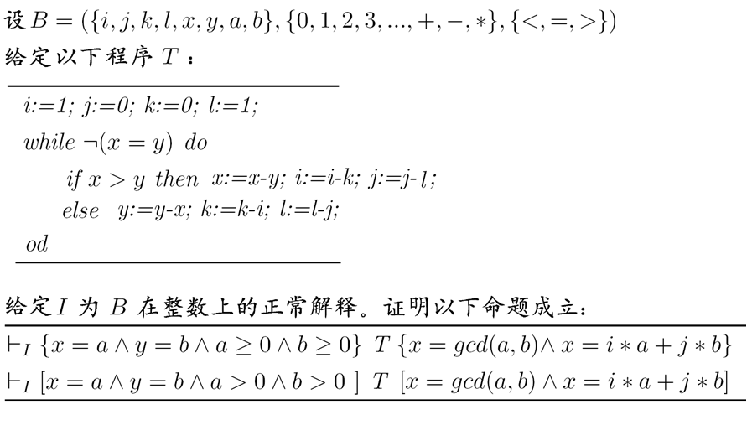
练习题1：
给定I为B在整数上的正常解释。
记以下程序为T 。
if (x>y) then x:=x-y; i:=i-k; j:=j-l; else y:=y-x; k:=k-i; l:=l-j;
计算最弱宽松前断言[T] (x=i*a+j*b)，
并证明|=_{I} { y=k*a+l*b ∧(x=i*a+j*b) } T { x=i*a+j*b}。

Slide 46
练习题2：

Slide 47
Questions?

